Slide 1

Algorithm
RISHI.

Slide 2
What is Algorithm:
Algorithm is a step-by-step procedure, which defines a set of instructions to be executed in a certain order to get the desired output. Algorithms are generally created independent of underlying languages, i.e. an algorithm can be implemented in more than one programming language.

Slide 3
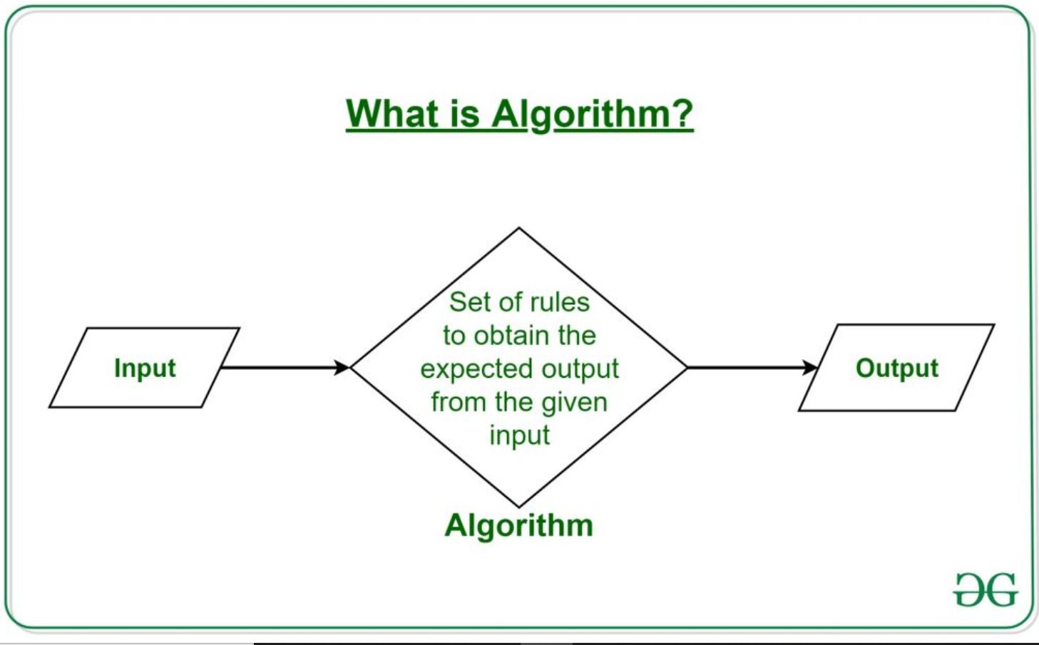
What is Algorithm

Slide 4
Characteristics of an Algorithm
Not all procedures can be called an algorithm. An algorithm should have the following characteristics −
Unambiguous − Algorithm should be clear and unambiguous. Each of its steps (or phases), and their inputs/outputs should be clear and must lead to only one meaning.
Input − An algorithm should have 0 or more well-defined inputs.
Output − An algorithm should have 1 or more well-defined outputs, and should match the desired output.
Finiteness − Algorithms must terminate after a finite number of steps.
Feasibility − Should be feasible with the available resources.
Independent − An algorithm should have step-by-step directions, which should be independent of any programming code.

Slide 5
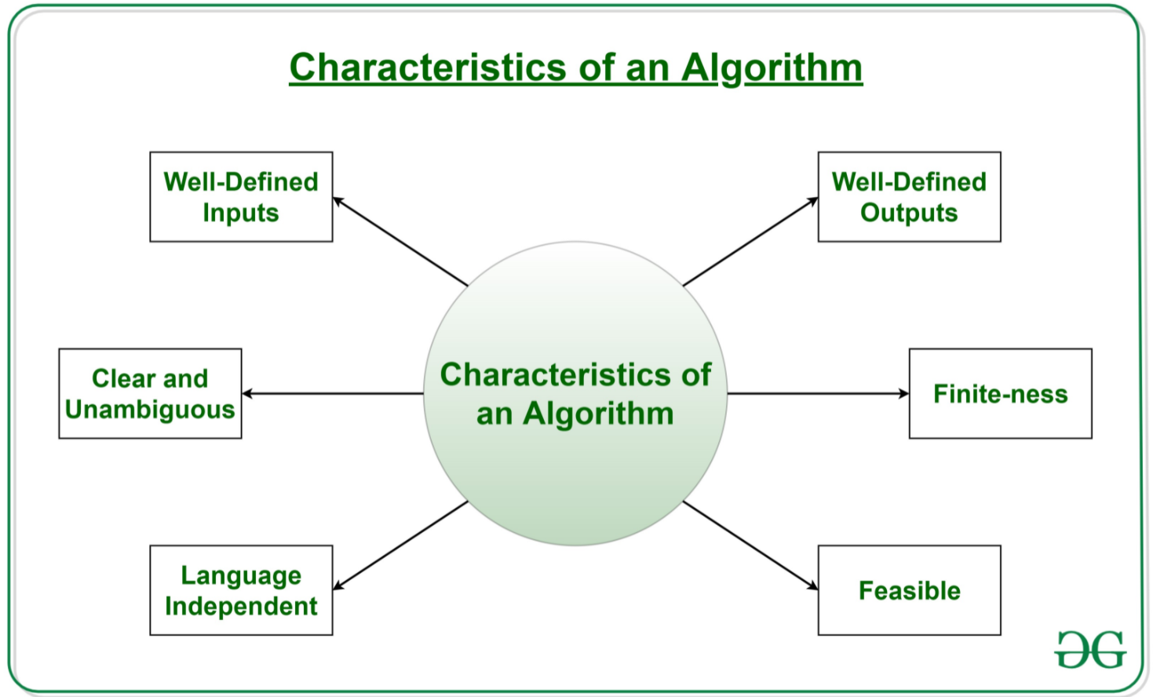
Characteristics

Slide 6
Examples
Write an Algorithm to make a Cup of Tea
Write an Algorithm to add two separate numbers
https://www.tcyonline.com/tests/computer-algorithms
https://www.hackerrank.com/domains/algorithms
https://leetcode.com/problemset/algorithms/

Slide 7
Make a Cup of Tea
Input – Pot, Half a Cup of Water, Cup, Half a Cup Milk, Tea Powder, Sugar, Heater
Take a Pot
Add Half Cup of Water
Boil the water for 3 min
Add Tea Powder, Sugar and ginger (masala)
Add Milk
Let it Boil for 90 seconds
Serve hot

Slide 8
Write an Algorithm to add two separate numbers
Take First Number
Take Second Number
Make Addition of First and Second Number
Provide addition as output
Input firstNumber
Input secondNumber
Addition = firstNumber + secondNumber
Print Addition

Slide 9
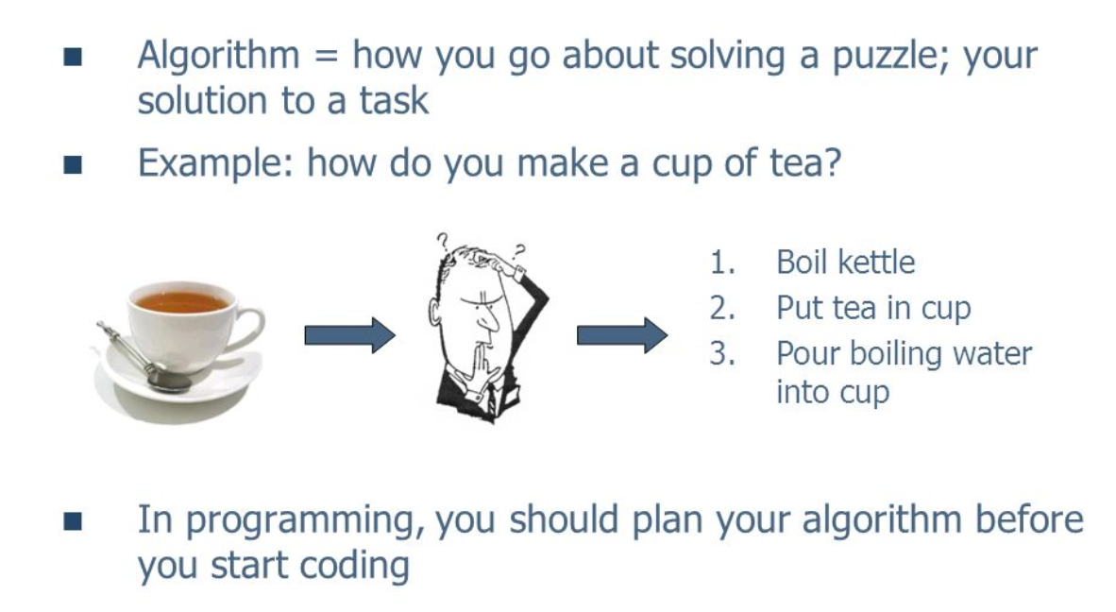
Make a Cup of Tea?

Slide 10
Algorithm & Pseudo Code?
Pseudo code is a term which is often used in programming and algorithm based fields.
It is a methodology that allows the programmer to represent the implementation of an algorithm.
Pseudo code, as the name suggests, is a false code or a representation of code which can be understood by even a layman with some school level programming knowledge.
It has no syntax like any of the programming language and thus can’t be compiled or interpreted by the computer.

Slide 11
Advantages of Pseudocode
Improves the readability of any approach. It’s one of the best approaches to start implementation of an algorithm.
Acts as a bridge between the program and the algorithm or flowchart. Also works as a rough documentation, so the program of one developer can be understood easily when a pseudo code is written out. In industries, the approach of documentation is essential. And that’s where a pseudo-code proves vital.
The main goal of a pseudo code is to explain what exactly each line of a program should do, hence making the code construction phase easier for the programmer.

Slide 12
Disadvantages of Pseudocode
Pseudocode does not provide a visual representation of the logic of programming.
There are no proper format for writing the for pseudocode.
In Pseudocode their is extra need of maintain documentation.
In Pseudocode their is no proper standard very company follow their own standard for writing the pseudocode.

Slide 13
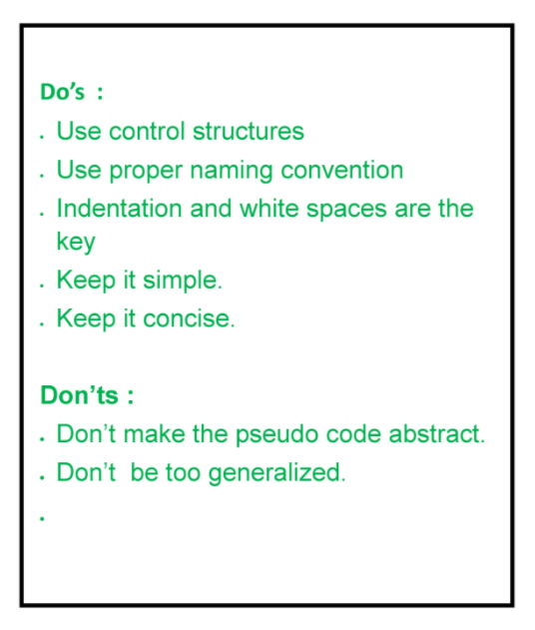
Pseudocode

