Slide 1

IntelliFile: Intelligence in Every File.
Daksh Gopani
SAP ID - 60003250013
Samyak Chheda
SAP ID - 60003250013
Rishi Vejani
SAP ID - 60003250013
Rudra Parmar
SAP ID - 60003250013
Under the guidance of
Dr. Abhijit Joshi (IT) and Prof. Aniket Kore (COMPS)
Project Guide
Department of Information Technology
DJSCE
Mumbai University
2025-26

Slide 2
Overview
Introduction
Literature Survey
Problem statement
Conclusion
References

Slide 3
Problem Statement
Modern File Management is Broken : In today's digital world, file organization on devices wastes time, creates chaos, and risks privacy:
Frustrating Searches: Minutes lost hunting for files by vague names or buried folders.
Tedious Organization: Manual sorting leads to lost, untagged files.
Versioning Nightmares: Accidental overwrites, messy merges, and no edit tracking leave us stressed and confused.
Privacy Gaps: Smart features often require cloud exposure, compromising sensitive data.
No Intelligent Help: No conversational AI to assist with files on-device.
Hidden Insights Lost: Valuable information in files - like key dates, receipts, or project summaries - remains buried and unused.
Result: Productivity breaks, frustration builds, and your files control you - not the other way around.

Slide 4
Solution
IntelliFile: Intelligence in Every File.
IntelliFile swaps out your old file app for one powered by AI that runs right on your phone or computer. It makes handling files quick, neat, and safe - all without sending data anywhere:
Smart Searches: Type or say what you’re looking for, and it understands the intent - not just the file name. Example: “Latest contract with John from January” → finds “final_v18.pdf”
Auto Sorting: New file? It puts it in the right folder and adds tags on its own.
Easy Updates: Tracks changes, saves old copies, and mixes edits without mix-ups.
Total Safety: All AI stays on your device - your info never leaves.
Chat Buddy: Ask "what's in my photo folder?" and get a fast answer or summary.
Smart Reminders: AI suggests you about important files - like deadlines, unpaid invoices, or follow-ups.
Cross-Device Smart Link & Offline Access: Link your phone with our desktop app and access your desktop files anywhere and anytime.
Result: Files stay organized, you save tons of time, and you stay in control. Work feels easy and worry-free!

Slide 5
Existing System with their gaps/drawback
Existing System | Major Drawbacks
Windows/Mac File Explorer | No AI/semantic search: Only finds files by name/date. Manual folder management. No cross-device sync. No collaboration or smart versioning. Lacks automation and smart organization.
Google Drive/OneDrive/Dropbox | Privacy concerns: Provider can view/analyze your files. All-or-nothing sync; hard to selectively sync. Limited offline access. Basic keyword search, no semantic/AI search. Collaboration/merge is manual and confusing. Internet dependent for best features.
Mobile File Managers | Weak search: No smart or semantic results. Poor organizational automation. No real collaboration/version control. Sync and privacy controls are usually missing. Limited AI or chat assistance.

Slide 6
Literature Review
Title | Author | Summary
Survey on Use of AI/ML Algorithms in Enhancing Filesystem Performance and Efficiency | V. Olekar, Y. Patil, V. Pawar, S. Pitale, V. R. Jaiswal and V. Naranje | As CPUs get faster, slow disk access limits performance. This survey explores how machine learning can detect file access patterns to optimize I/O and boost system efficiency.
Scaling AI-Driven Solutions for Semantic Search | A. Srivastava, M. Nalluri, T. Lata, G. Ramadas, N. Sreekanth and H. B | AI-driven semantic search combines NLP, machine learning, knowledge graphs, ontologies, and text analytics to understand queries and retrieve relevant results efficiently. Indexing and SEO ensure fast and optimized content access.
Managing computer files via artificial intelligence approaches | Jin, X., Jiang, J. & Min | An intelligent agent–based file management system using case-based reasoning (CBR) guides users in deciding which files to keep, delete, or preserve, demonstrating effective and efficient performance.
On-Device AI Models : Advancing Privacy-First Machine Learning for Mobile Applications | Ubale, Sushant | On-device AI enhances mobile computing by improving privacy, reducing latency, and enabling advanced AI on resource-limited devices, with applications in social media, healthcare, and finance.
Enhancing Document Retrieval with Semantic Embeddings | Solmaz Seyed Monir, Irene Lau, Shubing Yang, Dongfang Zhao | VectorSearch enhances document retrieval by using embeddings and multi-vector search to capture semantics, outperforming traditional methods on large-scale datasets.
Federated Learning: A Survey on Privacy-Preserving Collaborative Intelligence | Ratun Rahman | Federated Learning allows collaborative model training without sharing sensitive data, addressing privacy, heterogeneity, and communication challenges, with applications in healthcare, finance, and IoT.

Slide 7
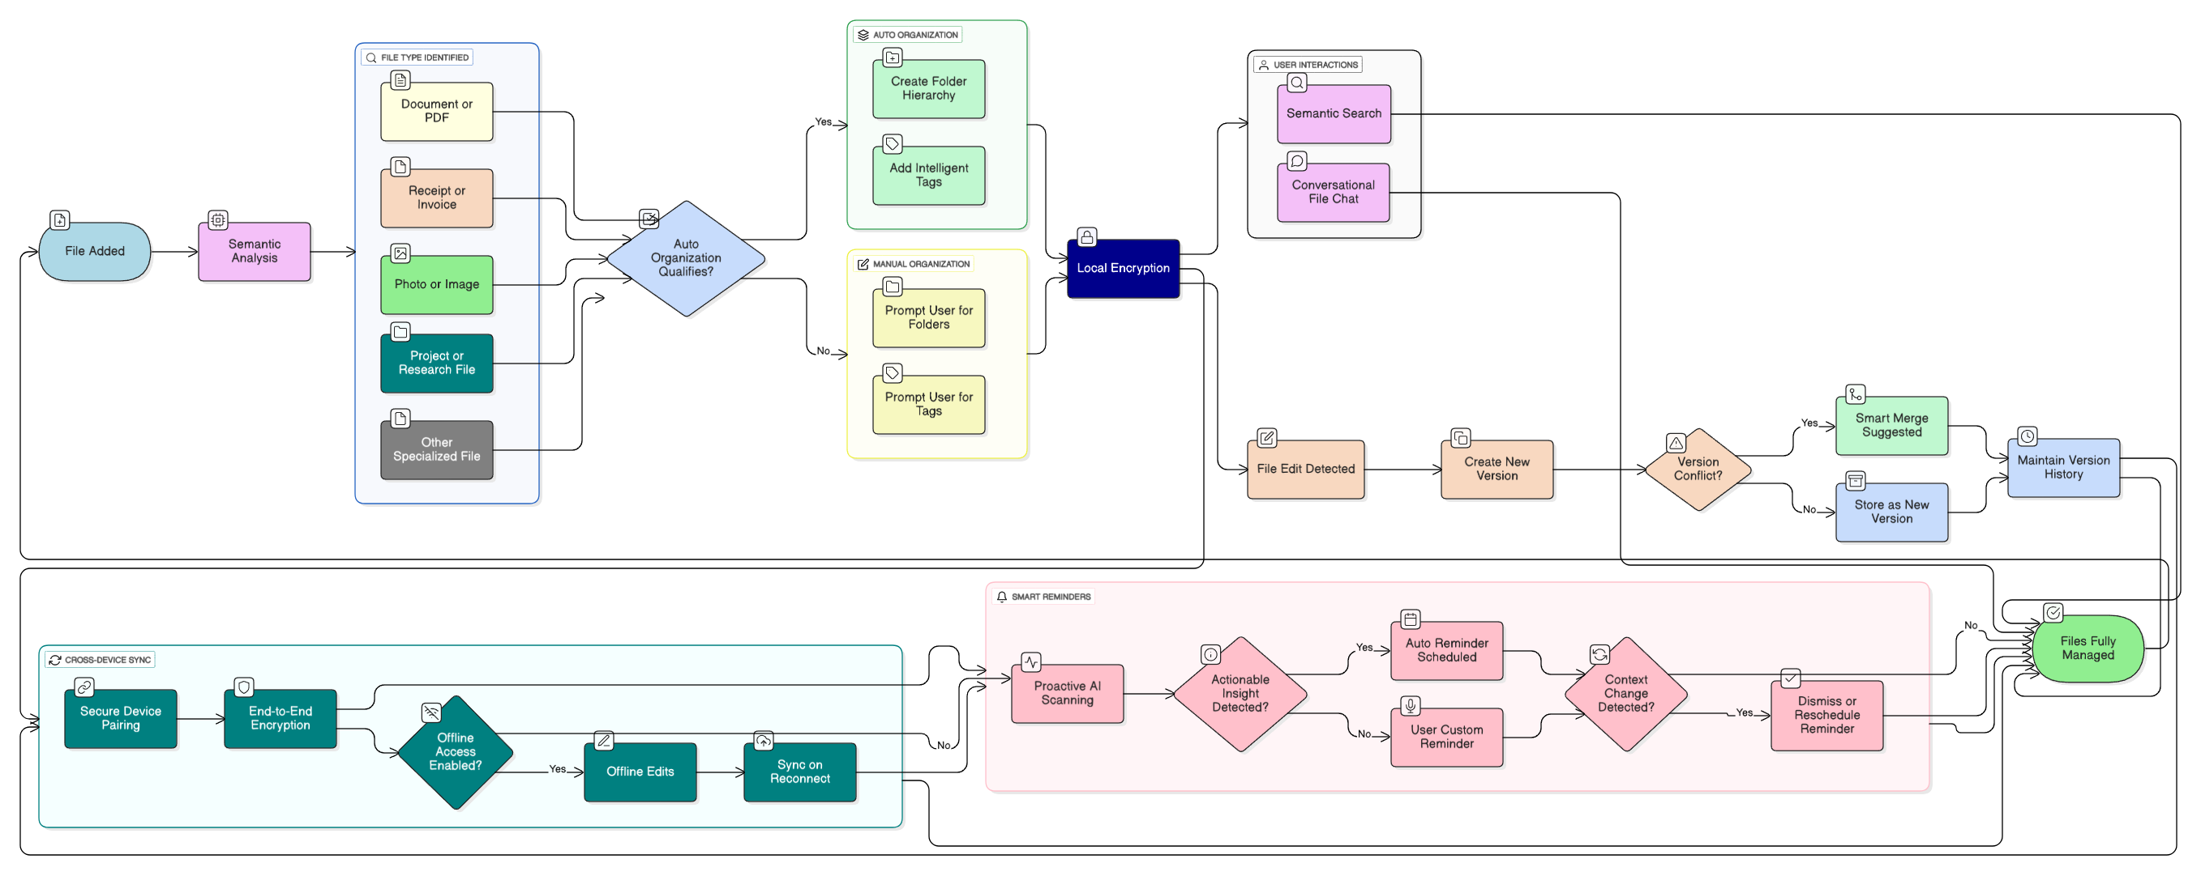
Flowchart

Slide 8
Proposed Methodology
1.Ingest & Extract – Detect new/updated files → extract text, metadata, and OCR content.
2.Embed & Index – Generate on-device AI embeddings and store in a local vector index.
3. Semantic Search – Convert user queries into embeddings → retrieve files by meaning, not filename.
4. Auto-Organization – AI classifies files and assigns folders/tags automatically.
5. Conversational File Assistant – Ask anything about your files (summaries, insights, search) — processed fully offline.
6. AI Versioning – Track edits automatically, detect conflicts, and provide smart merge suggestions.
7. Privacy-First Execution – All processing, indexing, and AI inference runs locally — zero cloud dependency

Slide 9
Selected Algorithms
1. Text & Metadata Extraction – OCR (Tesseract / On-device OCR) – PDF/DOC parsing & metadata extraction
2. Semantic Embedding Models – On-device sentence embedding (MiniLM / MobileBERT / DistilBERT variants) – Vector representations for meaning-based retrieval
3. Vector Search Engine – Local vector store (FAISS / SQLite-IVF / HNSW) – Approximate nearest neighbor search for fast file lookup
4. Document Classification & Auto-Tagging – Lightweight on-device classifiers – Keyword extraction & topic modeling (TF-IDF + embeddings)

Slide 10
Selected Algorithms
5. Natural Language Understanding (NLU) – Intent detection for user queries – Query parsing using embedding similarity + rule-based refinements
6. AI Versioning & Diffing – Semantic diff algorithms (token-level & sentence-level comparison) – Conflict detection & AI-assisted merge suggestions
7. Privacy-First Local Execution – All models run offline using Python backend via Flutter "Serious Python" – Encrypted local storage for indexes & versions

Slide 11
Description Of Exsisting Dataset
1. Dataset Source The existing dataset consists of real user device files collected from typical daily usage—documents, images, PDFs, notes, and media stored locally on the system.
2. Dataset Composition
- Documents: PDFs, Word files, text files, research papers
- Images: Screenshots, receipts, photos, scanned documents
- Media: Audio/video files with metadata
- System Files: Logs, configuration files, downloaded items
3. Size & Diversity
Includes hundreds to thousands of mixed-format files.
Contains both structured files (PDFs, DOCX) and unstructured ones (images, handwritten notes).
Dataset varies in naming styles, quality, and organization—ideal for testing semantic search and auto-organization.

Slide 12
Description Of Exsisting Dataset
4. Characteristics
- Unorganized: Random folder placements and inconsistent naming.
- Multi-format: Wide range of file types requiring different extraction techniques.
- Content-Rich: Suitable for text extraction, OCR, tagging, and version tracking.
5. Purpose in The Project
Used to train, test, and validate:
Semantic search accuracy
Auto-organization models
OCR and text extraction
AI versioning and merging
Conversational file interaction

Slide 13
Conclusion
IntelliFile redefines file management by combining on-device intelligence, privacy-first design, and seamless cross-device access. With features like semantic search, conversational file interaction, smart versioning, offline access, and proactive reminders, it empowers users to organize, retrieve, and manage files efficiently without relying on the cloud. By integrating AI directly on the device, IntelliFile ensures data privacy, reduces latency, and provides a smarter, more intuitive file management experience for modern users.

Slide 14
Thank You!!!

