Slide 1
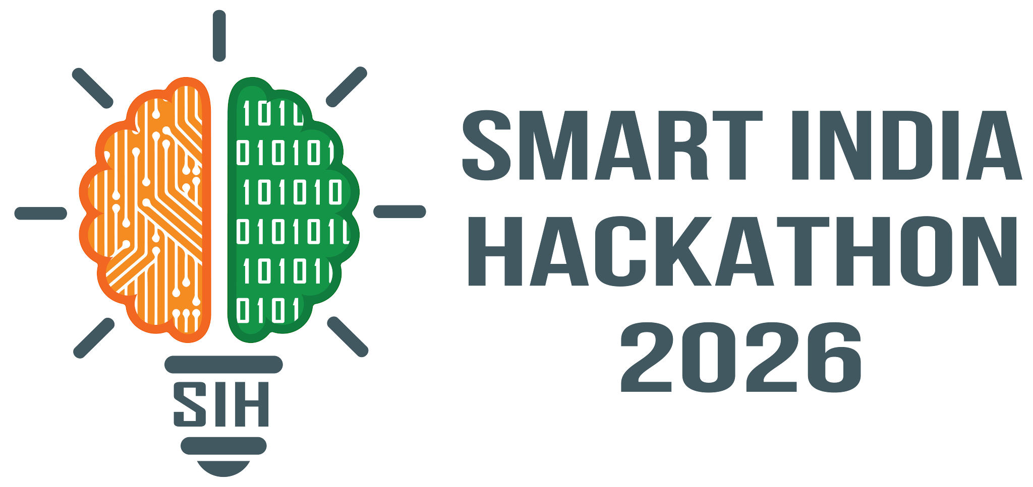

SMART INDIA HACKATHON 2026
TITLE PAGE
Problem Statement number- SIH26224
Problem Statement Title- Student Innovation
Theme- Smart Education
PS Category- Hardware
Team Name- HackTuah

Slide 2




PROPOSED SOLUTION
HackTuah
DETAILED EXPLANATION OF THE PROPOSED SOLUTION
INNOVATION AND UNIQUENESS OF THE SOLUTION
Table Tot
An AI-powered desk companion robot that lives on the student's study desk.
Learns the student's routine and study patterns, then builds personalised productivity workflows around them. Raspberry Pi, camera, mic, speaker, servos and an animated face in one desk-sized body.
Age and psychology adaptive
Offline-first by design
A small language model on the Pi answers questions and builds quizzes offline, and decides when a cloud LLM is really needed.
A student in a hostel with no WiFi still gets a full study session, quizzes included.
Difficulty, prompts, tone and personality adjust to the student's developmental stage and observed study patterns.
A 9-year-old gets playful story prompts; a class 12 student gets exam-style drills.
HOW IT ADDRESSES THE PROBLEM
No structured self-study guidance
Builds and enforces a personal study rhythm: timers, revision scheduling and reminders.
Multi-modal interaction
Dynamic personality
Study apps are easy to ignore
A physical companion with voice, gestures and expressions creates engagement and accountability.
Voice, gesture control, face recognition and proximity sensing give a hands-free, natural way to study.
Raise a palm to pause the timer; Tot wakes up when the student sits down.
Friend, teacher or detective personas, plus an expressive animated face, keep engagement fresh across age groups.
Detective mode turns a history chapter into clues to solve.
Parents have no visibility
A local web dashboard shows study insights without intrusive surveillance.

Slide 3




KEY FEATURES
HackTuah
Study Tools
Smart Interaction
Wellness and Safety
Parent Dashboard
Pomodoro and normal timers, alarms
To-do list and calendar
AI tutor: on-device SLM + cloud
Quizzes and flashcards, offline
Notes with OCR from books and handwriting
Daily news and general knowledge feed
Voice input and spoken replies
Face recognition and proximity sensing
Gesture control for hands-free use
Animated face and dynamic screens
Servo-driven head and body movement
Student persona and pattern tracking
Hydration, posture and break reminders
Fatigue cues from camera and usage
Child-safe content filtering
All personal data stays on-device
No cloud storage of face or voice
Cloud queries anonymised first
KPI tracking: focus time, streaks, quiz scores
Study insights and weekly summaries
Controls over bot behaviour and limits
Upload notes, syllabus and homework
Any browser on the home WiFi, no app install
A STUDY SESSION WITH TABLE TOT
1
2
3
4
5
Student sits down
PIR wakes Tot, face recognised, persona loaded
Plan the session
Today's to-dos, syllabus and due homework
Focus block
Pomodoro timer, posture and hydration nudges
Active recall break
Voice quiz from the student's own notes
Wrap up
Revision scheduled, KPIs logged to dashboard

Slide 4


KEY FEATURES (CONTD.)
HackTuah
Content Intelligence
Engagement and Learning Modes
Syllabus ingestion and automatic study planner
Last-minute revision notes generation
Spaced-repetition revision scheduling
Homework upload and tracking
Curated open-source videos and articles
Robot personalities: friend, teacher, detective
Story-based and game-based learning
Competitive mode and group learning
Public speaking and language practice
Concept animations generated with Manim
CONNECTIVITY MODEL: SELF-SUFFICIENT OFFLINE, SMARTER ONLINE
OFFLINE MODE always available
ONLINE MODE when WiFi is available
Timers, alarms, calendar, to-do
On-device SLM: Q&A and quizzes
Moonshine STT and Kokoro TTS
Face detection (YuNet)
Wellness reminders
Scheduling, persona, KPIs
router
Cloud LLM for hard questions
New flashcards and quizzes
Daily news and GK feed
Whisper STT, ElevenLabs TTS
Module download and updates
Syllabus and content ingestion
decides
Storage: SQLite plus a quantised SLM; scheduling and persona data stay local.
Escalation: queries are anonymised before sending; no personal data is pushed.

Slide 5


TECHNICAL APPROACH
HackTuah
Hardware
Software Stack
Raspberry Pi 5 (4 GB) main compute
BeagleBone development board
2 x servos head and body movement
Camera module face, gesture, OCR
IPS display animated face and UI
USB mic + speaker voice in and out
PIR motion sensor presence detection
Python
FastAPI REST + WebSocket server on the Pi
SQLite offline-first, zero-setup local DB
OpenCV
Moonshine + Kokoro offline speech in and out
C / C++ local on-robot display
React + Vite parent dashboard over WiFi
Local SLM Qwen via llama.cpp
Ingestion pdfplumber, Tesseract, FFmpeg, Whisper
ON-DEVICE MODELS
Kokoro-82M TTS
Piper TTS fallback
Moonshine STT
openWakeWord wake word
Silero VAD voice activity detection
YuNet face detection
SFace face recognition
MobileGaze gaze estimation
Tesseract / PaddleOCR OCR
Qwen local SLM, image + text
all-MiniLM-L6-v2 embeddings and search
Pi, servos and camera in hand. BOM stays affordable.
VOICE PIPELINE: ON-DEVICE SLM FIRST, CLOUD LLM ONLY WHEN NEEDED
PIR detects
presence
Wake word
detection
Speech-to-text
Intent router
Text-to-speech
Speaker +
face animation
Moonshine offline
Whisper online
SLM on device
cloud LLM if needed
Kokoro offline
ElevenLabs online

Slide 6
SYSTEM ARCHITECTURE
HackTuah
INPUTS
OUTPUTS
Microphone
voice commands
audio
RASPBERRY PI 5
FastAPI backend, all processing on-device
face + UI
Display
animated face + UI
Camera Module
face, gesture, OCR
video
STT / TTS engine
Vision (OpenCV)
On-device SLM (llama.cpp)
Scheduler and timers
TTS audio
Speaker
TTS replies
PIR Sensor
presence
signal
SQLite database
Student persona model
PWM
Servos
head and body motion
Display (touch)
taps and swipes
touch
Escalation router
Query scrubber + cloud API
local WiFi, REST API + WebSocket
No cloud dependency
Sensors, the language model and every record live on the Pi. The cloud is called only for hard questions.
PARENT DASHBOARD
React + Vite web app on any laptop or phone browser
KPI charts, study insights, uploads, parental controls
Live state over WebSocket
Face expression, listening status and timer state stream to the dashboard in real time.

Slide 7

FEASIBILITY AND VIABILITY
HackTuah
POTENTIAL CHALLENGES AND RISKS
STRATEGIES FOR OVERCOMING THEM
Why it is feasible
Compute limits on Pi 5
Vision, STT, TTS and the SLM compete for CPU.
Lightweight models
YuNet and SFace for vision, Moonshine for speech, a 0.8B 4-bit SLM; heavy jobs run on demand.
Affordable
total bill of materials per unit
Voice latency offline
Local STT / TTS is slower than cloud.
Wake-word gating
Listen for the wake word only, then stream short utterances; pre-cache common replies.
Off-the-shelf parts: everything is commercially available; Pi, camera and servos in hand
Fully open-source stack: Python, FastAPI, OpenCV, Moonshine, Kokoro, llama.cpp, React
Huge Pi community: documented drivers for every peripheral used
Works without internet: the on-device SLM answers everyday questions offline
Own it forever: the local SLM is a one-time cost, while cloud API bills compound over time
Child data privacy
Face, voice and study patterns are sensitive, and cloud APIs see every query.
On-device by default
Scheduling and persona modelling stay on the Pi; cloud queries are anonymised first; dashboard is local-network only.
Rs 0/mo
recurring AI cost offline
0
personal records in cloud
Heat and power
Sustained load inside an enclosure throttles the Pi.
Thermal design
Heatsink plus fan, vented shell, duty-cycled servos instead of continuous hold.

Slide 8



IMPACT AND BENEFITS
HackTuah
TARGET AUDIENCE
Primary K-12 and college students who self-study at home
Secondary parents, teachers, coaching centres and libraries
Educational
Social
Economic
Wellness
Dedicated, distraction-free study companion replaces passive screen time
Spaced repetition and revision scheduling improve long-term retention
Active-recall quizzes built from the student's own notes
Adaptive difficulty keeps every age group engaged
Bridges the parent-student gap with insight, not surveillance
Physical, expressive companion supports students who study alone
Group and competitive modes encourage peer learning
Works in Hindi and regional languages through Moonshine and Kokoro
Low bill of materials makes it affordable for middle-income Indian homes
Offline-first design serves areas with poor connectivity
Scales to schools, libraries and government learning centres with minimal infrastructure
Replaces paid apps and subscriptions; no recurring AI bill
Hydration, posture and break reminders reduce strain during long sessions
Fatigue cues trigger a break or a lighter activity
Personas and story mode make studying feel less like a chore
No doom-scrolling: the companion has no social feed
OUTCOME
Higher retention, less last-minute cramming
OUTCOME
Trust between parents and students
OUTCOME
Affordable and deployable at scale
OUTCOME
Healthier, sustainable study habits

Slide 9

RESEARCH AND REFERENCES
HackTuah
Learning Science
Technology
Comparable Products
Pomodoro Technique. Cirillo, F. (2006). The Pomodoro Technique.
pomodorotechnique.com
Spacing and retention. Cepeda et al. (2006). Distributed practice in verbal recall tasks. Psychological Bulletin.
doi.org/10.1037/0033-2909.132.3.354
Active recall. Roediger and Karpicke (2006). Test-enhanced learning. Psychological Science.
doi.org/10.1111/j.1467-9280.2006.01693.x
Forgetting curve. Ebbinghaus, H. (1885). Memory: A contribution to experimental psychology.
psychclassics.yorku.ca/Ebbinghaus/index.htm
Policy. National Education Policy 2020, Ministry of Education, Govt. of India.
static.pib.gov.in/WriteReadData/userfiles/NEP_Final_English_0.pdf
Qwen3. Alibaba. Open-weight small language models for on-device use.
github.com/QwenLM/Qwen3
llama.cpp. Quantised LLM inference in C/C++ on CPU.
github.com/ggml-org/llama.cpp
Kokoro-82M. Open-weight neural TTS, 82M parameters, 8 languages.
huggingface.co/hexgrad/Kokoro-82M
Moonshine. Useful Sensors. Real-time on-device speech recognition.
github.com/usefulsensors/moonshine
OpenCV Zoo. YuNet face detection and SFace face recognition.
github.com/opencv/opencv_zoo
piper-tts. Rhasspy. Fast neural TTS fallback for Raspberry Pi.
github.com/rhasspy/piper
Raspberry Pi docs. Camera, GPIO and PWM servo control.
raspberrypi.com/documentation
Miko (India). Companion robot for kids; cloud-dependent, no study workflow or OCR.
miko.ai
Amazon Echo Show Kids. Voice-first, no physical expressiveness or study tracking.
amazon.in
Wonder Workshop Cue. Coding-focused robot, not a study companion.
makewonder.com
Emo / Loona desk robots. Emotive desk pets with no study workflow, OCR or parent view.
living.ai
Table Tot differentiators. offline-first AI, study-specific workflows, parent dashboard, on-device privacy.

