Slide 1
Normalization
CS 605 Data Modeling
Refer to the paper titled “A SlMPLE GUIDE TO FIVE NORMAL FORMS IN
RELATIONAL DATABASE THEORY” by William Kent

Slide 2
Design through normalization
Data Requirements
Universal schema
Functional dependencies
normalization
Logical Database Design
Logical Schema
(vendor-neutral SQL scripts)
mapping
Physical / Implementation Database Design
Logical Schema
(vendor-specific SQL scripts)

Slide 3
Functional Dependency
A functional dependency X → Y (read as “X functionally determines Y”) holds on a relation under the following condition:
If there are two tuples t1 and t2 such that t1(X) = t2(X), then t1(Y) = t2(Y)

Slide 4
Key Motivation for Normalization
Insertion Anomalies
Modification Anomalies
Deletion Anomalies

Slide 5
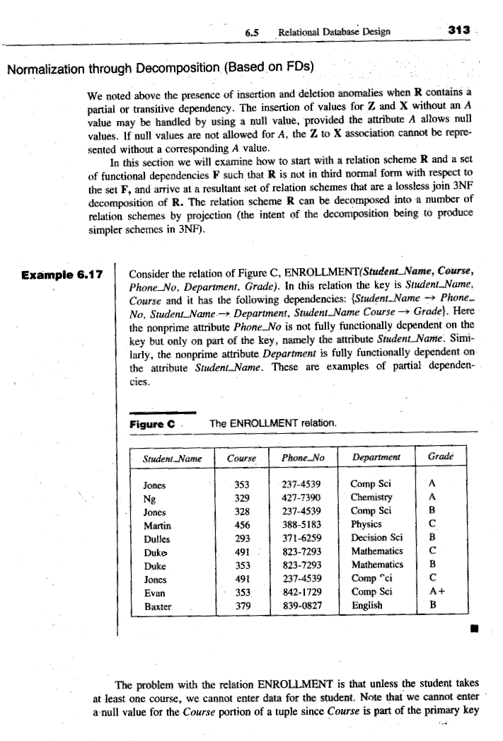
Example of FD
{Student_Name, Course} → {Phone_No., Department, Grade}
{Student_Name} → {Phone_No., Department}
How do you define KEY using the concept of FD?

Slide 6
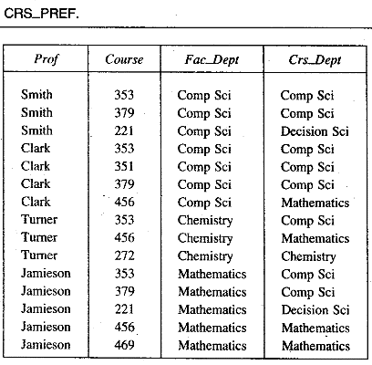
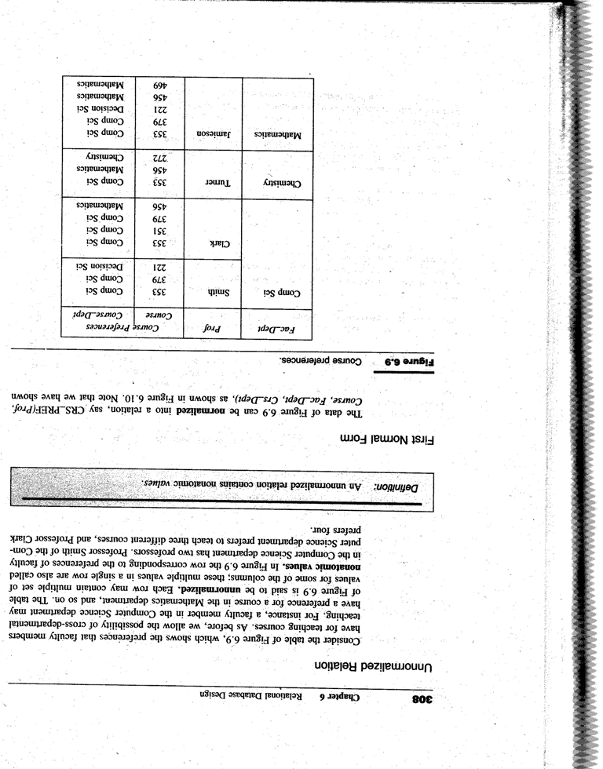
Example 1: Unnormalized → 1NF

Slide 7
Example 1 (Normalized)
Insertion anomalies?
Deletion anomalies?
Modification anomalies?

Slide 8
Second Normal Form
A relation schema R is in second normal form (2NF) if every non-prime attribute A in R is fully functionally dependent on the primary key

Slide 9
Example 2:
Is this in 1NF?
Is this in 2NF?
Key is {Student_Name, Course}
FDs
{Student_Name, Course} → {Phone_No., Department, Grade}
{Student_Name} → {Phone_No., Department}
Non-prime attributes
Phone_No., Department, Grade

Slide 10
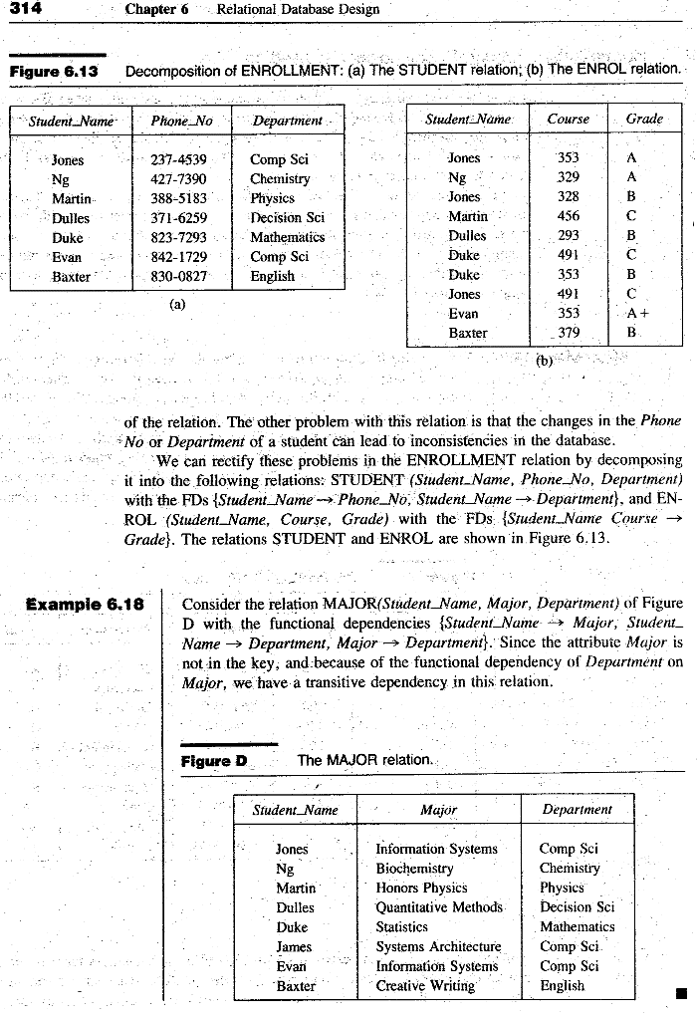
Example 2: 1NF → 2NF
Key is {Student_Name}
FDs
{Student_Name} → {Phone_No., Department}
Non-prime attributes
Phone_No., Department
Key is {Student_Name, Course}
FDs
{Student_Name, Course} → {Grade}
Non-prime attributes
Grade

Slide 11
Example 3
Key is {Student_Name}
FDs
{Student_Name} → {Major}
{Student_Name} → {Department}
{Major} → {Department}
Insertion anomalies?
Deletion anomalies?
Modification anomalies?

Slide 12
Third Normal Form
A relation schema R is in third normal form (3NF) if it is in 2NF and no non-prime attribute A in R is transitively dependent on the primary key

Slide 13
Example 3
Is this in 1NF?
Is this in 2NF?
Is this in 3NF?
Key is {Student_Name}
FDs
{Student_Name} → {Major}
{Student_Name} → {Department}
{Major} → {Department}
Non-prime attributes
Major, Department

Slide 14
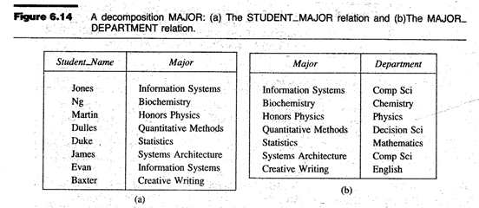
Example 3: 2NF → 3NF
Key is {Student_Name}
FDs
{Student_Name} → {Major}
Non-prime attributes
Major
Key is {Major}
FDs
{Major} → {Department}
Non-prime attributes
Department

Slide 15
Example 4
Student# | Aadhar# | Course | Grade
S01 | A01 | C01 | A
S01 | A01 | C02 | A
S01 | A01 | C03 | B
S02 | A02 | C01 | A-
S02 | A02 | C02 | B+
S02 | A02 | C03 | A
FDs:
{Aadhar#, Course} → Grade
{Student#, Course} → Grade
{Aadhar#} → Student#
{Student#} → Aadhar#
Is this in 1NF?
Insertion anomalies?
Deletion anomalies?
Modification anomalies?
Is this in 2NF?
Is this in 3NF?

Slide 16
Example 4 – BCNF
Student (Student#, Aadhar#)
FD: Student# → Aadhar# Aadhar# → Student#
Enrolment (Student#, Course, Grade)
FD: {Student#, Course} → Grade
Enrollment
Student# | Course | Grade
S01 | C01 | A
S01 | C02 | A
S01 | C03 | B
S02 | C01 | A-
S02 | C02 | B+
S02 | C03 | A
Student
Student# | Aadhar#
S01 | A01
S02 | A02
Is this in 3NF too?

Slide 17
Multi-valued Attributes
Implementing Multi-Valued Attributes
Executive | Department | CreditScore
Jones | {Administration, Finance, IT} | 25
Cooper | {Marketing, Personnel, Production} | 27
Executive | Department | CreditScore
Jones | Administration | 25
Jones | Finance | 25
Jones | IT | 25
Cooper | Marketing | 27
Cooper | Personnel | 27
Cooper | Production | 27

Slide 18
Multi-valued Dependency MVD
A dependency X →→ Y is a MVD if Y is a multi-value attribute
AND
If there are two tuples t1 and t2 such that t1(X) = t2(X), then t1(Y) = t2(Y)

Slide 19
Multi-valued Attributes
Executive → → Department
How do you insert a new row for Jones without violating the above MVD?
Executive | Department | CreditScore
Jones | {Administration, Finance, IT} | 25
Cooper | {Marketing, Personnel, Production} | 27
Show the modified relation if I insert a new CreditScore of 46 for Jones

Slide 20
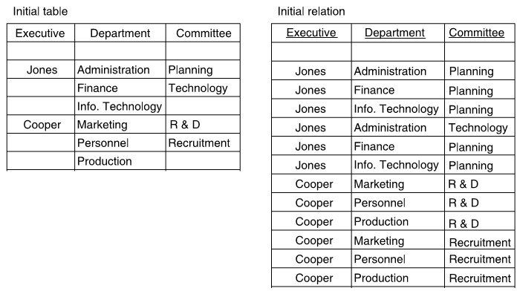
More than one MVD
Executive
Department
Committee
Jones
{Administration, Finance, IT}
{Planning, Technology}
Cooper
{Marketing, Personnel, Production}
{R&D, Recruitment}
Technology
Technology
Insertion anomalies?
Deletion anomalies?
Modification anomalies?
Executive → → Department
Executive → → Committee
See the uploaded paper for other implementations of MVD relations

Slide 21
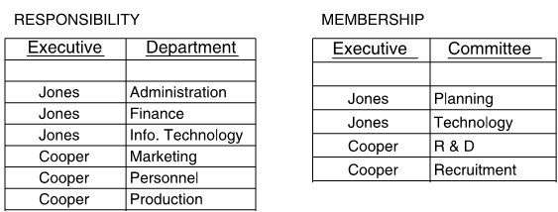
4th Normal Form

Slide 22
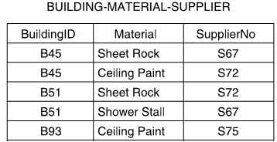
Example 1: Ternary Relationship
Building
Supplies
Supplier
Material

Slide 23
What is Fifth Normal Form (5NF)
JOIN dependency is a type of constraint that allows data of a relation R to be re-generated exactly (“lossless”) by doing the JOIN operation on smaller decomposition (R₁, R₂, …R_{n})of the original table
A relation R is in 5NF if there are no JOIN dependencies in R
You can verify if a relation is in 5NF by showing that a lossless JOIN of decomposition is not possible

Slide 24
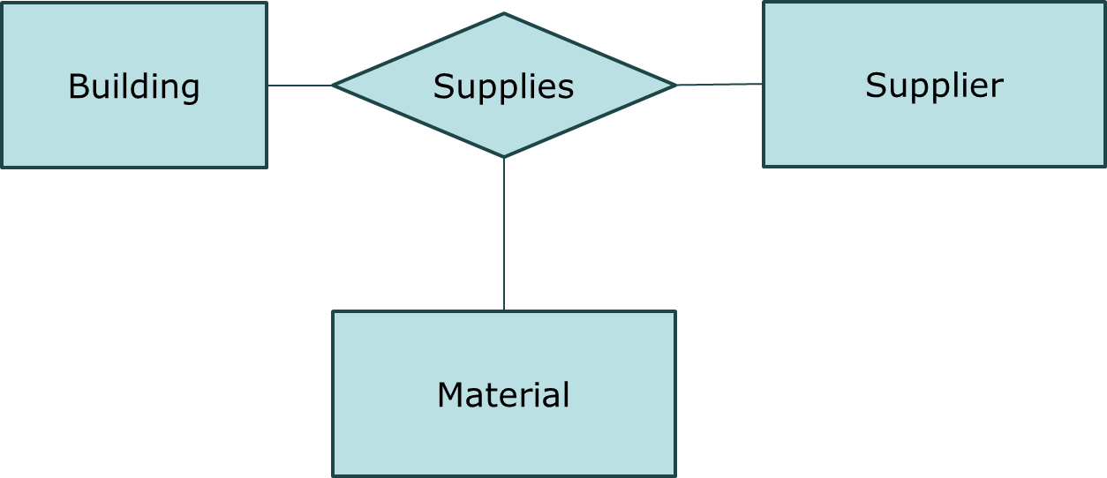
Example 1: Ternary Relationship

Slide 25
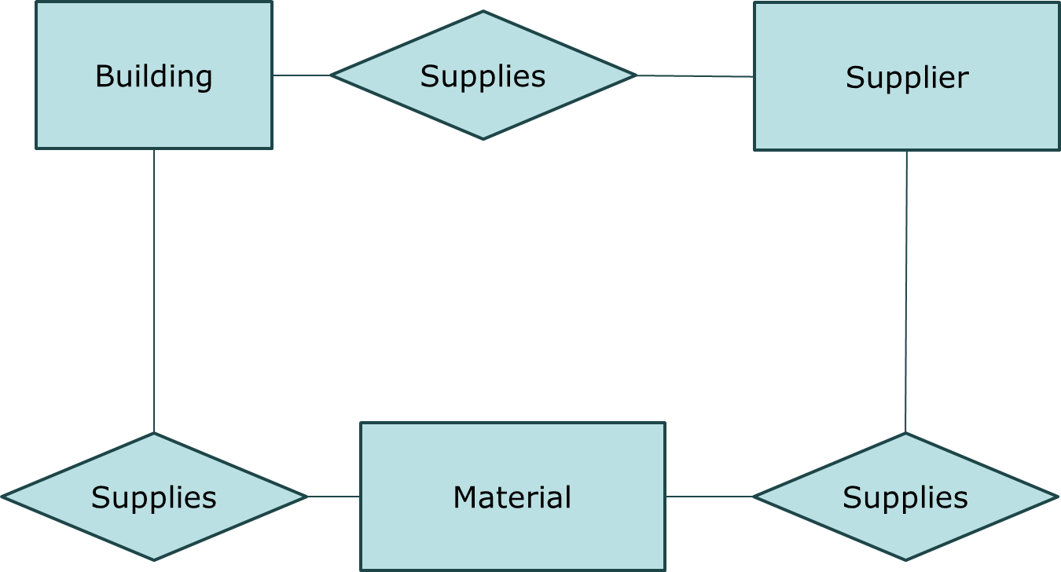
Binary Decomposition of Ternary
TERNARY RELATIONSHIP
BINARY DECOMPOSITION OF TERNARY

Slide 26
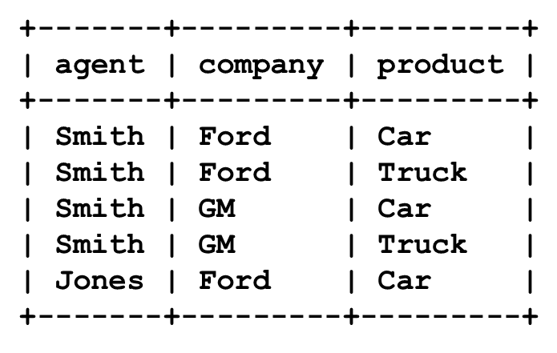
Example 2: Ternary Relationship
Agent
SELLS
Company
Product

Slide 27
Ternary → Binary
Agent
Sells-products-of
Company
Sells
Product
Made-by

Slide 28
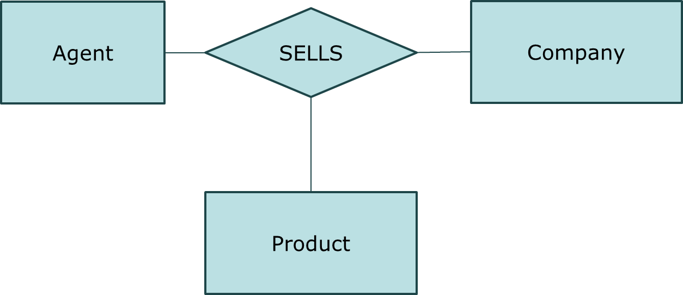

Binary Decomposition of Ternary
TERNARY RELATIONSHIP
BINARY DECOMPOSITION OF TERNARY

Slide 29
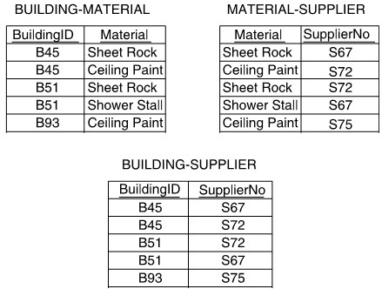
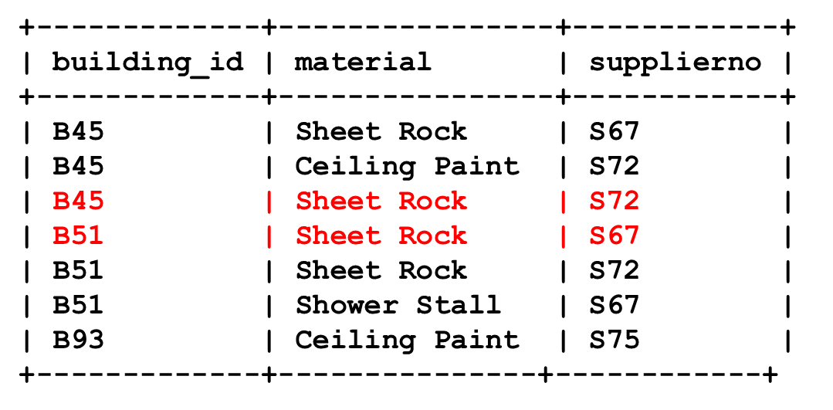
Example 1: LOSSY DECOMPOSITION
Original Table
Decomposed Tables
JOIN of the three decomposed tables
In 5NF already
(because decomposition
Is LOSSY)
THE ABOVE IS NOT EQUAL TO ORIGINAL TABLE. So the decomposition is LOSSY.
In other words, there is NO JOIN DEPENDENCY in the original relation.
This means the Original Table is already in 5NF
Application Interpretation:
It is okay if we are selective about supply of materials from suppliers to buildings. In other words, it is okay if B45 does NOT take Sheet Rock from supplier S72

Slide 30
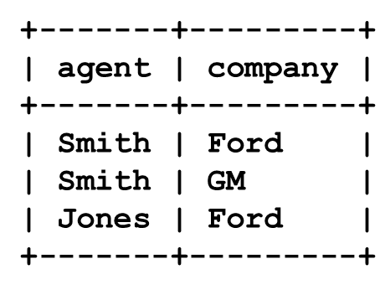
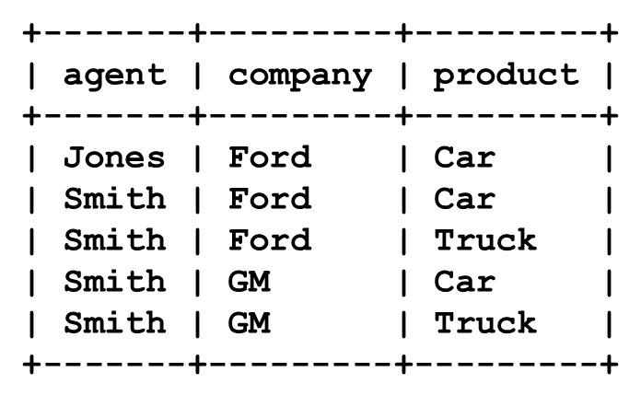
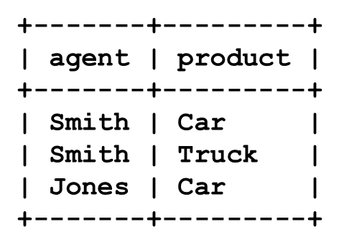
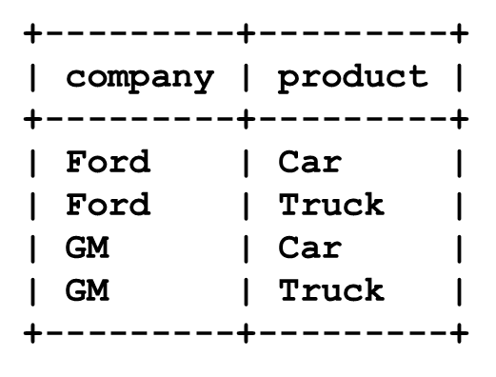
Example 2: LOSSLESS DECOMPOSITION
Original Table
Decomposed Tables
JOIN of the three decomposed tables
THE ABOVE IS EQUAL TO ORIGINAL TABLE. So the decomposition is LOSSLESS.
In other words, there is JOIN DEPENDENCY in the original relation.
This means the Original Table can be decomposed further to convert the relations into 5NF
NOT IN 5NF
(decomposable)
Application Interpretation:
Jones cannot selectively sell GM’s Truck. If he wants to sell GM’s Truck, he should sell Ford’s truck as well as GM’s car!
5NF decomposition)

Slide 31
Ternary → Binary : Is it okay?
Not every ternary relationship can be converted into binary decompositions
A ternary relationship can be converted into binary decomposition if and only if there is JOIN dependency

Slide 32
Summary (Moral of Story!)
Normalization-oriented database design’s goal is to remove possibilities of anomalies
If you want a normal form named after you:
Create a schema that has anomalies
Decompose the tables to remove anomalies
Give the normal form your name!

