Slide 1
Traditional Data Models
CS 605 Data Modeling
Those who forget history are doomed to repeat it
- An old saying

Slide 2
Topics
Hierarchical Data Model
The Network Data Model (CODASYL)
Relational Data Model
ER and EER Model

Slide 3
The Hierarchical Data Model

Slide 4
Overview
Developed to represent hierarchical data more accurately
No formal document or standards available for hierarchical model
Popularized by commercial information system vendors (IBM-IMS, CDC-MARS, etc.)

Slide 5
Basic Terminology
Record Type
  Defines the structure of a record (similar to struct)
Record
  An instance of a Record Type
Parent-Child Relationship (PCR) Type
  Specifies 1:N relationship between Parent Record Type and Child Record Type

Slide 6
Some more terminology
PCR Type Instance
  One record of parent record type and multiple records of the child record type

Slide 7
Basic Rules
There is a distinguished record type called ROOT of a schema
The ROOT does not participate as a child record type of any PCR type
Every record type (except ROOT) participates as a child record in exactly one PCR type
A record type can participate as a parent record in more than one PCR type

Slide 8
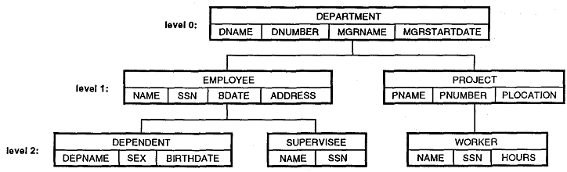
Example

Slide 9
Example
ROOT
Customer
CName
Address
Has_Account
Account
AccNum
AccType

Slide 10
Occurrence Trees
root
Customer
Customer
C1
Ulsoor
C2
Malleswaram
Account
Account
Account
A11
Savings
A21
Savings
A23
Demat
Account
Account
A12
Current
A22
Current

Slide 11
Example – Many-to-Many
Customer
CName
Address
Belongs_to_many
Has_Many
Account
AccNum
AccType
Not possible in Hierarchical data model

Slide 12
Work around: Data Duplication
Customer
Customer
C1
Ulsoor
C2
Malleswaram
Account
Account
Account
A11
Savings
A21
Savings
A23
Demat
Account
Account
A12
Current
A12
Current

Slide 13
Virtual Record Type
The record contains a pointer to the data rather than the actual data itself
Customer
CName
Address
Account
Has_Account
AccNum
AccType
Account_Ptr

Slide 14
Occurrence Tree with VPTR
Customer
Account
C1
Ulsoor
A11
Savings
Account
A11_Ptr
A12
Current
A12_Ptr
Account
A21
Savings
Customer
Account
C2
Malleswaram
A23
Demat
A21_Ptr
A12_Ptr
A23_Ptr

Slide 15
DDL for Hierarchical Model
Record Type and Data Item declarations (similar to COBOL syntax)
Hierarchy declarations
  Includes ROOT, PARENT, CHILD options
Virtual Record Types
  VIRTUAL PARENT and VIRTUAL CHILD

Slide 16
DML for Hierarchical Model
Host language is required
  COBOL and PL/I
DML uses record-at-a-time commands
  Currency Indicators (next, prev, etc.)
  Status Indicators (e.g., DB_STATUS)
DML Commands
  GET, INSERT, DELETE, REPLACE, GET HOLD

Slide 17
Commercial Implementations
IMS (Information Management System) from IBM
MARS VI from CDC
System 3000 from MRI/SAS

Slide 18
The Network Data Model (CODASYL)

Slide 19
History
Originally presented in CODASYL DBTG’s report in 1971
Revised in 1978 and 1981

Slide 20
Terminology
Record Type
  Defines the structure of a record (similar to struct)
Record
  An instance of a Record Type
Data Item
  Data values stored in a Record
Data Type
  Defines the format of the data items in a Record

Slide 21
More Terminology
Set Type
  A named 1:N relationship between two record types
  Set Type is defined by a triple
    <Name, Owner, Member>
Set Instance
  A collection of (pointers to) records
  Contains one “owner” record and multiple “member” records

Slide 22
And Finally…
System-owned (Singular) Sets
  No explicit owner record
  Just a collection of instances of a given record type
  Provides entry points into the database

Slide 23
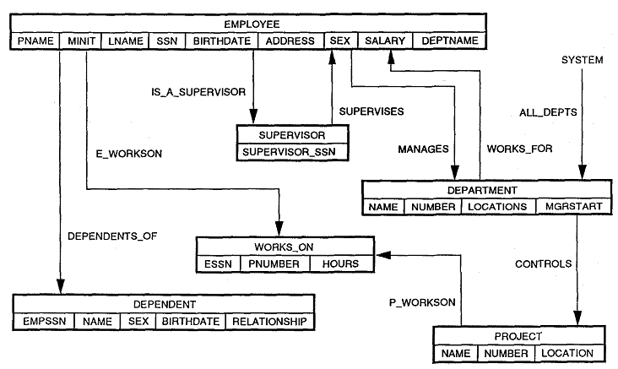
Example of an NDM Schema

Slide 24
Example of an NDM Schema
Bank Branch
BName
Address
Branch_Cust
Customer
CName
Address

Slide 25
Physical Representation
BRANCH-INSTANCE-1
MGRD
100, MG Road, BLR
FIRST
(Branch_Cust)
CUSTOMER-INSTANCE-1
John
24, 2nd Main, Ulsoor
NEXT
(Branch_Cust)
CUSTOMER-INSTANCE-2
John
24, 2nd Main, Ulsoor
NEXT
(Branch_Cust)

Slide 26
DDL for Network Model
Record Type and Data Item declarations (similar to COBOL syntax)
Set Type declarations
  Includes INSERTION and RETENTION options
Set Selection options
  STRUCTURAL, BY APPLICATION, BY VALUE OF

Slide 27
DML for Network Model
Host language is required
  COBOL and PL/I
DML uses record-at-a-time commands
  Currency Indicators (next, prev, etc.)
  Status Indicators (e.g., DB_STATUS)
DML Commands
  GET, FIND, STORE, ERASE, MODIFY, CONNECT, DISCONNECT, RECONNECT

Slide 28
Commercial Implementations
IDMS (Integrated Database Management System)
  Currently marketed by Computer Associates
IMAGE from Hewlett Packard
IDS II from Honeywell
VAX-DBMS from Digital

Slide 29
The Relational Data Model

Slide 30
History
Defined by E F Codd in 1970
  A relational model of data for large shared data banks
Elaborated in multiple publications between 1970 and 1983
Provides a mathematical foundation to the theory of database modeling

Slide 31
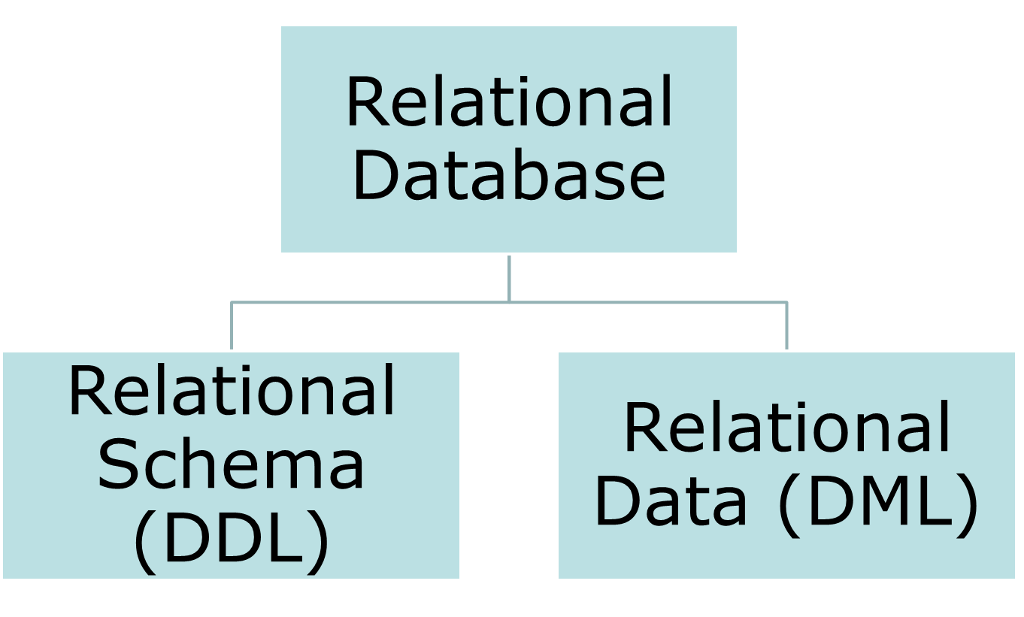
Elements of a Relational database

Slide 32
Elements of a Relational Schema
Structure
  Tables (Relation), Columns (Attribute), Tuple (Row)
Constraints
  Entity Constraints
  Referential Constraints
  Semantic Constraints

Slide 33
Entity Constraints
Key
Simple Key
Composite Key
Minimal / Non-Minimal Key
Surrogate Key
Primary Key
Unique Key

Slide 34
Referential Constraints
Foreign Key
  How many?
  Unique?
  Can one FK refer to multiple PK?
Savings Account Master
Account_ID
Interest_Rate
Txn_Details
Txn_ID
Txn_Date
Txn_Type
Txn_Amount
Account_ID
Current Account Master
Account_ID
OD_Limit
Is this type of FK allowed?

Slide 35
Referential Constraints
Foreign Key
  How many?
  Unique?
  Can it refer to multiple tables?
  But one PK can be referred to by many FK
Is this type of FK allowed?
Account Master
Account_ID
Cust_ID
Acc_Type
Opening_Date
Balance
Txn_Details
Txn_ID
Txn_Date
Txn_Type
Txn_Amount
Account_ID
Savings Account Master
Account_ID
Interest_Rate
Current Account Master
Account_ID
OD_Limit

Slide 36
Semantic Constraints
Data Types
NULL / NOT NULL
Enumeration
CHECK constraints
CREATE TABLE account( acc_num VARCHAR(40), acc_type ENUM(‘SAVINGS', ‘CURRENT', ‘INV' ));
CREATE TABLE customer (acc_id INTEGER,
Age INTEGER CHECK (age >= 18));

Slide 37
SQL Sub-Lanugages
Data Definition Language (DDL)
  CREATE <schema objects>
  ALTER
  DROP
Data Manipulation Language (DML)
  INSERT
  UPDATE
  DELETE
  SELECT

Slide 38
DML - SELECT
SELECT
FROM
WHERE
GROUP BY
HAVING
ORDER BY

Slide 39
SELECT - JOIN
INNER JOIN
  EQUI JOIN
  NATURAL JOIN
  CROSS JOIN
OUTER JOIN
  LEFT OUTER JOIN
  RIGHT OUTER JOIN
  FULL OUTER JOIN

Slide 40
SQL
Data Definition
  CREATE
  ALTER
  DROP
Data Retrieval and Manipulation
  SELECT
  INSERT
  UPDATE
  DELETE

Slide 41
Discussion - Review of
Strengths and Limitations

Slide 42
Hierarchical Data Model
Hierarchies are represented efficiently
Insertion anomaly
Needs special techniques (Virtual Records) for representing M:N relationship
Data access mechanisms are tightly coupled with programming languages
Difficult to maintain (Discuss: Why?)

Slide 43
Network Data Model
1:N Relationships are represented efficiently
M:N Relationships can be implemented using multiple 1:N relationship sets
Data access mechanisms are tightly coupled to programming languages
Difficult to maintain (Discuss: Why?)

Slide 44
Relational Data Model
Based on sound mathematical principles
Easy-to-use query language without any need for extensive programming
Gained wide commercial acceptance
Relational model may not be amenable to represent complex data
Relationships are not modeled in a “natural” manner

