Slide 1
Indian Institute of Information Technology Pune Department of Computer Science Engineering
Project Review
on
Football Predictor Using ML
By
Group No.: 349
MIS | NAME
111915104 | Rishubh Chahar
111915105 | Ritik Modi
111916043 | Sandeep Verma
111916011 | Anshul Shende
Mentor Dr. Tanmoy Hazra

Slide 2
OUTLINE
Introduction
Problem Statement
Motivation
Literature survey
Research Gaps
Objective
Methodology
Results and discussion
Conclusion and future scope
References

Slide 3
INTRODUCTION
Nowadays, Machine learning and Artificial Intelligence is growing at a very rapid speed. Humans are slowly adapting to live besides new technologies. Particularly in sports, ML has been very influential recently. Following the trend our project is based on Predicting Football match using ML. Using the available data we have built a model to predict outcome of a football match.

Slide 4
PROBLEM STATEMENT
This project aims to create a machine learning model to predict the outcome of football matches using Deep Neural Network.
We have taken team ratings and past matches history and results dataset from various sources.

Slide 5
MOTIVATION
Football prediction is an interesting task for the general public, researchers, clubs, media, news and advertising companies, and professional odds setters. Football prediction has been the subject of research since 60s but there hasn’t been enough success till the date.
With a motive to increase the accuracy as much as possible and surpass all the past works, we are motivated to give our best for the project and also looking forward to improve it in coming days, as it has a lot of scope in future.

Slide 6
LITERATURE SURVEY
Several attempts have been made previously such as :
One such study was done on Qatar Sports League. Different ML models were considered and the Logistic regression based model was the best performing model with more than 80% accuracy.
Another Study focused on player-to-player interaction. By examining the structure of interactions/passing networks, recurrent pass sequences can be identified and linked to a team’s playing style.

Slide 7
RESEARCH GAPS
Previous studies do not take into account individual player’s current status like fitness of player and current form.
Understanding more about how the off-ball movement characteristics impact the decision-making and passing ability of a team.
The format of the soccer log data differs as different vendors use different data formats. Leading football data providers do not make their information publicly available.
Lacks practicality.

Slide 8
OBJECTIVE
Data availability & quality: Finding a public database of football data with the necessary statistical depth.We will need to scour various public football databases to find one that is suitable for us to use.
Research and understanding of prediction landscape: To design our models and test different hypotheses, we need to take a thorough background research of prediction techniques and develop a thorough understanding of Deep Neural Networks.

Slide 9
METHODOLOGY
DATA FLOW CHART
START
DIVIDE DATASET INTO 2 PARTS FOR TRAINING AND TESTING
DEFINE FEATURES AND LABELS
ENCODE THE DEPENDENT VARIABLE
READ THE DATASET
IMPLEMENT THE CODE/
ALGORITHM
TENSORFLOW DATA STRUCTURE FOR LABEL HOLDING
TRAIN THE MODEL
REPEAT THE PROCEDURE TO REDUCE LOSS/ERROR
MAKE PREDICTION ON TEST DATA
REDUCE ENTROPY
END

Slide 10
FEATURES
'strong_overall',
'weak_overall',
'strong_attack',
'weak_attack',
'strong_midfield',
'weak_midfield',
'strong_deffense',
'weak_deffense',
'strong_bu_speed',
'weak_bu_speed',
'strong_bu_passing',
'weak_bu_passing',
'strong_cc_crossing',
'weak_cc_crossing', 'strong_cc_passing',
weak_cc_passing’
'strong_avg_age',
'weak_avg_age',
'dif_overall',
'dif_attack',
'dif_midfield',
'dif_deffense',
'dif_bu_speed',
'dif_bu_passing',
'dif_cc_crossing',
'dif_cc_passing',
'dif_cc_shooting',
'dif_aggression',
'dif_preassure',
'dif_avg_age',
'strong_form',
‘Weak_form’,
'strong_cc_shooting',
'weak_cc_shooting',
'strong_aggression',
'weak_aggression',

Slide 11
MODEL(DNN)
Input Layer (1) - Nodes = 38(No of features)
Output Layer (1) - Nodes = 1
Hidden Layers (3) = [80,40,20]
Learning Rate = 10^-3
Dropout Rate = 0.3
Epochs = 1000
batch size = 64
Validation_split = 0.3
Activation function = Sigmoid

Slide 12
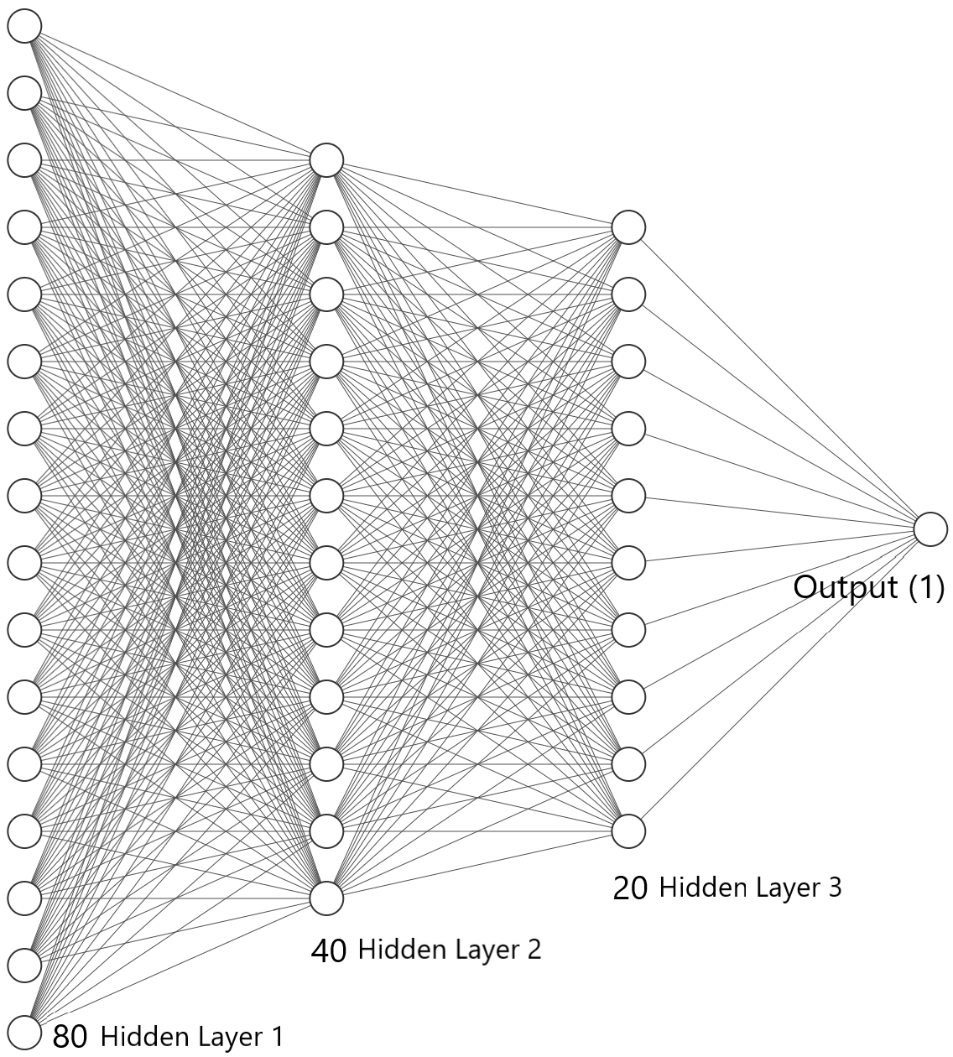
DNN Model Architecture

Slide 13
RESULTS AND DISCUSSION
We worked on different models and compared their accuracy like- Logistic Regression, Support Vector Machines(SVM), Gradient Boosting(XGBoost), Naive Bayes Classifier, Deep Neural Network(DNN) and came to know that DNN is best suited for our project.If we exclude DNN, we got Logistic Regression as our second best working model but due to less flexibility and future scope in regressors and classifiers, we chose DNN as our base model. We discussed about the activation functions, epochs, batch size, learning rate, dropout and number of hidden layers. Our Deep Neural Network Model’s accuracy is 68-74% .

Slide 14
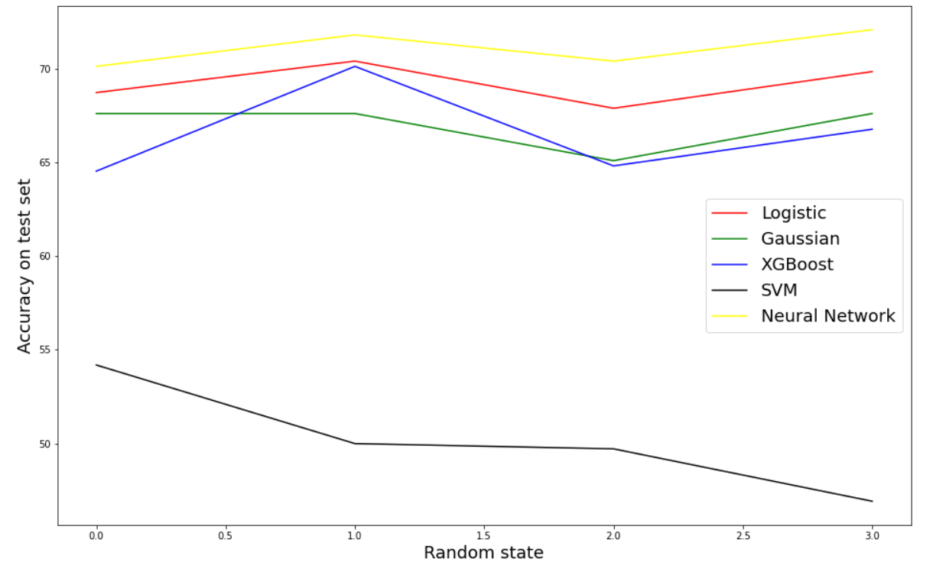
Here’s the accuracy of different models we worked on-

Slide 15
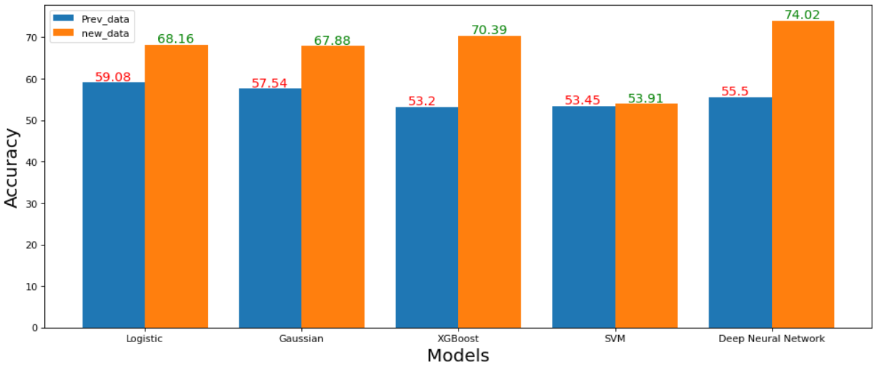
Comparison of Accuracy on Prev_data, new_data among Different Models.

Slide 16
CONCLUSION & FUTURE SCOPE
Our work delivers a machine learning framework for forecasting future football matches and achieving excess returns through appropriate betting. To be more specific, the profits are generated by exploiting a large amount of data about characteristics of both the match and the players involved.
In the short-term future, the presented framework could be used to forecast the results of other sporting events, e.g., rugby, American football, or basketball.
Machine learning is also relevant in the area of individual sports, such as tennis or golf, since individual player skills play a very important role.

Slide 17
REFERENCES
pandas documentation — pandas 1.3.3 documentation (pydata.org)
NumPy Documentation
Overview — Matplotlib 3.4.3 documentation
DevDocs — scikit-learn documentation
Home - Keras Documentation (faroit.com)
API Documentation | TensorFlow Core v2.6.0

Slide 18
PUBLICATIONS
1. Gil, R.G.R.; Levitt, S.D. Testing the efficiency of markets in the 2002 World Cup. J. Predict. Mark. 2012, 1, 255–270.
2. Md. Ashiqur Rahman, A deep learning framework for football match prediction. Springer
3. Forrest, D.; Simmons, R. Sentiment in the betting market on Spanish football. Appl. Econ. 2008, 40, 119–126.Appl. Sci. 2020, 10, 46 14 of 15
4. J. Almulla, T. Alam: ML Models Reveal Key Performance Metrics of Football Players to Win Matches in QSL. IEEE
5. Spann, M.; Skiera, B. Sports forecasting: A comparison of the forecast accuracy of prediction markets, betting odds and tipsters. J. Forecast. 2009, 28, 55–72.
6. Stekler, H.O.; Sendor, D.; Verlander, R. Issues in sports forecasting. Int. J. Forecast. 2010, 26, 606–621.
7. S. Kusmakar: Machine Learning Enabled Team Performance Analysis in the Dynamical Environment of Soccer. IEEE

