Slide 1

Smart electricity bill calculator using blockchain technology
Submitted By:
Ashish Kumar (2144006)
Devesh (2144017)
Gyanesh Ray (2144019)
Rishu (2144022)
Course: MCA-CSE-(3rd Semester)
Under the Supervision of: Dr. Ditipriya Sinha
Dept. of CSE, NIT Patna

Slide 2
Outline
Introduction
Literature Survey
Tools and Softwares
Architecture
Application Functionality
Proposed Method
Conclusion and Future Work
References

Slide 3
INTRODUCTION
The electricity industry has always been under scrutiny in order to improve the quality of electricity supply, measurement and billing services to have the at most user transparency. While providing these services with the highest efficiency.
An electricity power consumption tracking application solution, harnessing Blockchain utilities to provide a decentralized and secure recording mechanism, that provides an improved architecture to the smart meter is proposed in this project.
The application provides a high security and cost efficient decentralized live electricity power consumption recording of the user that is maintained by a Ethereum network.

Slide 4
Literature Survey
Reference Number | Task
Bhalaji et al. [1], 2020 | EL DAPP – An Electricity Meter Tracking Decentralized Application
Aiman et al.[2], 2022 | Smart Electricity Billing System Using Blockchain Technology
Nguyen et al.[3], 2019 | Digitizing Invoice and Managing VAT Payment Using Blockchain Smart Contract

Slide 5
TOOLS AND SOFTWAREs
Hardware: Any operating system having a modern web browser.
e.g. Chrome, Microsoft Edge, Brave, Firefox, DuckDuckGO.
Software : VS Code - Visual Studio Code is a lightweight but powerful source code editor which runs on your desktop and is available for Windows, macOS and Linux.
Truffle - Truffle is a development environment, testing framework, and asset pipeline for Ethereum, aiming to make life as an Ethereum developer easier.
Ganache - Ganache is an Ethereum simulator that makes developing Ethereum applications faster, easier, and safer. It includes all popular RPC functions and features (like events) and can be run deterministically to make development a breeze.
MetaMask - MetaMask is an extension for accessing Ethereum enabled distributed applications. The extension injects the Ethereum web3 API into every website’s javascript context, so that dapps can read from the blockchain.
Programming Language : JavaScript, Solidity, HTML, and CSS.

Slide 6
architecture
Normal Approach of a web application:
Traditionally we when access the internet through the web browser it connects to a server.
And on the server, it contains the backend code, and it connects to the database.
The same application in blockchain:
In this method we don’t directly connect to the server, first it connects to the client-side application that we will build.
And this client-side application won’t connect to the web server backend, it will directly connect to the blockchain.
And inside the blockchain there will be code which will be written in Ethereum Smart Contract

Slide 7
Application functionality
The user will register through the web app.
After successful registration, the user will get his unique CA number.
Then the registered user can generate electricity bill by providing CA number and units consumed.
And if the user is already registered then they can directly go to the search section and search their electricity bill.
The user can also print the generated electricity bill.

Slide 8


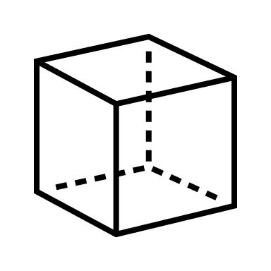

Proposed Method
CLIENT-SIDE APPLICATION
BLOCKCHAIN

Slide 9
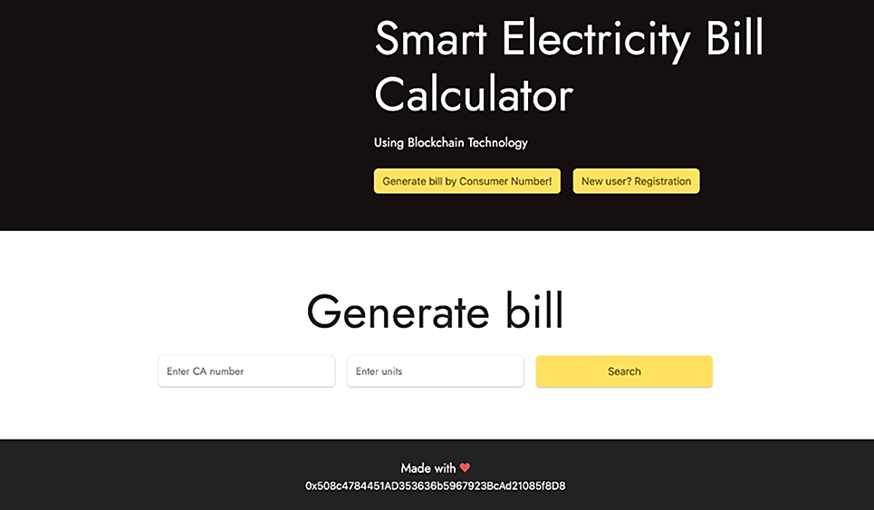
Preview
Home Page

Slide 10
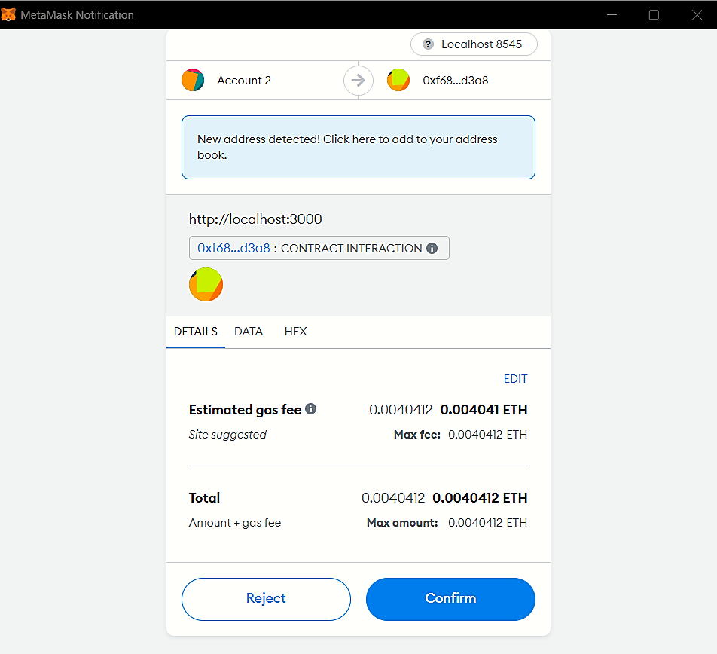
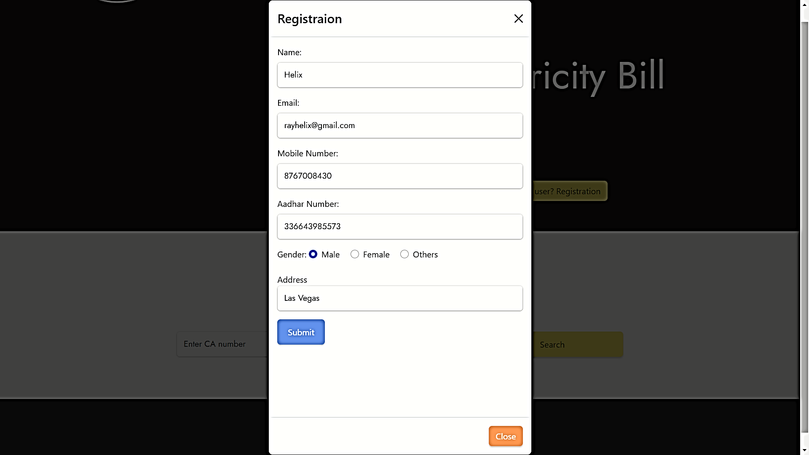
Preview
Registration

Slide 11
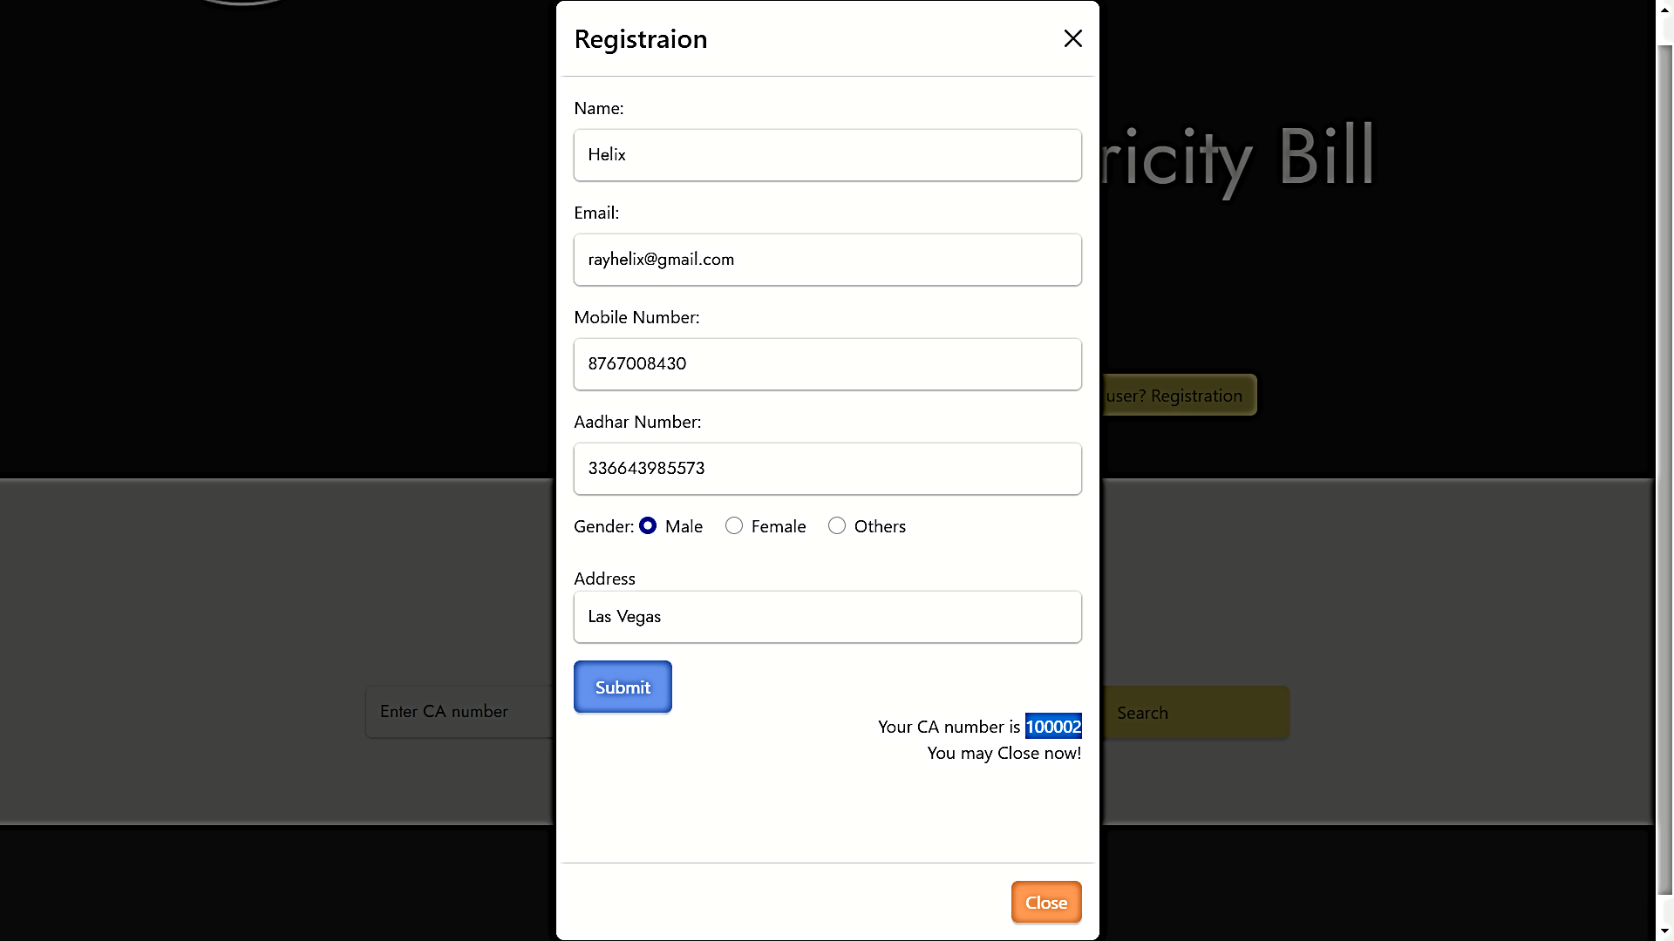
Preview
CA Number

Slide 12
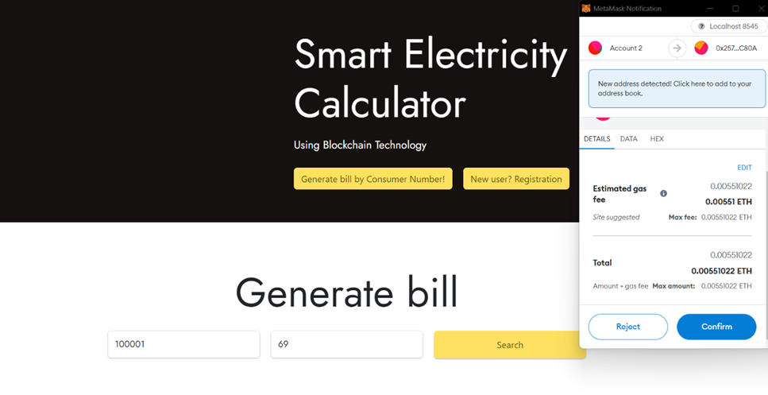
Electricity Bill Generation

Slide 13
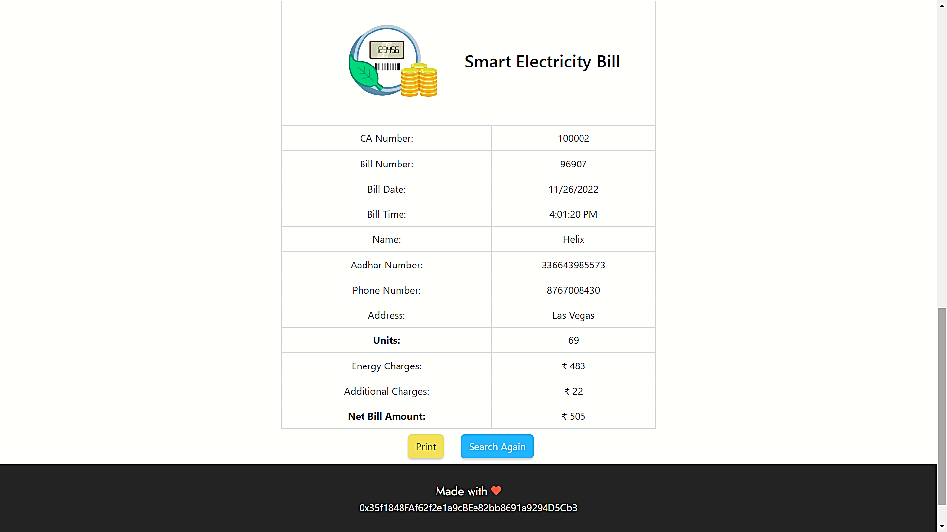
Preview
Generated Electricity Bill

Slide 14
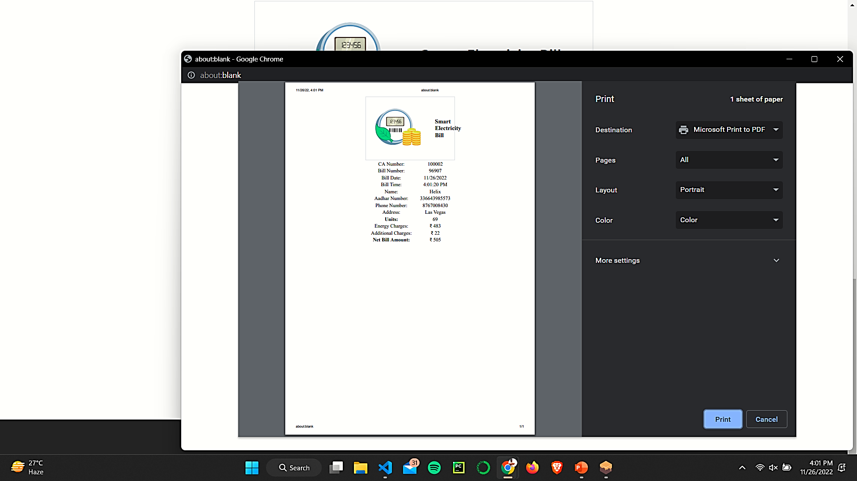
Printing of Bill

Slide 15
Conclusion and future work
In this paper, we presented an approach to implement the electricity bill generator utilizing a blockchain platform by using the existing power distribution system.
The smart contract is designed to the make transactions and requests to the Ethereum Virtual Machine. We made this application which can be accessed through a web browser of a computer to generate electricity bill by providing CA number and number of units consumed.
In real implementation of this project, the electricity meter with plugged IoT device can periodically sends the electricity units consumed by the user over the Ethereum platform to generate the bill.
Since it is feasible to build such a system, a further study involves the automatic generation of electricity bills based on the periodically received electricity units.

Slide 16
References
Dr. N. Bhalaji, Shanmuga Skandh Vinayak E, EL DAPP – An Electrıcıty Meter Trackıng Decentralızed Applıcatıon, Journal of Electronics and Informatics (2020)
Shafiq Aiman, Suhaidi Hassan, Adib Habbal, Athirah Rosli, and Ahmad Hanis Mohd Shabli, “Smart Electricity Billing System Using Blockchain Technology”, University Utara Malaysia, 06010 UUM Sintok, 2022
Van-Cam NGUYEN, Hoai-Luan PHAM, Thi-Hong TRAN, Huu-Thuan HUYNH, Yasuhiko NAKASHIMA, “Digitizing Invoice and Managing VAT Payment Using Blockchain Smart Contract”, IEEE International Conference on Blockchain and Cryptocurrency (ICBC), 2019
Lukas Thielen, “Blockchain Technology and Smart Contracts. Application in the Automotive Industry”, Publisher – Grin Verlag, ISBN - 978-3668884328, 25 February 2019
Wanderlustsaxshy, “How to Store Data in Blockchain?”, Geeksforgeeks, Sep 2022 https://www.geeksforgeeks.org/how-to-store-data-in-blockchain/

Slide 17
THANK YOU

