Slide 1
Disease Frequency Analysis Using Indian Healthcare Records
Data Analytics Using Python (CSL0312)
Academic Session: 2026–27
Presented to:
DR. Sanjay Jain
Professor, Dept. of CSA, SOET
Presented by:
Rishu Gupta (BETN1AI25110)
Vinit Yadav (BETN1AI25084)
Sudhanshu Kumar (BETN1AI25109)

Slide 2
CONTENT
Introduction
Problem Statement
Objectives
Dataset & Tools
Methodology
Data Cleaning & Preprocessing
Exploratory Data Analysis
Clinical Indicators & Correlation
Conclusion
Limitations & Future Scope

Slide 3
Introduction
• The project, “Disease Frequency Analysis Using Indian Healthcare Records with Python” focuses on analysing healthcare data using Python.
• Healthcare data analysis helps identify patterns in recorded patient information and disease frequency.
• The dataset was obtained from Kaggle and initially contained 600 records and 19 attributes.
• Data cleaning and preprocessing were performed to prepare the dataset for analysis, retaining 590 records.
• The project uses Python libraries to analyse disease patterns and visualize findings through charts and a Power BI dashboard.

Slide 4
Problem Statement
• Healthcare records contain information that needs proper analysis to understand disease patterns.
• Identifying frequently recorded diseases and comparing them across age groups, gender and regions is a key challenge
.
• Understanding the relationship between BMI, treatment outcomes, blood glucose and HbA1c requires data analysis.
• Raw healthcare data may contain missing values and duplicate records that need cleaning.
• The project converts healthcare records into meaningful information using data analysis and visualizations.

Slide 5
Objectives
• To analyse healthcare data to identify disease frequency and determine the most common diseases.
• To identify relationships between diseases and demographic factors such as age, gender, and region.
• To understand disease patterns across different age groups and genders.
• To identify variations in disease occurrence across different regions and demographic groups.
• To present key findings through an interactive dashboard with filters for disease, age, gender, and region.

Slide 6
Dataset Description & Source
• Dataset: Indian Healthcare Patient Records
• Source: Kaggle
• Initial Size: 600 records and 19 attributes
• Final Size: 590 records after data cleaning
• Data includes patient details, diagnoses, clinical measurements, and treatment outcomes.
Tools & Technologies
• Python — Programming and data analysis
• Pandas & NumPy — Data cleaning and processing
• Matplotlib & Seaborn — Data visualization
• Power BI — Interactive dashboard development
• Streamlit — Python-based web application development

Slide 7
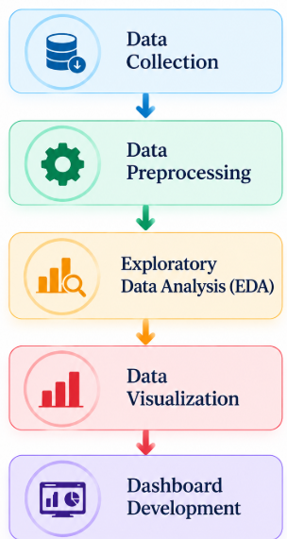
Methodology

Slide 8
Data Cleaning & Preprocessing
Removed 10 duplicate records, reducing the dataset from 600 to 590 records (19 columns).
Replaced the invalid placeholder value 999 in blood glucose (4 records) with the median, 122.1.
Filled missing HbA1c and BMI values with the median; missing treatment outcomes were labelled "Unknown".
Standardised disease names in Primary Diagnosis and Gender entries.
Set missing imaging type to "No imaging performed" and converted Visit Date to datetime format.
Checked outliers using the IQR method; plausible values were retained.

Slide 9
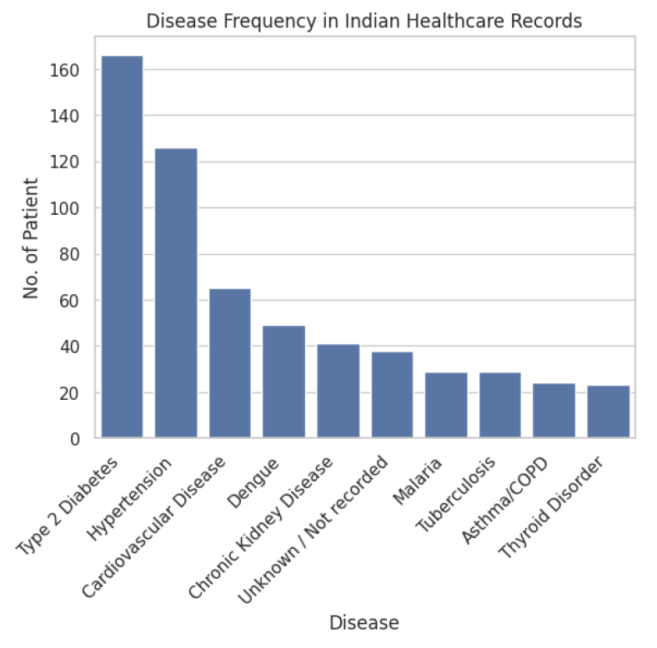
Disease Frequency Analysis
Type 2 Diabetes is the most recorded disease: 177 records.
Hypertension is second with 134 records.
Cardiovascular Disease is third with 68 records.
Asthma/COPD and Thyroid Disorder have the fewest records.
These are record counts from this dataset, not national prevalence.

Slide 10
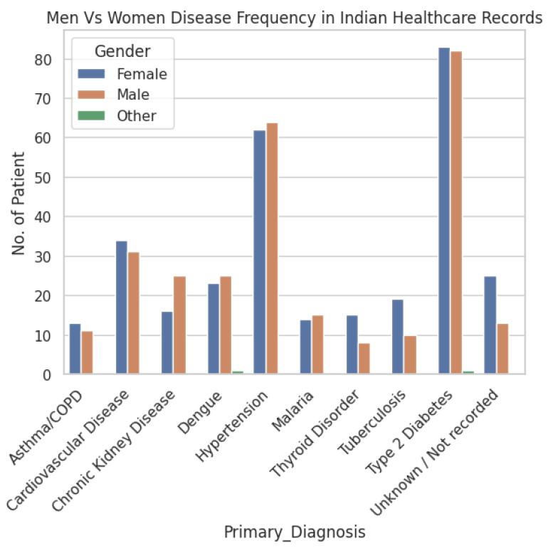
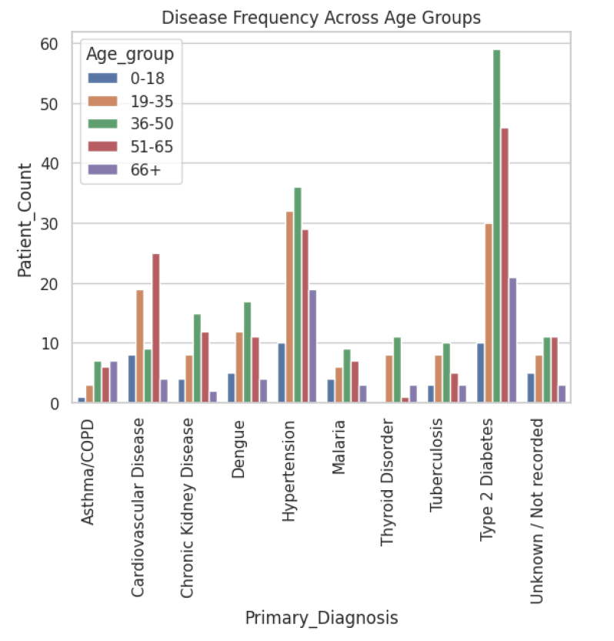
Gender and Age Group Analysis
Type 2 Diabetes is almost equal across genders: 83 female and 82 male records.
Hypertension is high for both genders; differences vary by diagnosis.
The 36–50 age group has the most Type 2 Diabetes records, followed by 51–65.
Cardiovascular Disease is more represented in the 51–65 group.

Slide 11
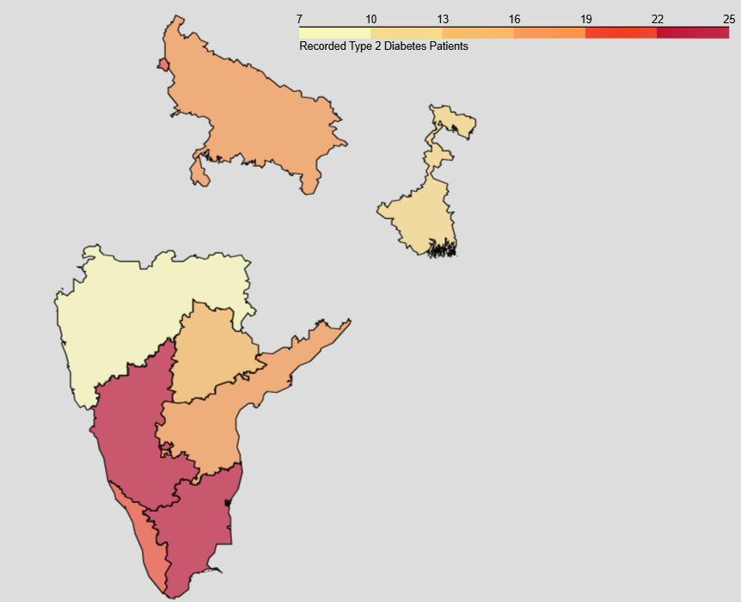
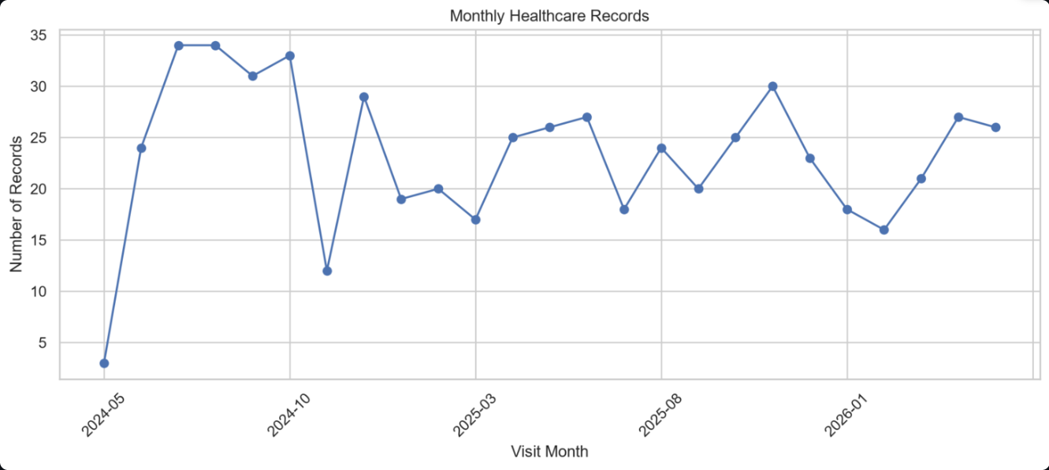
Regional and Monthly Trends
Tamil Nadu has the most Type 2 Diabetes records (25), followed by Karnataka (24).
Monthly records peak at 34 in July 2024; Type 2 Diabetes peaks at 13 records in May 2025.
These show how records are distributed in the dataset, not true prevalence or incidence.

Slide 12
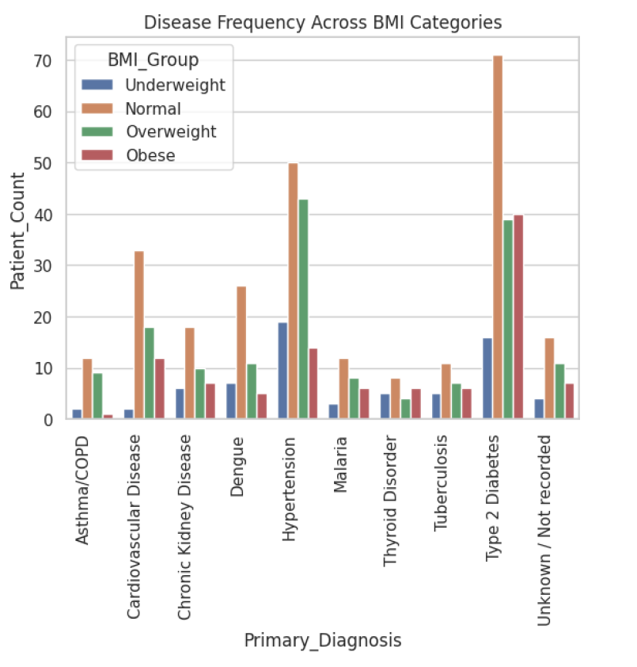
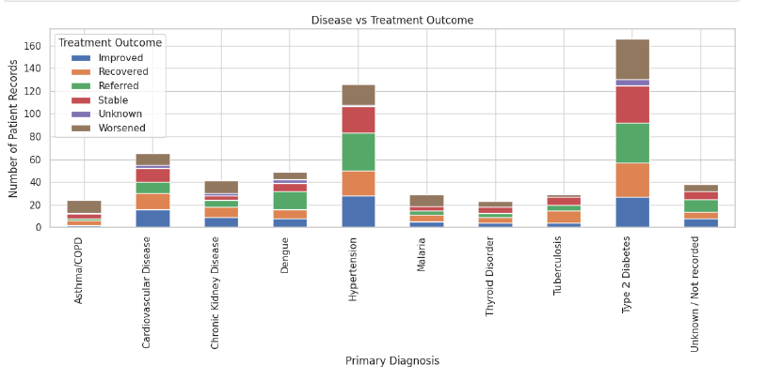
BMI and Treatment Outcomes
Normal BMI has the most records for Type 2 Diabetes and Hypertension; Overweight and Obese groups also hold substantial counts.
Type 2 Diabetes and Hypertension have the largest totals across treatment outcomes.
These are frequency comparisons and do not show causation or which treatment works best.

Slide 13
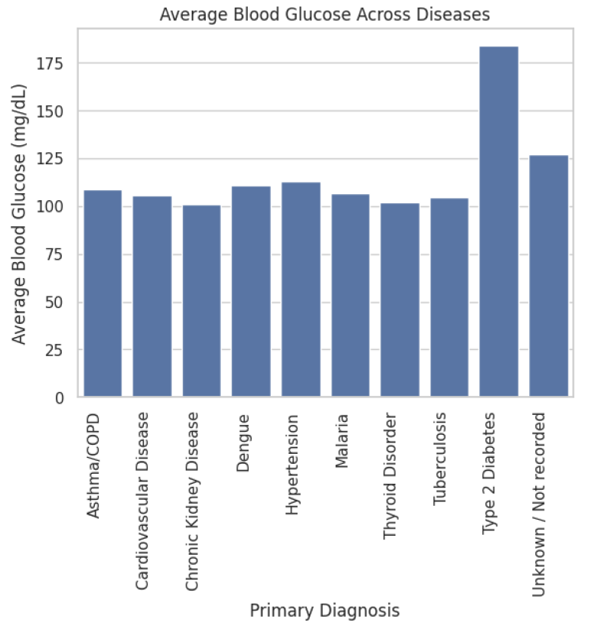
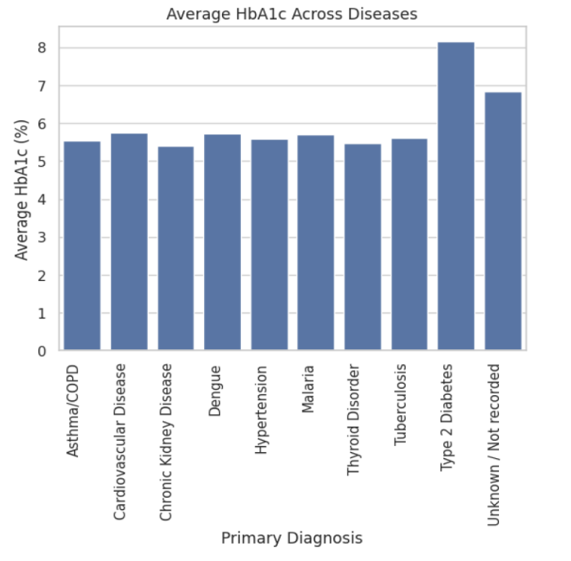
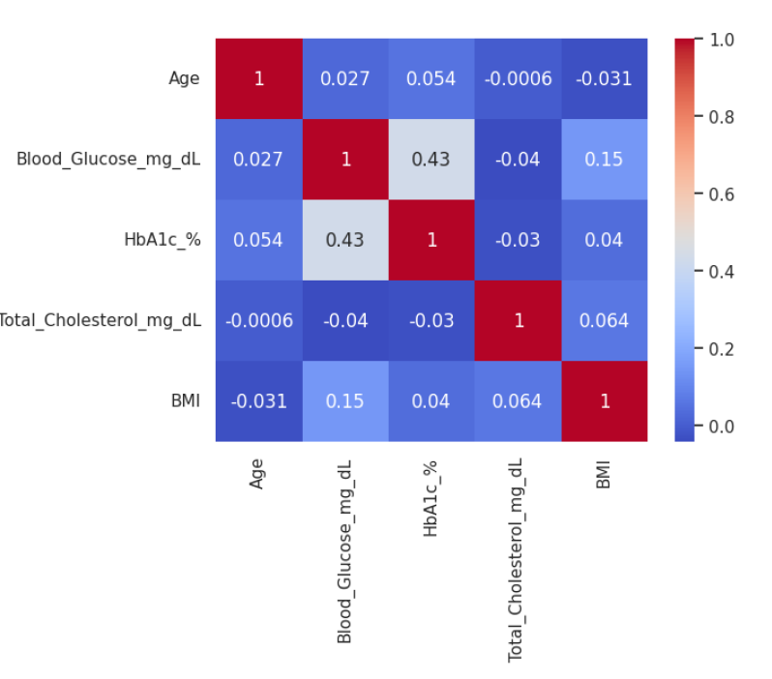
Clinical Indicators and Correlation
Type 2 Diabetes has the highest average blood glucose (184.12 mg/dL) and HbA1c (8.15%); other diseases are around 100–113 mg/dL and 5.4–5.7%.
Glucose and HbA1c show a moderate positive correlation (about 0.43); most other pairs are weak.
Correlation does not imply causation.

Slide 14
Conclusion and Future Scope
Conclusion
Limitations & Future Scope
Analysed 590 cleaned healthcare records using Python.
Type 2 Diabetes (177), Hypertension (134) and Cardiovascular Disease (68) are the most recorded diseases.
Patterns were compared across gender, age, region, BMI and treatment outcomes.
Type 2 Diabetes shows the highest glucose and HbA1c.
Limited to 590 records; findings are descriptive, not prevalence or causation.
Use larger multi-hospital datasets.
Apply machine learning for early risk assessment.
Build the interactive Power BI / Streamlit dashboard with filters.

Slide 15


