Slide 1
MYSQL DATA ANALYSIS
OnlineBookStore
SQL Project
20 SQL queries with execution results
Prepared by Rishu Gupta
01
Notes:
Source: OnlineBookStore_SQL_Solutions_Ready_for_GitHub.pdf, supplied project document. Questions and SQL retain the source wording. Dataset observations are reported from the PDF and were not independently recalculated.

Slide 2
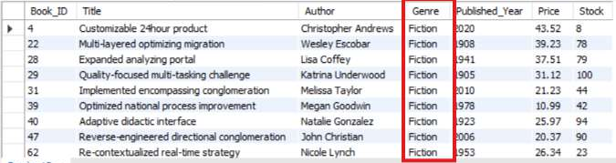
BASIC QUESTIONS
1. Retrieve all books in the "Fiction" genre
SELECT * FROM Books
WHERE Genre = 'Fiction';
QUERY RESULT
Visible excerpt: Fiction titles returned by the Genre filter.
02
Notes:
Source: Calculate the total revenue generated from all orders.pdf, page 7. Screenshot result shown as provided. Visible excerpt: Fiction titles returned by the Genre filter. Query text follows the previous project PDF except Basic 1 uses Genre as executed in screenshot, and Basic 7 includes the screenshot ORDER BY. Screenshots may show only the visible part of a result set. Original screenshot is embedded with a display crop.

Slide 3
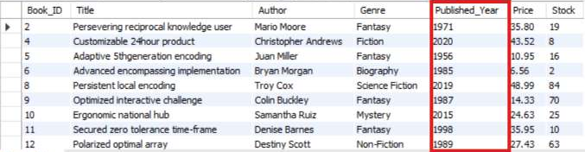
BASIC QUESTIONS
2. Find books published after the year 1950
SELECT * FROM books
WHERE Published_Year > 1950;
QUERY RESULT
Visible excerpt: all displayed publication years are later than 1950.
03
Notes:
Source: Calculate the total revenue generated from all orders.pdf, page 2. Screenshot result shown as provided. Visible excerpt: all displayed publication years are later than 1950. Query text follows the previous project PDF except Basic 1 uses Genre as executed in screenshot, and Basic 7 includes the screenshot ORDER BY. Screenshots may show only the visible part of a result set. Original screenshot is embedded with a display crop.

Slide 4
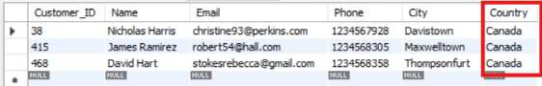
BASIC QUESTIONS
3. List all customers from the Canada
SELECT *
FROM Customers
WHERE Country = 'Canada';
QUERY RESULT
3 Canadian customers are visible in the result grid.
04
Notes:
Source: Calculate the total revenue generated from all orders.pdf, page 5. Screenshot result shown as provided. 3 Canadian customers are visible in the result grid. Query text follows the previous project PDF except Basic 1 uses Genre as executed in screenshot, and Basic 7 includes the screenshot ORDER BY. Screenshots may show only the visible part of a result set. Original screenshot is embedded with a display crop.

Slide 5
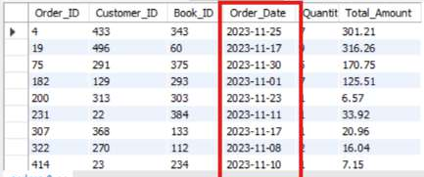
BASIC QUESTIONS
4. Show orders placed in November 2023
SELECT *
FROM orders
WHERE Order_Date BETWEEN '2023-11-01' AND '2023-11-30';
QUERY RESULT
Visible excerpt: order dates fall within November 2023.
05
Notes:
Source: Calculate the total revenue generated from all orders.pdf, page 11. Screenshot result shown as provided. Visible excerpt: order dates fall within November 2023. Query text follows the previous project PDF except Basic 1 uses Genre as executed in screenshot, and Basic 7 includes the screenshot ORDER BY. Screenshots may show only the visible part of a result set. Original screenshot is embedded with a display crop.

Slide 6
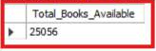
BASIC QUESTIONS
5. Retrieve the total stock of books available
SELECT SUM(Stock) AS Total_Books_Available
FROM books;
QUERY RESULT
Total stock: 25,056 books.
06
Notes:
Source: Calculate the total revenue generated from all orders.pdf, page 9. Screenshot result shown as provided. Total stock: 25,056 books. Query text follows the previous project PDF except Basic 1 uses Genre as executed in screenshot, and Basic 7 includes the screenshot ORDER BY. Screenshots may show only the visible part of a result set. Original screenshot is embedded with a display crop.

Slide 7
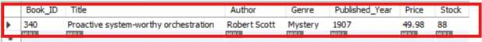
BASIC QUESTIONS
6. Find the details of the most expensive book.
SELECT * FROM books
ORDER BY Price DESC
LIMIT 1;
QUERY RESULT
Most expensive book: $49.98, Book_ID 340.
07
Notes:
Source: Calculate the total revenue generated from all orders.pdf, page 4. Screenshot result shown as provided. Most expensive book: $49.98, Book_ID 340. Query text follows the previous project PDF except Basic 1 uses Genre as executed in screenshot, and Basic 7 includes the screenshot ORDER BY. Screenshots may show only the visible part of a result set. Original screenshot is embedded with a display crop.

Slide 8
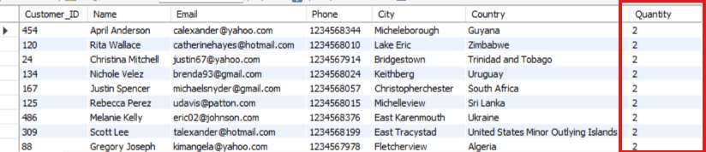
BASIC QUESTIONS
7. Show customers who ordered more than one quantity of a book.
SELECT c.Customer_ID, c.Name, c.Email, c.Phone,
c.City, c.Country, o.Quantity
FROM customers AS c
INNER JOIN orders AS o ON c.Customer_ID = o.Customer_ID
WHERE o.Quantity > 1
ORDER BY o.Quantity ASC;
QUERY RESULT
Visible excerpt: quantities are 2, sorted in ascending order.
08
Notes:
Source: Calculate the total revenue generated from all orders.pdf, page 10. Screenshot result shown as provided. Visible excerpt: quantities are 2, sorted in ascending order. Query text follows the previous project PDF except Basic 1 uses Genre as executed in screenshot, and Basic 7 includes the screenshot ORDER BY. Screenshots may show only the visible part of a result set. Original screenshot is embedded with a display crop.

Slide 9
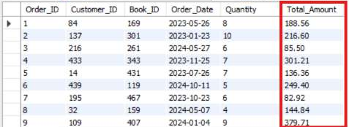
BASIC QUESTIONS
8. Retrieve orders where the total amount exceeds $20.
SELECT *
FROM orders
WHERE Total_Amount > 20;
QUERY RESULT
Visible excerpt: each displayed order amount exceeds $20.
09
Notes:
Source: Calculate the total revenue generated from all orders.pdf, page 8. Screenshot result shown as provided. Visible excerpt: each displayed order amount exceeds $20. Query text follows the previous project PDF except Basic 1 uses Genre as executed in screenshot, and Basic 7 includes the screenshot ORDER BY. Screenshots may show only the visible part of a result set. Original screenshot is embedded with a display crop.

Slide 10
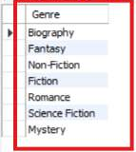
BASIC QUESTIONS
9. List all genres available in the Books table.
SELECT DISTINCT Genre FROM books;
QUERY RESULT
7 genres: Biography, Fantasy, Non-Fiction, Fiction, Romance, Science Fiction and Mystery.
10
Notes:
Source: Calculate the total revenue generated from all orders.pdf, page 6. Screenshot result shown as provided. 7 genres: Biography, Fantasy, Non-Fiction, Fiction, Romance, Science Fiction and Mystery. Query text follows the previous project PDF except Basic 1 uses Genre as executed in screenshot, and Basic 7 includes the screenshot ORDER BY. Screenshots may show only the visible part of a result set. Original screenshot is embedded with a display crop.

Slide 11
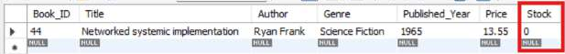
BASIC QUESTIONS
10. Find the book with the lowest stock.
SELECT * FROM books
ORDER BY Stock ASC
LIMIT 1;
QUERY RESULT
Lowest stock: 0 units, Book_ID 44.
11
Notes:
Source: Calculate the total revenue generated from all orders.pdf, page 3. Screenshot result shown as provided. Lowest stock: 0 units, Book_ID 44. Query text follows the previous project PDF except Basic 1 uses Genre as executed in screenshot, and Basic 7 includes the screenshot ORDER BY. Screenshots may show only the visible part of a result set. Original screenshot is embedded with a display crop.

Slide 12

BASIC QUESTIONS
11. Calculate the total revenue generated from all orders.
SELECT SUM(Total_Amount) AS Total_Revenue
FROM orders;
QUERY RESULT
12
Notes:
Source: Calculate the total revenue generated from all orders.pdf, page 1. Screenshot result shown as provided. Recorded revenue in this query run: $36,445.58. Query text follows the previous project PDF except Basic 1 uses Genre as executed in screenshot, and Basic 7 includes the screenshot ORDER BY. Screenshots may show only the visible part of a result set. Original screenshot is embedded with a display crop.

Slide 13
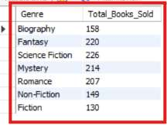
ADVANCED QUESTIONS
1. Retrieve the total number of books sold for each genre:
SELECT b.Genre, SUM(o.Quantity) AS Total_Books_Sold
FROM orders o
JOIN books b
ON o.Book_ID = b.Book_ID
GROUP BY b.Genre;
QUERY RESULT
Science Fiction leads with 226 units; the seven genre totals sum to 1,304.
13
Notes:
Source: Calculate the total revenue generated from all orders.pdf, page 18. Screenshot result shown as provided. Science Fiction leads with 226 units; the seven genre totals sum to 1,304. Query text follows the previous project PDF except Basic 1 uses Genre as executed in screenshot, and Basic 7 includes the screenshot ORDER BY. Screenshots may show only the visible part of a result set. Original screenshot is embedded with a display crop.

Slide 14
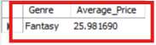
ADVANCED QUESTIONS
2. Find the average price of books in the "Fantasy" genre:
SELECT Genre, AVG(Price) AS Average_Price
FROM books
WHERE Genre = "Fantasy";
QUERY RESULT
Fantasy average price: $25.981690, approximately $25.98.
14
Notes:
Source: Calculate the total revenue generated from all orders.pdf, page 13. Screenshot result shown as provided. Fantasy average price: $25.981690, approximately $25.98. Query text follows the previous project PDF except Basic 1 uses Genre as executed in screenshot, and Basic 7 includes the screenshot ORDER BY. Screenshots may show only the visible part of a result set. Original screenshot is embedded with a display crop.

Slide 15
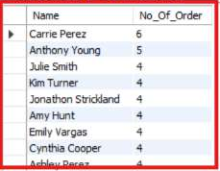
ADVANCED QUESTIONS
3. List customers who have placed at least 2 orders:
SELECT c.Name, COUNT(o.Customer_ID) AS No_Of_Order
FROM Customers AS c
INNER JOIN orders AS o
ON c.Customer_ID = o.Customer_ID
GROUP BY c. Name
HAVING No_Of_Order >=2
ORDER BY No_Of_Order DESC;
QUERY RESULT
Visible excerpt: Carrie Perez has 6 orders, followed by Anthony Young with 5.
15
Notes:
Source: Calculate the total revenue generated from all orders.pdf, page 16. Screenshot result shown as provided. Visible excerpt: Carrie Perez has 6 orders, followed by Anthony Young with 5. Query text follows the previous project PDF except Basic 1 uses Genre as executed in screenshot, and Basic 7 includes the screenshot ORDER BY. Screenshots may show only the visible part of a result set. Original screenshot is embedded with a display crop.

Slide 16
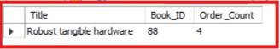
ADVANCED QUESTIONS
4. Find the most frequently ordered book:
SELECT b.Title, o.Book_ID, COUNT(o.Order_id) AS Order_Count
FROM orders o
INNER JOIN books b
ON o.Book_ID = b.Book_ID
GROUP BY o.Book_id
ORDER BY Order_Count DESC
LIMIT 1;
QUERY RESULT
Robust tangible hardware (Book_ID 88) appears in 4 order records.
16
Notes:
Source: Calculate the total revenue generated from all orders.pdf, page 15. Screenshot result shown as provided. Robust tangible hardware (Book_ID 88) appears in 4 order records. Query text follows the previous project PDF except Basic 1 uses Genre as executed in screenshot, and Basic 7 includes the screenshot ORDER BY. Screenshots may show only the visible part of a result set. Original screenshot is embedded with a display crop.

Slide 17
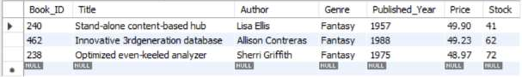
ADVANCED QUESTIONS
5. Show the top 3 most expensive books
of 'Fantasy' Genre:
SELECT * FROM books
WHERE Genre = "Fantasy"
ORDER BY Price DESC
LIMIT 3;
QUERY RESULT
Top Fantasy prices: $49.90, $49.23 and $48.97.
17
Notes:
Source: Calculate the total revenue generated from all orders.pdf, page 20. Screenshot result shown as provided. Top Fantasy prices: $49.90, $49.23 and $48.97. Query text follows the previous project PDF except Basic 1 uses Genre as executed in screenshot, and Basic 7 includes the screenshot ORDER BY. Screenshots may show only the visible part of a result set. Original screenshot is embedded with a display crop.

Slide 18
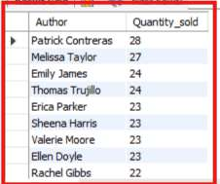
ADVANCED QUESTIONS
6. Retrieve the total quantity of books sold by each author:
SELECT b.Author, SUM(o.Quantity) AS Quantity_sold
FROM orders o
JOIN books b
ON o.Book_ID = b.Book_ID
GROUP BY b.Author
ORDER BY Quantity_sold DESC;
QUERY RESULT
Visible excerpt: Patrick Contreras leads with 28 units, followed by Melissa Taylor with 27.
18
Notes:
Source: Calculate the total revenue generated from all orders.pdf, page 19. Screenshot result shown as provided. Visible excerpt: Patrick Contreras leads with 28 units, followed by Melissa Taylor with 27. Query text follows the previous project PDF except Basic 1 uses Genre as executed in screenshot, and Basic 7 includes the screenshot ORDER BY. Screenshots may show only the visible part of a result set. Original screenshot is embedded with a display crop.

Slide 19

ADVANCED QUESTIONS
7. List the cities where customers who spent over $30 are located:
SELECT DISTINCT c.City, Total_Amount
FROM orders o
JOIN customers c
ON o.Customer_ID = c.Customer_ID
WHERE o. Total_Amount > 30;
QUERY RESULT
Visible excerpt: cities associated with individual orders above $30.
19
Notes:
Source: Calculate the total revenue generated from all orders.pdf, page 17. Screenshot result shown as provided. Visible excerpt: cities associated with individual orders above $30. Query text follows the previous project PDF except Basic 1 uses Genre as executed in screenshot, and Basic 7 includes the screenshot ORDER BY. Screenshots may show only the visible part of a result set. Original screenshot is embedded with a display crop.

Slide 20
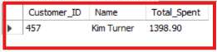
ADVANCED QUESTIONS
8. Find the customer who spent the most on orders:
SELECT c.Customer_ID, c.Name, SUM(o.Total_Amount) AS Total_Spent
FROM customers c
JOIN orders o
ON c.Customer_ID = o.Customer_ID
GROUP BY c.Customer_ID , c.Name
ORDER BY Total_Spent DESC
LIMIT 1;
QUERY RESULT
Highest total spend: Kim Turner (Customer_ID 457), $1,398.90.
20
Notes:
Source: Calculate the total revenue generated from all orders.pdf, page 14. Screenshot result shown as provided. Highest total spend: Kim Turner (Customer_ID 457), $1,398.90. Query text follows the previous project PDF except Basic 1 uses Genre as executed in screenshot, and Basic 7 includes the screenshot ORDER BY. Screenshots may show only the visible part of a result set. Original screenshot is embedded with a display crop.

Slide 21
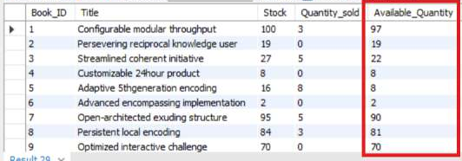
ADVANCED QUESTIONS
9. Calculate the stock remaining after fulfilling all orders:
SELECT b.Book_ID, b.Title, b.Stock,
COALESCE(SUM(o.Quantity), 0) AS Quantity_sold,
(b.Stock - COALESCE(SUM(o.Quantity), 0)) AS Available_Quantity
FROM books b LEFT JOIN orders o ON b.Book_ID = o.Book_ID
GROUP BY b.Book_ID, b.Stock;
QUERY RESULT
Visible excerpt: Book_ID 1 has 97 units remaining (100 stock minus 3 sold).
21
Notes:
Source: Calculate the total revenue generated from all orders.pdf, page 12. Screenshot result shown as provided. Visible excerpt: Book_ID 1 has 97 units remaining (100 stock minus 3 sold). Query text follows the previous project PDF except Basic 1 uses Genre as executed in screenshot, and Basic 7 includes the screenshot ORDER BY. Screenshots may show only the visible part of a result set. Original screenshot is embedded with a display crop.

Slide 22
Results at a glance
Recorded revenue
$75,628.66
Total stock
25,056 books
22
Notes:
Source: supplied screenshots PDF. Revenue page 1; stock page 9; genre units page 18; top customer page 14; popular book page 15; low stock page 3; high price page 4; Fantasy average page 13. Total genre units calculated as 158 + 220 + 226 + 214 + 207 + 149 + 130 = 1,304. Earlier PDF figures differ and are not combined with these results.

Slide 23
Genre demand
Units sold by genre
Science Fiction leads with 226 units.
Total across the seven displayed genres
1,304 units
23
Notes:
Source: supplied screenshots PDF. Revenue page 1; stock page 9; genre units page 18; top customer page 14; popular book page 15; low stock page 3; high price page 4; Fantasy average page 13. Total genre units calculated as 158 + 220 + 226 + 214 + 207 + 149 + 130 = 1,304. Earlier PDF figures differ and are not combined with these results.

Slide 24
Customer and product leaders
Top customer
Kim Turner spent $1,398.90 across orders.
Most frequently ordered book
Robust tangible hardware appears in 4 order records.
24
Notes:
Source: supplied screenshots PDF. Revenue page 1; stock page 9; genre units page 18; top customer page 14; popular book page 15; low stock page 3; high price page 4; Fantasy average page 13. Total genre units calculated as 158 + 220 + 226 + 214 + 207 + 149 + 130 = 1,304. Earlier PDF figures differ and are not combined with these results.

Slide 25
Project findings and data scope
Inventory and pricing
Book_ID 44 has no stock. The most expensive book is $49.98. Fantasy books average $25.98.
25
Notes:
Source: supplied screenshots PDF. Revenue page 1; stock page 9; genre units page 18; top customer page 14; popular book page 15; low stock page 3; high price page 4; Fantasy average page 13. Total genre units calculated as 158 + 220 + 226 + 214 + 207 + 149 + 130 = 1,304. Earlier PDF figures differ and are not combined with these results.

