Slide 1
ML Report
Group Members:
Rishu Kumar (BT18CSE060)
Neha Pasine (BT18CSE017)

Slide 2
Dataset - Heart Disease Prediction
(Ready Dataset)
No. of rows - 918
No. of input features - 8
No. of output feature - 1(binary)
Training : Testing - 4:1
Dataset size - 36 kB

Slide 3
Input Attributes:
Features | Type | Range
Age | int | [28,77]
Sex | int | [0,1]
RestingBP | int | [0,200]
Cholesterol | int | [0,603]
FastingBS | int | [0,1]
MaxHR | int | [60,202]
ExerciseAngina | int | [0,1]
Oldpeak | float | [-2.6,6.2]

Slide 4
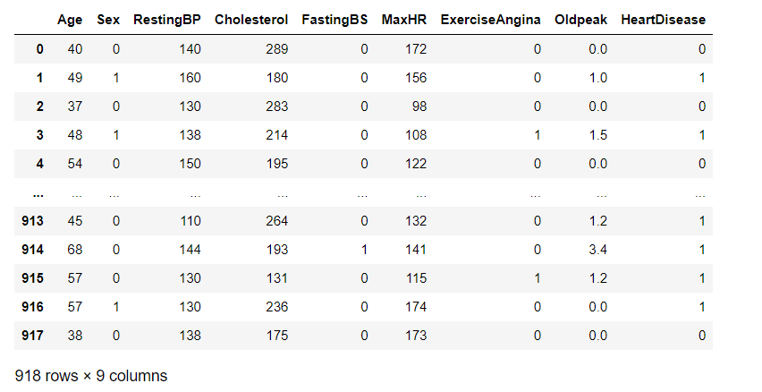
Sample entries of the Ready Dataset:

Slide 5
Candidate Algorithms:
Back Propagation Neural Network
K- Nearest neighbours(KNN)
Decision Trees
Support Vector Machine(SVM)
Chosen Algorithm : Back Propagation

Slide 6
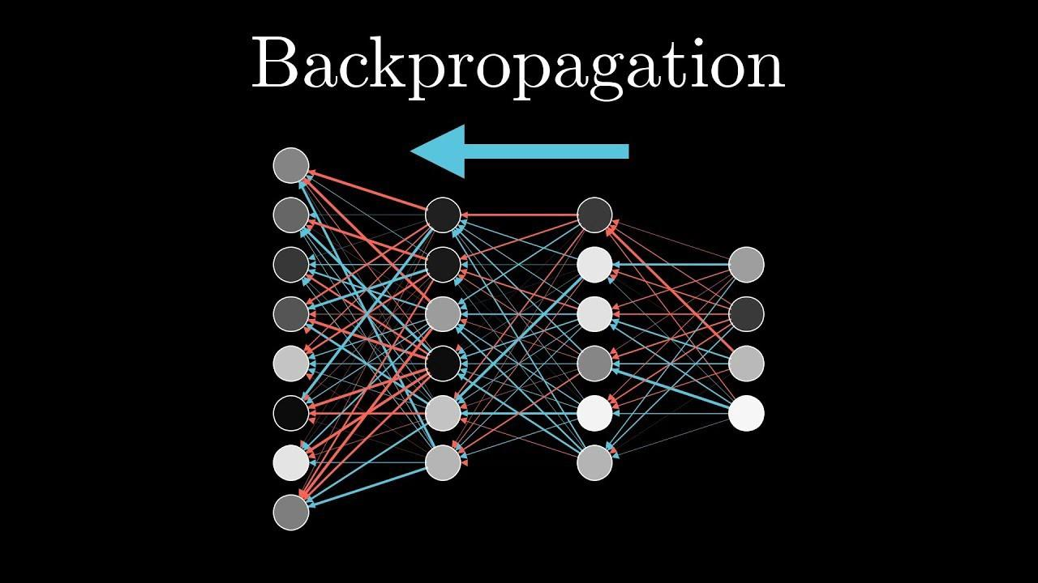
Why do we prefer Back Propagation ?
Effective for training of high dimensional data
No parameters to tune apart from the number of inputs
Does not require prior knowledge about the network

Slide 7
Libraries and APIs that can be used to implement Back Propagation:
Libraries we used in our code:
Numpy
Pandas
Matplotlib
PyTorch
TensorFlow
Scikit-Neural Network
NeuroLab
Keras
ffnet

Slide 8
Code:
Implemented the code of Neural Network Back Propagation from scratch using the python language.
Used K-fold cross validation of our dataset to test our model.
Also implemented the code for other 3 algorithms mentioned (KNN, SVM, Decision Tree) using sklearn library.

Slide 9
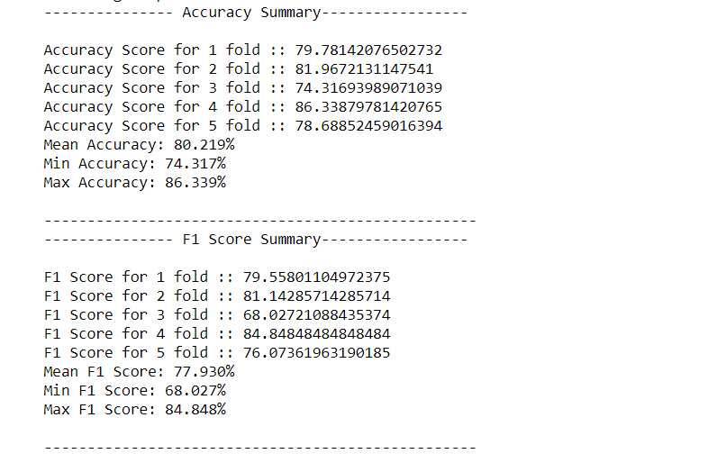
Performance Measure:
Used 2 performance metrics:
Accuracy
F1 Score
The accuracy for the other candidate algorithms
are either lesser(KNN, decision tree) compared to
our model or comparable(SVM) to our model.

Slide 10
ADVANTAGES OF BACK PROPAGATION ALGORITHM:
It is fast, simple, and easy to implement
It is able to adapt and learn independently.
Allows efficient computation of the gradient at each layer.

Slide 11
DISADVANTAGES OF BACK PROPAGATION ALGORITHM
Sensitive to complex/noisy data which lead to inaccurate results.
It needs the derivatives of activation functions for the network design time.
Sensitive of the initial weights and bias.

Slide 12


