Slide 1

IILM UNIVERSITY, GREATER NOIDA
School of Computer Science & Engineering
INTERNSHIP EVALUATION PRESENTATION
LeadOne 2.0: Enterprise Lead Management System, CRM & Cloud Telephony Platform
STUDENT DETAILS
Student Name: RISHU RAJ
Enrollment / Roll No: CS-2341354
Program & Semester: B.Tech CSE (4th Sem / 4CSE6)
Batch: 2023 – 2027
INTERNSHIP ORGANIZATION
Organization Name: FinZ
Designation: Full Stack Developer (Intern)
Internship Tenure: 18-May-2026 to 18-Aug-2026
Project Worked On: LeadOne 2.0 Platform

Slide 2
01 / PROJECT SCOPE
Project Overview & Key Objectives
CORE PROJECT OBJECTIVES
✔ Centralized Lead Tracking: Capture, assign, & track leads across multi-channel sales pipelines.
✔ Cloud Telephony Integration: Live call queue monitoring & CDR webhook processing.
✔ Android SIM Call Logger: Automatic background call duration & status sync for mobile agents.
✔ Geofenced Attendance: GPS check-in/check-out validated against office radius limits.
✔ Helpdesk & SLA Engine: SLA timer countdowns, breach detection, & automated escalation.
✔ Workflow Automation: Custom trigger-action builder for automated system notifications.
WHAT IS LEADONE 2.0?
Unified Enterprise Platform: Developed at FinZ during an 8-week full-stack internship (May–Aug 2026).
Problem Solved: Replaces fragmented sales software with a single platform integrating lead routing, cloud calls, field GPS tracking, and SLA ticketing.
Target Stakeholders: Telecallers, On-ground Field Executives, Team Supervisors, and System Administrators.
Deployment Scale: High-concurrency enterprise web application backed by Laravel, real-time WebSockets, and Android APIs.

Slide 3
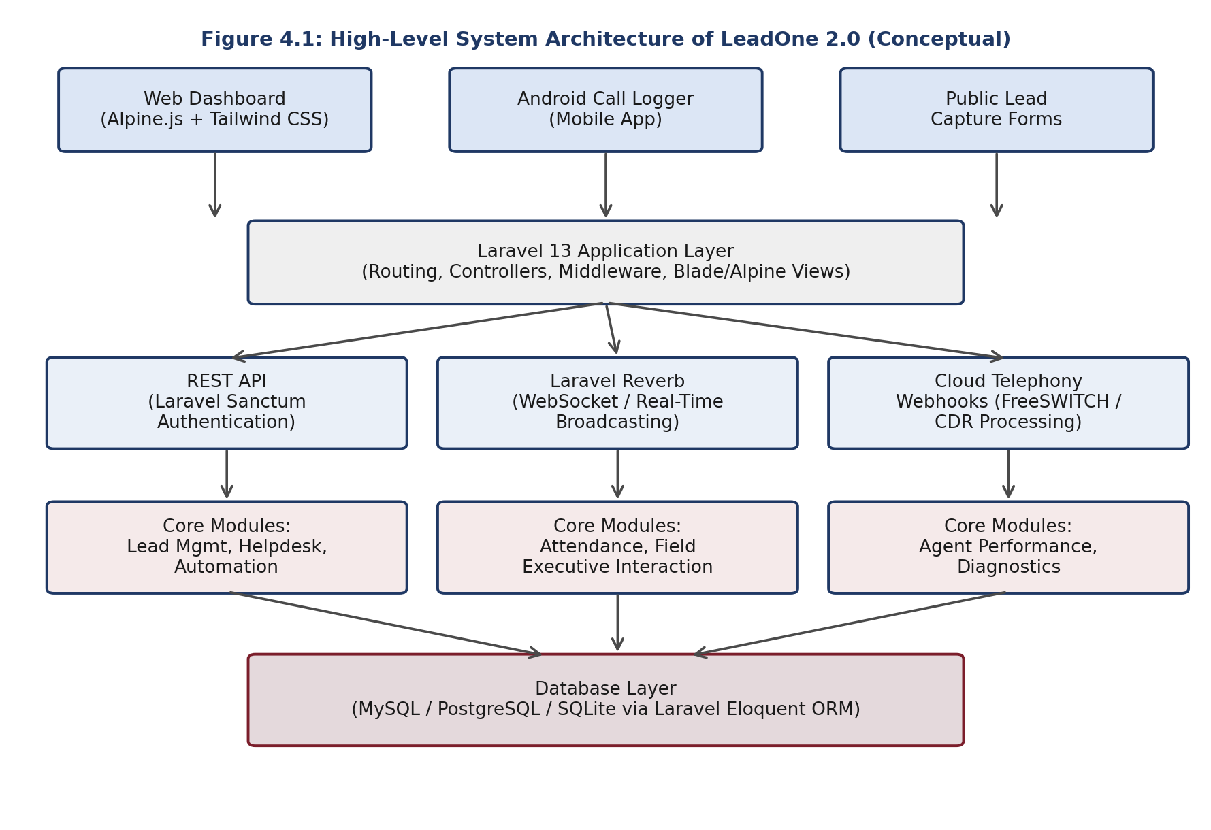
02 / TECH ARCHITECTURE
Technology Stack & High-Level Architecture
TECHNOLOGY STACK USED
Backend: Laravel 13 (PHP 8.3+), Eloquent ORM
Real-Time: Laravel Reverb WebSockets
Frontend: Alpine.js & Tailwind CSS 4.0
Auth & Security: Laravel Sanctum REST APIs
Bundler: Vite 8 & Node.js pipeline
Database: MySQL 8.0 / PostgreSQL

Slide 4
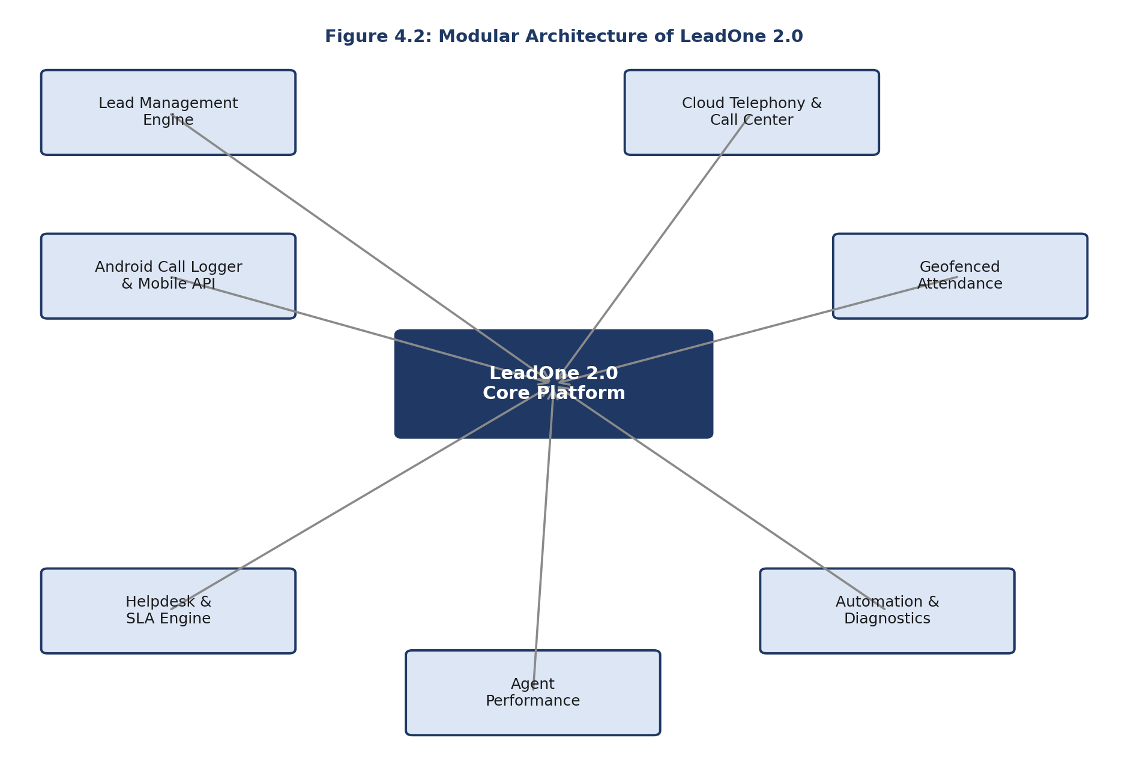
03 / SYSTEM MODULES
The 7 Functional Modules of LeadOne 2.0
7 MODULAR COMPONENTS
1. Lead Engine: Intake, auto-assignment & stage tracking.
2. Cloud Telephony: Inbound/outbound queues & CDR webhooks.
3. Mobile API & Logger: Android background call log sync.
4. Geofenced Attendance: GPS check-in/out & field visit logs.
5. Helpdesk & SLA Engine: SLA timers & supervisor escalation.
6. Agent Performance: Break tracking & violation alerts.
7. Automation Engine: Trigger-action workflow builder.

Slide 5
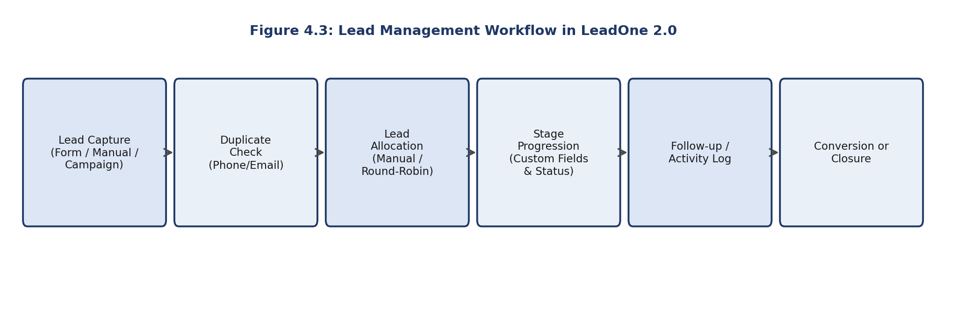
04 / WORKFLOW ENGINE
Lead Lifecycle & Telephony Workflow
1. Lead Capture & Routing
Multi-channel intake (web, API, phone) with automatic deduplication & round-robin agent routing.
2. Activity & Call Logging
Unified interaction timeline logging call durations via Cloud Telephony & Android Call Logger APIs.
3. Stage Conversion & SLA
Stage progression from New Lead -> Contacted -> Converted, backed by SLA response timers.

Slide 6
05 / MY WORK & IMPACT
My Contributions & Technical Challenges Solved
MY DIRECT CONTRIBUTIONS
• REST API Controller Scaffolding: Built endpoints for Lead Management & SLA Helpdesk modules.
• Real-Time Event Streaming: Configured Laravel Reverb listeners for agent break tracking & status sync.
• Authentication Middleware: Implemented Sanctum token auth for mobile Android app communication.
• Schema & Migration Design: Structured relational database schemas & Eloquent ORM model relations.
• End-to-End API Testing: Verified API payload validation, status codes, and error trace handling.
CHALLENGES & RESOLUTIONS
✔ Role Access Control (RBAC): Enforced Laravel Policy gates & Sanctum token scopes for Agents, Supervisors, & Admins.
✔ Real-Time Dual State Sync: Solved state desync between web dashboard & mobile clients via Reverb WebSockets.
✔ High Telephony Webhook Load: Queued incoming telephony webhooks asynchronously using Laravel Jobs.
✔ GPS Geofence Jitter: Implemented Haversine distance formula with threshold radius for accurate field check-in.

Slide 7
THANK YOU

