Slide 1
Towards a polyalgorithm for land cover trend and change detection
Rishu Saxena
Department of Computer Science & Applications
Virginia Polytechnic Institute & State University
Advisors: Prof. Layne T. Watson, Prof. Randolph H. Wynne

Slide 2
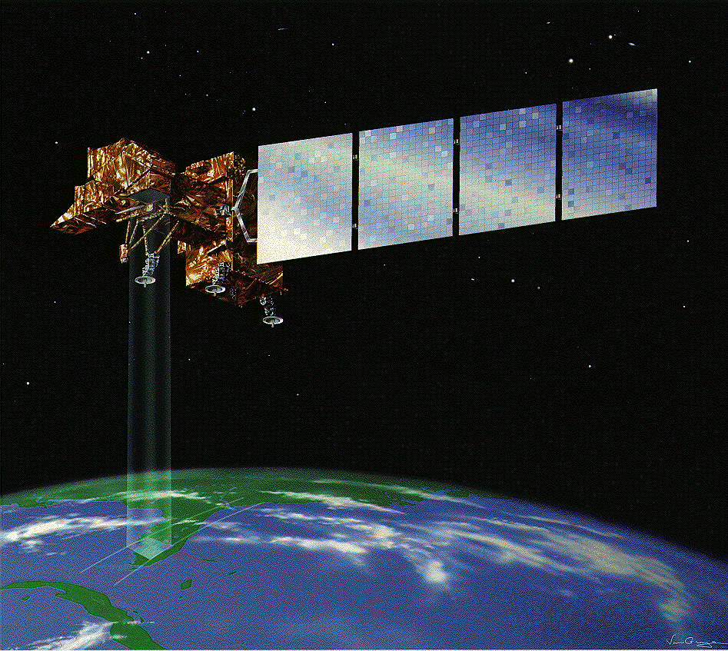
Introduction
Earth observation satellites (EOS) such as Landsat take images of the Earth’s surface at regular time intervals.
These images can be immensely useful for numerous purposes, including monitoring land use and land cover (LULC).
Source: https://www.nasa.gov/

Slide 3
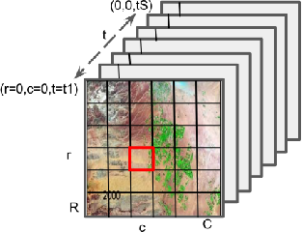
Problem setup
Definitions:
Scene: A rectangular patch of Earth’s surface.
Image: A snapshot of the scene at a given time instant.
  Pixel: in an image corresponds to a square sub-patch in the scene. For Landsat, a pixel is 30m x 30m sub-patch.
Image stack: Series of images of the same scene taken at a sequence of timepoints.
NDVI: Each pixel in the image is assigned a data value that encodes information about land cover.
Time series: Sequence of (timepoint, data) pairs for a fixed pixel in the image stack.
An image stack

Slide 4
Problem setup
Goal: For each pixel of a given image stack, identify “change points” from its timeseries.
Change: Informally, is a lasting shift in cover type of the patch corresponding to the pixel.
A model agnostic definition of change has so far not been established.
Here, we define a change point as a breakpoint computed by some mathematical model of the data.

Slide 5
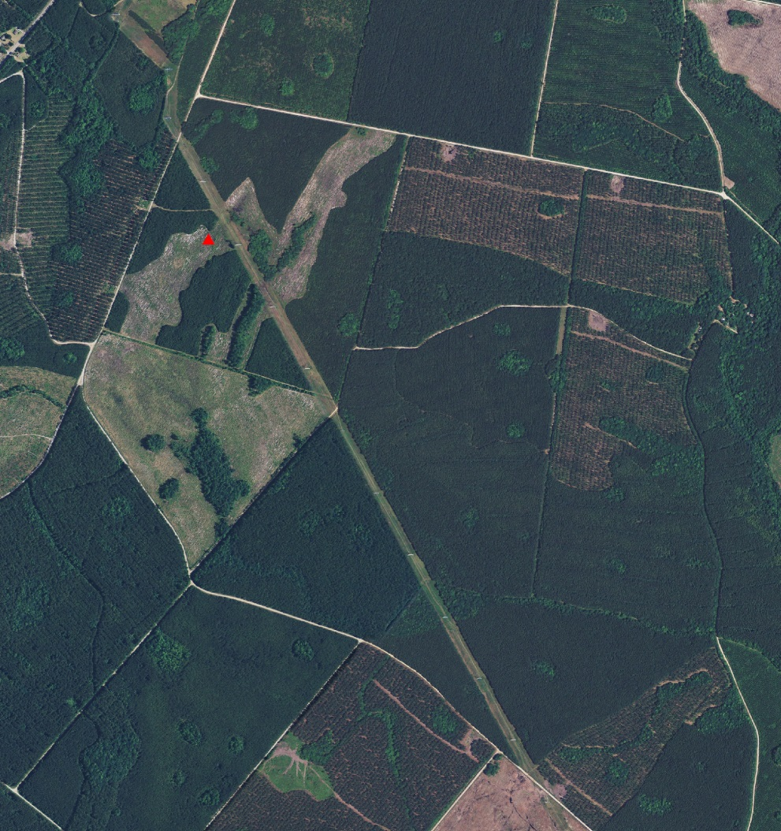
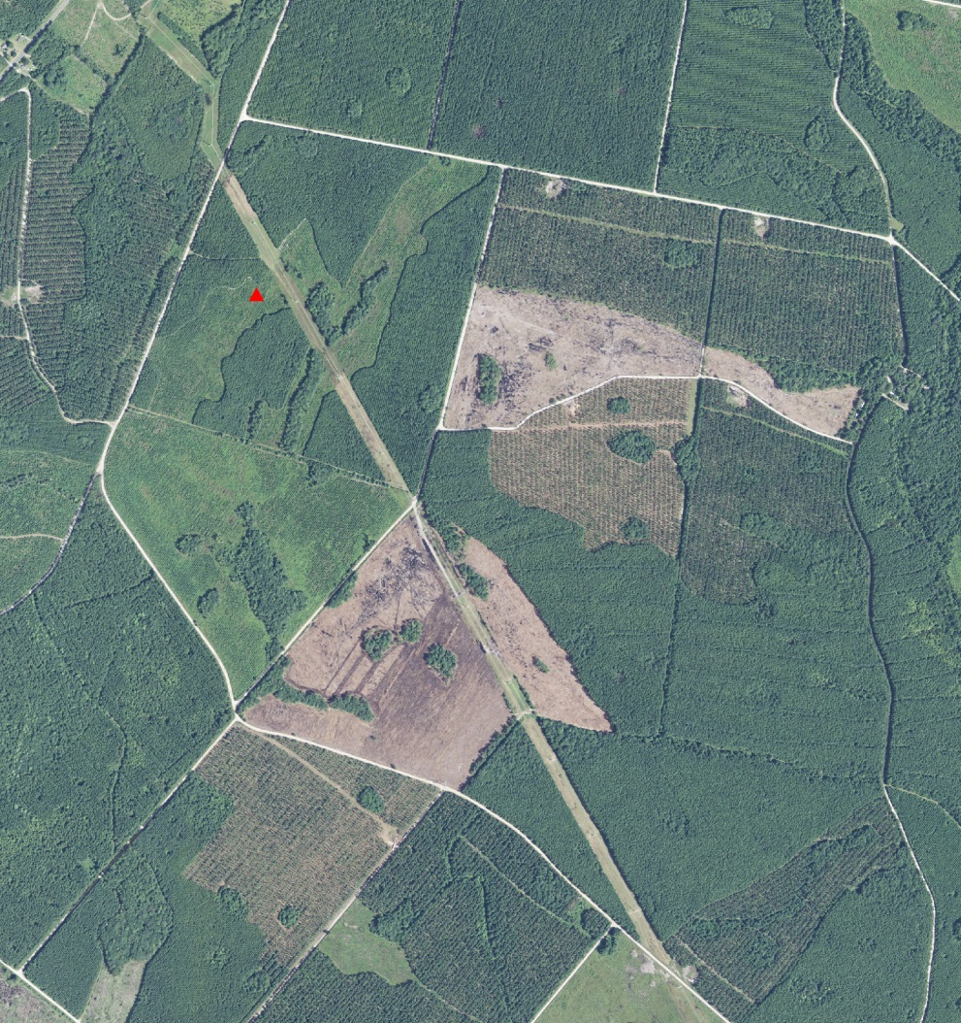
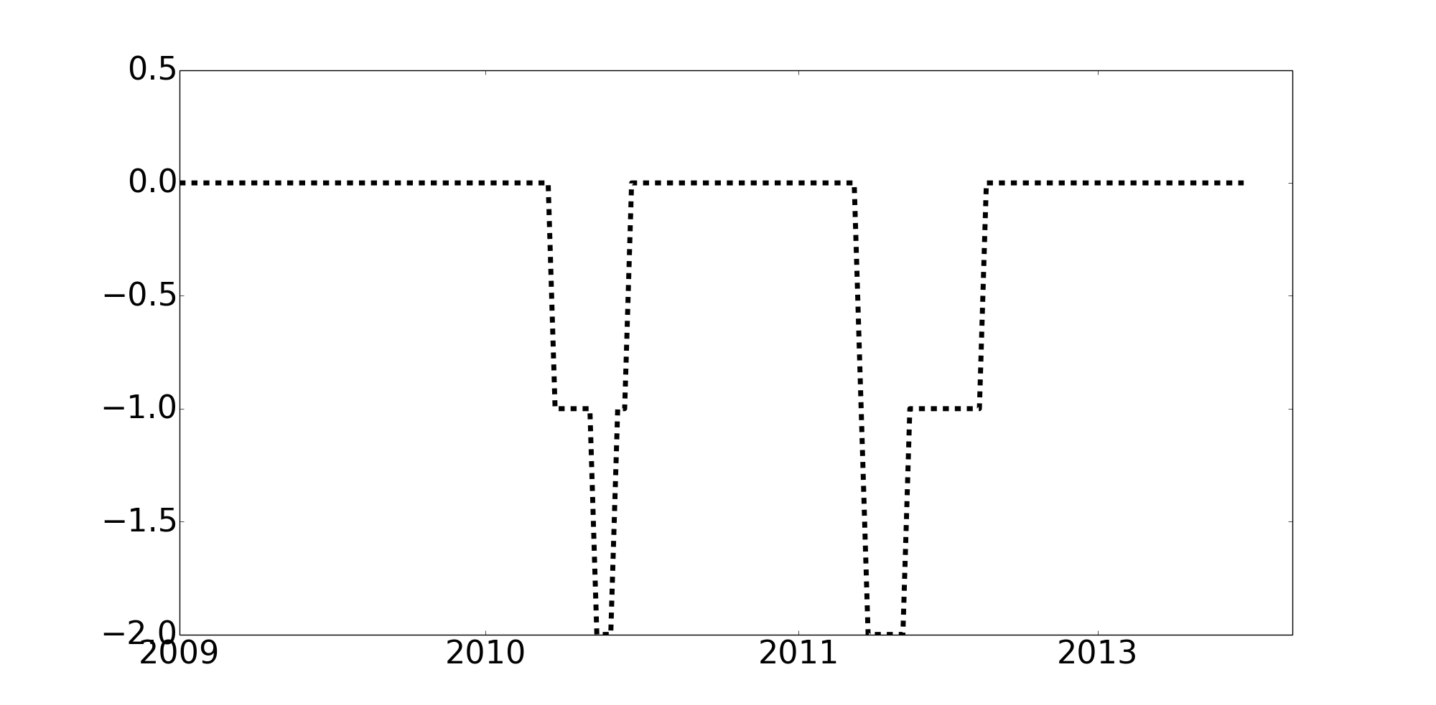
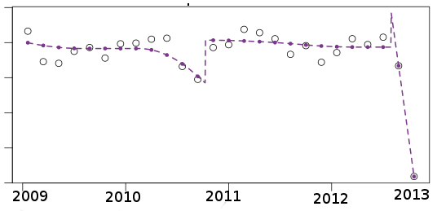
Problem setup
2009
2013
Model 1 (EWMA-CD)
Model 2 (SSF)

Slide 6
Problem setup
Different algorithms (models) give different results.
No single model performs accurately across a variety of scenes picked randomly from across the globe.
Hypothesis: An algorithm that
  combines multiple algorithms
  that differ in terms of the phenomena they capture,
will adequately address the problem of analyzing time series coming from anywhere
across the globe.
Question: How do we combine different algorithms?

Slide 7
Contributions
Lays the foundation for a polyalgorithm for LULCC detection.
  Choose algorithms unique to each other in the phenomenon they capture.
  A unified I/O framework for all component algorithms.
  Initiate the design of the polyalgorithm.
Systematic investigation of the issues involved.
Implementation:
  Scalable, space and time efficient on available hardware?
  Codes in Python 2.7 and Fortran 2008.
Rishu Saxena, Layne T. Watson, Valerie A. Thomas, and Randolph H. Wynne. 2017. Scaling constituent algorithms of a trend and change detection polyalgorithm. In Proceedings of the 25th High Performance Computing Symposium (HPC '17),San Diego, CA, USA, Article 6, 12 pages.
Rishu Saxena, Layne T. Watson, Randolph H. Wynne, Valerie A. Thomas. Scalability of Land Use Monitoring Codes, International Conference on Scientific Computing (CSC17), Las Vegas, USA, pages 3-9
Rishu Saxena, Layne T. Watson, Randolph H. Wynne, Evan B. Brooks, Valerie A. Thomas,Yang Zhiqiang, and Robert E. Kennedy, Towards a polyalgorithm for land use change detection, in preparation.

Slide 8
State-of-the-art
Segmentation approaches in general time series literature
Algorithms in Remote Sensing
BFAST (2009)
VCT (2009)
ModelMap (2009)
LandTrendR (2010)
MIICA (2011)
EWMACD (2012)
VerDET (2014)
CCDC (2014)
Shape-Select-Forest (2015)
Kernel Regression methods
Top-down approaches
Bottom-up approaches
Remote sensing vs. the broader picture

Slide 9
State-of-the-art
Segmentation approaches in general time series literature
Algorithms in Remote Sensing
EWMACD, CCDC,
Shape-Select-Forest
LandTrendR, VerDET
BFAST, VCT, MIICA, ModelMap
Kernel Regression methods
Top-down approaches
Bottom-up approaches
Remote sensing vs. the broader picture

Slide 10
State-of-the-art
Segmentation approaches in general time series literature
Algorithms in Remote Sensing
EWMACD, CCDC,
Shape-Select-Forest
LandTrendR, VerDET
BFAST, VCT, MIICA, ModelMap
Kernel Regression methods
Top-down approaches
Bottom-up approaches
Remote sensing vs. the broader picture

Slide 11
Validation datasets
For 1D: Timesync data
  Timesync dataset is based on human interpretation of Landsat time series in concert with historical aerial photographs.
  Major events covered include harvest, fire, flood, stress, mechanical.
  Consists of both forest and non-forest pixels.
  Here, normalized difference vegetation index (NDVI) trajectories are used.
    NDVI = (NIR - RED)/(NIR + RED)
  Years 2000 to 2012 (both included) are used here.
For 2D: Path/row 1837, NDVI data, years 2009 to 2014 (included).
  7411 lines, 8801 samples.
  198 time points.
  Sensors 5 and 7.

Slide 12
Algorithms
Exponentially Weighted Moving Average Change Detection (EWMA-CD)
Uses harmonic regression with control chart.
  Kernel regression approach.
  Harmonic regression on training data.
    Initial few years of data is used as training data.
  Compute errors from the harmonic model predictions.
  Control chart to determine whether an error indicates a persistent change.
  Output: Sequence of flags that correspond to presence or absence of disturbance in trajectory.
Brooks, E.B., Thomas, V.A., Wynne, R.H., and Coulston, J. W., 2012, “Fitting the multitemporal curve: a Fourier series approach to the missing data problem in remote sensing analysis,” IEEE Transactions on Geosciences and Remote Sensing, 59, 3340–3353.

Slide 13
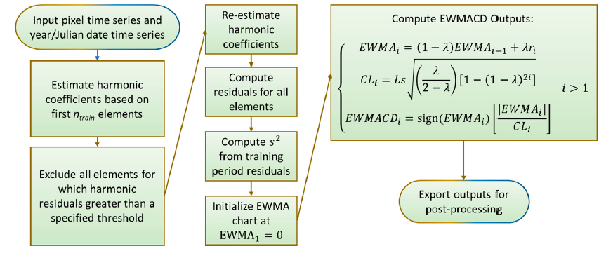
Algorithms
Exponentially Weighted Moving Average Change Detection (EWMA-CD)
Source: Brooks, E.B., Zhiqiang, Y., Thomas, V.A., and Wynne, R.H., 2017, “Edyn: Dynamic Signaling of Changes to Forests Using Exponentially Weighted Moving Average Charts,” Forests, 8(304), 18.

Slide 14
EWMACD
Parameters
Number of harmonics, K | 2
Training start | 2000
Training end | (end of) 2002
L | 3.0
λ | 0.5
Persistence ⍵ | 7
xbar_lim1 | 1.5 * standard deviation
xbar_lim2 | 20 * standard deviation

Slide 15
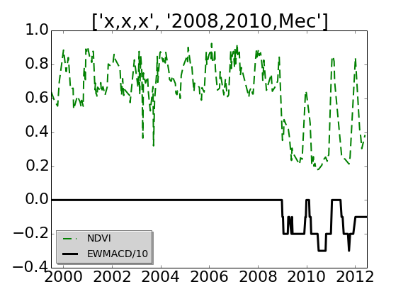
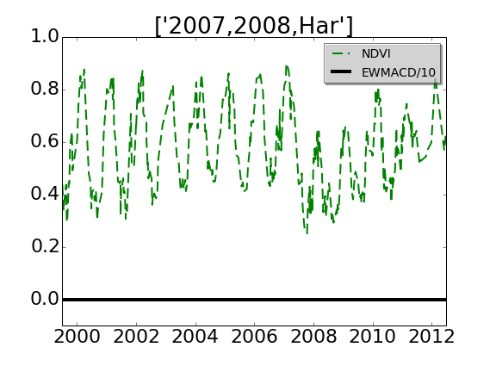
EWMACD
Example outcomes
Forest →Agriculture
(Success)
Harvest in Forest
(Failure)
Significant limitations:
Unstable training period.
Change during an ongoing recovery or loss period.

Slide 16
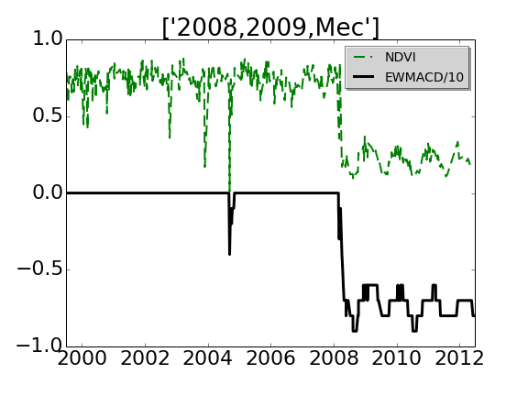
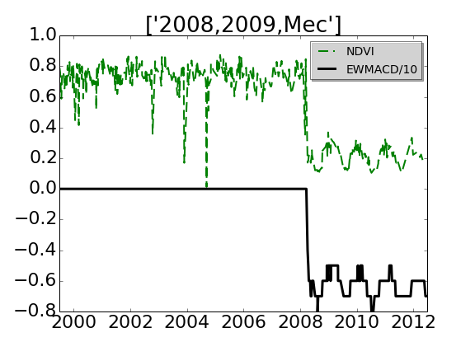
EWMACD
Parameter dependence
λ = 0.4
λ = 0.5
Dependence on parameters:
λ = 0.4 had a false alarm in 2004. The false alarm disappears for λ = 0.5.
Results also change with L, and persistence.

Slide 17
BFAST
Breaks For Additive and Seasonal Trend
Bottom-up approach.
The probability of presence of a breakpoint is calculated using OLS-Mosum test.
  If the probability is lower than a user defined threshold, stability (no breakpoint) is assumed.
If a breakpoint is present, every single point in the domain is treated as a candidate breakpoint.
  Regression is done on both sides of the each point and mean squared error (MSE) of the fit calculated.
The point that corresponds to minimum value of MSEs in fits on its either sides is taken as a true breakpoint.
  Dynamic programming/recursive residuals.
Output: (i) breakpoints, (ii) a discontinuous piecewise linear approximation to the trend.

Slide 18
BFAST
Parameters
Number of harmonics, K | 1
Number of breakpoints, ν | 2
Breakpoint spacing factor, h | 0.15
Threshold for pvalue | 0.05
Maximum number of iterations | 2

Slide 19
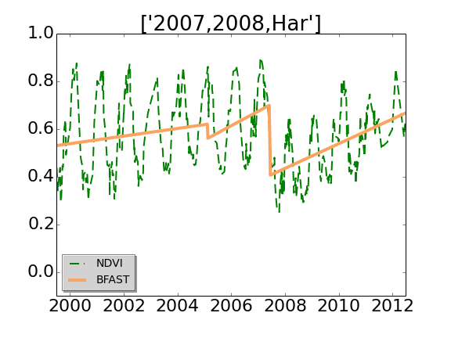
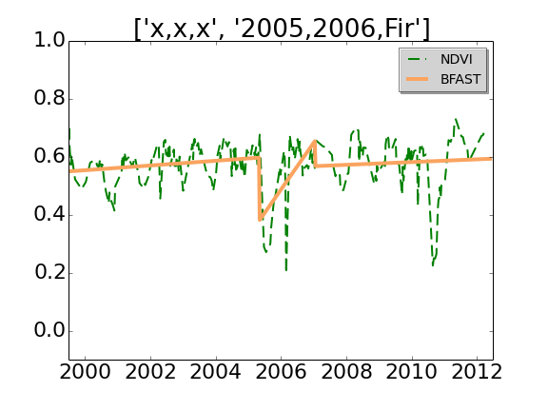
BFAST
Example outcomes
Harvest in forest
(Success)
Fire in Non-forest vegetation
(Failure on 2010 event)
Significant limitations:
Fixed number of breakpoints.

Slide 20
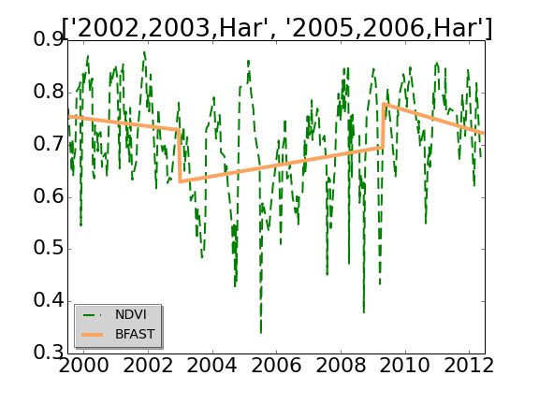
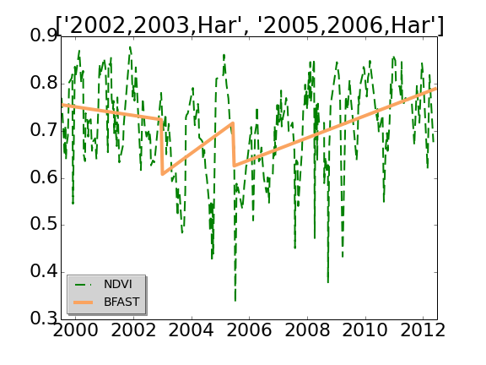
BFAST
Parameter dependence
K = 1
K = 2
Dependence on parameters:
In general, robust, up to the (limited) number of breakpoints allowed.
Rarely, number of harmonics may have effect.

Slide 21
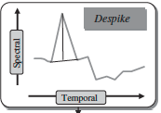
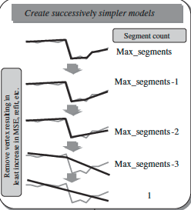
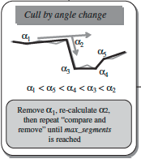
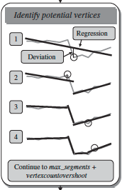
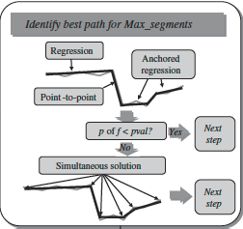
LandTrendR
1.
3.
5.
2.
4.
Kennedy, R.E., Yang, Z., and Cohen, W.B., 2010, “Detecting trends in forest disturbance and recovery using yearly Landsat time series: 1. LandTrendr –Temporal segmentation algorithms,” Remote Sensing of Environment, 114, 2897–2910.

Slide 22
LandTrendR
Parameters
Despike tolerance | 0.9
pval | 0.2
Recovery threshold | 1.0
DistweightFactor | 2.0
Maximum number of segments | 6
Vertex count overshoot | 3

Slide 23
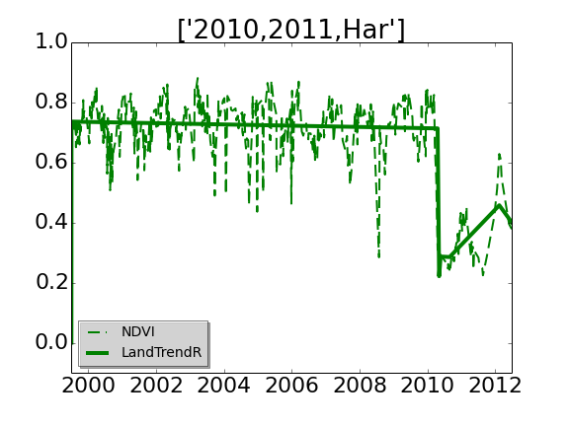
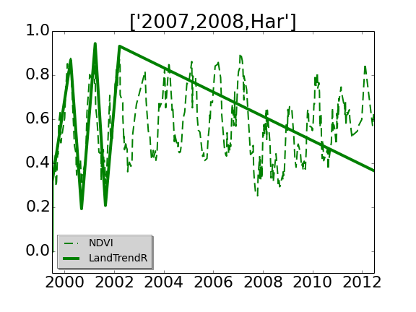
LandTrendR
Example outcomes
Harvest in forest
(Success)
Harvest in forest
(Failure)
Limitations:
Least squares based determination of initial set of breakpoints.
Using only two months (four to five images) per year.

Slide 24
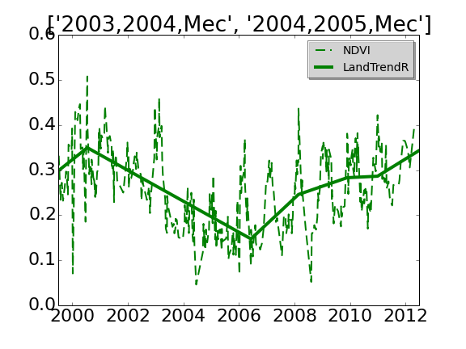
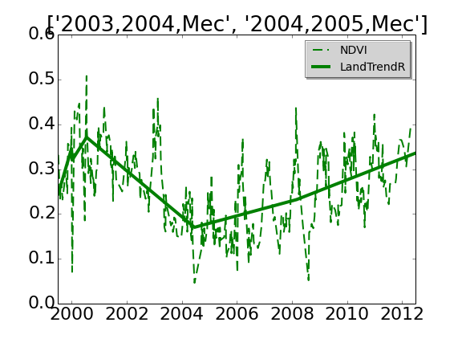
LandTrendR
Parameter dependence
Despike tolerance = 0.8
Despike tolerance = 0.9
Dependence on parameters:
Least squares fit based determination of initial breakpoints set is easily influenced by data and tends to produce clustered/localized sets of breakpoints.
Despike tolerance makes a difference sometimes.

Slide 25
Unifying the algorithms
Ensemble
Hybrid
Polyalgorithm
Multiple learners called base learners.
Base learners are generated from training data by a base learning algorithm that can be a decision tree, a neural network, or any other kind of learning algorithm.
e.g., Random Forests.
Combines two or more different algorithms that solve the same problem, either choosing one (depending on the data), or switching between them over the course of the algorithm.
e.g., (i) Introsort for sorting, (ii) Brent’s method for root finding.
Collection of several algorithms
Each component answers the same question(s), only that the answers may differ.
Strategy to determine which algorithm to use in a given scenario.
e.g., Root finding algorithm in NAPSS (uses secant method with requisite tests).

Slide 26
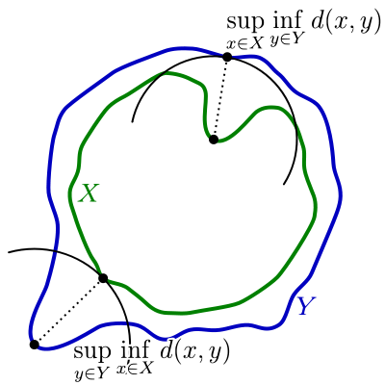
Matching algorithm outcomes
Hausdorff distance
X, Y: breakpoints from Algorithms X and Y.
Distance between two points: d(x, y) = |x - y|
Distance from a point x to a set Y:
d(x, Y) = min_{{y in B}} {d(x, y)}
Distance from set X to a set Y:
d(X, Y) = max_{{x in X}} min_{{y in Y}}d(x,y)
d(X, Y) ≠ d(Y, X), in general.
If |X| < |Y| or if X ⊂ Y, d(X, Y) < d(Y, X).
For the present polyalgorithm, X and Y will take values
L, E, and B, where L is the set of breakpoints reported
by LandTrendR, B those reported by BFAST, and E
those set of breakpoints reported by EWMACD.
(figure: wikipedia)

Slide 27
Polyalgorithm
Outline of our polyalgorithm^{[1]}:
Run the three algorithms on the input.
Consider only the breakpoints from each algorithm. Ignore the fits/flags.
For EWMACD, consider only the ‘isolated’ breakpoints.
If a pixel does not have sufficient data during EWMACD’s training period, default ‘missing data’ status is attributed to that pixel for all other algorithms as well.
If BFAST predicts a change during the training period of EWMACD, EWMACD results are not used for that pixel.

Slide 28
Polyalgorithm
Pairwise directional Hausdorff distances:
  d(X, Y) can be calculated when both X and Y are non-empty.
  If X = {} and Y ≠ {}, then d(X, Y) is undefined and not used.
  If X ≠ {} and Y = {}, then d(X, Y) = ∞.
  If X = {} and Y = {}, then assign d(X, Y) = d(Y, X) = 0.
If BFAST predicts a change during the training period of EWMACD, then EWMACD results are not used for that pixel. This is achieved by setting d(·, E) = ∞, d(E, ·) = ∞ .
Let d_{𝝉} be a user defined threshold. If d(X, Y) > d_{𝝉}, for all X, Y ϵ {E, L, B}, X ≠ Y, then none of the algorithms agree on breakpoints. Assign default stability to the pixel.
The algorithm that has smallest d(·, ·) values is selected as the final algorithm for that pixel.

Slide 29
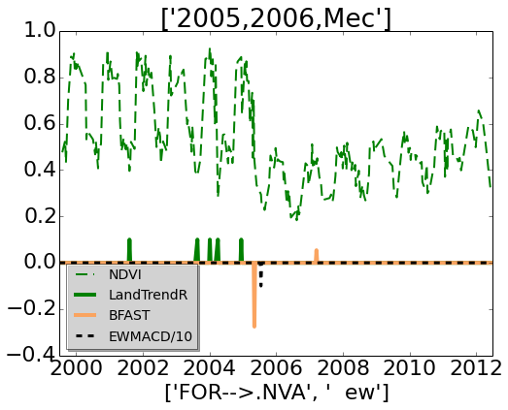
Experiments
Example outcomes
Forest with Mechanical change in 2005.
E = {2006.03}
B = {2005.85, 2007.72}
L = {2002.1, 2004.2, 2004.5, 2005.5}
d(B, E) = 1.7, d(E, B) = 0.18, d(B, L) = 2.25,
d(L, B) = 3.7, d(L, E) = 3.9, d(L, E) = 0.6
Final algorithm: EWMACD.
Final breakpoint(s): 2005.

Slide 30
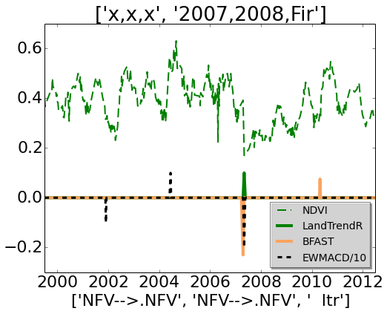
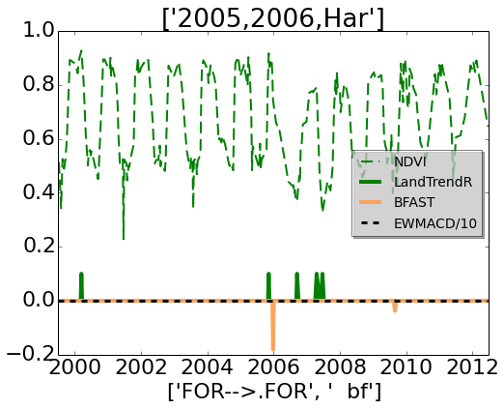
Experiments
Example outcomes
Forest
d(B, E) = 3.02, d(E, B) = 5.4, d(B, L) = 2.97,
d(L, B) = 0.04, d(L, E) = 0.04, d(E, L) = 5.5
Final algorithm: LandTrendR.
Final breakpoint(s): 2007.
Forest 🠊 anthropogenic
d(B, E) = ∞, d(E, B) = *, d(B, L) = 2.2,
d(L, B) = 5.7, d(L,E) = ∞, d(E,L) = *.
Final algorithm: BFAST.
Final breakpoint(s): 2006.

Slide 31
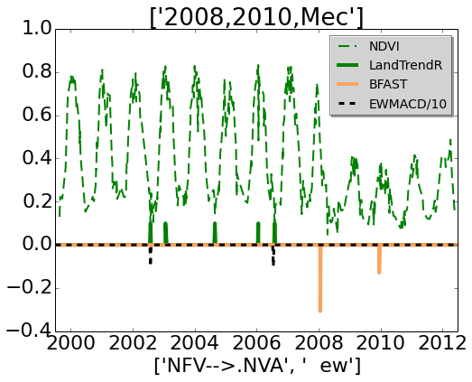
Experiments
Current limitations
‘Majority’ of the component algorithms may capture proximal set of incorrect breakpoints.
Forest
d(B, E) = 3.4, d(E, B) = 5.5, d(B, L) = 3.4,
d(L, B) = 5.47, d(L, E) = 1.9, d(E, L) = 0.07
Final algorithm: EWMACD
Final breakpoint(s): 2002 and 2006.

Slide 32
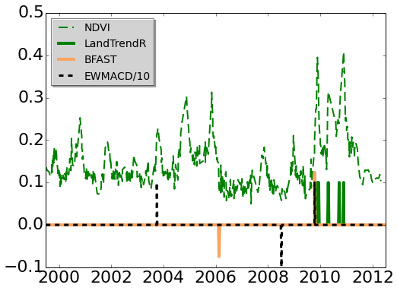
Experiments
TimeSync vs NDVI trajectory
Counting is not exhaustive.
  True positives are under counted.
  False negatives (and false positive) are overcounted.
  There exist instances where TimeSync lists a change but
    the change is not seen in the NDVI Trajectory, or
    The year does not match.
  This could be TimeSync error, or, the change may be reflect in a different spectral band.
Forest
d(B, E) = 2.36, d(E, B) = 2.39, d(B, L) = 3.76,
d(L, B) = 1.115, d(L, E) = 1.118, d(E, L) = 6.2
Final algorithm: LandTrendR

Slide 33
Algorithm hit/miss rates
Breakpoint detection relative to Timesync data:
true positives (top numbers), false negatives (bottom numbers).
EWMACD
LandTrendR
BFAST
Polyalgo
Harvest
(in 558 pixels)
Urbanization
(in 58 pixels)
Flood
(in 19 pixels)
Fire
(in 130 pixels)
271
345
33
39
8
12
79
54
310
306
44
28
11
9
72
61
368
248
49
23
9
11
88
45
344
272
44
28
8
12
84
49

Slide 34
Algorithm selection rates
Percentage of algorithm selection
EWMACD
LandTrendR
BFAST
None
Harvest
Urbanization
Flood
Fire
31%
20%
30%
27%
16.6%
17%
25%
23%
49.6%
60%
40%
47%
2.5%
1.2%
5%
2.3%

Slide 35
Discussion
Despite BFAST reporting more accurate results, one of EWMACD and LandTrendR gets selected for final as the final algorithm. This could be because of
  Both algorithms finding similar sets of incorrect breakpoints, and therefore being in consensus.
  One of the component algorithms yields a clustered set of breakpoints, which also happens to be close to any one breakpoint from of the other algorithms.
BFAST vs. polyalgorithm:
  BFAST is very thorough.
  It appears that using BFAST alone may be better than using multiple algorithms.
  BFAST cannot be used for full scenes as it does not scale well.
  The fixed number of breakpoints is a significant limitation.

Slide 36
Discussion
Dependence on parameters:
  Variation in parameters can cause wide variability in algorithm outputs.
Imbalance in number of breakpoints:
  Different algorithms producing different number of breakpoints causes a significant imbalance in Hausdorff distance based voting.

Slide 37
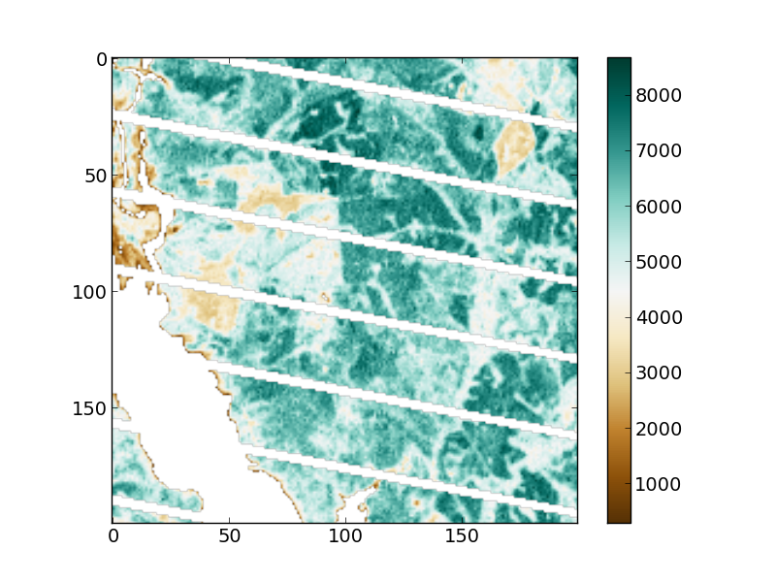
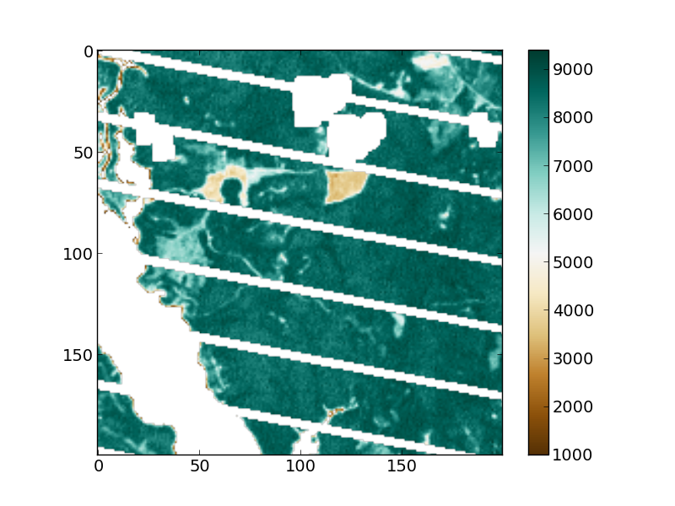
2D results
Input: Path/row 18/37, a 200x200 sandbox image
2012
2013

Slide 38
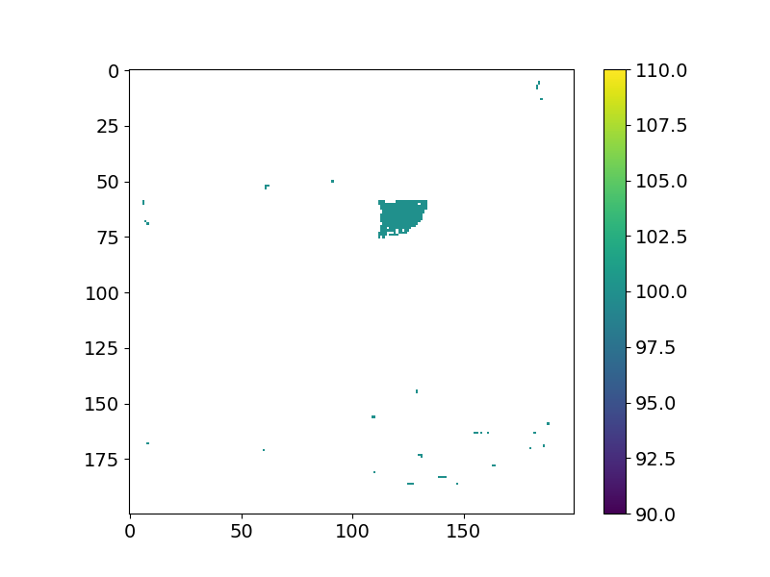
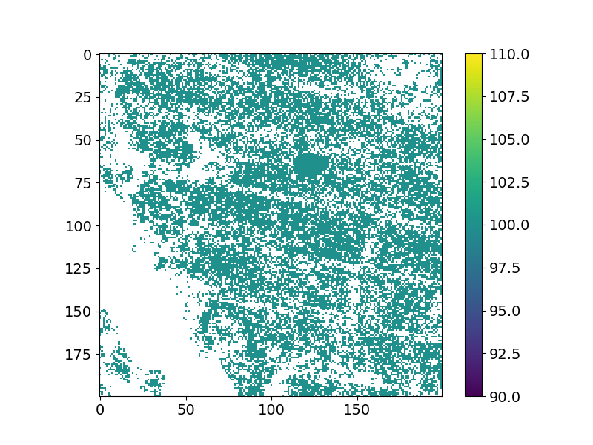
2D results
Results of different algorithms
EWMA 2013
LandTrendR 2013

Slide 39
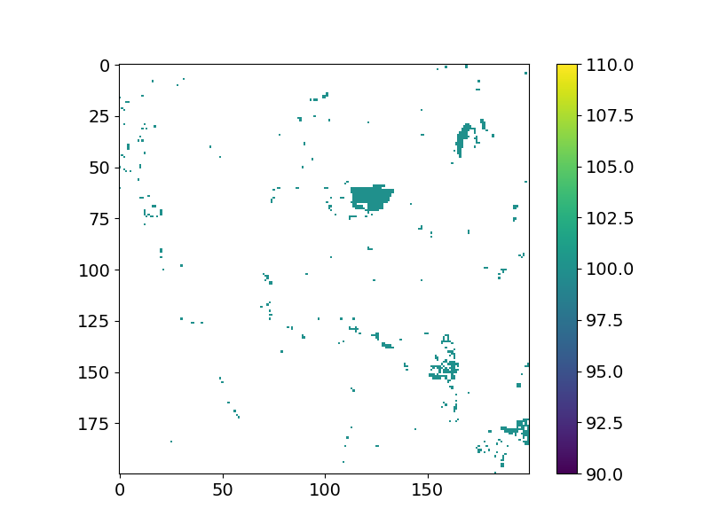
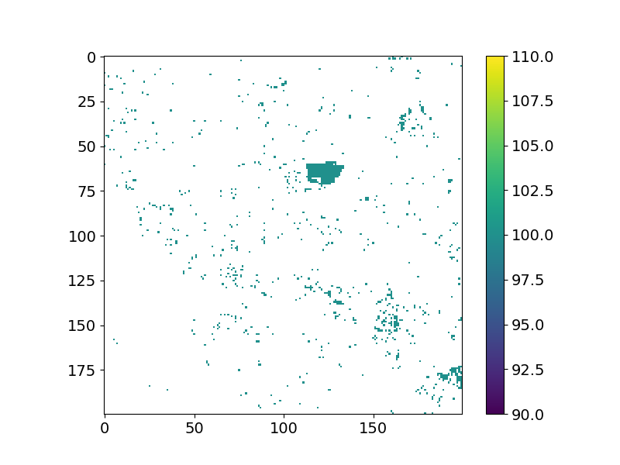
2D results
Results of different algorithms
BFAST 2013
PolyAlgorithm 2013

Slide 40
Conclusions
Summary
Need more algorithms.
Input format and one output format is standardized across algorithms.
  Three algorithms brought together into a unified framework and mathematical formulations proposed.
The polyalgorithm performs better than EWMACD or LandTrendR alone.
  BFAST performs best, limited primarily by ‘fixed’ number of breakpoints.
  BFAST, with its current implementation, cannot be used in the final polyalgorithm because it does not scale.
Including more algorithms will mitigate the current limitations.
  Need at least five algorithms for robust voting.
  Current algorithms lead to consensus that is not always correct.
All codes are written in both Python and Fortran.
  Fortran is faster than Python and indispensable for national level simulations.

Slide 41
Conclusions
Future work
Include more algorithms for robust consensus.
Include parameter tuning.
Resource allocation:
  Parallelization across algorithms and/or paramters.
BFAST:
  Either replace it with a scalable algorithm, or
  Improve its implementation, or
  Use it only on a need basis.
Need more algorithms to address flooding.
  Performance of none of the component algorithms considered this far is good enough on pixels with flooding.
Hausdorff distance alone is not sufficient.
  Preemptively check whether an algorithm is even suitable for a pixel.
  Other distance measures.

Slide 42
Algorithm hit/miss rates
Breakpoint detection relative to Timesync data:
true positives (top numbers), false negatives (bottom numbers).
EWMACD
LandTrendR
BFAST
Polyalgo
Harvest
(in 558 pixels)
Urbanization
(in 58 pixels)
Flood
(in 19 pixels)
Fire
(in 130 pixels)
276(276)
340(335)
34
34
8
12
79
54
352(327)
259(298)
44
24
9
12
95
38
373(373)
238(238)
49
19
9
12
88
45
321(343)
290(272)
49
19
6
15
95
38

Slide 43
Algorithm selection rates
Percentage of algorithm selection
EWMACD
LandTrendR
BFAST
None
Harvest
Urbanization
Flood
Fire
32.8%
25.8%
42%
27.7%
50.5%
25.8%
26.3%
20.8%
14.9%
46.5%
31.6%
49.2%
1.7%
1.7%
0
3%

