Slide 1




SMART INDIA HACKATHON 2026
MAHALINK
  Problem Statement ID - SIH26129
  Problem Statement Title-System integration and interoperability among government digital platforms, resulting in fragmented service delivery
  Theme- SMART AUTOMATION
  PS Category- Software
  Team ID- SIH2026-158
  Team Name (Registered on portal)-INFERNO Vl

Slide 2
INFERNO VI
MAHALINK: INTEROPERABILITY MIDDLEWARE FOR MAHARASHTRA'S DIGITAL GOVERNMENT
Real-world issue
RISK → SOLUTION
Citizens accessing Aaple Sarkar (500+ services) must manually submit redundant physical affidavits and duplicate scans because backend state databases (Mahabhumi, Vahan, Sarathi, MahaOnline) operate in isolated departmental silos, violating the IndEA 2.0 'Once-Only Principle' (OOP).
Siloed Portals & Repetitive Paperwork
Meri Pehchaan (NSSO) + Once-Only Auto-Fill
Why it matters
DPDP Act Compliance & Snooping Risks
CAG State Audit revealed 67% of key citizen services remain functionally fragmented at the backend, with 33 lakh pending applications. MSDP-2024 officially established the State Data Authority (SDA) specifically to eliminate this multi-hundred-crore vendor lock-in and inter-departmental barrier.
DEPA Consent Artifacts + SHA-256 Block Ledger
Vendor Resistance & Closed Databases
Our solution
Estonian X-Road DMZ Security Server Adapters
MahaLink: A State-Level Federated Interoperability & DEPA Consent Middleware deployed at State Data Centre (SDC Mahape). It wraps departmental legacy backends with DMZ adapters over MSWAN, enabling automated machine-to-machine data verification under DPDP Act 2023 compliance.
₹250 Cr Central Database Breach Liability
Zero-Persistence: Data Stays at Source Depts
SIH 2026 Idea Submission — MahaLink
2
Notes:
2

Slide 3
INFERNO VI
TECHNICAL APPROACH
END-TO-END CITIZEN SERVICE LIFECYCLE
ENTERPRISE PRODUCTION STACK
1
National SSO
Frontend
Citizen authenticates via Meri Pehchaan (Jan Parichay) with Aadhaar OTP.
STATEWIDE ENTERPRISE ARCHITECTURE
React 18 / Vite — Trilingual Portal (EN/MR/HI) with Sub-180KB Bundle
Citizen Layer
Aaple Sarkar 2.0 Web · Mobile Seva · CSC Terminals
Backend
2
Statutory Mapping
Node.js v20+ LTS / TypeScript / Express (Stateless Distributed Core)
Citizen selects service (e.g. Income Certificate); engine maps 7/12 & Vahan proofs.
Identity & Trust Layer
Meri Pehchaan (NSSO / Jan Parichay) + Aadhaar VID
API Gateway
3
DEPA Consent
Zero-Trust Gateway: mTLS, Sliding Rate-Limiter (300 req/m), OWASP Security
DEPA Consent Manager renders purpose, participating departments, and 15-min TTL per DPDP Act.
Middleware Core (SDC Mahape / Maha-IT Cloud)
Zero-Trust Gateway · DEPA Engine · MGAS Normalizer · SHA-256 Ledger
Database
Zero Central Persistence (Volatile Memory); Department Sources: Postgres/MySQL/Mongo
4
Parallel DMZ Queries
Adapters in SDC DMZ query local read-replicas in parallel over MSWAN; zero central persistence.
Auth
Meri Pehchaan (OIDC / OAuth 2.0) + DEPA ECDSA P-256 Signed Tokens
Department DMZ Adapter Layer (MSWAN)
Authoritative State Repositories
5
Audit & Write-Back
Mahabhumi (7/12) · MoRTH Vahan 4.0 · MahaOnline Issuance Adapters
Mahabhumi SDC (Postgres) · Vahan NICNET · Aaple Sarkar (Maha-IT)
SHA-256 block hash chain records immutable proof; approved certificate emits to DigiLocker.
Hosting
Maha-IT State Data Centre (SDC Mahape) / MeghRaj (GI Cloud)
SIH 2026 Idea Submission — MahaLink
3
Notes:
3

Slide 4
INFERNO VI
FEASIBILITY AND VIABILITY
FEASIBILITY ANALYSIS
VIABILITY
BUSINESS POTENTIAL
Adapter, not rebuild
Wraps each department's existing system with a containerized DMZ adapter on read-replicas — zero vendor rebuild required.
Battle-Tested Model
Estonia X-Road (<€1M/yr) & IndEA 2.0 benchmarked; provides 99.9% federated uptime at state scale.
₹500 Cr Budget Savings
Eliminates redundant departmental software tenders and duplicate data verification infrastructure.
Federated by design
Stateless Zero-Persistence: Real-time queries resolve via pointers; no central citizen database, eliminating DPDP liability.
DPDP Act Compliance
Section 6 consent artifacts + immutable SHA-256 hash chains fulfill Right to Services (RTS) audits.
Institutional Funding
Funded through Digital India Mission state component, MeitY grants, and MSDP-2024 allocations.
Standards & Interoperability
Standardized on Maharashtra Govt API Standard (MGAS), publishing directly to national API Setu.
State Data Authority Mandate
Backed by Maharashtra State Data Policy (MSDP-2024) to enforce unified API data-sharing.
Sustainable Cost Recovery
Nominal per-transaction API clearing fee ensures self-sustaining operations post-deployment.
Rapid Phased Rollout Blueprint
48-hour containerized department onboarding; Phase-1 pilot in Pune & Nagpur districts before statewide 36-district rollout.
Digital India Alignment
Plugs into Meri Pehchaan, DigiLocker, and API Setu; complements national digital public infrastructure.
Digital Public Good (DPG)
Open-source 'State Interoperability Kit' allows immediate replication across other Indian states.
SIH 2026 Idea Submission — MahaLink
4
Notes:
4

Slide 5
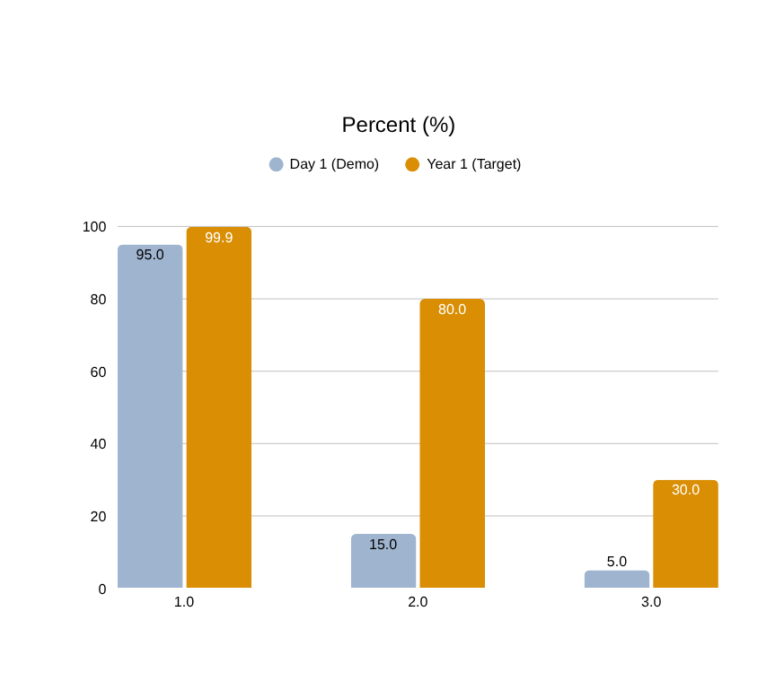
INFERNO VI
IMPACT AND BENEFITS
1
2
PRODUCTION SLAs: <500ms Multi-Dept Fetch • 99.9% Uptime • Zero Central Storage • 100% DPDP Act Compliant
Time saved
Scale
Sub-Second Service Delivery: Application processing time reduced from 15-21 days to sub-second authoritative auto-verification.
Statewide Citizen Impact: 125M citizens served; 20M annual service requests saving 40+ million citizen-hours annually.
3
Fewer trips
4
Compliance
Elimination of Physical Visits: Over 20 million physical trips to Tehsildar & Setu Kendras avoided every year.
Statutory RTS & DPDP Compliance: 100% automated SLA tracking under Maharashtra Right to Public Services Act 2015.
5
Trust
6
Governance
Cryptographic Fraud Prevention: Eliminates fake paper/PDF certificates via direct cryptographic source verification.
Resilient Zero-Downtime Governance: Circuit-breaker isolated architecture eliminates the single point of failure that plagued SSDG.
SIH 2026 Idea Submission — MahaLink
5
Notes:
5

Slide 6
RESEARCH AND REFERENCES
INFERNO VI
NeGP (2006)
IndEA 2.0
API Setu
X-Road (Estonia)
MSDP-2024
DPDP Act
CAG Audit Reports
Mission-Mode Projects funded departments in isolation — the root cause of today's silos.
National architecture blueprint; MahaLink implements its Integration Reference Model at state level.
9,138+ national APIs; MahaLink publishes department APIs here rather than duplicating it.
Federated, no-central-database model MahaLink's adapter layer is built on.
Maharashtra's own policy creating a State Data Authority to fix this exact problem.
Legal basis for the Consent Manager's data-sharing and audit-logging design.
Independent evidence: 67% services unavailable online, 33 lakh pending applications.
CITIZEN SERVICE JOURNEY — REAL-WORLD GOVERNMENT SCENARIO
1
2
3
4
5
Priya logs in
Applies for Income Cert.
Grants consent
Data flows automatically
Opens the hood
Priya signs into Aaple Sarkar using Meri Pehchaan (National SSO) via Aadhaar OTP.
Priya applies for an Income Certificate; system dynamically queries Mahabhumi 7/12 & Vahan 4.0.
Priya reviews DEPA modal: specifies 15-minute validity, purpose, and participating departments.
Revenue & RTO adapters fetch data simultaneously; Identity Resolver reconciles Marathi/English names.
Form auto-fills with verified green badges; immutable audit proof logged and viewable on citizen dashboard.
Solution: MahaLink — Maharashtra Interoperability & Consent Middleware
Enterprise Architecture Reference Implementation engineered for Maha-IT State Data Centre deployment. Fully compliant with IndEA 2.0, DEPA, and DPDP Act 2023. Scalable for 125 million citizens across 36 districts of Maharashtra.
SIH 2026 Idea Submission — MahaLink
6
Notes:
6

