Slide 1




SMART INDIA HACKATHON 2026
MAHALINK
  Problem Statement ID - SIH26129
  Problem Statement Title-System integration and interoperability among government digital platforms, resulting in fragmented service delivery
  Theme- SMART AUTOMATION
  PS Category- Software
  Team ID- SIH2026-158
  Team Name (Registered on portal)-INFERNO Vl

Slide 2
INFERNO VI
MAHALINK: INTEROPERABILITY MIDDLEWARE FOR MAHARASHTRA'S DIGITAL GOVERNMENT
Real-world issue
RISK → SOLUTION
A citizen needs a caste certificate, a 7/12 land extract, an RTO service and a police clearance — and must juggle 4+ separate logins on disconnected portals, re-entering the same details every time.
Fragmented logins & repeated paperwork
Unified SSO + auto-filled data via consent
Why it matters
No visibility into who accessed citizen data
A CAG audit found 67% of key citizen services still unavailable online, 33 lakh applications pending, and 45% of Aaple Sarkar service centres non-functional — despite Aaple Sarkar's “single window” claim.
Consent Manager + immutable audit log
Legacy systems can't talk to each other
Our solution
Adapter APIs wrap each department, no rebuild
MahaLink is a federated middleware layer: adapter APIs wrap each department's existing system (no rebuild), a consent manager governs every data request, and a gateway publishes it all to the national API Setu.
Central mega-database = privacy risk
Federated “golden record” — data stays at source
SIH 2026 Idea Submission — MahaLink
2
Notes:
2

Slide 3
INFERNO VI
TECHNICAL APPROACH
METHODOLOGY — DEMO WALKTHROUGH
TECHNOLOGIES USED
1
SSO Login
Frontend
Citizen signs in once via Meri Pehchaan / OAuth 2.0 stub — no separate registration.
MVP ARCHITECTURE
React — citizen portal & consent dashboard
Citizen Layer
Web · Mobile · AI Chatbot
Backend
2
Service Request
Node.js/Express or Python FastAPI
Citizen applies for a service; system identifies which departments' data are needed.
Auth Layer
Meri Pehchaan SSO / OAuth 2.0
API Gateway
3
Consent Request
Kong (Docker) or Express middleware
Consent Manager asks the citizen to approve each department data pull.
Middleware (core build)
API Gateway · Consent Manager · Workflow Engine · Audit Logger
Database
PostgreSQL (prod) · SQLite (demo)
4
Federated Fetch
Approved adapters pull data live from source departments — nothing copied centrally.
Auth
Passport.js (OAuth 2.0) → Meri Pehchaan in prod
Adapter Layer
Department Backends
5
Audit & Review
Revenue · RTO · Certificate adapters
Mocked in MVP demo
Every access is logged; citizen can view or revoke consent anytime.
Hosting
Railway / Vercel / Render (free tier)
SIH 2026 Idea Submission — MahaLink
3
Notes:
3

Slide 4
INFERNO VI
FEASIBILITY AND VIABILITY
FEASIBILITY ANALYSIS
VIABILITY
BUSINESS POTENTIAL
Adapter, not rebuild
Wraps each department's existing system with an adapter API — no legacy system is replaced.
Proven model
Estonia's X-Road runs national interoperability for <€1M/year — the federated pattern is battle-tested.
Government cost savings
Reduces duplicate department IT spend on siloed integration efforts.
Federated by design
No central mega-database: a master index maps citizen ID → department record pointers only.
Builds public trust
Consent artifacts + immutable audit logs give citizens visibility into every data access.
Funded pathways
Digital India Mission state grants, MeitY funding, MSDP-2024 implementation budget.
Sandboxes exist today
API Setu developer portal and the X-Road Playground are publicly accessible for prototyping.
State mandate exists
MSDP-2024 already creates a State Data Authority with the power to enforce participation.
Per-transaction model
Sustainable cost recovery once services scale beyond the pilot districts.
36-hour MVP is realistic
Gateway + 3 mock department APIs + consent flow + audit log fits a 4–6 person team's build window.
National alignment
Publishes to API Setu and authenticates via Meri Pehchaan — plugs into Digital India, doesn't compete with it.
Open-source replication
“State Interoperability Kit” lets other states deploy their own instance.
SIH 2026 Idea Submission — MahaLink
4
Notes:
4

Slide 5
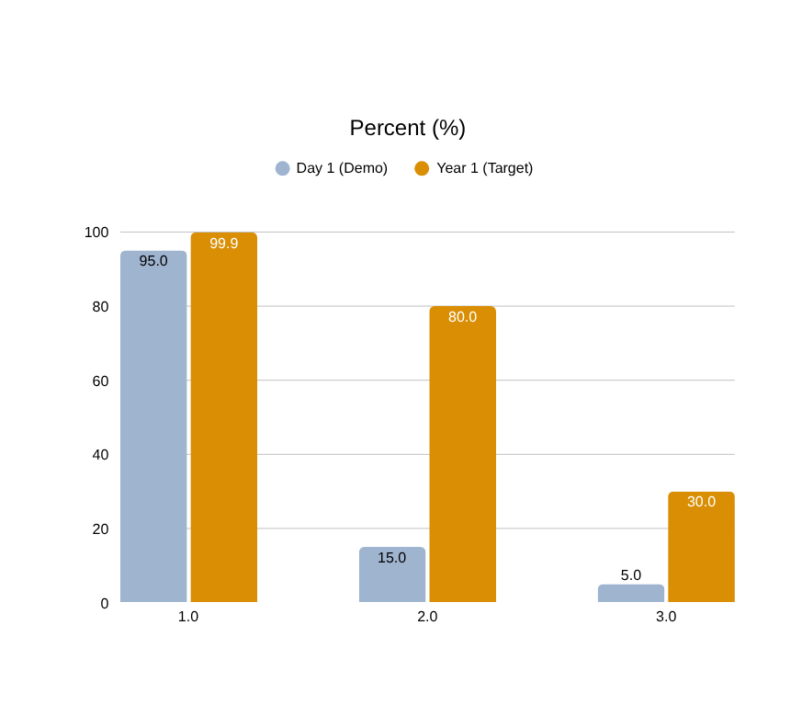
INFERNO VI
IMPACT AND BENEFITS
1
2
KEY METRICS — DEMO vs. YEAR-1 TARGET
Time saved
Scale
~2 hours saved per citizen interaction — 15–30 min online vs. 2–4 hours today.
20 million interactions/year × 2 hrs ≈ 40 million citizen-hours saved annually.
3
Fewer trips
4
Compliance
~20 million physical office visits avoided each year once services are integrated.
Faster, automated data sharing improves RTS Act service-delivery timelines.
5
Trust
6
Governance
Timestamped consent + audit logs replace WhatsApp/photocopy data sharing.
Federated design removes the single point of failure that hit SSDG.
SIH 2026 Idea Submission — MahaLink
5
Notes:
5

Slide 6
RESEARCH AND REFERENCES
INFERNO VI
NeGP (2006)
IndEA 2.0
API Setu
X-Road (Estonia)
MSDP-2024
DPDP Act
CAG Audit Reports
Mission-Mode Projects funded departments in isolation — the root cause of today's silos.
National architecture blueprint; MahaLink implements its Integration Reference Model at state level.
9,138+ national APIs; MahaLink publishes department APIs here rather than duplicating it.
Federated, no-central-database model MahaLink's adapter layer is built on.
Maharashtra's own policy creating a State Data Authority to fix this exact problem.
Legal basis for the Consent Manager's data-sharing and audit-logging design.
Independent evidence: 67% services unavailable online, 33 lakh pending applications.
DEMO STORYLINE — “ONE CITIZEN, ONE IDENTITY, THREE SERVICES”
1
2
3
4
5
Priya logs in
Applies for Income Cert.
Grants consent
Data flows automatically
Opens the hood
Meri Pehchaan SSO stub — no separate registration.
System flags Land Record + Employment data are needed.
“Allow Revenue Dept to share your land record?” — approved.
Certificate auto-populates — no manual document upload.
Gateway logs, consent artifacts and audit trail on screen.
Solution: MahaLink — Maharashtra's Interoperability Middleware
A lightweight, federated middleware that wraps existing department systems with adapter APIs, routes citizen data requests through a consent-managed pipeline, publishes to API Setu, authenticates via Meri Pehchaan, and logs every access for DPDP Act compliance. Prototype, GitHub and demo video links: [add once built].
SIH 2026 Idea Submission — MahaLink
6
Notes:
6

