Slide 1




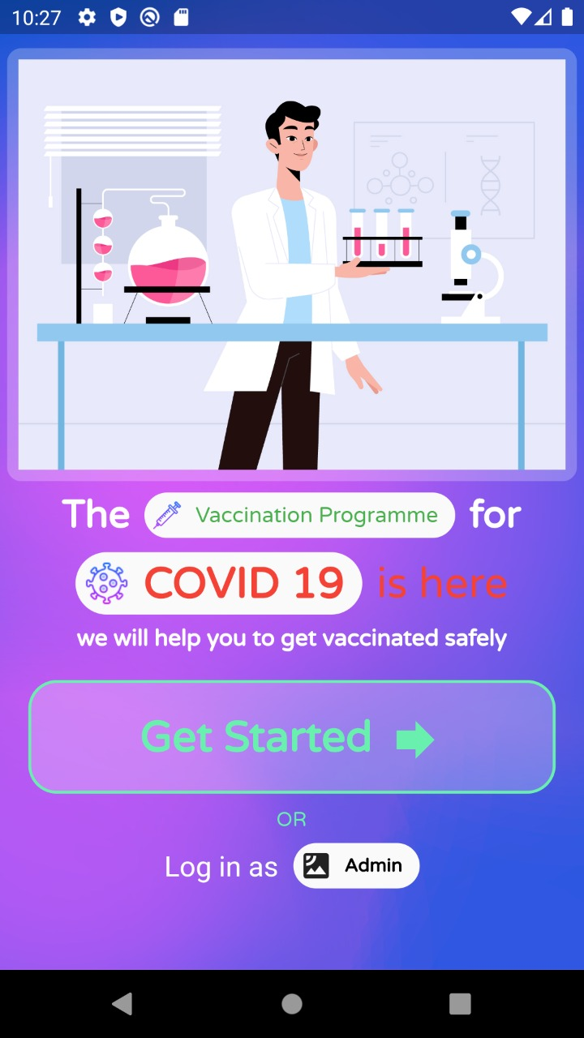


COVID:
VIJAY APP
( It will be available for both mobile and web interface )

Slide 2
WHY VIJAY APP?
Have you ever wondered even if covid vaccine is made available to you, this time of quarantine will remain for a very long time why so?
Even if vaccine is available how it going to vaccinate a country with a population of 138 crores people, with so many states,so many district how?
So here is our app which resolve all these issues :)

Slide 3









WHAT IS VIJAY APP?
The Vijay is all about
how a person can be
vaccinated safely
Our idea is to bring People to dedicated centre for Vaccination process of Covid-19.
Assume certain amount of Vaccine supply daily. On this basis, we will call people to a dedicated center located near to his/her home address.
People will be allotted certain date on which they are supposed to come to the designated center for vaccination.
They will be marked vaccinated in their unique aadhar card number.
This all will be done through COVID: Vijay App

Slide 4



HOW VIJAY APP ON THE INTERFACE WORKS?
A certain date will be display on user screen on which they are supposed to come to the designated center for vaccination.
This date will be generated by a certain algorithm that considers the following factors in mind.
1. Vaccine Supply available on daily basis.
2. Priority order with which people will be called are as follows:-
a. Frontline Healthcare Workers.
b. People at certain risk
c. Children and Senior Citizens
d. All others.

Slide 5
Cont..
Now, we assume that a database consisting
of required records is already available.
Citizens can be identified using their unique
aadhar card number. This database will be
used to predict the correct date for
vaccination.
Currently, it works for one zone only which
can be extended later.
One administrator (who will be present
at the dedicated covid center) will be given
special access to the COVID: Vijay App
so that he/she can check who is vaccinated
and assign the person who has been vaccinated
in the database through the app interface.

Slide 6

LET’S GET INTO THE
APP INTERFACE

Slide 7





OUR APP INCLUDES..
Onboarding screen
Admin Control panel
User Screen
4
User status screen

Slide 8

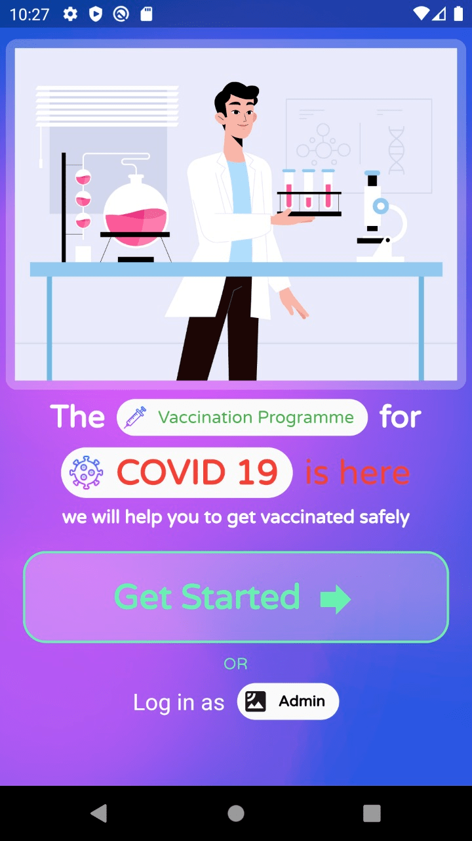
ON BOARD
SCREEN
Get Started will take take them to the
user screen
LogIn as admin will take place us to
admin Login

Slide 9
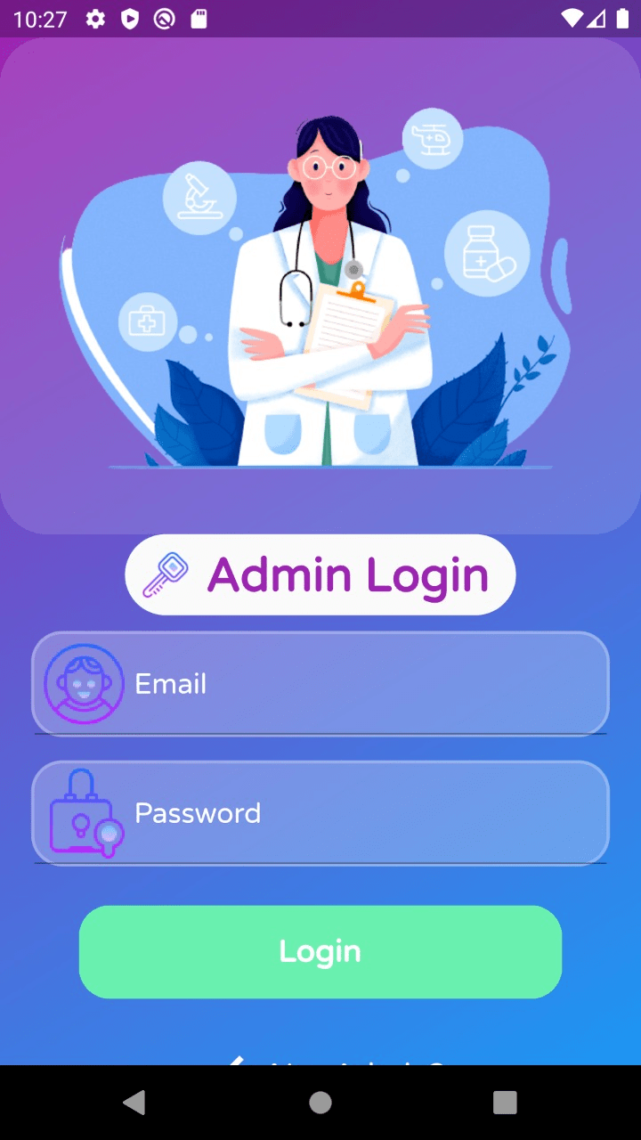
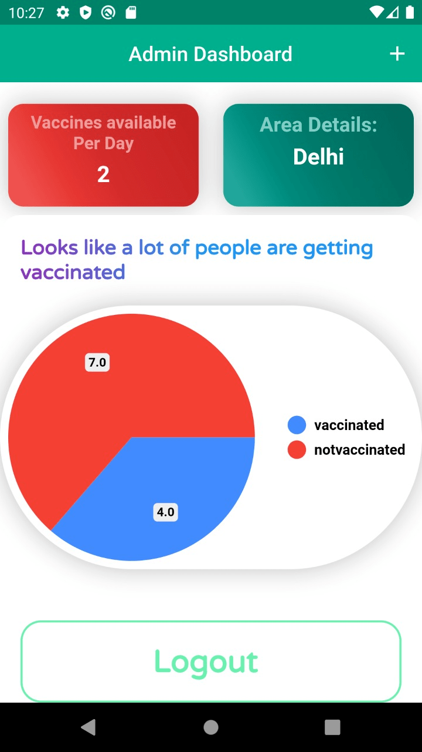


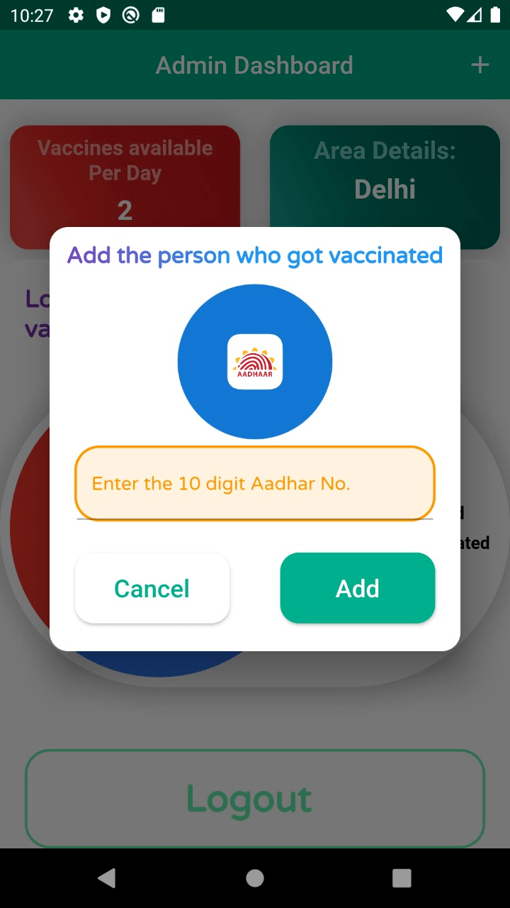
Admin Dashboard
number of vaccines in stock
area details
graph showing the percentage of people which are already being vaccinated and which are yet to be vaccinated.
The + button at the top is used the add the person Aadhar No. who recently got vaccinated and it will post the details using rest api.

Slide 10
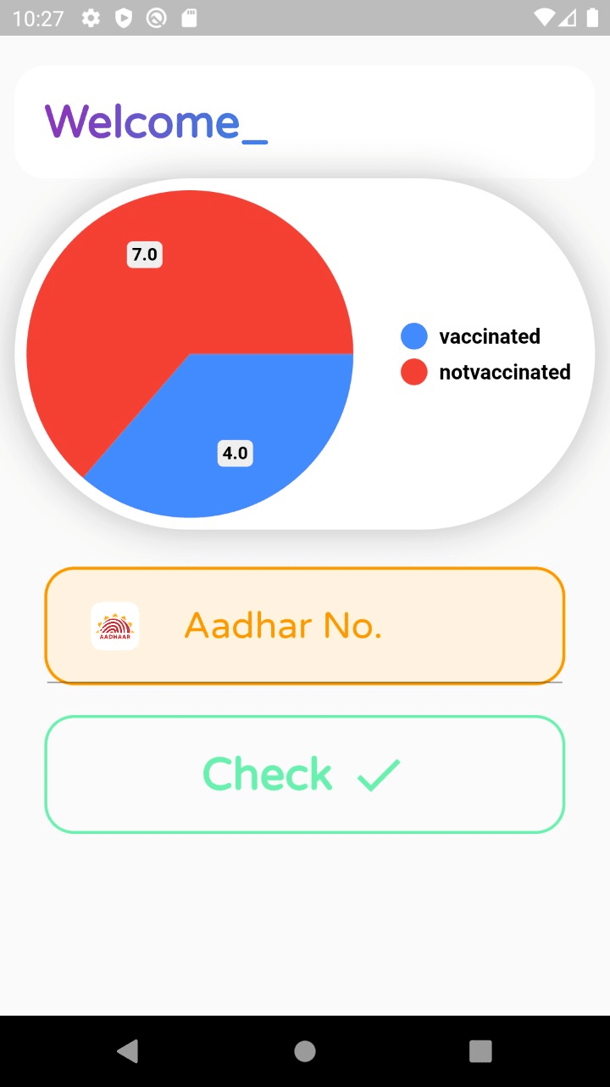

USER SCREEN
Graph of number of people vaccinated in there zone.
As the user clicks on checks after entering
their Aadhar No. they will be rendered to
there Vaccination status.

Slide 11
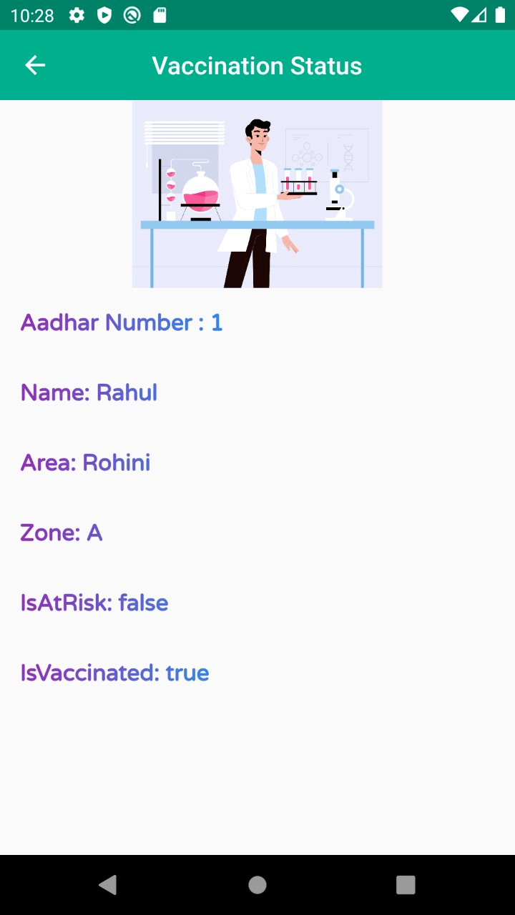
USER STATUS SCREEN
User details
And whether vaccinated or not

Slide 12
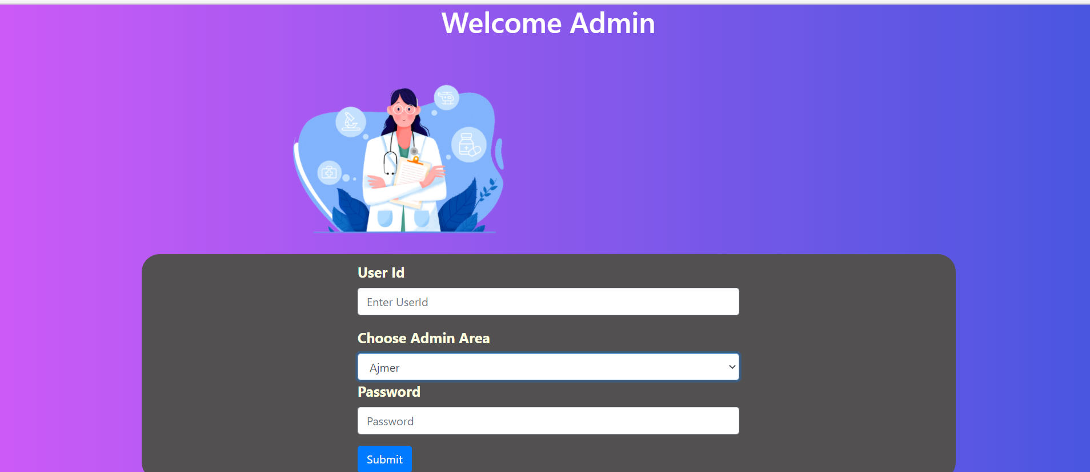
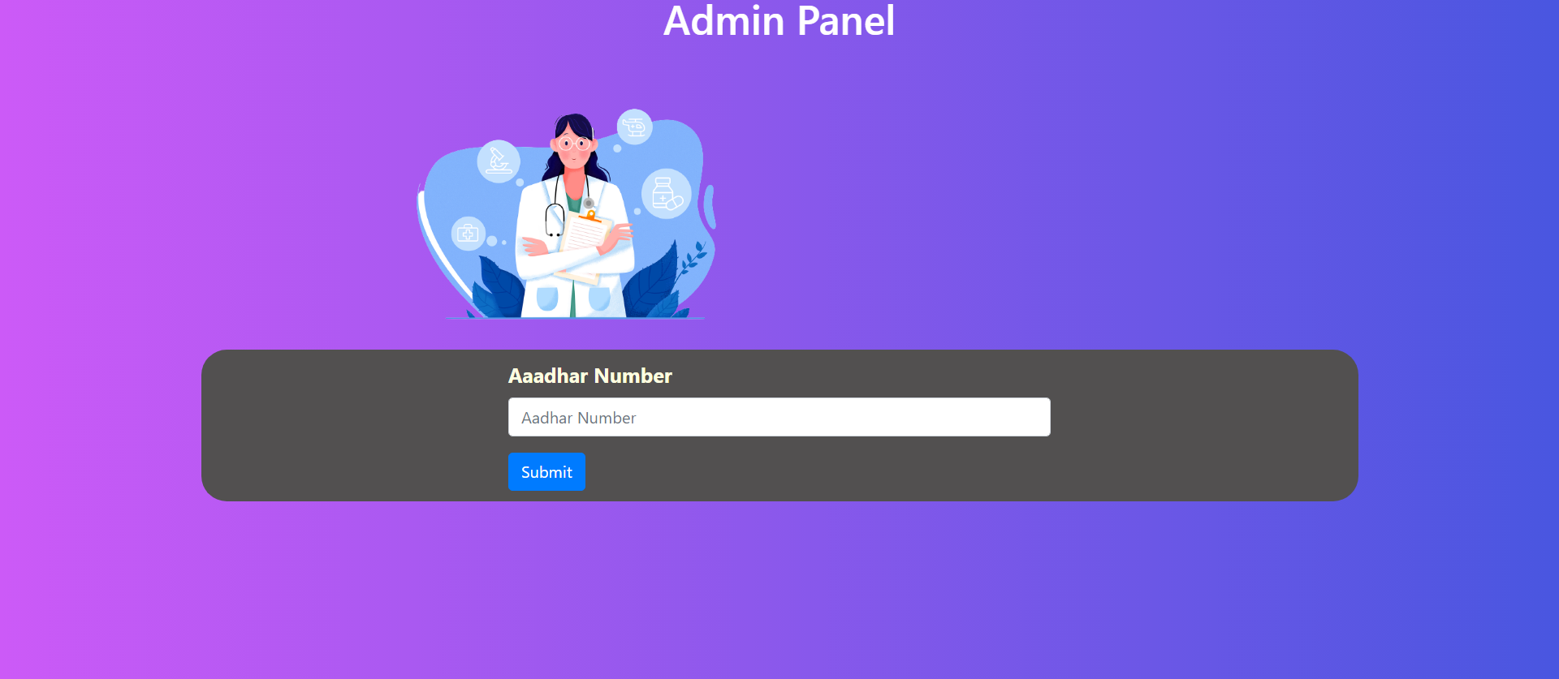
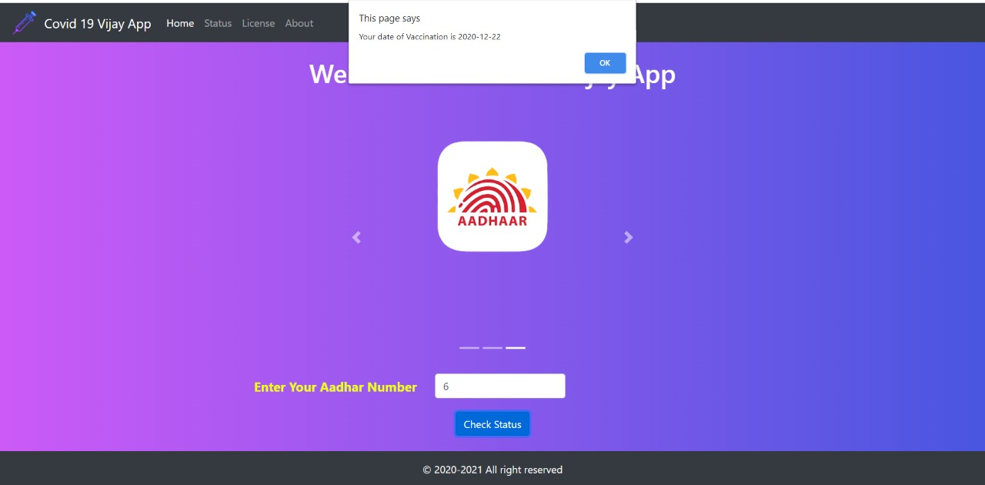
WEB INTERFACE

Slide 13






TECHNOLOGY USED..
HTML
CSS
Flutter
Django
Django rest
framework
Javascript

Slide 14







THANKS!
Team Geeky Ignitors :)

