Slide 1
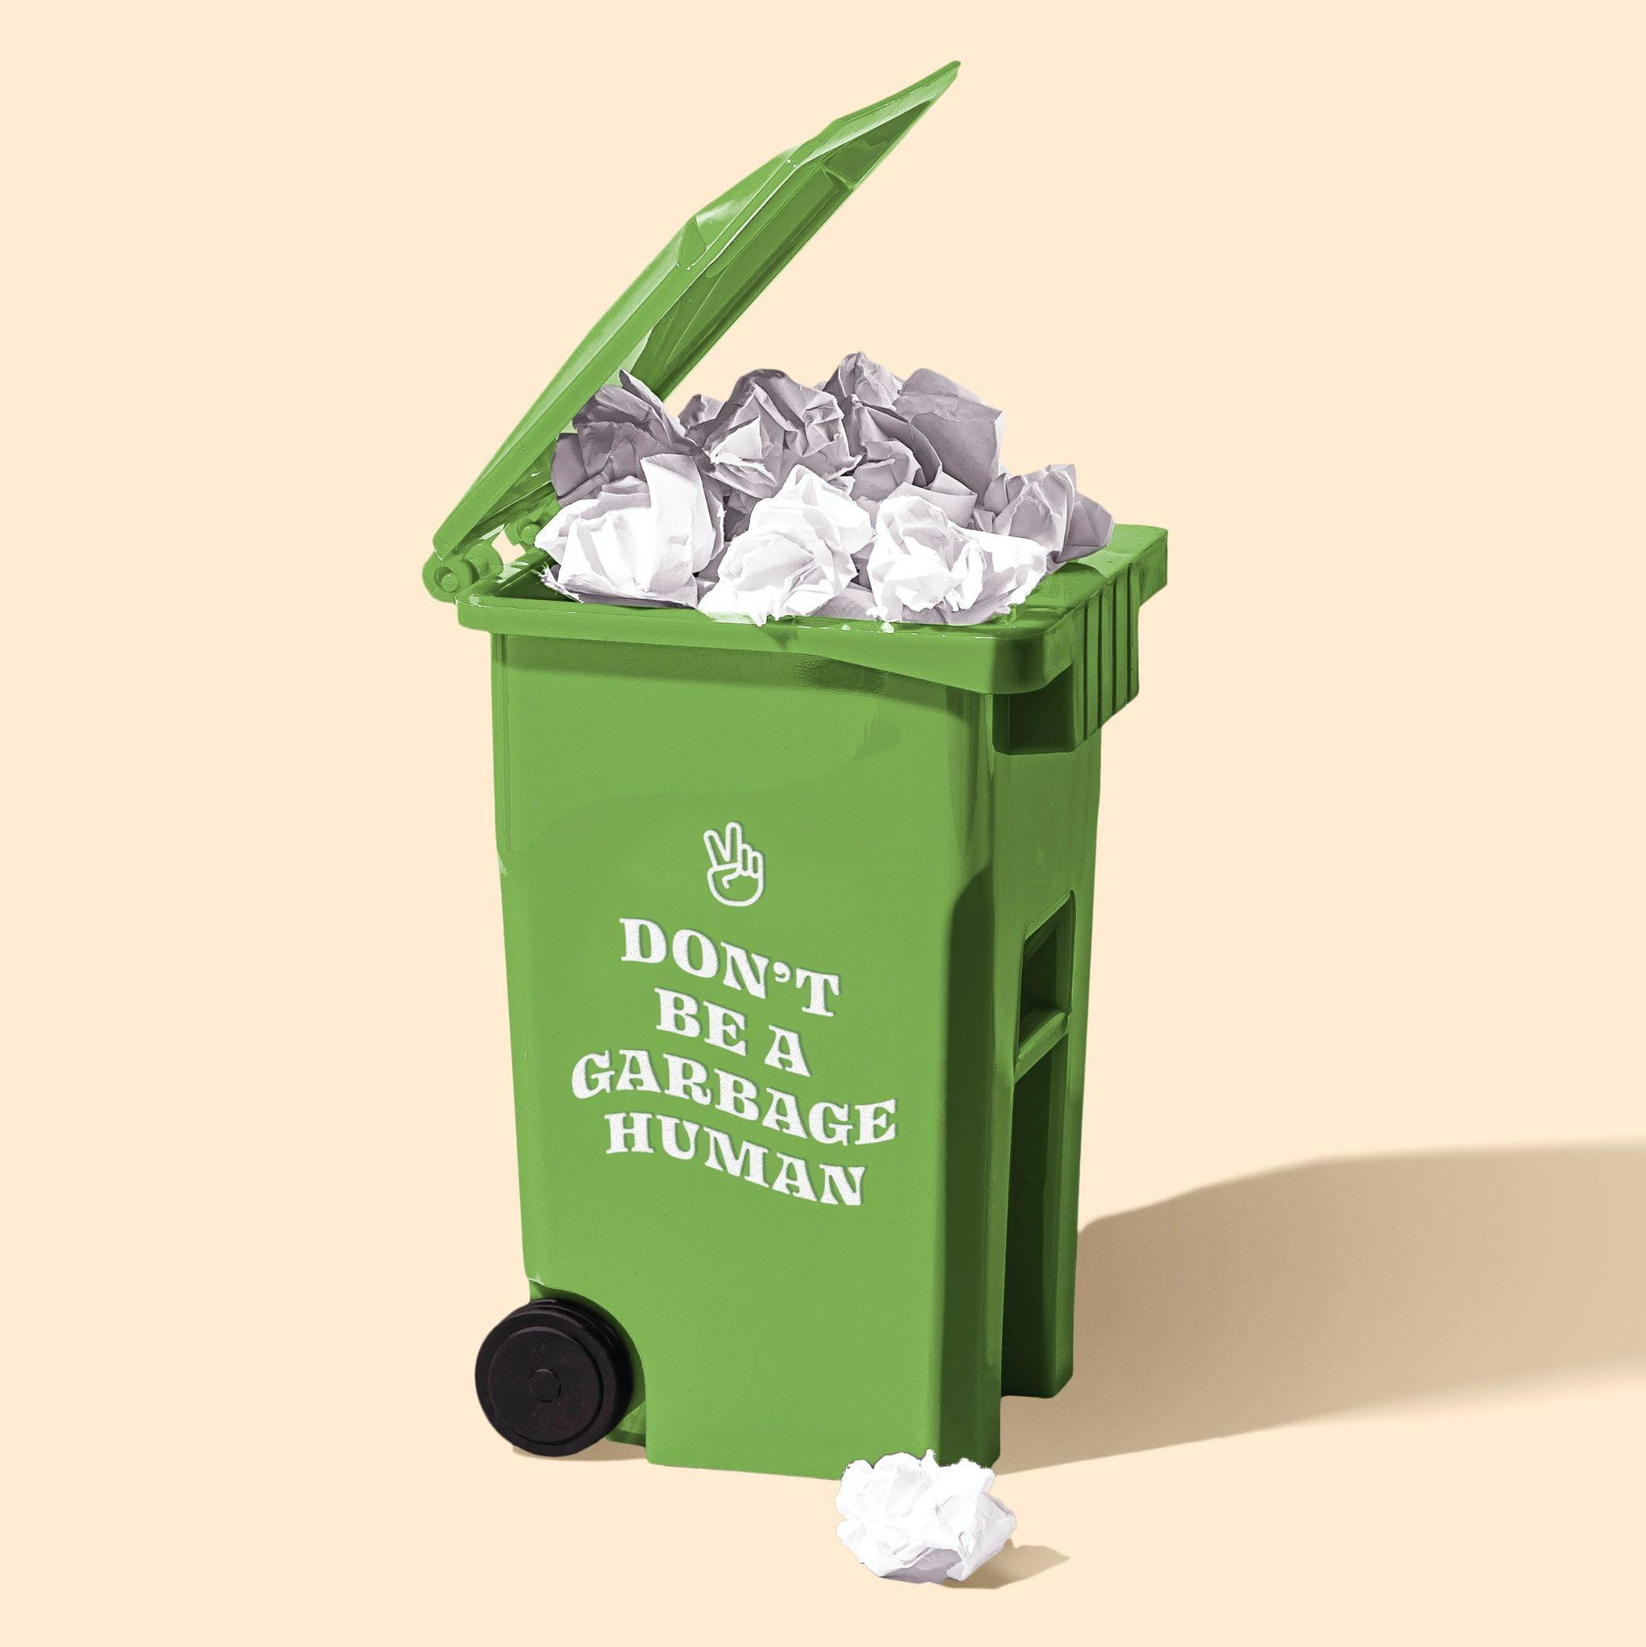
trashOverflow
Team Turing - (Team 14)
Shreyan Yoge
Rishikesh Sivakumar
Sonali Bedade
Tejaswi Chaudhari

Slide 2
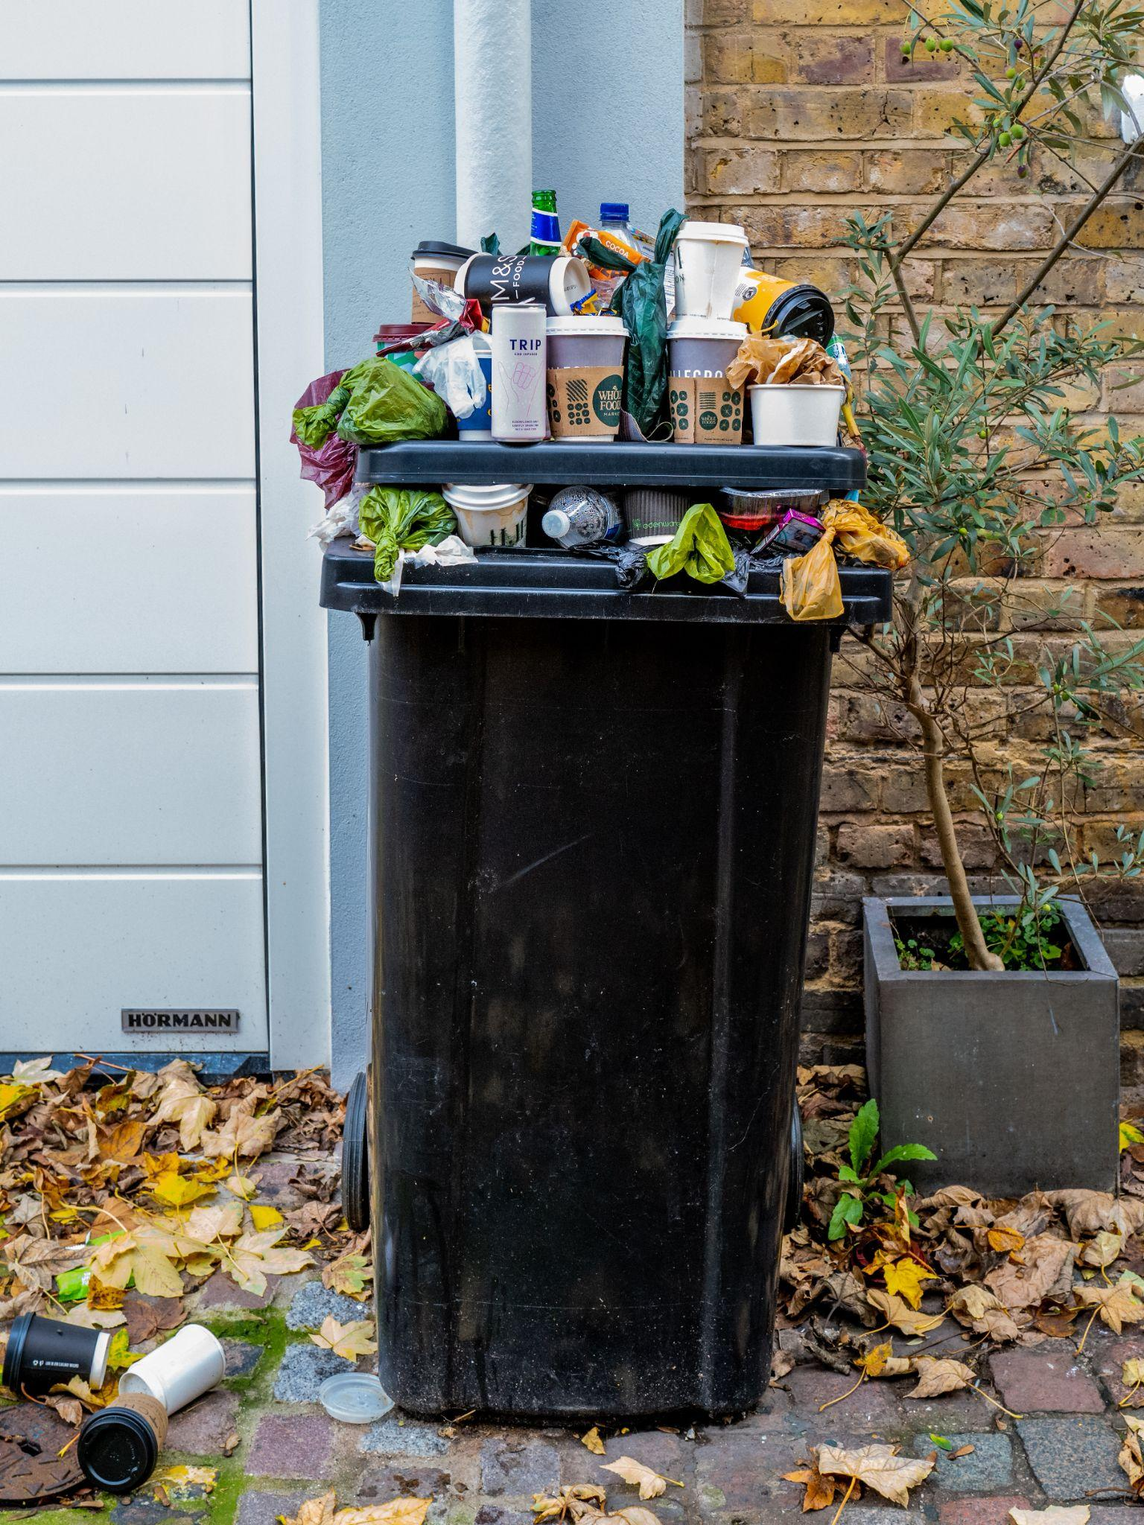
Problem Statement
Public trash bins commonly overflow due to the huge amount of waste generated everyday, and is exasperated by the proper authorities not being notified on time to empty them.
This poses as a major threat to both the environment and human health.

Slide 3
Our Approach
Using Deep Learning and Computer Vision to detect the overflow of waste in and around trash cans
01
02
03
Data Extraction
Data Analysis
Data Augmentation
04
05
06
Model Creation
Interactive GUI
Training and Validation

Slide 4
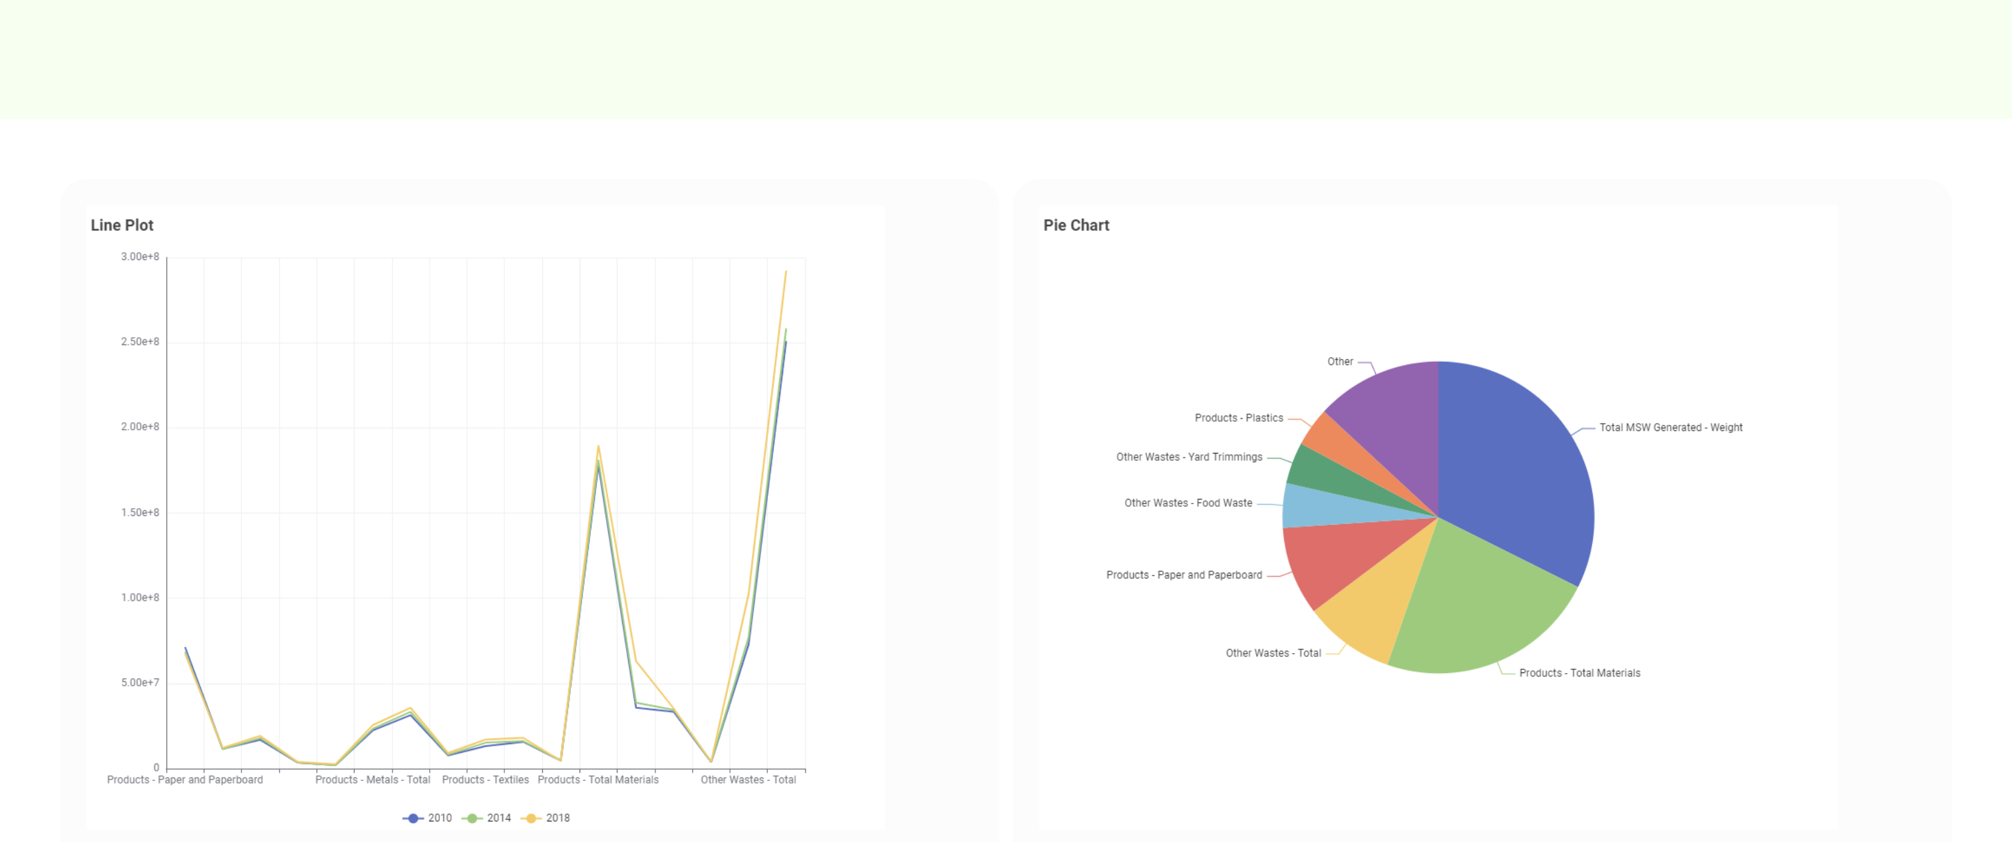
Usage of Knime
We used Knime to perform Data Analysis and analyze the trends and categories in waste generation!!!

Slide 5
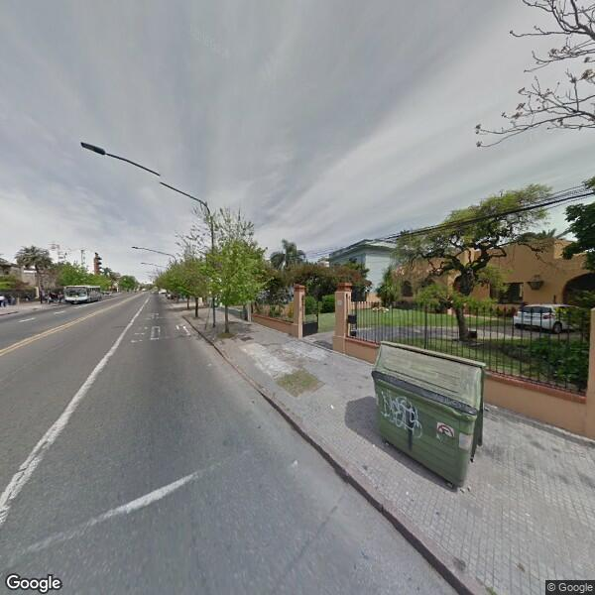
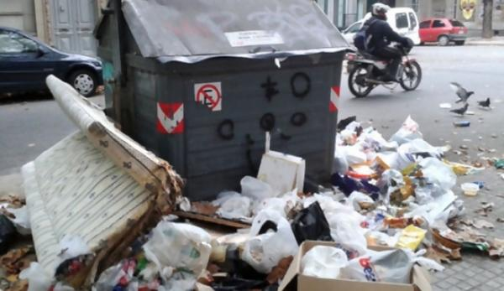
Data Extraction
Scraped data from google using certain tools.
Obtained dataset from a research paper
  https://www.sciencedirect.com/science/article/pii/S0957417423000453

Slide 6
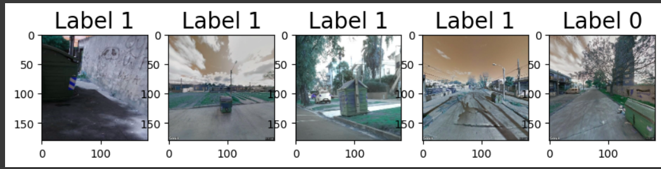
Data Preprocessing
Multiple Image processing techniques like scaling, transformation,etc. Were implemented on the extracted image.

Slide 7
Data Augmentation
Data augmentation is performed to provide additional training data generated from existing data to obtain a more generalized real world dataset.
Some augmentation techniques we used are translation and zoom.

Slide 8
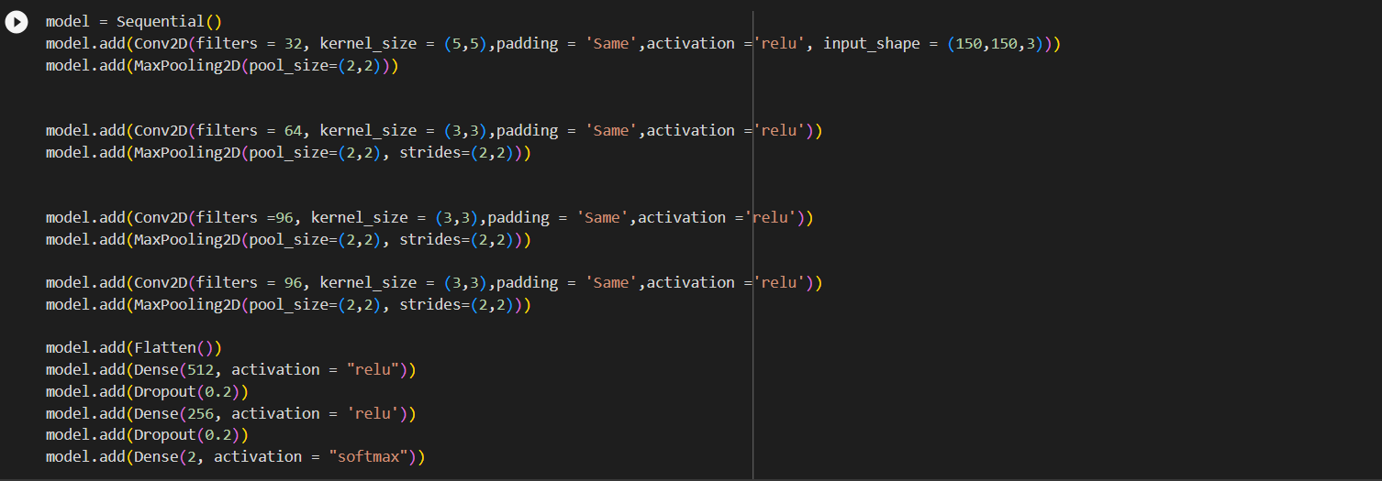
Model Creation
We created a CNN model with the following structure for detecting whether the trash bin is overflowing.

Slide 9
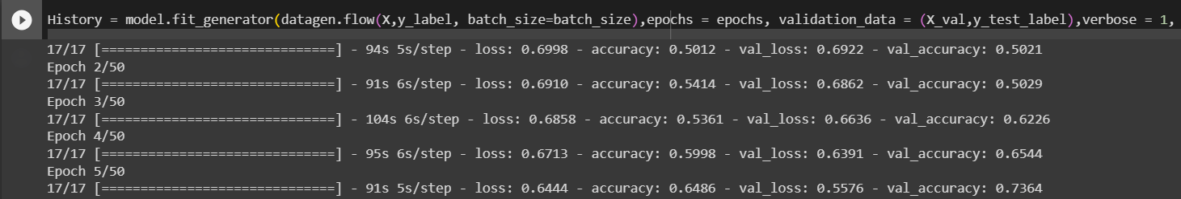
Training and Validation
We trained the model for 50 epochs and achieved a test accuracy of 80% and training accuracy of 99%.

Slide 10
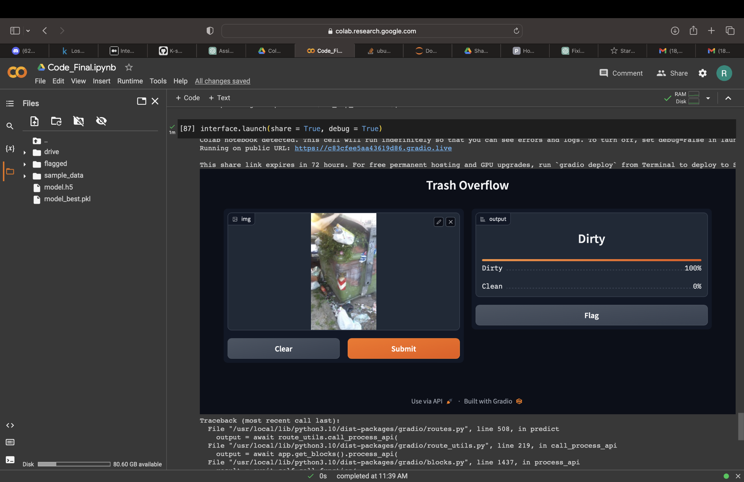
Interactive GUI
Created an interactive GUI which can take an image and classify it as clean or dirty

Slide 11
Thank You!

