Slide 1
Post Processing for crew Scheduling for Long-distance Passenger Railway Transportation
(Rishuv Gorka 190070052)
EE491 – BTP-1

Slide 2
Indian Railway
The Indian Railways (IR) is a statutory body under the ownership of the Government of India's Ministry of Railways. It boasts one of the most extensive rail networks globally.
IR is overseen by a Railway Board and is divided into 17 administrative zones and each zone is headed by a General Manager.
These zones are further divided into 68 smaller division, and each led by Divisional General Managers.
Within IR, each crew member is affiliated with a specific division and one of its crew bases, commonly situated at terminals or stations with high train service frequencies.
In the context of long-distance services, the entire train journey is divided into smaller task with the different crews handling each of these tasks.

Slide 3
Crew change points (CCPs), where crew changes occur, are typically major stations within the division or border stations.
CCPs are equipped with basic facilities for crew members to rest after completing a task.
Each crew operates within the jurisdiction of the associated division.
Additionally, deadhead trips, involving a crew member being transported as a passenger to a home base or another CCP, are incorporated into crew planning to enhance workforce utilization and satisfaction.
Task refers to a trip that a crew can operate in a single stretch and is characterized by starting and ending time and location. On the other hand, duty refers to a sequence of tasks over a defined period, satisfying all the operational constraints and labour union rules, and can be assigned to a single operator.

Slide 4
Introduction
Crew scheduling plays a crucial role in transportation systems, with distinct features and challenges in various applications.
In rail operations, transportation services are broadly classified into passenger and freight services. Passenger services are operated based on a pre-determined timetable, while freight services are a combination of scheduled and ad-hoc services.
Figure 1: Operational Planning Process in Passenger railway transportation

Slide 5
The operational planning process in passenger railway transportation is outlined as-
Line Planning - determining lines, stations, and train types to meet travel demands.
Train Timetabling - establishing arrival and departure times while ensuring safety constraints.
Train Platforming – it assigns platforms at station.
Rolling stock scheduling - scheduling allocates railway vehicles to scheduled trains, incorporating regular maintenance. Train unit shunting - During non-operational periods, such as at night, parked trains need shunting, referred to as the train unit shunting problem
Figure 1: Operational Planning Process in Passenger railway transportation

Slide 6
Crew scheduling - consists of creating anonymous duties covering all the trains for a defined period based on a given timetable. Each duty specifies a sequence of tasks satisfying operational constraints and labour union rules.
Crew Rostering - Finally, the duties are combined for a larger time and assigned to individual crew members, known as crew rostering
Figure 1: Operational Planning Process in Passenger railway transportation

Slide 7
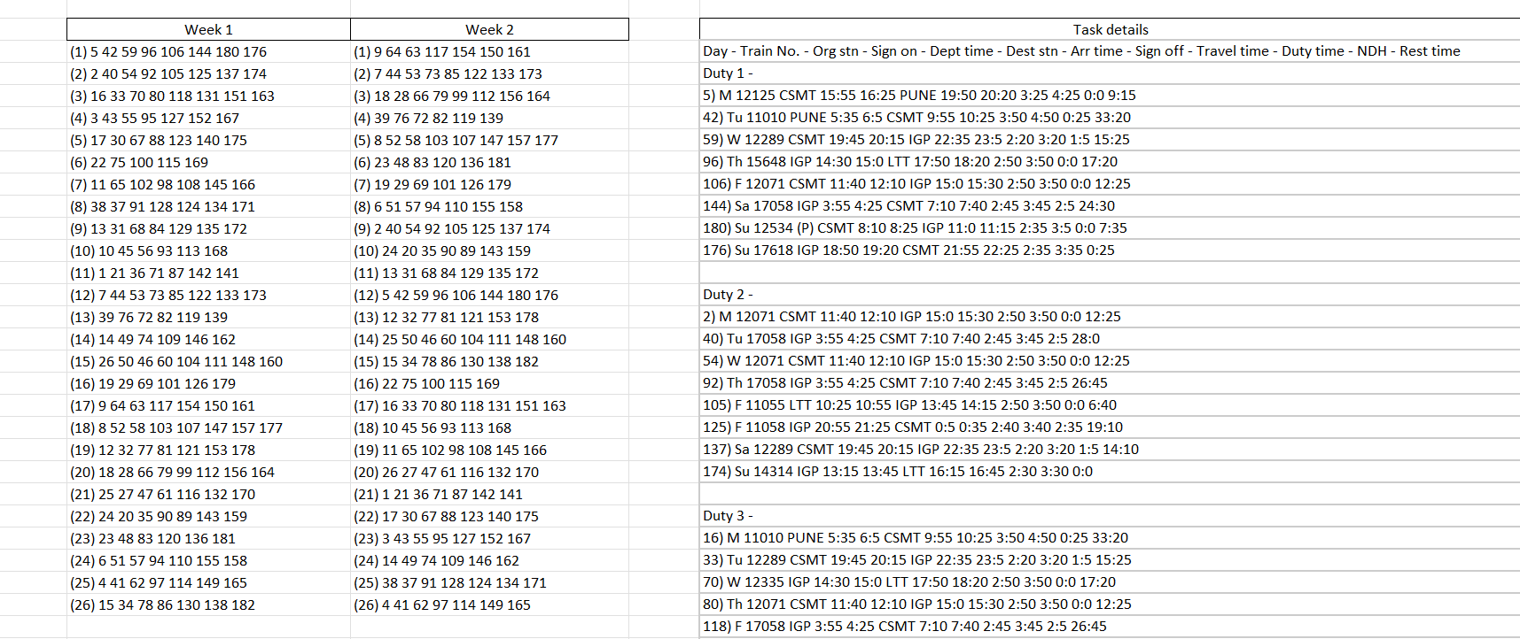
Input to the code
In [1], three data outputs: week1, week2, and task details are generated, and these are fed to the post processing code.
In week 1 and week 2, each line represent a duty.
In task details, details about tasks in each duty is given.
Figure 2: data generated by [1]

Slide 8
Processing
After giving input to the code, the week 1 and week 2 data is fed to the function called findcycle, which find the circular pattern in which the data is generated for each run. It generate a 2-D vector in which each row represent a complete cycle.
Figure 2: data generated by [1]

Slide 9
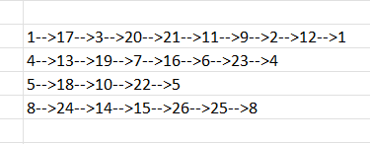
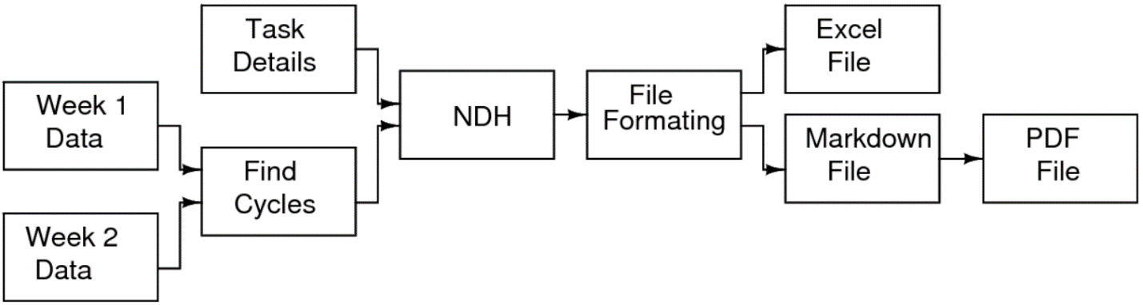
Figure 3, shows the different cycles formed in data
shown in figure 2.
After identifying all the cycles, this data along with
task details is fed to NDH function.
NDH function sort the task details according to the output of findcycle and calculating parameters like total night duty hours, total rest time, and total duty hours.
Figure 3: Formed Cycles
Figure 4: Flow Chart of Procedure

Slide 10
The output of the NDH function is sorted task details followed by the summary of parameters for each duty, stored as single database. It also calculated the missing rest time for the last task of each duty.
In main function of the code, from this output two files are generated: one excel file and another markdown file.
Figure 4: Flow Chart of Procedure

Slide 11
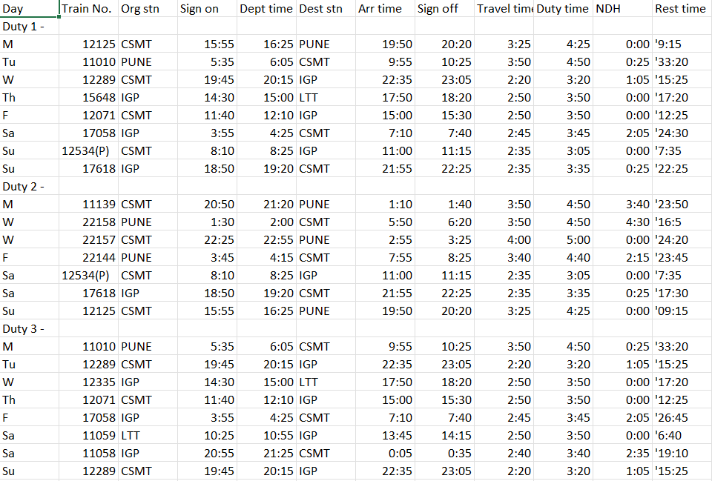
Output of the code
Excel file –
From the output of
the NDH function, this
Excel file is generated. It simply stored the output without any formatting. Firstly, duties are stored like shown in the figure 5 and after that summary
of the duties are stored.
Figure 5: Output as excel sheet.

Slide 12
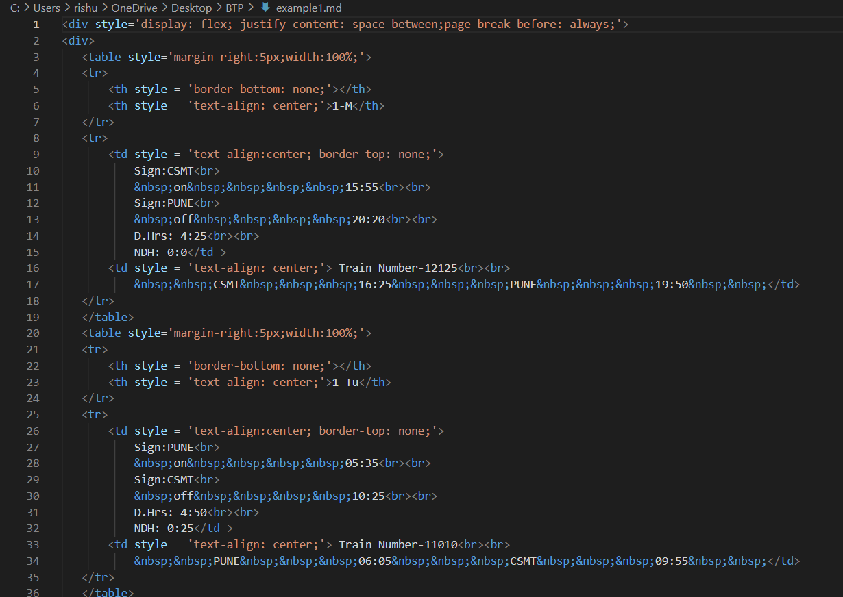
Markdown file –
Another file generated from the output of NDH function is a markdown file. It is generated to achieve the specific format that is used by the crew members.
Figure 6: Output as markdown file.

Slide 13
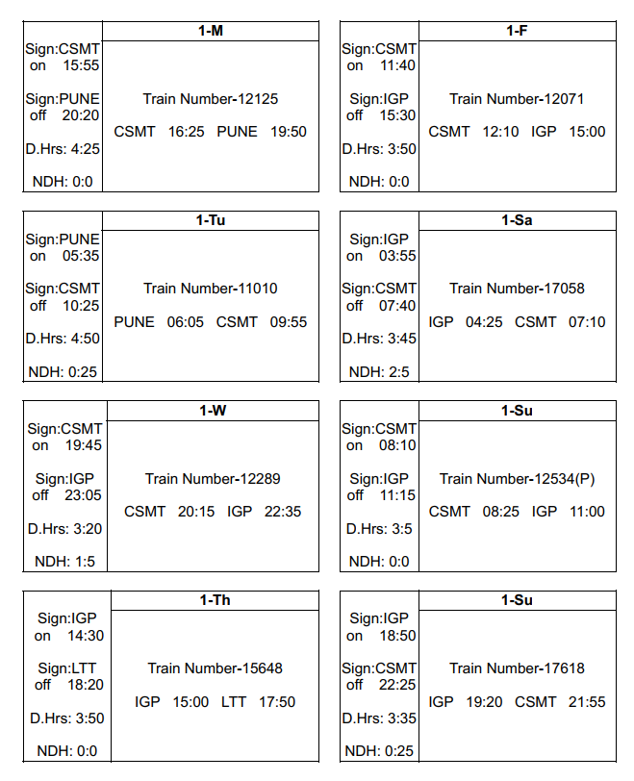
Conversion of markdown file into pdf will generate a file in specific format as shown in adjacent figure. Each task is shown as a table and contain details like sign on and off time and station, train number, night duty hours, duty hours etc.
Figure 7: Pdf file generated from markdown file.

Slide 14
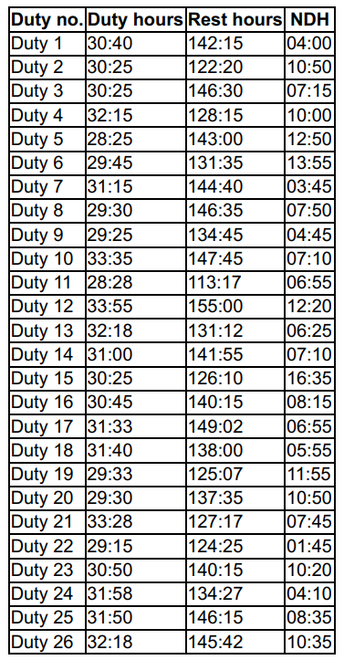
Summary in the end of each file contains the total duty hours, total rest hours and total night duty hours for each duty.
Figure 8: Summary

Slide 15
References
[1] “Crew Scheduling for Long-distance Passenger Railway Transportation” by Akshat Bansal,
2022.
[2] https://www.geeksforgeeks.org/file-handling-c-classes/?ref=lbp
[3] https://www.youtube.com/watch?v=DLLrcr9u_XI

Slide 16
Questions?

