Slide 1



SMART INDIA HACKATHON 2026 · GRAND SUBMISSION
AYUSH-SETU
One Platform · One Ecosystem for skill mapping, AI-proctored NSQF assessments, internships & placements across the six Ayush systems
Ayurveda
Yoga & Naturopathy
Unani
Siddha
Sowa-Rigpa
Homoeopathy
PROBLEM STATEMENT ID
THEME
SIH26044
Smart Automation
PROBLEM STATEMENT TITLE
Portal for Academia–Industry collaboration for Skill Mapping, Internships and Placement
ORGANISATION
PS CATEGORY
Ministry of Ayush
Software
TEAM NAME
TEAM ID
Tenet
Notes:
Fill in the Team ID from the SIH portal and confirm the theme before submitting.

Slide 2







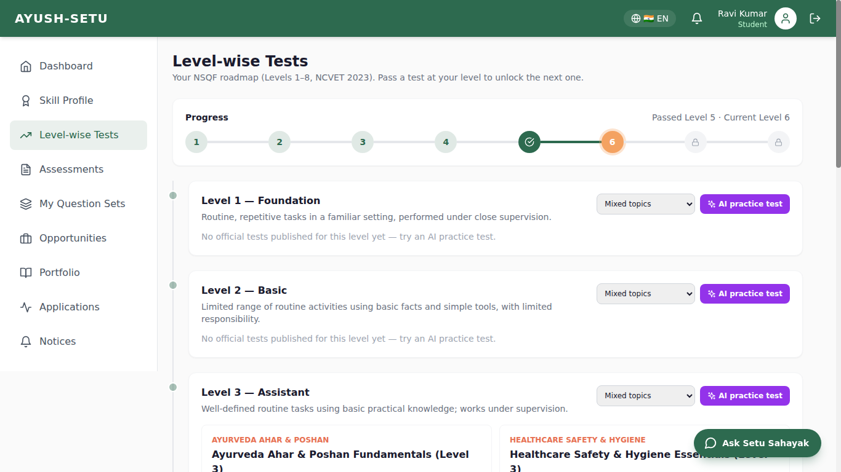

Proposed Solution
A unified web platform (installable PWA) connecting AYUSH students, academicians, institutions and industry across skill mapping, NSQF-verified assessments, internships and placements.
ONE PLATFORM, ONE ECOSYSTEM
Students
Academicians
Skill Intelligence Layer
NSQF level-wise tests (Levels 1–8) on HSSC Ayush Qualification Packs — Ahar & Poshan Sahayak, Panchakarma Technician, Ayurveda Dietician — build verified skill profiles, bar-chart gap analysis and PDF reports.
AYUSH-
SETU
Trusted AI-Proctored Assessments
Create tests two ways — upload CSV/JSON/manual or AI-generated level-wise tests — and run them with camera, microphone and entire-screen AI proctoring plus live proctors.
Opportunity & Collaboration Hub
Institutions
Industry
Industry posts internships & jobs matched by AI to verified scores; academicians mentor students; institutions track readiness and placement outcomes.
Portfolio, Notices & Setu Sahayak
Certificates, projects, application tracking, notices and a role-aware chatbot that guides users to features and answers doubts.
Why it’s different: an Ayush-focused skill-to-placement portal where every skill score comes from an AI-proctored, NSQF level-wise test — so industry can trust the shortlist.
Live prototype: NSQF Level-wise Tests roadmap
AYUSH-SETU | PS ID 26044 | Team Tenet
2

Slide 3
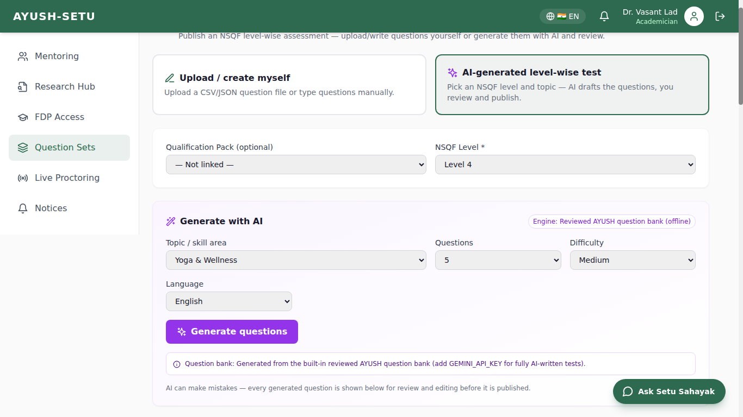
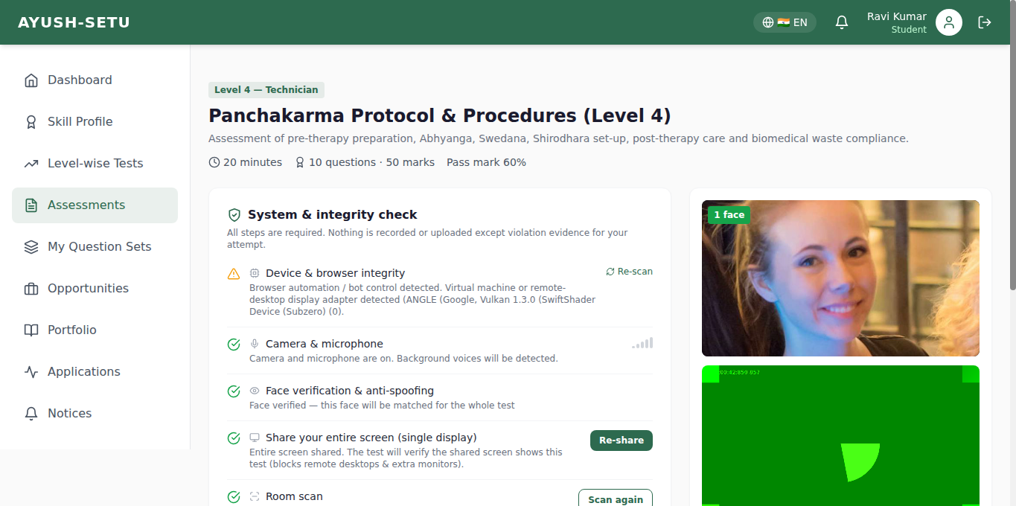
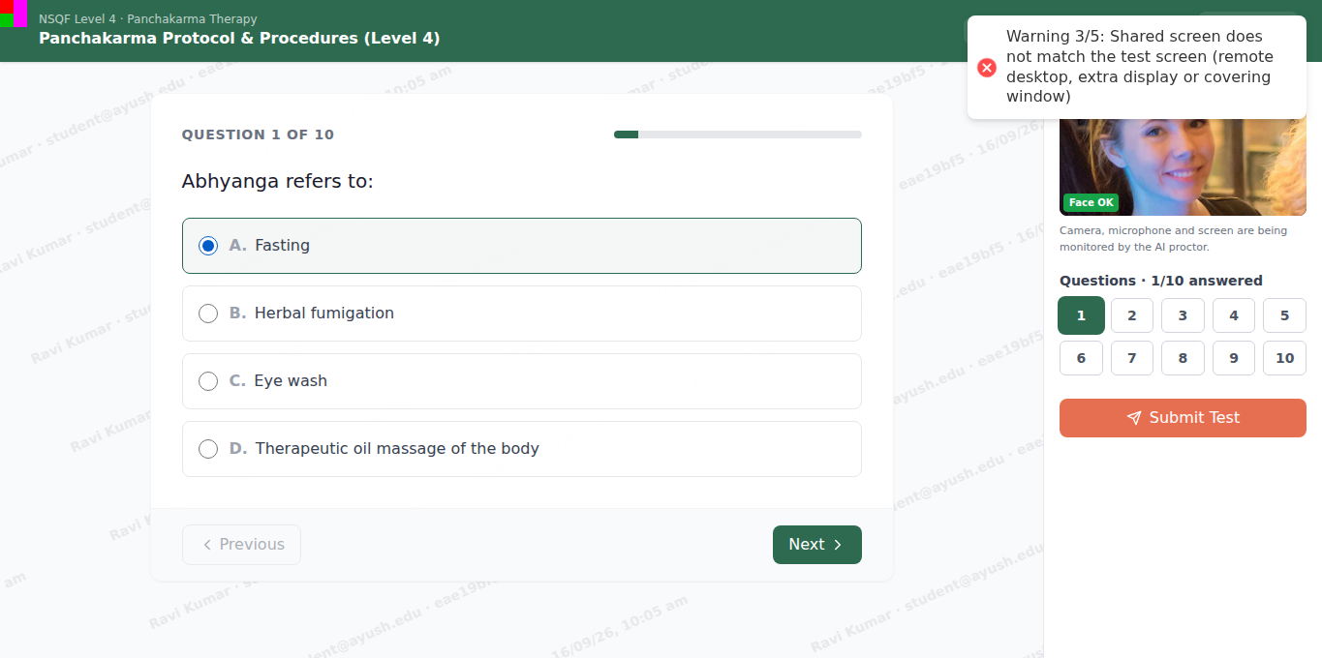
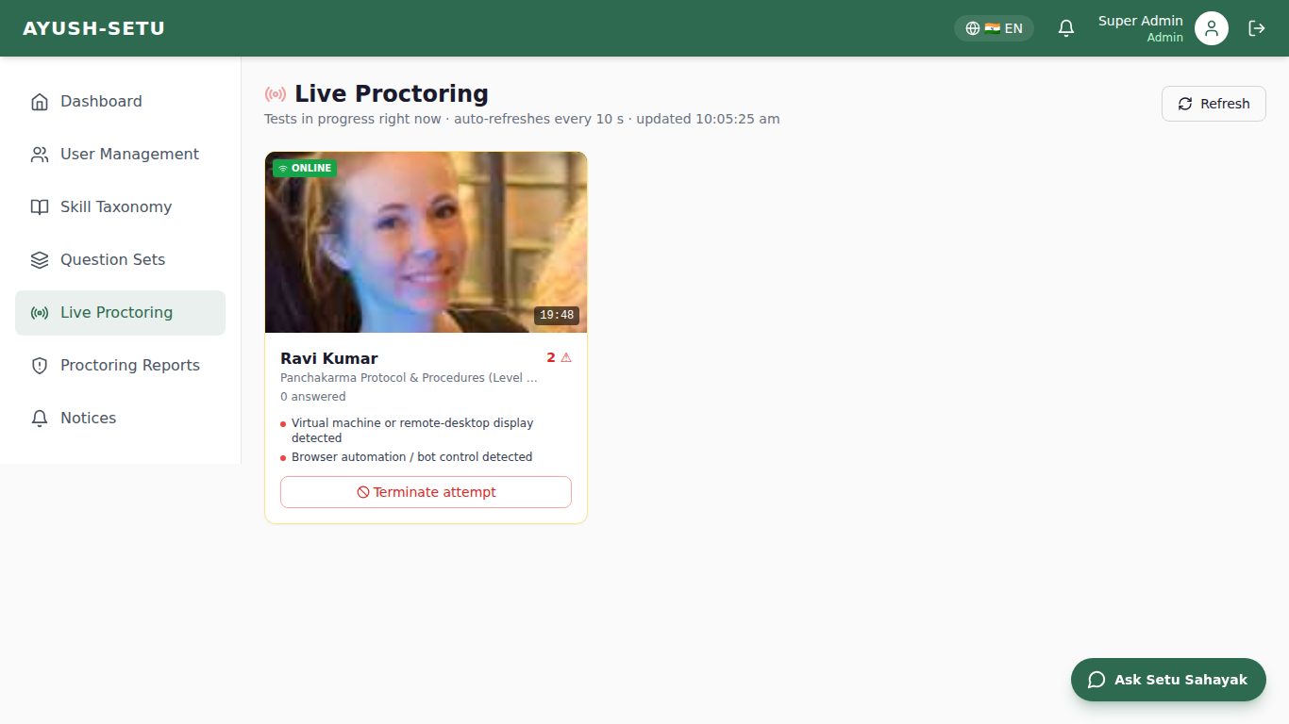
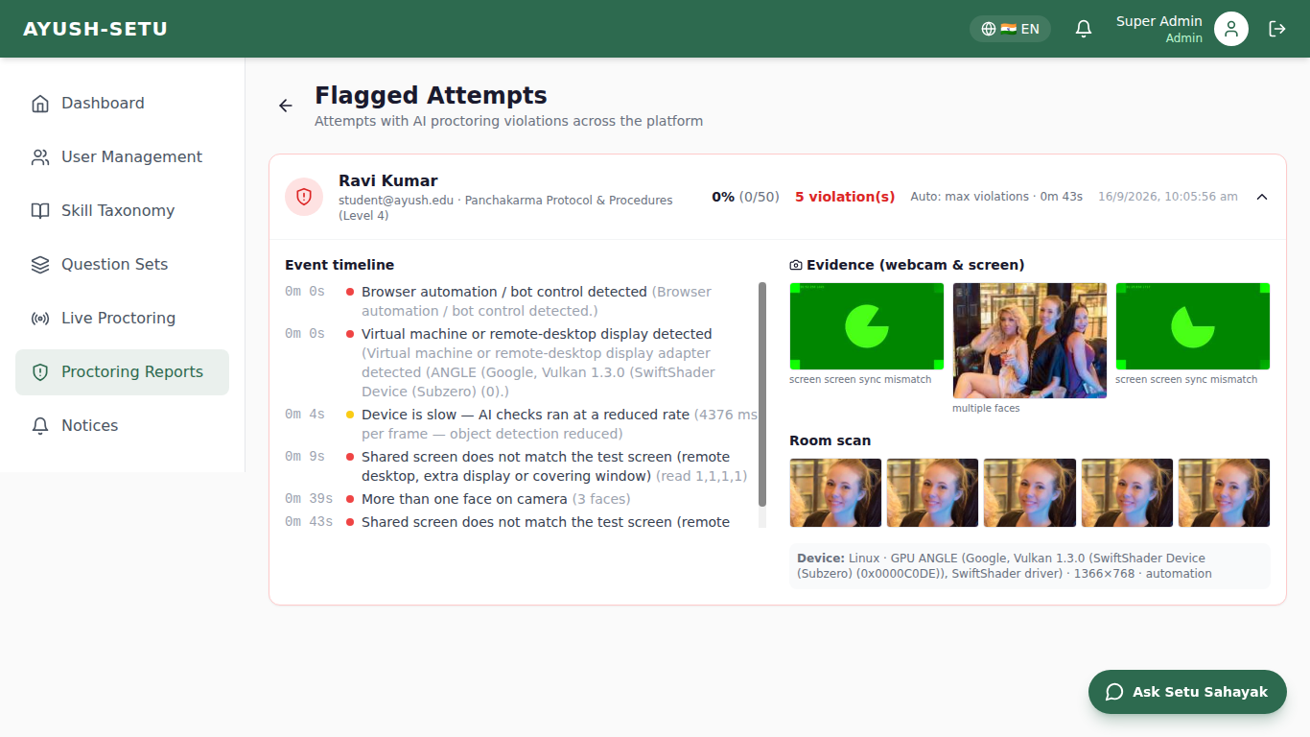







Technical Approach
MODULAR, SCALABLE & EXPLAINABLE ARCHITECTURE
1
CREATE TEST
2
SYSTEM CHECK
3
PROCTORED TEST
4
LIVE PROCTOR
5
RESULT & SKILLS
→
→
→
→
AI ANTI-CHEATING ENGINE
TESTS, LEARNING & ASSISTANT
Keyboard + Screen Sync (remote access)
Voice Monitoring
Camera: Extra Person & Phone
Two ways to create tests
Upload CSV/JSON/manual OR AI-generate (Gemini/OpenAI + offline bank); review, then publish
Entire-screen share with a rotating colour sync marker; keyboard/mouse input is checked against the verified face on camera; AnyDesk/RDP/VM display & cursor-teleport detection; extra monitors blocked.
On-device speech detection against calibrated room noise; a voice while the candidate’s lips don’t move = another person helping; mic-off alert.
Multi-face + person detection, mobile-phone detection (photos for AI help), look-down tracking, face recognition and anti-spoofing.
NSQF Level-wise Tests
Levels 1–8 roadmap, unlock next level on pass, AI practice test per level
No Tab Switch / Background Apps
Other Cheating Methods Closed
Enforcement & Evidence
Setu Sahayak Chatbot
Takes students, industry & admin to tests, notices, jobs; answers doubts; off during tests
Forced full screen until submit; tab, app & focus tracking; questions hidden when another app takes focus; screen snapshot as evidence.
Copy/paste, print, shortcuts, DevTools, AI extensions & bots blocked; per-student question/option shuffle; watermark; chatbot off; one live attempt.
5 serious violations → auto-submit + flag; live proctor can terminate; server timer & autosave; timeline with webcam/screen snapshots.
Working tests & bar-graph results
Camera on at start, full-screen test, instant score, skill bar graph vs benchmark, notices
IMPLEMENTATION STACK
Frontend
Backend
AI Layer
Database
Security
React 18 · Vite · Tailwind (PWA)
Node.js · Express · Prisma · FastAPI
TensorFlow.js (Human) · Web Audio · Gemini/OpenAI
PostgreSQL + pgvector
JWT + RBAC · server timer · HTTPS
Methodology: Agile sprints → Working prototype → Pilot with institutions → Feedback loop → Scale through APIs & integrations
AYUSH-SETU | PS ID 26044 | Team Tenet
3
Notes:
All features on this slide are implemented and demoed from the running prototype. Camera, voice and screen AI run in the browser; no video stream is uploaded, only violation snapshots.

Slide 4
FEASIBILITY AND VIABILITY
FEASIBLE TODAY. DESIGNED TO SCALE TOMORROW.
WHY IT IS FEASIBLE
✓ Working prototype already built
✓ Open-source stack · free-tier cloud
✓ Only a laptop with webcam & mic
✓ AI keys optional · offline fallback
LOOPHOLES WE FOUND → HOW AYUSH-SETU CLOSES THEM
BUILT
ROADMAP
1
Remote helpers & second screens
BUILT
2
Copied & photographed questions
BUILT
3
Help from someone in the room
BUILT
4
Impersonation
BUILT
AnyDesk-style control or an extra monitor lets someone else see and answer.
Questions get copied, screenshotted or photographed with a phone.
A friend sits nearby or whispers answers off-camera.
A different person sits the test or holds up a photo.
HOW WE SOLVE IT
HOW WE SOLVE IT
HOW WE SOLVE IT
HOW WE SOLVE IT
Entire-screen share with a colour screen-sync marker, display count, remote-display & cursor checks; clicks with no face on camera are flagged.
Per-student question & option shuffle, copy/print/shortcut blocking, traceable watermark and mobile-phone detection.
Multi-face & extra-person detection and voice detection matched with the candidate’s lip movement.
Face recognition against the face verified at start, plus anti-spoofing and liveness models.
5
Too little test content
BUILT
6
Low-end laptops & weak internet
BUILT
7
MCQs can’t prove clinical skill
ROADMAP
8
Fake certificates
ROADMAP
Faculty and industry lack time to write level-wise question banks.
Heavy AI or a dropped connection can break an online test.
A web quiz cannot show a student can treat a patient.
Students can upload unverified certificates.
HOW WE SOLVE IT
HOW WE SOLVE IT
HOW WE SOLVE IT
HOW WE SOLVE IT
Upload CSV/JSON/manual or AI-generate a level-wise test in minutes; offline reviewed AYUSH question bank.
Adaptive AI frame rate, heartbeat autosave, server-side timer and resume with the attempt recorded.
Proctored theory + mentor feedback today; clinic-observed Guru-Shishya endorsements next.
Skill scores come only from proctored tests; DigiLocker / ABC credential verification in the next phase.
PHASED EXECUTION
ROADMAP
MVP ✓
→
PILOT
→
EXPAND
→
SCALE
Proctored level-wise tests, profiles, AI test creation
Institution onboarding, matching + applications
DigiLocker/ABC verification, mentor endorsements
Analytics, lockdown desktop client, more languages
AYUSH-SETU | PS ID 26044 | Team Tenet
4

Slide 5

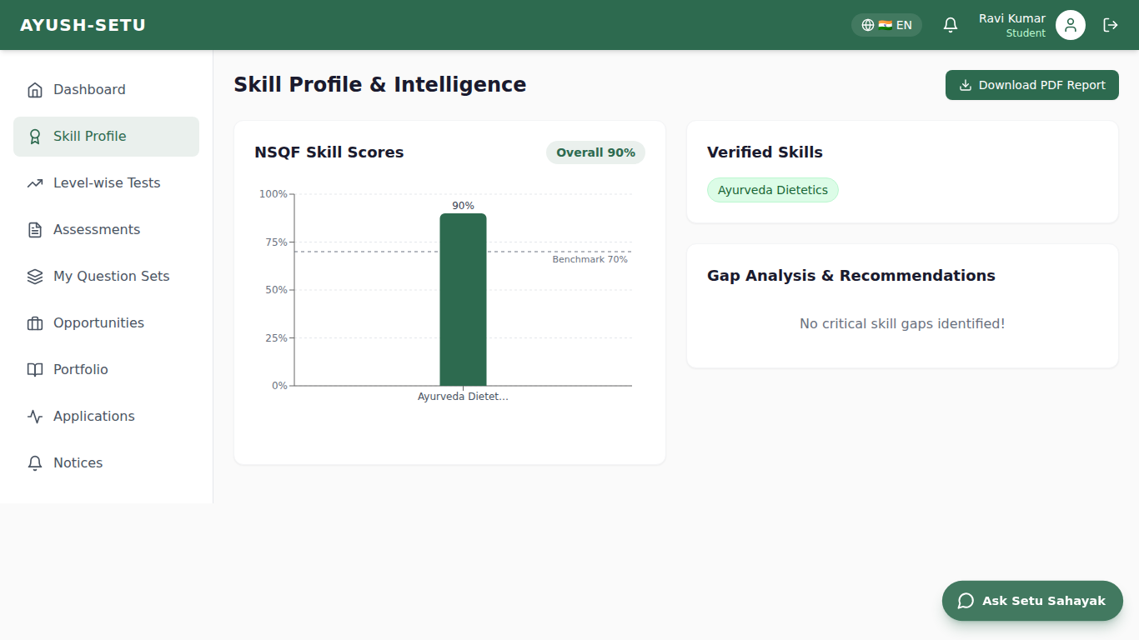
IMPACT AND BENEFITS
FROM SKILL VISIBILITY TO EMPLOYABILITY OUTCOMES
STUDENTS
INDUSTRY
ACADEMICIANS
INSTITUTIONS
Verified NSQF level evidence
AI practice tests for every unlocked level
Clear skill gaps & PDF report
Matched internships & jobs
Shortlists from proctored scores
Publish own level-wise tests
Live proctoring with evidence
Faster, fairer hiring
AI-drafted tests in minutes
Mentoring & feedback
Research hub & FDP access
Curriculum insight from gaps
Fair online exams at scale
Readiness dashboards
Flagged-attempt reports
Placement outcome tracking
IMPACT FLYWHEEL
Map
Assess
Learn
Match
Measure
Understand capability
→
Verify with proctored tests
→
Close skill gaps
→
Connect to opportunities
→
Improve outcomes
8
44
2
0
NSQF levels on one roadmap
integrity signals per proctored test
ways to create tests: upload or AI
video streams uploaded (on-device AI)
Skill Profile: verified scores vs 70% benchmark with gap analysis
AYUSH-SETU | PS ID 26044 | Team Tenet
5

Slide 6


Research & References
RESEARCH BASIS
SIH 2026 – Problem Statement SIH26044
Ministry of Ayush
NCVET – NSQF 2023
Ministry of Ayush: Portal for Academia–Industry collaboration for Skill Mapping, Internships and Placement.
The six Ayush systems and national digital initiatives relevant to Ayush education and employment.
Revised NSQF notified on 6 June 2023: eight levels with descriptor domains that drive our level-wise tests.
sih.gov.in
ayush.gov.in
ncvet.gov.in
HSSC & National Qualifications Register
DigiLocker
On-device AI & Web APIs
Ayush qualification packs, e.g. Panchakarma Technician (HSS/Q3601, NSQF Level 4), used as the skill taxonomy.
Verifiable digital credentials — portfolio KYC today, certificate verification in the next phase.
Human (TensorFlow.js) face, anti-spoofing and object models; Screen Capture & Window Management APIs.
healthcare-ssc.in · nqr.gov.in
digilocker.gov.in
github.com/vladmandic/human
AYUSH-SETU | PS ID 26044 | Team Tenet
6

