Slide 1
CUDA SPICE Circuit Simulator
Milestone 1
Angelina Risi, EE 2018

Slide 2
What is SPICE?
Simulation Program with Integrated Circuit Emphasis
Basis of most modern simulators (ngspice, Cadence (PSpice), etc)
First version in 1973
Has fairly well-documented netlist/input file format

Slide 3
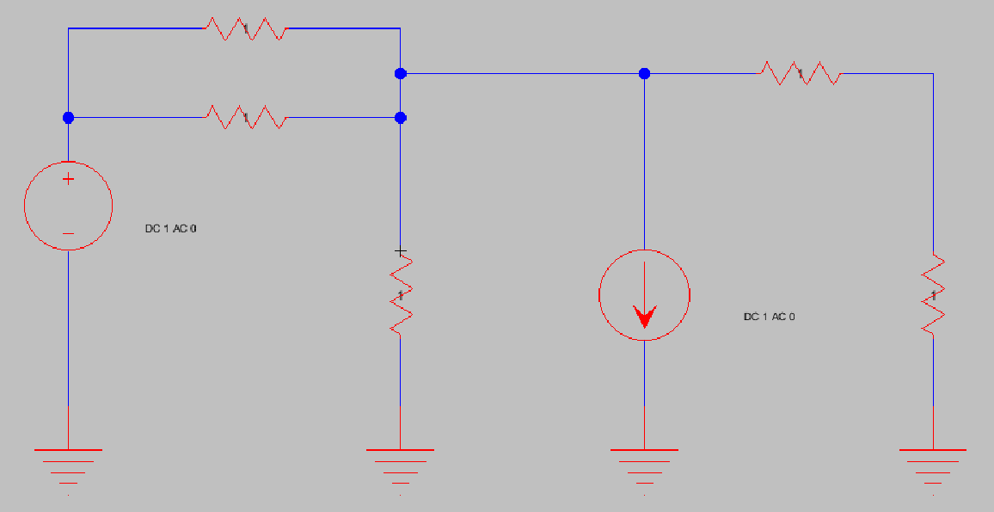
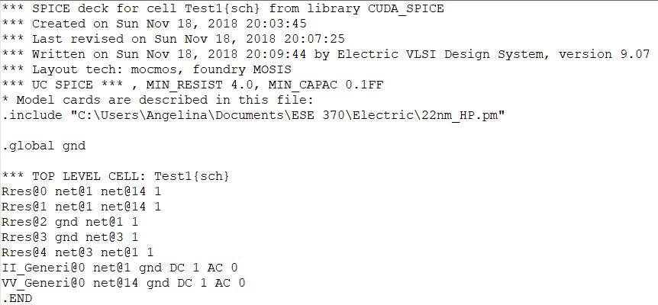

Slide 4
Milestone 1 Features
Partial file parsing – only reads Resistors, VDC, IDC, VCCS elements from input SPICE netlists
DC Operating Point simulation for simple, (ideally) fully linear circuits
Started with CPU implementation
Moved matrix solving code to GPU
Began adding code for transistor (nonlinear) implementation
Element structure, current calculation
Currently working on framework for non-linear convergence

Slide 5
Linear Solver
Circuit elements are converted into Conductance, Current, and Voltage matrices, initialized at 0.0f
Kirchhoff’s Current Law and Ohm’s Law
[ G ] * [ V ] = [ I ], solve for V
Matrix reduction
Plug in known voltages (e.g. voltage source with one end to GND)
Solve

Slide 6
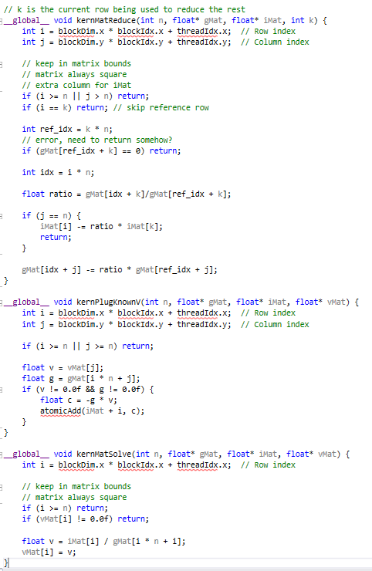
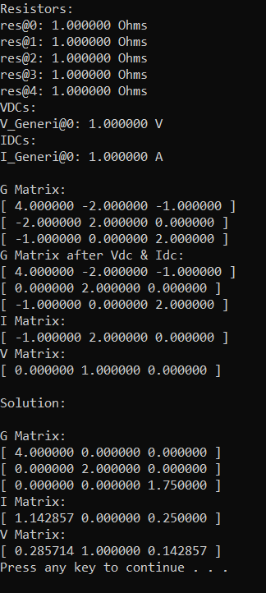

Slide 7
Plans for NON-Linear Convergence
SPICE apparently uses Newton-Raphson Method
Successive approximation until error within tolerance
Start with “guess” voltages for unknown non-linear dependencies
Substitute into equations to populate matrices
Linear solver for new voltage estimate
If outside of tolerance, new guess and try again
Parallelization ideas:
Guess voltage and current calculations in parallel for each node
First guess multiple values in parallel and choose nearest?

Slide 8
IMPROVEMENTS NEEDED Next MILESTONE
Complete netlist and model file parsing
DC Sweep simulation
Full 1st order transistor implementation (which means ignoring 2nd order effects, e.g. body, channel length modulation)
Working non-linear solver
Branch current calculation

Slide 9
Future Milestones
Transient (Time step) Simulation
Add in capacitors, inductors, AC sources (time-dependent elements)
Second-order effects (improved transistor modelling)
Graphical interface or data export and plotting
Performance optimizations
Stream compaction of matrices (expected to be sparse in large circuits)
Move more calculations to GPU

