Slide 1
CUDA SPICE Circuit Simulator
Final Demo Presentation
Angelina Risi, EE 2018

Slide 2
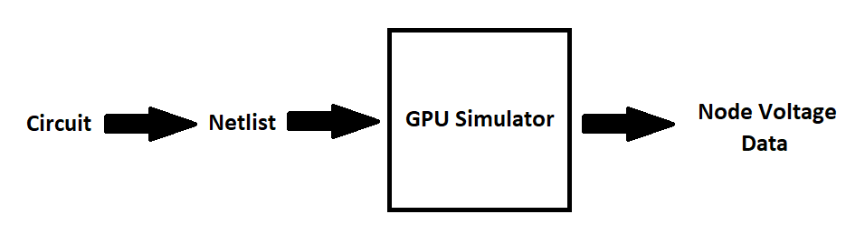
Goal
Use GPU to accelerate circuit solution, especially for very large circuits (e.g. VLSI design)
Parse arbitrary circuits, simulate on GPU, and output useful information

Slide 3
Features
Simple GUI – file and simulation selection
Partial SPICE file parsing (capacitors, resistors, DC & pulse voltage sources, DC current and VCC sources, MOSFETs and their model files) on CPU, with copy of netlist on GPU for simulation
Operating point, DC Sweep, and Transient simulation completely on GPU (except for final output and control loops)
Outputs solutions to CSV file for easy plotting using Excel or a MatLab script

Slide 4
Solving NON-Linear Circuits
Each circuit element is linearized into Conductance (G) and Current (I) elements
Parallel population of G and I matrices using atomic addition, parallel solution of voltage(V) matrix using linear matrix reduction and solution
MOSFETs solved by successive “guessing” until convergence (Newton-Raphson)
Serial iteration of parallel solver until converges within tolerance
Capacitances in transient approximated using Backward Euler
Must serially iterate each time-step, as it is reliant on prev. step’s solution

Slide 5
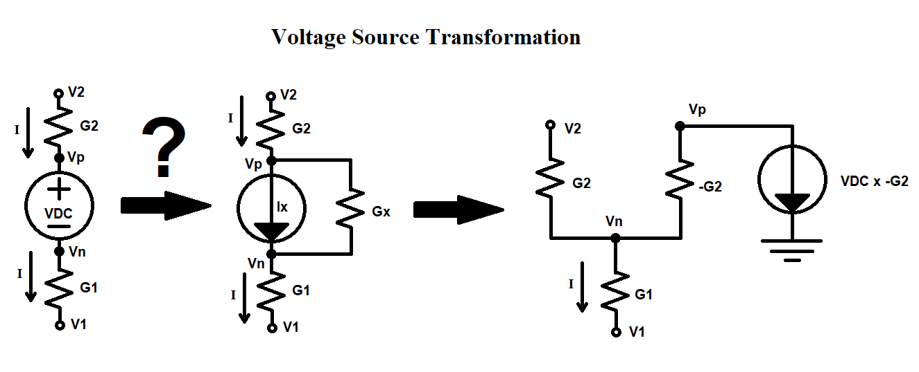
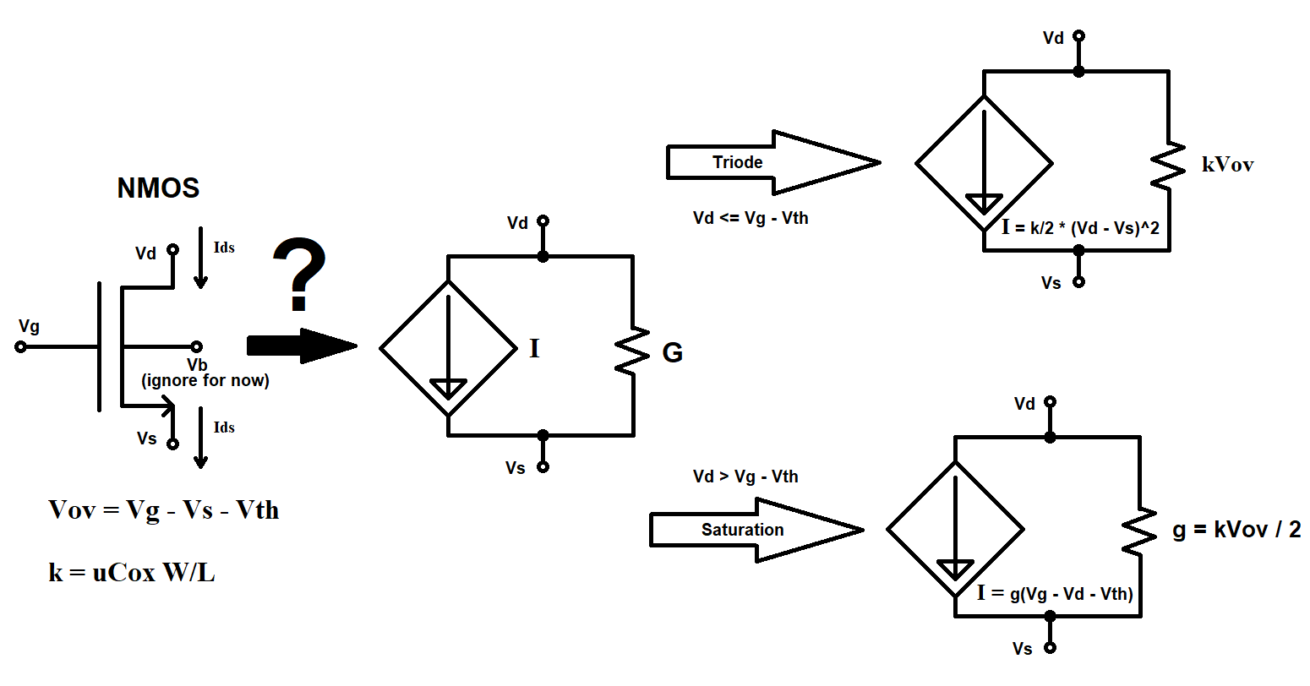

Slide 6
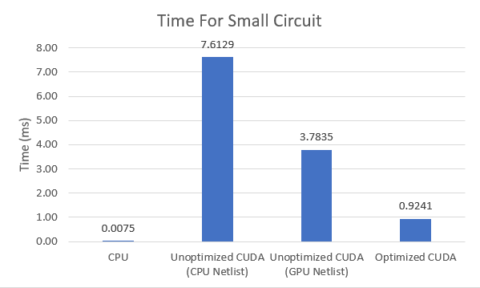
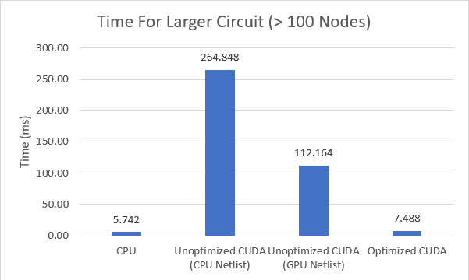
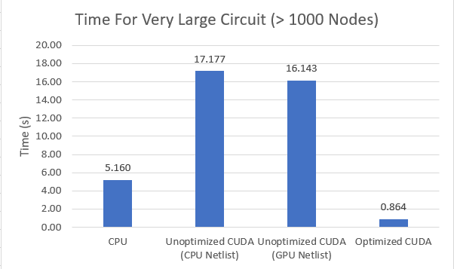
Performance
Testing the OP Simulation, CPU generally faster for small circuits
For larger circuits (e.g. 1000 nodes) optimized CUDA has better performance

Slide 7
DEMO

