Slide 1
CUDA SPICE Circuit Simulator
Milestone 2
Angelina Risi, EE 2018

Slide 2
Progress Since Milestone 1:
Code cleanup: overhaul on how we handle circuit elements
Instead of separate structs and lists for each type of element, all passives are the same Element with node and parameter arrays (instead of hardcoding how many they have)
Other than voltage sources, all passives can be stored on the same list (because VDC needs to be applied last to matrices for reasons described below
Will need further modification to properly port netlist to GPU (currently using std::vectors for dynamic arrays)
More edge case testing to locate and correct bugs
Located a problem with VDC modelling (problem with conversion to I and G when neither node grounded)
Before: Used the fact that the currents flowing out of both positive and negative node are equal to generate G and I matrix entries
Problem: Even though Vp = Vn + Vdc used to replace on of the voltages in one of the equations to assert Vdc dependence, still both voltages dependent on G seen at each node
Solution: seems really obvious, but Vp – Vn = Vdc, => Vp(Gx) – Vn(Gx) = Vdc(Gx) => divide by Gx. So, I use the previous method to populate the matrix for Vn but this new equation for Vp

Slide 3
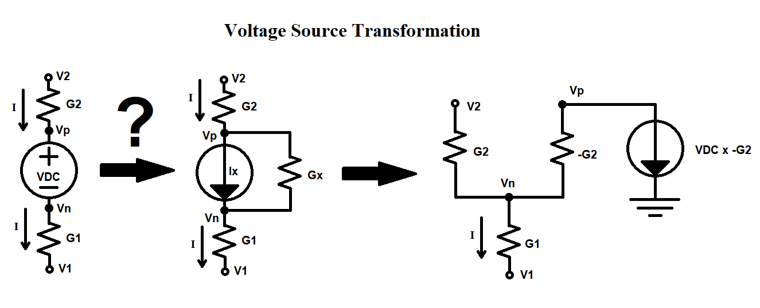

Slide 4
Progress Since Milestone 1: Transistors
Added transistor parsing, not including any extra geometry/layout parameters
Currently use a default hard-coded MOSFET models, need to add model parsing
Transistor linearization to G and I elements
Added channel-length modulation parameter
Adds dependence on drain-source voltage in saturation
Otherwise, for example for a simple inverter w/ Vdd/2 input there are 3 different solutions possible and it converges to one of those, not necessarily the one we want
Solution of circuits including transistors by:
Using previous solution as “Guess” voltages to linearize model
Iterating solving circuit until new solution and previous guess converge to within some absolute tolerance (currently 1µV)
This implicitly performs Newton-Raphson method
Currently very serial loop method, only matrix solving on GPU

Slide 5
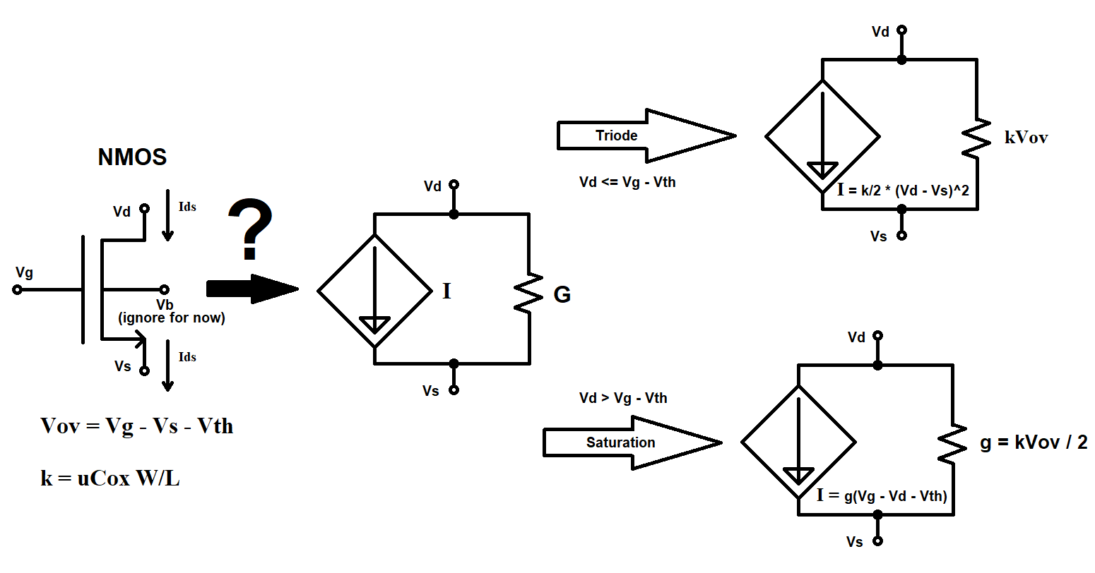

Slide 6
Currently Working ON:
Model parsing and multiline content parsing
Models generally specified in separate .incude files, but can be in netlist file, .model line
Parameters spilling into multiple lines start new line with ‘+’ character, need to look ahead to next line
DC Sweep – already have idea of how to setup
Find swept element, save original parameter value, overwrite with start value
Solve, increment value by step size, repeat until stop value reached
Porting matrix setup to GPU:
Parallelize by elements
Atomics for race conditions between elements on same node
Current issue with this is passing netlist to GPU, needs modifications

Slide 7
Next MilestonE:
Transient (Time step) Simulation
Add in capacitors, inductors, AC sources, etc. (time-dependent elements)
More second-order effects (improved transistor modelling)
Graphical interface or data export and plotting
Performance optimizations & comparison
Stream compaction of matrices (expected to be sparse in large circuits)
For better memory usage, as ultimate goal is to be useful for VLSI

