Slide 1
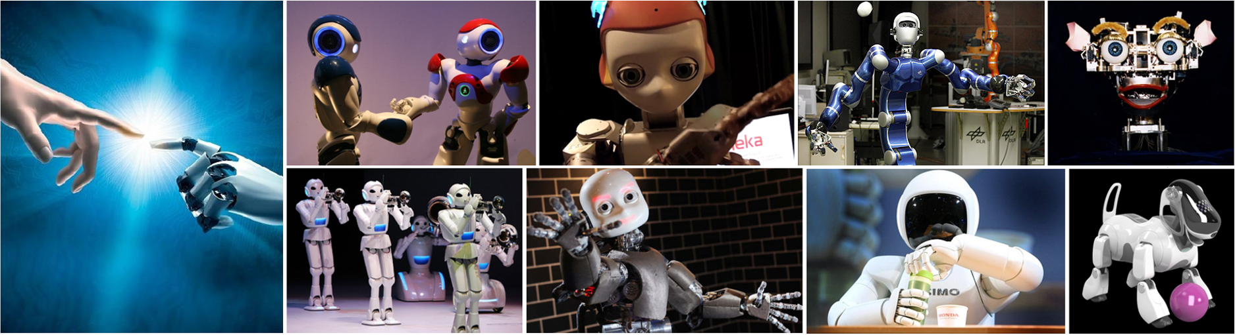
CMSC 591
Robotic Vision
Notes:
1

Slide 2
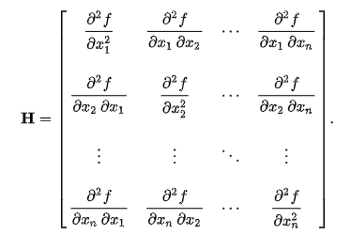
Hessian Matrix = Information Matrix?

Slide 3
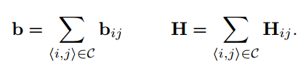
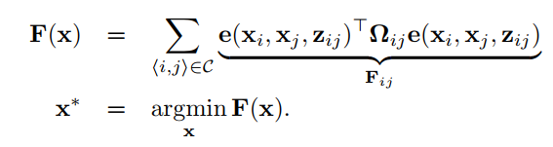


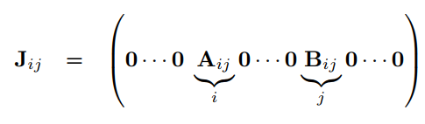


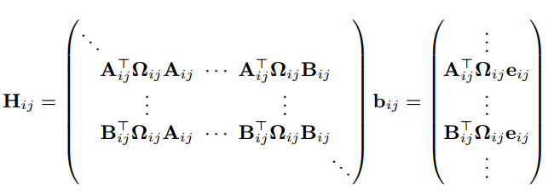
Linearized Structure of G2O
Gauss Newton
Levenberg Marquardt
Is the information matrix H is also the Hessian matrix of the cost function f(x)?
Notes:
Now let’s dive into the structure of the information matrix H and residual vector b.
the matrix H and the vector b are obtained by summing up a set of matrices and vectors
The structure of this addend depends on the Jacobian of the error function. Since the error function of a constraint depends only on the values of two nodes, the Jacobian.
Here Aij and Bij are the derivatives of the error function with respect to ∆xi and ∆xj.
Then we can obtain the following structure for the block matrix Hij, does it seem to be familiar to you, it is nothing magic. Last class we learn how to solve this graph problem? Just compute the information matrix A and the residual vector b, here it’s the same concept.
For simplicity of notation we omitted the zero blocks. You might notice that the block structure of the matrix H is the adjacency matrix of the graph. Thus, it has a number of non-zero blocks proportional to number of edges in the graph. This typically results in sparse H matrices. G2o take advantage of this characteristic of H by utilizing state-of-the-art approaches to solve the linear system this equation.

Slide 4
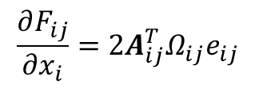
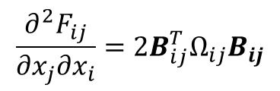

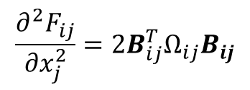

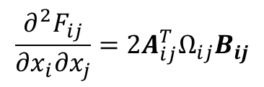

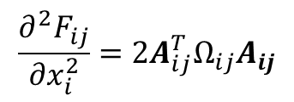
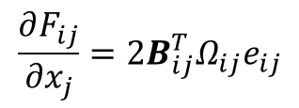
Take Fij as example
$$e_{ij}\left(x⊞Δx\right)≈e_{ij}\left(x\right)+A_{ij}{Δx}_{i}+B_{ij}{Δx}_{j}$$
Remove factor 2
$\frac{∂e_{ij}}{{∂x}_{i}}=A_{ij}$ , $\frac{∂e_{ij}}{{∂x}_{j}}=B_{ij}$,
$$\frac{∂F_{ij}}{{∂x}_{i}}={2A_{ij}^{T}Ω_{ij}e}_{ij}$$
$$\frac{∂^{2}F_{ij}}{{∂x}_{i}^{2}}={{2A}_{ij}^{T}Ω_{ij}A}_{ij}$$
$$\frac{∂^{2}F_{ij}}{{∂x}_{i}{∂x}_{j}}={{2A}_{ij}^{T}Ω_{ij}B}_{ij}$$
$F_{ij}=e_{ij}^{T}Ω_{ij}e_{ij}$
$$\frac{∂F_{ij}}{{∂x}_{j}}={2B_{ij}^{T}Ω_{ij}e}_{ij}$$
$$\frac{∂^{2}F_{ij}}{{∂x}_{j}{∂x}_{i}}={{2B}_{ij}^{T}Ω_{ij}B}_{ij}$$
$$\frac{∂^{2}F_{ij}}{{∂x}_{j}^{2}}={{2B}_{ij}^{T}Ω_{ij}B}_{ij}$$
Notes:
By taking out constant factor 2, we see that, Hij is exactly the second partial derivative of the error eij with respect to the variable xi and xj, so, the information matrix that is computed in g2o is exactly the hessian matrix of the cost function with respect to all the variables from x0 to xn.

Slide 5
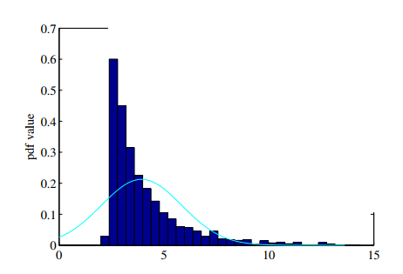
Graph SLAM non-Gaussian distribution
1. robust cost function
[R. Hartley and A. Zisserman 2004]
2. mixture gaussian model
[E. Olson and P. Agarwal 2012]
3. non-gaussian models
[David M. Rosen et al. 2013]
e

Slide 6





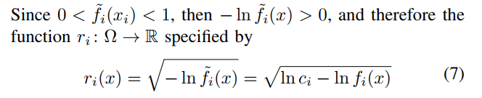
General Non-Gaussian Model
Rosen, David M., Michael Kaess, and John J. Leonard. "Robust incremental online inference over sparse factor graphs: Beyond the Gaussian case." 2013 ICRA.

Slide 7
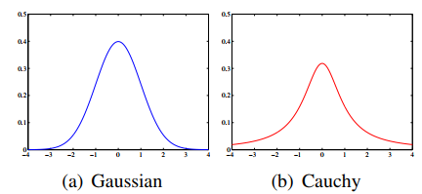
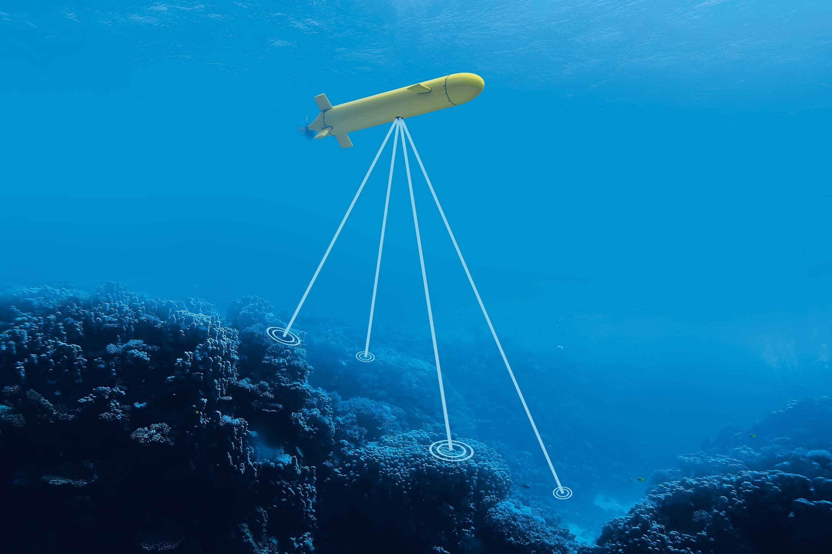
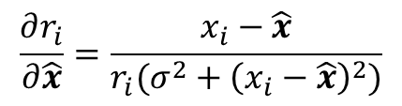
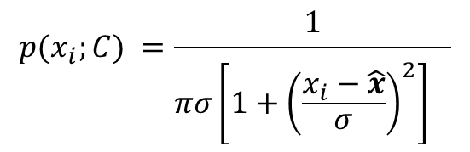
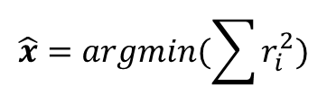

Case Study
$$X_{N}=\left(x_{1},x_{2},…,x_{N}\right), x_{i}=\hat{x}+e_{i}$$
$e_{i}\sim C(0,σ)$
$$p(x_{i};C) =\frac{1}{πσ{\left[1+{\left(\frac{x_{i}−\hat{x}}{σ}\right)}^{2}\right]}^{}}$$
$$r_{i}=\sqrt{−\ln\left(p\left(x_{i};C\right)\right)}=\sqrt{\ln\left(π\right)+\ln\left({σ^{2}+\left(x_{i}−\hat{x}\right)}^{2}\right)−ln⁡(σ)}$$
$$\hat{x}=argmin(\sum{r_{i}^{2}})$$
$$\frac{∂r_{i}}{∂\hat{x}}=\frac{x_{i}−\hat{x}}{r_{i}({σ^{2}+\left(x_{i}−\hat{x}\right)}^{2})}$$
Notes:
The underwater environment is extremely acoustically noisy; so much so, in fact, that it has been hypothesized that time-of-flight measurement errors in long-baseline (LBL) underwater localization systems may follow a Cauchy distribution.
Suppose that this is so, and consider a perfectly stationary autonomous underwater vehicle (AUV) attempting to measure the acoustic time-of-flight to a particular sonar beacon through repeated measurement.
Mathematically, this corresponds to the simplest possible inference problem: estimating the value of an unknown parameter a given a sequence YN = (y1; : : : ; yN ) of measurements corrupted by additive i.i.d. noise. We suppose that this noise is generated by a Cauchy distribution

Slide 8
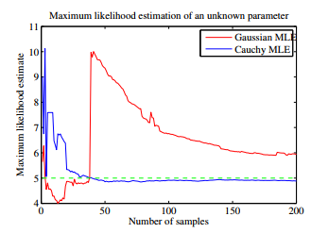
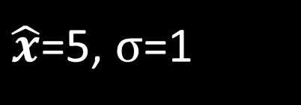
Case Study
$\hat{x}$=5, $σ$=1
Rosen, David M., Michael Kaess, and John J. Leonard. "Robust incremental online inference over sparse factor graphs: Beyond the Gaussian case." 2013 ICRA.

Slide 9
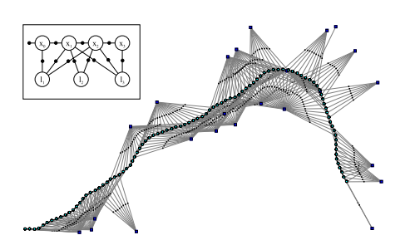
GTSAM & ISAM Introduction
He Zhang (David)
Notes:
A general framework for graph optimization

Slide 10
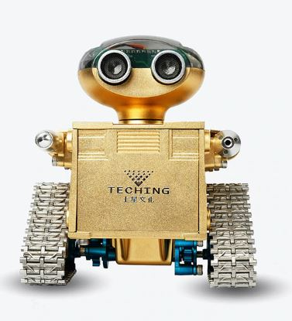
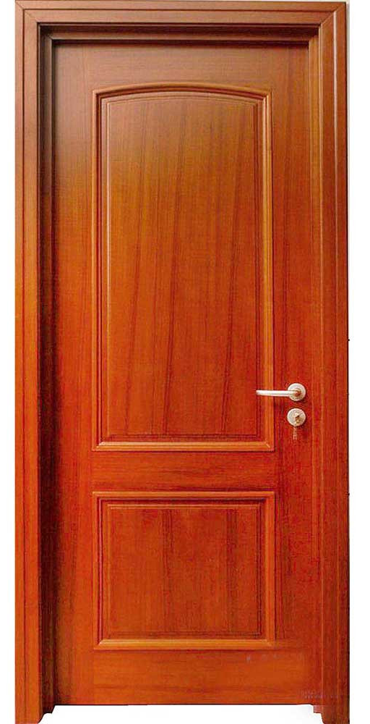
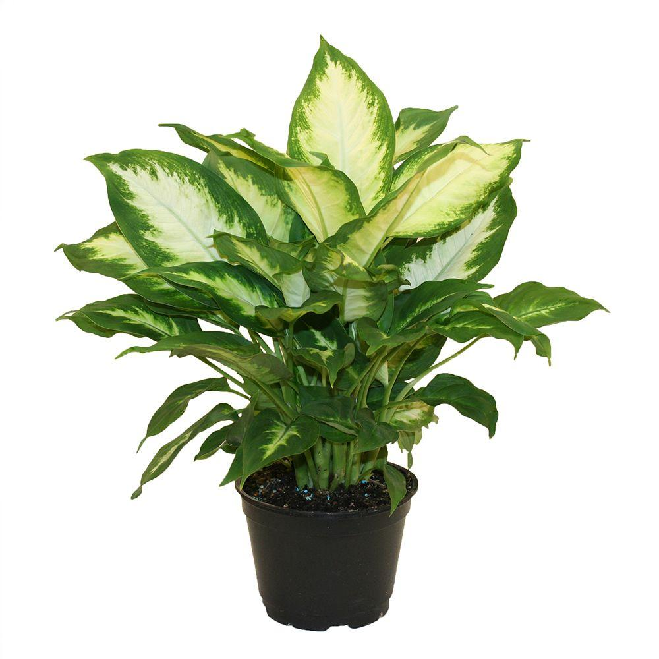


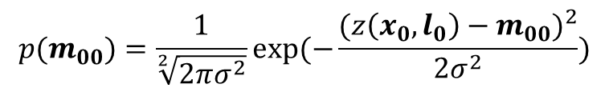


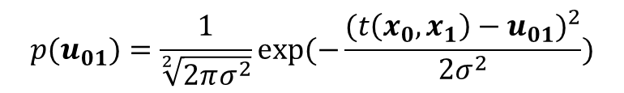

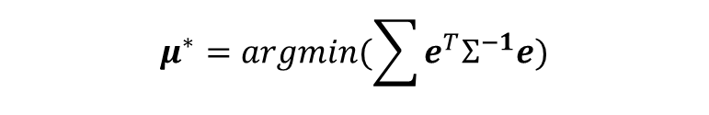




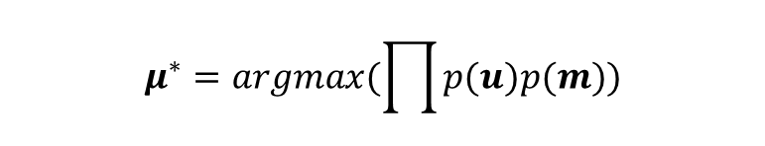



Graph SLAM in Math
$$x_{0}$$
$$x_{1}$$
$$x_{2}$$
$$u_{01}$$
$$u_{12}$$
$$m_{11}$$
$$p(u_{01})=\frac{1}{\sqrt[2]{2πσ^{2}}}exp⁡(−\frac{{(t\left(x_{0},x_{1}\right)−u_{01})}^{2}}{2σ^{2}})$$
$$m_{21}$$
$$m_{00}$$
$$m_{10}$$
$$p(m_{00})=\frac{1}{\sqrt[2]{2πσ^{2}}}exp⁡(−\frac{{(z\left(x_{0},l_{0}\right)−m_{00})}^{2}}{2σ^{2}})$$
$$l_{0}$$
$$l_{1}$$
$$μ^{∗}=argmax(\prod{p(u)p(m)})$$
Iteratively Solve Linearized System
$$μ^{∗}=argmin(\sum{e^{T}Σ^{−1}e})$$
$$μ^{∗}=argmin({||Aμ−b||}^{2})$$
Where $e\left(u_{01}\right)=t\left(x_{0},x_{1}\right)−$ $u_{01}$, $e\left(m_{00}\right)=z\left(x_{0},l_{0}\right)−m_{00}$

Slide 11
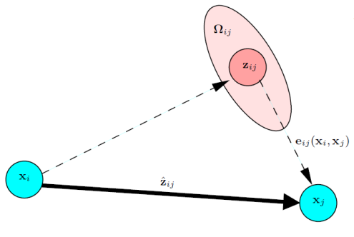











G2O Model
$$x_{0}$$
$$x_{1}$$
$$x_{2}$$
$$e_{01}$$
$$e_{12}$$
$$e_{14}$$
$$e_{24}$$
$$e_{03}$$
$$e_{13}$$
$$x_{3}$$
$$x_{4}$$
$$e_{ij}\left(x\right)={\hat{z}}_{ij}−z_{ij}$$
$${\hat{z}}_{ij}=z(x_{i},x_{j})$$
Notes:
In G2O, all the variables are generally treated as nodes, representing the parameters to be estimated. They are denoted as x. An edge is represented by the residual error of its constraint, which is denoted by e. Each constraint is modeled like this figure. The zij and Omega represent the mean and information matrix of a constraint relating to the parameters xi and xj. Z hat ij, represents the estimator for the mean value of this measurement constraint. This constraint could be a odometry measurement, or a landmark measurement.
The difference between the estimator z hat ij and the true mean value is called the residual error.

Slide 12








GTSAM: factor graph
Odometry measurement
Loop Closure measurement
$$c_{0}$$
$$p$$
$$x_{0}$$
$$x_{1}$$
$$x_{2}$$
$$u_{0}$$
$$u_{1}$$
$$m_{2}$$
$$m_{3}$$
$$m_{0}$$
$$m_{1}$$
Landmark measurement
$$x_{3}$$
$$x_{4}$$
Bipartite graph with variable nodes and factor nodes
Notes:
This is a factor graph representation of the estimation problem. The factor graph is a bipartite graph contains variable nodes and factor nodes.
The variable nodes are the robot poses and landmark positions in this case, the factor nodes are usually derived from measurements, so the odometry and landmark measurements and prior measurement that may come from gps, or just fixing the graph to an arbitrary origin. There might be additional measurement like loop closure constraint that derived by aligning data of the same place at two different times. For example, laser data, and you coming to the same place taking a scan, you align it to get a relative transformation. This will a loop closure constraint.

Slide 13
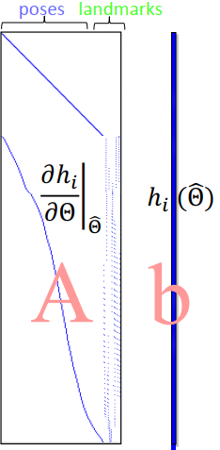
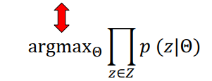


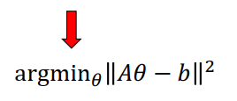








Nonlinear Least-Squares
$$c_{0}$$
$$p$$
$$x_{0}$$
$$u_{0}$$
$$x_{1}$$
$$u_{1}$$
$$x_{2}$$
$$m_{2}$$
$$m_{3}$$
$$m_{0}$$
$$m_{1}$$
$$x_{3}$$
$$x_{4}$$
Notes:
The graph itself is factorization of a probability distribution. So factor graph factorize the probability density where each of this terms correspond to one of the factors one of constraint.
By assuming gaussian noise, this maximize likelihood problem can be converted to a least square problem. Minimize the sum of the squared cost functions. This is typically be done in a gauss newton or Levenberg Marquardt framework by iteratively solving the linearized version of the systems. Each time update the estimate until converging, so this linear system contains matrix A, that so called measurement jacobian, these are linearized measurements, so each row contains a measurement of the columns of the variables. The top hill are the odometry measurement, diagonal. The bottom contains the landmark measurements, so each row contains one pose and one landmark.
The right is the vector b, that is the residuals of the system.
How to solve this problem efficiently?

Slide 14

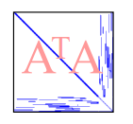
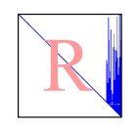
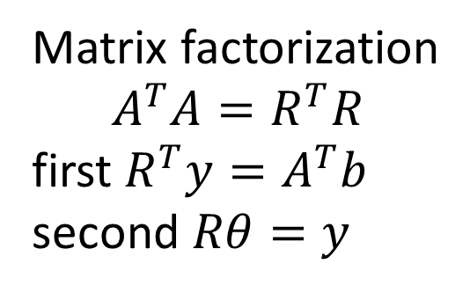
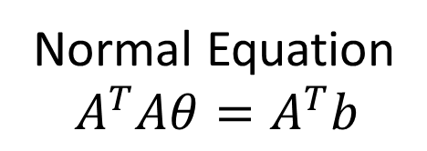
Solving the Linear Least Squares System
Normal Equation
$$A^{T}Aθ=A^{T}b$$
Cholesky decomposition
Information Matrix
Matrix factorization
$$A^{T}A=R^{T}R$$
first $R^{T}y=A^{T}b$
second $Rθ=y$
Square root Information Matrix
Measurement Jacobian
Notes:
To solve this squared function, the simple way is to take derivative, and set the derivative to zero. You get the normal equation, that is . The AtA squared of the jacoabians.
How to solve this normal equation.
One way is to invert the information m, bad, the inversion is a dense matrix, and this matrix is usually very large. Hundreds or thousands items. You have a dense matrix here, you cannot do any thing efficient.
Instead, isam take the sparsity of this matrix. For example, Cholesky factorization end up a upper triangular matrix R, that AtA = RtR. This is so called square root information matrix. You can simply do forward and backward substitution to recover this solution. If the matrix R is sparse, this can be done very efficiently.

Slide 15
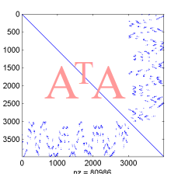
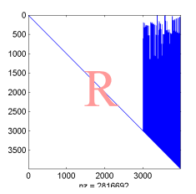
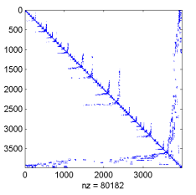
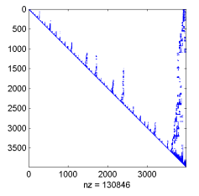
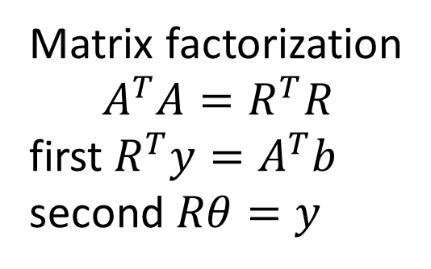
Retaining Sparsity: Variable Ordering
factor
Default Ordering
Matrix factorization
$$A^{T}A=R^{T}R$$
first $R^{T}y=A^{T}b$
second $Rθ=y$
permute
factor
Ordering based on
COLAMD heuristic
Notes:
Unfortunately, if you directly decompose AtA, it end up with a dese matrix R,
As well known in linear algebra,
You can permute the rows and columns of the original matrix, and end up with an equivalent matrix denotes the same system. But when you factorize this one, you will end up with a sparse squared root information matrix
Question is, how do you find such an ordering？
According to COLAMD heuristic, an approximate best ordering can be retrieved. This strategy has been used in matlab, so if in matlab you type A\b and A is a sparse matrix, it will exactly does the same as we have discussed here.

Slide 16
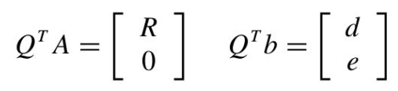
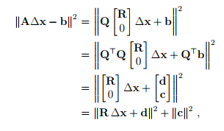
Solving the Linear Least Squares System
QR decomposition
QR
Givens
rotations
Measurement Jacobian
Notes:
Another solution to this linear Least squares problem is based on QR decomposition. You can decompose the measurement jacobian matrix A by a orthogonal matrix Q times a upper triangle matrix R. As denoted in this equation. Then the LSQ problem can be written in this form by using Q and R to represent A. Then times Q transpose to this equation, since Q is orthogonal matrix, times Q does not change the norm value.
QtQ equals to identity matrix, Qtb can be written as [d c]. By removing the bottom part, ends up with these two parts. The second item c square is const, so, the solution is to minimize the first item. And it can be simply computed by solving R dx = -d.
Again if R is sparse, then it can be solved very efficiently.

Slide 17
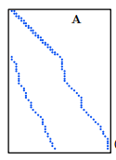
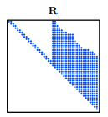
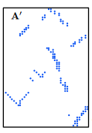
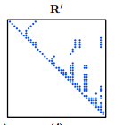
Retaining Sparsity: Variable Ordering
QR
Default Ordering
permute
QR
Ordering based on
COLAMD heuristic
Notes:
Similarly, direct run QR decomposition will end up with a dense and usually large size matrix. Instead, applying the reordering algorithm based on COLAMD heuristic, we can get a permuted matrix A’ that represents the same system with A. Then running the QR decomposition again we will end up a sparse matrix R’. With this sparse one, the solution can be solved very efficiently.

Slide 18



Links between methods
Information Matrix H
Measurement Jacobian A
Squared Root Information Matrix R
Notes:
It is interesting to see that the Cholesky method and the QR method are not that far apart. Indeed, if we consider a symmetric, positive-definite matrix H = A>A, with A rectangular, then the QR decomposition of A is. Whereas the Cholesky decomposition of H is, the two factorization share the same matrix R, as is shown in this equation.

Slide 19
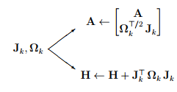


Links between methods
GTSAM
G2O
Notes:
The cost for both methods is similar, for Cholesky is lighter but demands the construction of H = A>A. The following graph illustrates the paths for both methods, starting at the time where a factor wants to be incorporated to the problem.

Slide 20
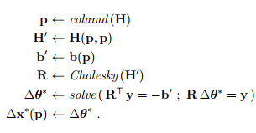

Algorithms
QR decomposition
Cholesky decomposition
GTSAM
G2O

Slide 21

Case Study

Slide 22

Case Study

Slide 23

Case Study

Slide 24

Case Study

Slide 25


Notes:
SLAM with 20 poses and 20 landmarks solved by QR factorization. a) weighted Jacobian matrix A. b) factor R. c) reordered A. d) factor R after reordering. For each case, we indicate the number of non-zero block-entries (one for each Jacobian block Jki).
Figure 5.5: SLAM with 20 poses and 20 landmarks solved by Cholesky factorization. a) Hessian matrix H. b) factor R. c) reordered H. d) factor R after reordering. Observe that the original R is the same as for the QR case, but that the effect of reordering has achieved a much sparser R than in the QR case. However, R is used here to solve two problems (line 22 of Algorithm 4), which counteracts this advantage.

Slide 26



iSAM [Kaess et al., TRO 08]
Growing system
Batch solution becomes expensive
Incremental system
Given R from previous step, how to add new measurements ?
Key idea:
Append to existing matrix R
Using Givens rotations
Notes:
But SLAM problem involves a growing system, as the robot traverses round the environment, more robot poses and landmark observations result in a large-scale jacobian matrix. To solve the linearized system, we have to repeatedly decompose this matrix, which will become more expensive as the system grows with time.
A better way is incremental

Slide 27
Materials
https://github.com/rising-turtle/slam_course
GTSAM 2006 & ISAM 2008 & ISAM2 2011
gtsam manual: Factor Graphs and GTSAM: A Hands-on Introduction
gtsam tutorial & icra16_slam_tutorial_kaess
Rosen, David M., Michael Kaess, and John J. Leonard. "Robust incremental online inference over sparse factor graphs: Beyond the Gaussian case." 2013 ICRA

Slide 28

Case Study
https://borg.cc.gatech.edu/download.html

Slide 29


Slide 30


