Slide 1
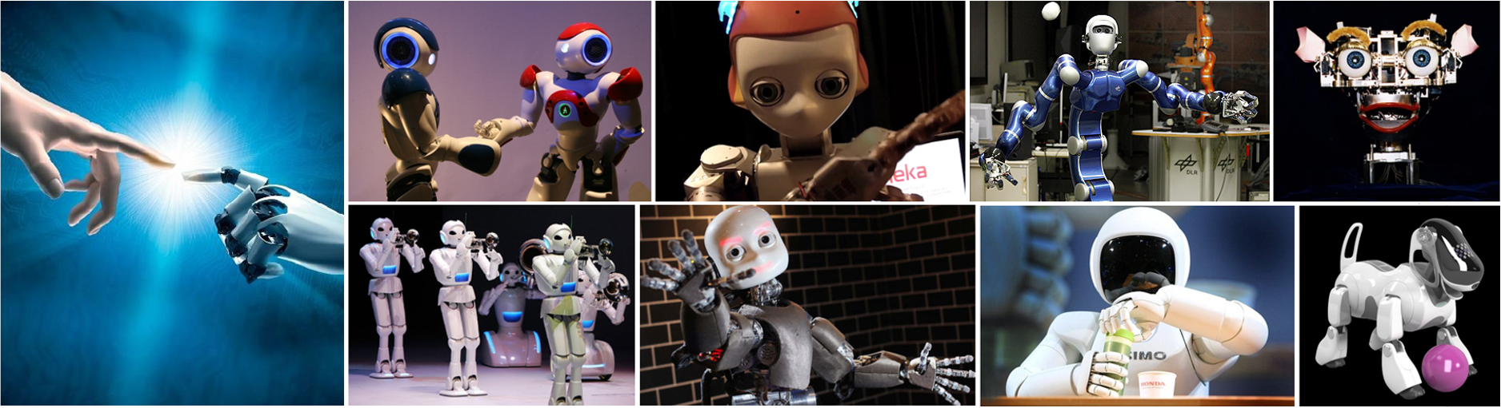
CMSC 591
Robotic Vision
Notes:
1

Slide 2
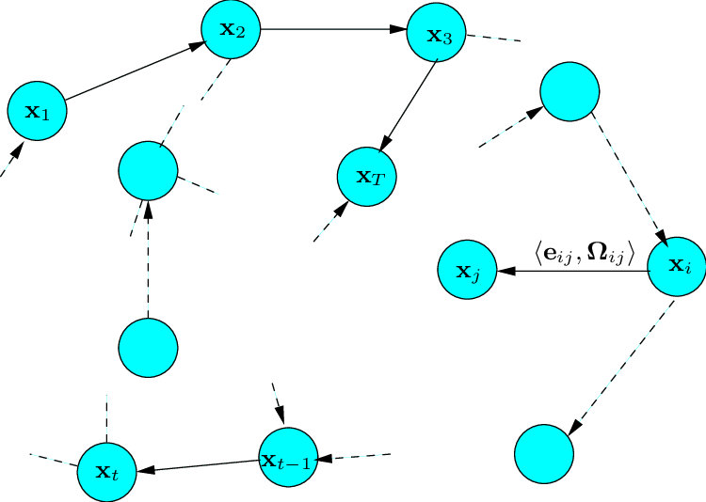
Graph SLAM Introduction
He Zhang (David)
Notes:
Today I will give a lecture about graph slam,

Slide 3
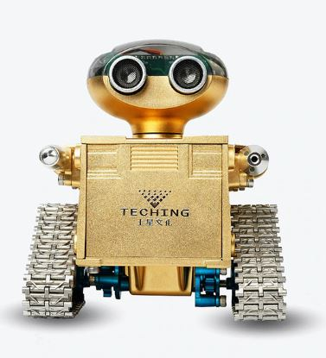
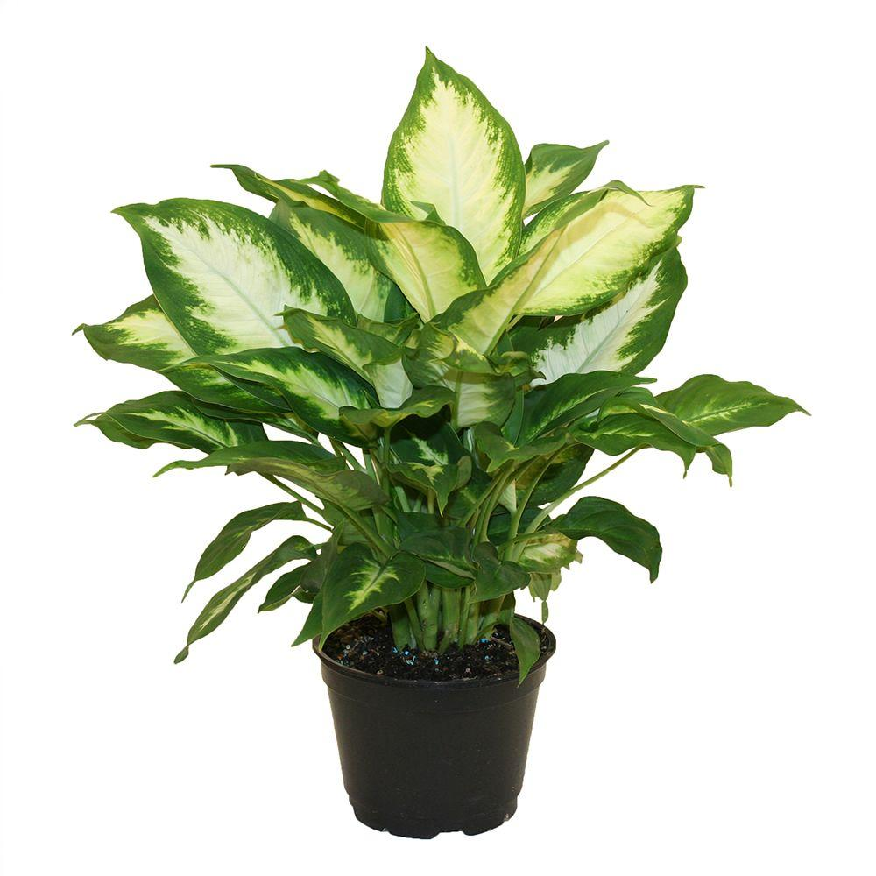
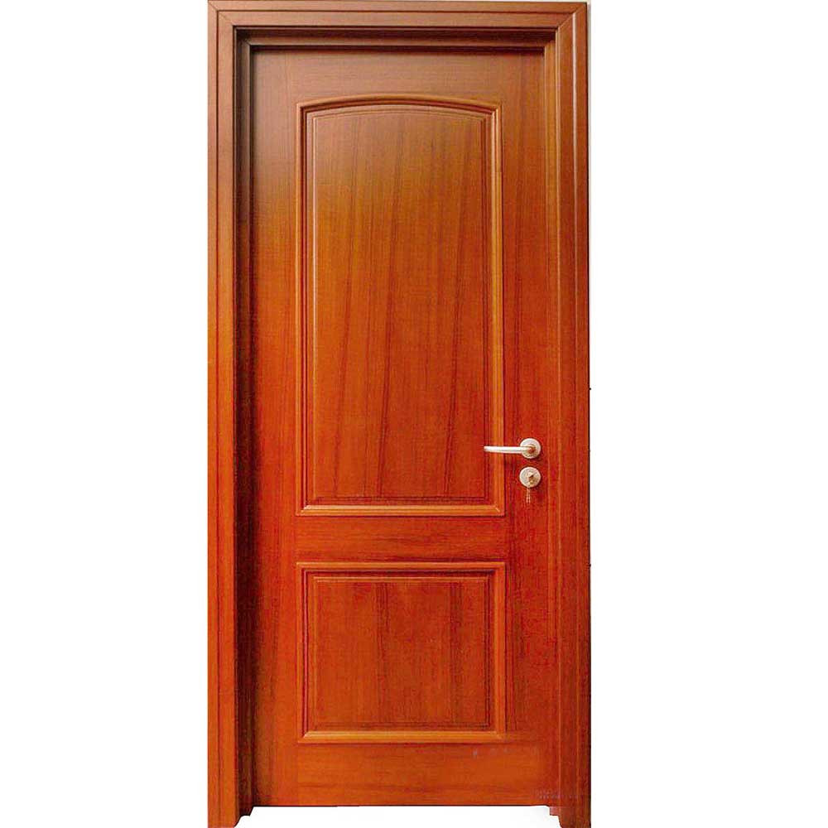
SLAM Problem
Odometry measurement
Landmark measurement
Notes:
The robot take a measurement from the environment, it is a landmark measurement that it observes a door. More specific, it could include many visual features like corner points or SIFT points. Here we just use this object for demonstration. As it moves to next position, it sees previous landmark and a new landmark plant. Then it moves again, and observes the plant. And the odometry measurement and the landmark measurement are not perfect and they have noise. As the robot moves along its trajectory, its pose estimation error accumulates. When it sees a previous landmark, this error can be reduced.

Slide 4
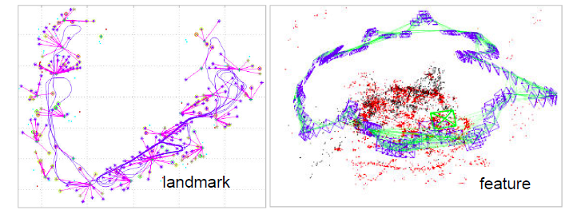











Graph SLAM Problem
$$x_{0}$$
$$x_{1}$$
$$x_{2}$$
$$u_{01}$$
$$u_{12}$$
$$m_{11}$$
$$m_{21}$$
$$m_{00}$$
$$m_{10}$$
$$l_{0}$$
$$l_{1}$$
Notes:
This figure shows a simple example, which gives us a glimpse of the graph structure. The nodes in the graph stand for robot poses and landmark positions. And the edges connecting the nodes are the constraints, either odometry constraint or landmark constraint.
in reality, the process will involve hundreds and thousands of robot poses and landmarks, and also it includes many loops
The structure of the graph will be very complex, then how to solve this problem?

Slide 5

















How to solve this problem?
Recall EKF
$$x_{0}$$
$$x_{1}$$
$$x_{2}$$
$$x_{N}$$
$$cost$$
$$u_{01}$$
$$u_{12}$$
…
$$m_{11}$$
$$m_{21}$$
$$m_{00}$$
$$m_{10}$$
$$m_{N1}$$
$$l_{0}$$
$$l_{1}$$
$$w_{0}$$
$$w_{t}$$
$$W$$
Notes:
The robot starts at X0, the odometry measurement U01 is treated as an action that moves the robot to X1=X0 + u01 with some uncertainty. This step is called prediction. At X1, the difference between the actual and predicted landmark measurements, denoted m10, is called innovation. Based on the innovation, the robot corrects its state prediction X1 and state covariance matrix. This step is called update. The predict-update loop repeats as the robots moves.
EKF SLAM only estimates the current pose. All previous poses are done. The advantage is high efficiency, since it has few variables to estimate. The disadvantage is low accuracy, since EKF linearize the process/observation models by the first order Taylor series, resulting in linearization error. Non-Gaussianity may further worsen the case. These errors can drive the EKF into inconsistance and make it diverge.
One case is shown in the right figure, for
can not re-linearize jacobians. As shown in this figure, the initial estimate for a variable x is w0, while its true value is wt. The linear approximation of its jacobian is shown as the slope of this red dash line. This jacobian is quite different from its true model at wt. In this case EKF will produce large error and the filter may diverge quickly.

Slide 6
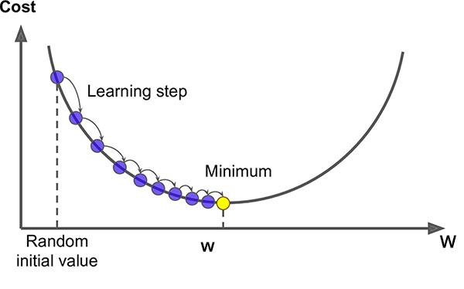



















How to solve the problem?
$$x_{0}$$
$$x_{1}$$
$$x_{2}$$
$$x_{N}$$
$$u_{01}$$
$$u_{12}$$
…
$$m_{11}$$
$$m_{21}$$
Graph SLAM
Estimate all the robot poses, plus landmarks
Iteratively update robot poses and re-linearize
$$m_{00}$$
$$m_{10}$$
$$m_{N1}$$
$$l_{0}$$
$$l_{1}$$
$$cost$$
$$w_{0}$$
$$w_{t}$$
$$w_{0}$$
$$w_{t}$$
$$W$$
Notes:
In contrast, Graph SLAM not only estimate the current robot pose, but also re-estimate the previous robot poses in each iteration. This process will iteratively update robot poses, and re-linearize the error function and re-compute jacobians at new state. Therefore, it can achieve higher accuracy. As shown in the left figure, the estimation iteratively approaches to wt, where its jacobian is zero, meaning the optimal solution is found.

Slide 7


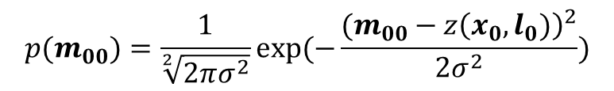


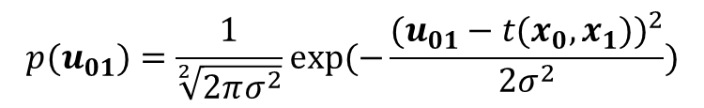






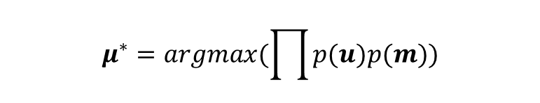



Graph SLAM in Math
$$x_{0}$$
$$x_{1}$$
$$x_{2}$$
$$u_{01}$$
$$u_{12}$$
$$m_{11}$$
$$p(u_{01})=\frac{1}{\sqrt[2]{2πσ^{2}}}exp⁡(−\frac{{(u_{01}−t(x_{0},x_{1}))}^{2}}{2σ^{2}})$$
$$m_{21}$$
$$m_{00}$$
$$m_{10}$$
$$p(m_{00})=\frac{1}{\sqrt[2]{2πσ^{2}}}exp⁡(−\frac{{(m_{00}−z\left(x_{0},l_{0})\right)}^{2}}{2σ^{2}})$$
$$l_{0}$$
$$l_{1}$$
$$μ^{∗}=argmax(\prod{p(u)p(m)})$$
Iteratively Solve Linearized System
$$μ^{∗}=argmin(\sum{e^{T}Σ^{−1}e})$$
$$μ^{∗}=argmin({||Aμ−b||}^{2})$$
Where $e\left(u_{01}\right)=u_{01}−t(x_{0},x_{1})$, $e\left(m_{00}\right)=m_{00}−z\left(x_{0},l_{0}\right)$
Notes:
What is a graph model? Let’s reuse previous example. Assume a robot moves from x0 to x2, and perceives two landmarks. Its graph structure is shown here. The red nodes stand for robot poses and the green for landmarks. The lines between them represent constraints: odometry constraints and landmark constraints. Each constraint represent a probability model. For example, assuming gaussian noise, p(u01) , now we want to estimate the value for variables x0 x1 x2 l0 and l1 that maximize the likelihood of the joint probability of this graph structure. By using log operation and remove the constant items, this maximize likelihood problem is converted into a nonlinear least square problem. The vector e incorporates residual error of each constraint, where sigma contains the corresponding measurement variance. Then it can be solved using an iterative nonlinear optimization method like gauss newton, gradient descendent or Levenberg–Marquardt algorithm. The linearized version can be represented by a matrix A and a vector b. A is called measurement jacobian and b include entries of the residual for each constraint. Later we will explain how they are constructed.

Slide 8
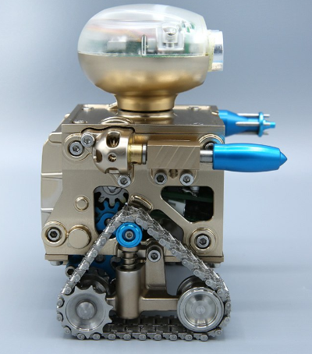














Example: A linear case
$$x_{0}$$
$$x_{1}$$
$$x_{2}$$
$$l_{0}$$
$$x_{0}$$
$$x_{1}$$
$$x_{2}$$
$$u_{00}$$
$$u_{01}$$
$$u_{12}$$
Initial Constraint
Odometry Constraint
Landmark Constraint
$$m_{10}$$
$$m_{00}$$
$$m_{20}$$
$$l_{0}$$
Quiz: how many constraints in this graph?
6
Notes:
Graph SLAM will collect all these constraints, and use them to find out the most likelihood estimations for the robot poses and landmark positions that fulfill these constraints. Just imagine the constraint as a rubber band, the optimization process is to stretch or shrink these rubber bands, to find the best solution.

Slide 9







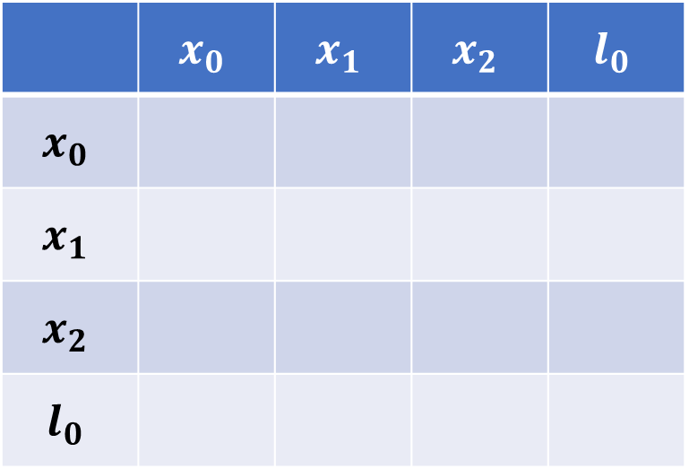





Example
$$x_{0}$$
$$x_{1}$$
$$x_{2}$$
$$u_{00}$$
$$u_{01}$$
$$u_{12}$$
Diagonal positive
Additive
$$m_{10}$$
$$m_{00}$$
$$m_{20}$$
Matrix A
Vector b
 | $$x_{0}$$ | $$x_{1}$$ | $$x_{2}$$ | $$l_{0}$$
$$x_{0}$$
$$x_{1}$$
$$x_{2}$$
$$l_{0}$$
$$l_{0}$$
1
-10
$$u_{01}=x_{1}−x_{0}=10$$
-1
$$u_{12}=x_{2}−x_{1}=−3$$
-1
1
10
Notes:
To solve this problem, what we do here is to build a matrix and a vector that come from these constraints. We build a quadratic matrix, the row and column stand for the poses and landmarks. And every time we make an observation, say a odometry u01, this will affect locally four elements in the matrix. Here the robot moves from x0 to x1, given u01,
Means x1 = x0 + 10, it has two ways to the matrix. First, x0 – x1 = -10, second, we let x1 be positive, in the second row, we have –x0 + x1 equal to 10. One rule here is that keep the diagonal entries positive and another is that the constraints are locally addictive to the corresponding entries. OK, based on these two rules, if the robot moves from x1 to x2 given u12, may I ask you what are the values in the matrix will be like? Let me give you a hint, the constraint u12 only affects the entries in these red boxes.

Slide 10

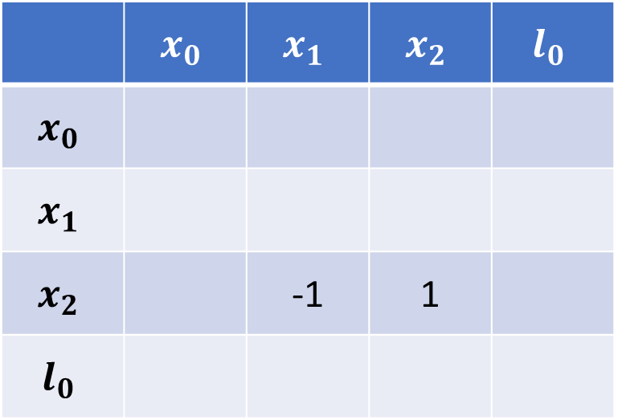
Example
$$x_{0}$$
$$x_{1}$$
$$x_{2}$$
$$u_{00}$$
$$u_{01}$$
$$u_{12}$$
$$m_{10}$$
$$m_{00}$$
$$m_{20}$$
Matrix A
Vector b
 | $$x_{0}$$ | $$x_{1}$$ | $$x_{2}$$ | $$l_{0}$$
$$x_{0}$$
$$x_{1}$$
$$x_{2}$$ |  | -1 | 1
$$l_{0}$$
-3
$$l_{0}$$
1
-10
$$u_{01}=x_{1}−x_{0}=10$$
-1
$$u_{12}=x_{2}−x_{1}=−3$$
-1
2
-1
13
$${{−x}_{0}+x}_{1}+x_{1}−x_{2} =10+3=13$$
$$m_{00}={x_{0}−l}_{0}=−15$$
Notes:
The second row will become, -x0 + 2 x1 – x2 = 13, where does it come from? It is derived by summing u01 and u12 together with x1 is positive. Exactly like this equation, x1 – x2 + x1 – x0 = 3 + 10 = 13
The third row will become –x1 + x2 = -3 which is exact the same with u12.
Then what will happen by adding landmark constraint m00? The affected entries are contained in the green boxes?

Slide 11

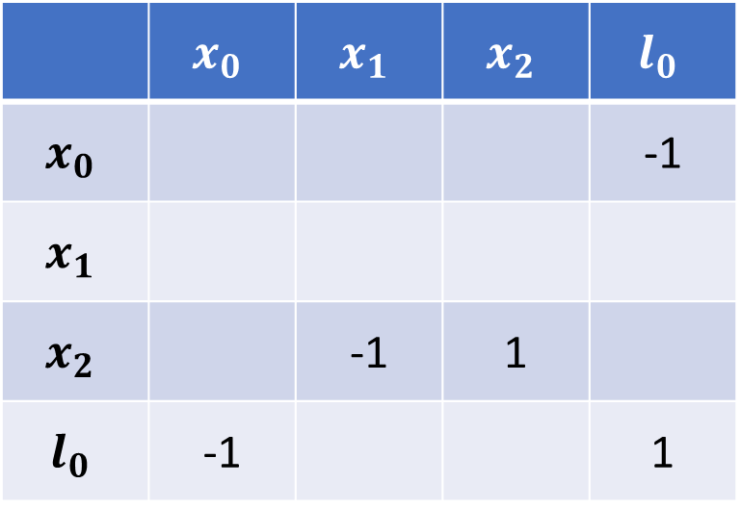
Example
$$x_{0}$$
$$x_{1}$$
$$x_{2}$$
$$u_{00}$$
$$u_{01}$$
$$u_{12}$$
$$m_{10}$$
$$m_{00}$$
$$m_{20}$$
Matrix A
Vector b
 | $$x_{0}$$ | $$x_{1}$$ | $$x_{2}$$ | $$l_{0}$$
$$x_{0}$$ |  |  |  | -1
$$x_{1}$$
$$x_{2}$$ |  | -1 | 1
$$l_{0}$$ | -1 |  |  | 1
-3
15
$$l_{0}$$
2
-25
$$u_{01}=x_{1}−x_{0}=10$$
-1
$$u_{12}=x_{2}−x_{1}=−3$$
-1
2
-1
13
$$m_{00}={x_{0}−l}_{0}=−15$$
$${x_{0}−x}_{1}+x_{0}−l_{0} =−10−15=−25$$
Notes:
The first row will become 2x0 – x1 – l0 = -25, the fourth row will become –x0 + l0 = 15, pretty easy, right?

Slide 12
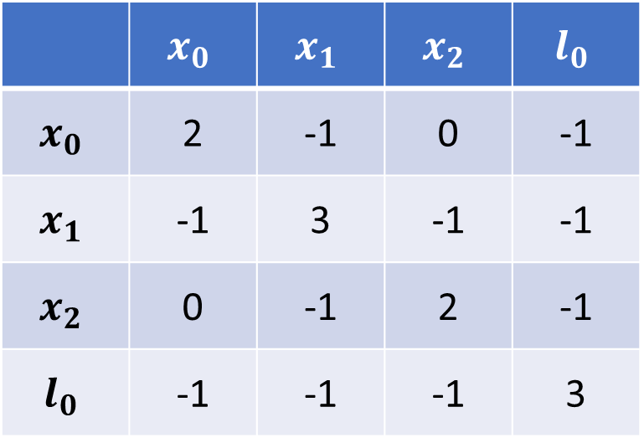




Example
$$x_{0}$$
$$x_{1}$$
$$x_{2}$$
$$u_{00}$$
$$u_{01}$$
$$u_{12}$$
$$m_{10}$$
$$m_{00}$$
$$m_{20}$$
Matrix A
Vector b
 | $$x_{0}$$ | $$x_{1}$$ | $$x_{2}$$ | $$l_{0}$$
$$x_{0}$$ | 2 | -1 | 0 | -1
$$x_{1}$$ | -1 | 3 | -1 | -1
$$x_{2}$$ | 0 | -1 | 2 | -1
$$l_{0}$$ | -1 | -1 | -1 | 3
-25
8
-11
28
$$l_{0}$$
$$u_{01}=x_{1}−x_{0}=10$$
$$u_{12}=x_{2}−x_{1}=−3$$
$$m_{00}={x_{0}−l}_{0}=−15$$
$$m_{10}={x_{1}−l}_{0}=−5$$
$m_{20}={x_{2}−l}_{0}=−8$
$$μ=A^{−1}∗b$$
Did we miss something?
$$u_{00}=x_{0}=−2$$
Notes:
Similarly, when we add all these constraints, the matrix A and vector b. Remember matrix A corresponds to measurement jacobian and b include residuals for each constraint. Then the magic part for graph slam is that the direct solution is inverse A times vector b, mu contains the robot poses x and landmark positions.
Therefore the major step for graph slam is that you keep adding the constraints into the jacobian matrix and the residual vector. When you done with that, you just need a very simple operation, then outcomes the best estimation for the robot poses and landmark positions.

Slide 13
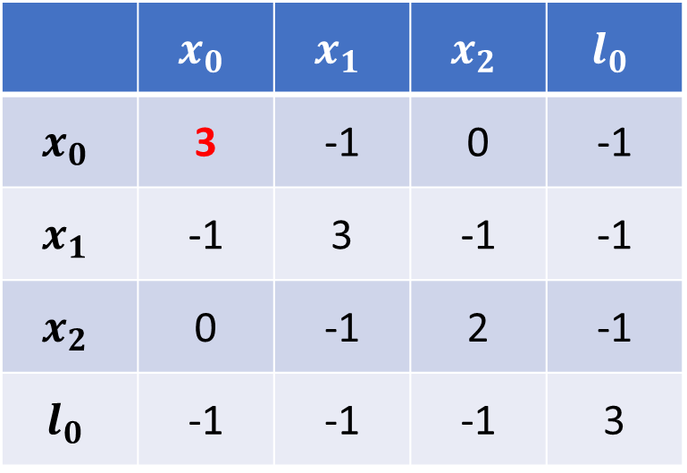

Example
$$x_{0}$$
$$x_{1}$$
$$x_{2}$$
$$u_{00}$$
$$u_{01}$$
$$u_{12}$$
$$m_{10}$$
$$m_{00}$$
$$m_{20}$$
Matrix A
Vector b
 | $$x_{0}$$ | $$x_{1}$$ | $$x_{2}$$ | $$l_{0}$$
$$x_{0}$$ | 3 | -1 | 0 | -1
$$x_{1}$$ | -1 | 3 | -1 | -1
$$x_{2}$$ | 0 | -1 | 2 | -1
$$l_{0}$$ | -1 | -1 | -1 | 3
-27
8
-11
28
$$l_{0}$$
$$u_{01}=x_{1}−x_{0}=10$$
$$u_{12}=x_{2}−x_{1}=−3$$
$$m_{00}={x_{0}−l}_{0}=−15$$
$$m_{10}={x_{1}−l}_{0}=−5$$
$m_{20}={x_{2}−l}_{0}=−8$
$$u_{00}=x_{0}=−2$$
$$μ=A^{−1}∗b$$
Notes:
Similarly, when we add all these constraints, the matrix A and vector b. Remember matrix A corresponds to measurement jacobian and b include residuals for each constraint. Then the magic part for graph slam is that the direct solution is inverse A times vector b, mu contains the robot poses x and landmark positions.
Therefore the major step for graph slam is that you keep adding the constraints into the jacobian matrix and the residual vector. When you done with that, you just need a very simple operation, then outcomes the best estimation for the robot poses and landmark positions.

Slide 14











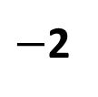









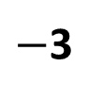





Example
$$x_{0}$$
$$x_{1}$$
$$x_{2}$$
$$x_{0}$$
$$x_{1}$$
$$x_{2}$$
$$u_{00}$$
$$u_{01}$$
$$u_{12}$$
$−$2
$$10$$
$−$3
$$m_{10}$$
5
$$m_{00}$$
$$m_{20}$$
15
8
$$l_{0}$$
$$l_{0}$$
$$x_{0}=−2$$
$$u_{01}=x_{1}−x_{0}=10$$
$$u_{12}=x_{2}−x_{1}=−3$$
$$x_{1}=8$$
$$m_{00}={x_{0}−l}_{0}=−15$$
$$μ=A^{−1}∗b$$
$$x_{2}=5$$
$$m_{10}={x_{1}−l}_{0}=−5$$
$m_{20}={x_{2}−l}_{0}=−8$
$$l_{0}=13$$
$$u_{00}=x_{0}=−2$$
Notes:
Now, constraints in the graph are valued as shown in the right, from which we can easily calculate the values of the poses and landmark positions. With x0 equal to 2, x1 8, x2 5, what is the value of l0. Now let’s verify whether the matrix solution can output the these values.

Slide 15







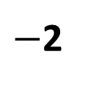

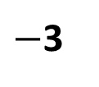



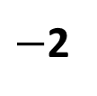


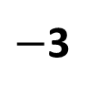






Example
$$μ=A^{−1}∗b$$
$$x_{0}$$
$$x_{1}$$
$$x_{2}$$
$$x_{0}$$
$$x_{1}$$
$$x_{2}$$
$−$2
$$10$$
$−$3
$−$2
$$10$$
$−$3
5
8
15
15
7
5
$$l_{0}$$
$$l_{0}$$
$$x_{0}=−2$$
$$x_{0}=?$$
$$x_{1}=?$$
$$x_{2}=?$$
$$l_{0}=?$$
$$x_{1}=8$$
A: x0 > -2
B: x0 = -2
C: x0 < -2
A: x1 > 8
B: x1 = 8
C: x1 < 8
A: x2 > 5
B: x2 = 5
C: x2 < 5
A: l0 > 13
B: l0 = 13
C: l0 < 13
$$x_{2}=5$$
$$l_{0}=13$$
B A A C
Notes:
Now let’s modify this graph a little bit, here the observation between x2 and l0 is not 8 but 7, then what’s the output of x2 and l0? I give you three options. X2 is larger than 5, while l0 is less than 13
Why ? Let’s recall the idea of rubber band. The rubber band between x2 and l0 is become shorter, which needs to pull these two nodes together so, the x2 is pulled towards right while l0 to the left. This picture does not explain it well since it is 2D picture, but in 1D it is exact what’s happening.
X0 is the only absolute constraint, all the other are relative constraints, no matter what these relative constraints change, they put no influence to the value of the x0. It is always -2.
X2 and l0 are pulled closer, while the rubber band between x0 and x1, x1 and x2 are stretch out.
How does this happen? This is where the magic of graph slam plays. There are loops in the graph structure which might not added up. Because of motion noise and measurement noise. What graph slam does, by computing A inverse times b, we find the best solution to the relaxation of those rubber bands.

Slide 16
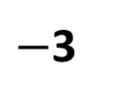






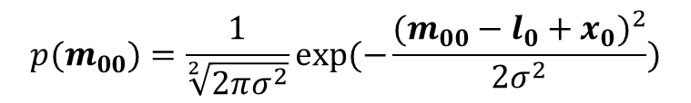

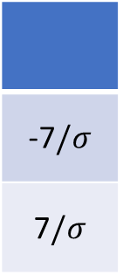
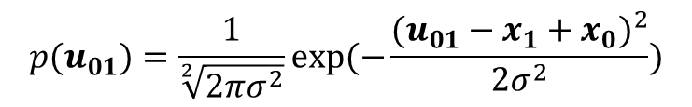

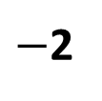
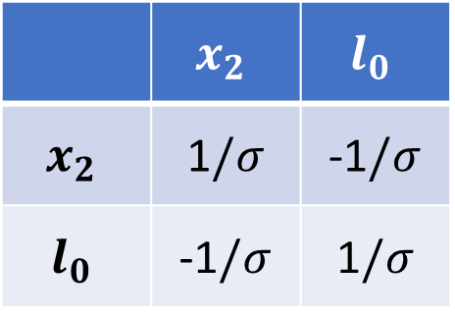
Example
$$p(u_{01})=\frac{1}{\sqrt[2]{2πσ^{2}}}exp⁡(−\frac{{(u_{01}−x_{1}+x_{0})}^{2}}{2σ^{2}})$$
$$p(m_{00})=\frac{1}{\sqrt[2]{2πσ^{2}}}exp⁡(−\frac{{(m_{00}−l_{0}+x_{0})}^{2}}{2σ^{2}})$$
$$x_{0}$$
$$x_{1}$$
$$x_{2}$$
$−$2
$$10$$
$−$3
$$μ^{∗}=argmax(\prod{p(u)p(m)})$$
$$μ^{∗}=argmin(\sum{e^{T}e})$$
15
7
5
$$e\left(m_{20}\right)=(m_{20}−l_{0}+x_{2})/σ$$
$$l_{0}$$
 | $$x_{2}$$ | $$l_{0}$$
$$x_{2}$$ | 1$/σ$ | -1$/σ$
$$l_{0}$$ | -1$/σ$ | 1$/σ$
-7$/σ$
7$/σ$
Notes:
Let’s recall a little bit math about how it works. Each constraint represent a gaussian distribution. To maximize the likelihood of the joint probability is equal to minimize the summation of the Mahalanobis distance. M-distance means we take the variance into consideration. Now let me give me a glimpse explanation about the role of variance. Take the measurement m02 as example, given its standard deviation, its value added to the matrix will be like this. Smaller sigma, larger weight or larger confident, or larger strength, power in the rubber band.
Let’s set the sigma for m02 as 0.1, which equally increases its weight by ten times. In this case, the constraint m02 will be over-proportional to the other constraints, let’s what will happen.

Slide 17


Linear Graph SLAM
Initial Position (absolute constraint)
Motion ( relative odometry constraint)
Measurement (relative landmark constraint)
$$A , b$$
$$μ=A^{−1}∗b$$
Trajectory + Map
Notes:
Now we have learned the linear graph slam. At start we have initial position, it is a absolute constraint. Then motion, relative odometry constraint, and measurement, relative landmark constraint. We add them into a matrix A and a vector b. But each time the value of the constraint is multiplied by a weight factor, its nothing else but 1/sigma, the uncertainty in motion or measurement. After we done with this adding, we simply compute the mu by inverse A times b. And then its done and outputs the best possible trajectory and along with the map of the landmark.
Now let’s dive into a real robot example.

Slide 18
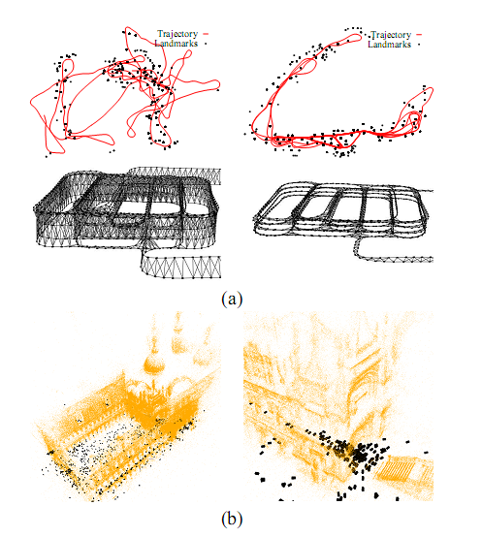
Graph SLAM Brief history
Why it becomes popular only recently ?
Linear Graph SLAM
Nonlinear Graph SLAM
G2O (a general framework for graph optimization )
ISAM (Incremental Smoothing and Mapping)
Lu, Feng, and Evangelos Milios. "Globally consistent range scan alignment for environment mapping." Autonomous robots4, no. 4 (1997): 333-349.
Notes:
Is Graph SLAM a new technique? No, actually, 1997, this is the first time in the robotics literature, the SLAM problem is formulated as a graph model. Since it was proposed about 20 years ago, why it is only become popular recently? A direct answer is efficiency. Direct solve the graph model involves to compute a inverse of a large matrix AtA. In the case of large-scale environment, direct computation of the inverse of the matrix AtA will be very time-consuming.
Recent advancement in sparse linear algebra greatly improves its efficiency. This enables graph slam undergone a renaissance and currently
belong to the state-of-the-art techniques with respect to speed and accuracy. In the next two classes, I will introduce a general framework for graph optimization, g2o, and isam, respectively.
Now let me give you a toy example to understand how the standard graph model works.

Slide 19
https://github.com/rising-turtle/slam_course
Question ?

