Slide 1
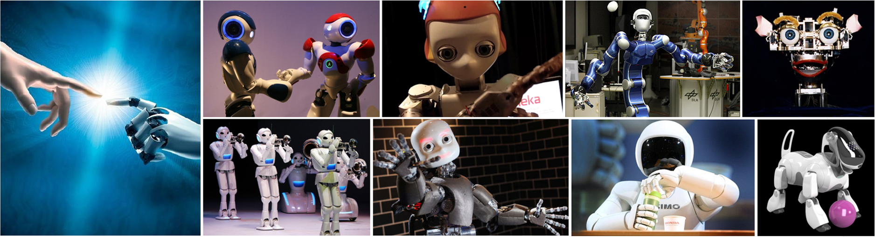
CMSC 591
Robotic Vision
Notes:
1

Slide 2
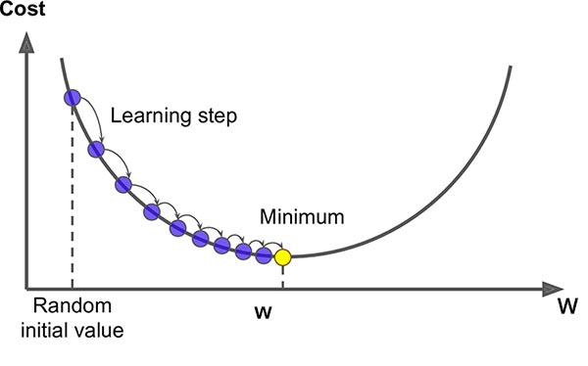












Graph SLAM
Differ from Kalman filter
Update all pose (current + previous)
Iterative optimization by relinearization (recomputing Jacobians)
MAP (maximum a posterior probability)
Linear SLAM
Non-Linear SLAM: G2O & GTSAM
$$\max{P\left(x_{0},x_{1},…x_{N−1},x_{N},l_{0},l_{1}…l_{M}\right|u_{01}u_{12}…u_{N−1N}m_{00}m_{11}…m_{N1})}$$
Nodes
Edges
$$u_{0}$$
$$x_{0}$$
$$x_{1}$$
$$x_{2}$$
$$u_{01}$$
$$u_{12}$$
$$m_{11}$$
$$m_{21}$$
$$m_{00}$$
$$m_{10}$$
$$l_{0}$$
$$l_{1}$$

Slide 3
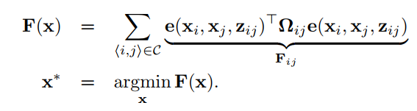











G2O
$$\max{P\left(x_{0},x_{1},…x_{N−1},x_{N},l_{0},l_{1}…l_{M}\right|u_{01}u_{12}…u_{N−1N}m_{00}m_{11}…m_{N1})}$$
Gauss Newton (GN)
Locally quadratic fitting
Levenberg Marquardt (LM)
Damping parameter
Dogleg
Trust region
$$x_{0}$$
$$x_{1}$$
$$x_{2}$$
$$u_{0}$$
$$x_{0}$$
$$x_{1}$$
$$x_{2}$$
$$e_{01}$$
$$e_{12}$$
$$u_{01}$$
$$u_{12}$$
$$m_{11}$$
$$e_{14}$$
$$e_{24}$$
$$m_{21}$$
$$e_{03}$$
$$e_{13}$$
$$m_{00}$$
$$m_{10}$$
$$l_{0}$$
$$l_{1}$$
$$x_{3}$$
$$x_{4}$$

Slide 4
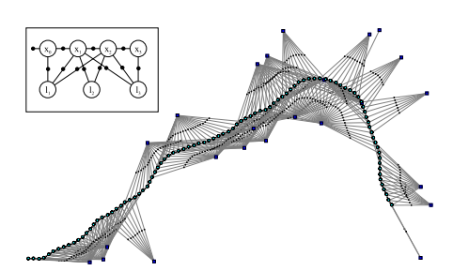
GTSAM & ISAM Introduction
He Zhang (David)
Notes:
A general framework for graph optimization,

Slide 5
Outline
Theory
SLAM as a Factor Graph
SLAM as a Non-linear Least Squares
iSAM
Applications
Visual-Inertial Odometry
Structure from Motion (SfM) - Mapping
Multi-Robot SLAM
Multi-View Stereo and Optical Flow
Motion Planning
Programming
C++ example
GTSAM in Matlab

Slide 6
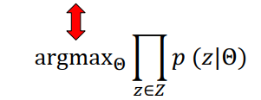


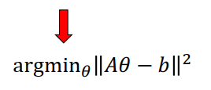









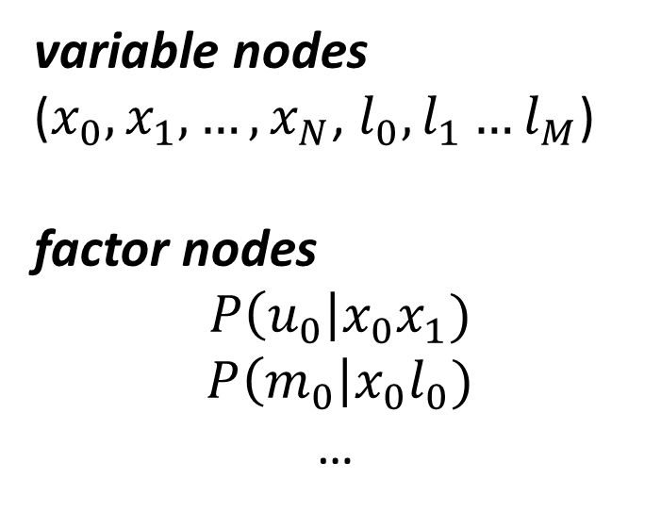
GTSAM
$$\max{P\left(x_{0},x_{1},…x_{N−1},x_{N},l_{0},l_{1}…l_{M}\right|u_{01}u_{12}…u_{N−1N}m_{00}m_{11}…m_{N1})}$$
Odometry measurement
variable nodes
($x_{0},x_{1},…,x_{N}$, $l_{0},l_{1}…l_{M}$)
factor nodes
$$P\left(u_{0}\right|x_{0}x_{1})$$
$$P\left(m_{0}\right|x_{0}l_{0})$$
…
$$p$$
$$x_{0}$$
$$x_{1}$$
$$x_{2}$$
$$u_{0}$$
$$u_{1}$$
$$m_{0}$$
$$m_{2}$$
$$m_{3}$$
$$m_{1}$$
Landmark measurement
$$l_{0}$$
$$l_{1}$$
$$u_{0}$$
$$x_{0}$$
$$x_{1}$$
$$x_{2}$$
$$u_{01}$$
$$u_{12}$$
Taylor Expansion
$$m_{11}$$
$$m_{21}$$
$$m_{00}$$
$$m_{10}$$
$$l_{0}$$
$$l_{1}$$

Slide 7
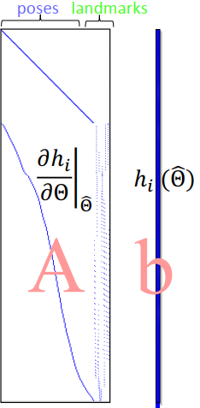








Nonlinear Least-Squares
$$c_{0}$$
$$p$$
$$x_{0}$$
$$u_{0}$$
$$x_{1}$$
$$u_{1}$$
$$x_{2}$$
$$m_{2}$$
$$m_{3}$$
$$m_{0}$$
$$m_{1}$$
$$x_{3}$$
$$x_{4}$$
Taylor Expansion
Cholesky
QR
Notes:
The graph itself is factorization of a probability distribution. So factor graph factorize the probability density where each of this terms correspond to one of the factors one of constraint.
By assuming gaussian noise, this maximize likelihood problem can be converted to a least square problem. Minimize the sum of the squared cost functions. This is typically be done in a gauss newton or Levenberg Marquardt framework by iteratively solving the linearized version of the systems. Each time update the estimate until converging, so this linear system contains matrix A, that so called measurement jacobian, these are linearized measurements, so each row contains a measurement of the columns of the variables. The top hill are the odometry measurement, diagonal. The bottom contains the landmark measurements, so each row contains one pose and one landmark.
The right is the vector b, that is the residuals of the system.
How to solve this problem efficiently?

Slide 8

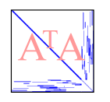
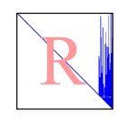
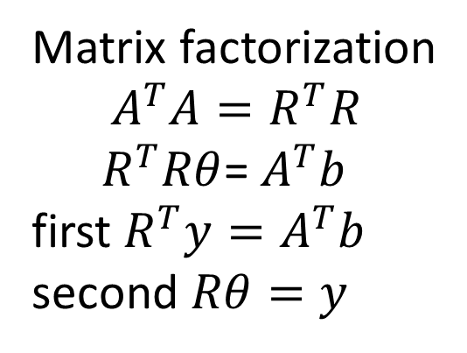
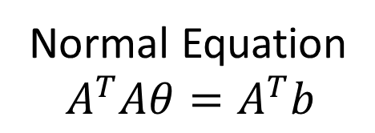
Solving the Least Squares System
Normal Equation
$$A^{T}Aθ=A^{T}b$$
Cholesky decomposition
Symmetric Matrix
Matrix factorization
$$A^{T}A=R^{T}R$$
$R^{T}Rθ$= $A^{T}b$
first $R^{T}y=A^{T}b$
second $Rθ=y$
Square root Matrix
Measurement Jacobian
Notes:
To solve this squared function, the simple way is to take derivative, and set the derivative to zero. You get the normal equation, that is . The AtA squared of the jacoabians.
How to solve this normal equation.
One way is to invert the information m, bad, the inversion is a dense matrix, and this matrix is usually very large. Hundreds or thousands items. You have a dense matrix here, you cannot do any thing efficient.
Instead, isam take the sparsity of this matrix. For example, Cholesky factorization end up a upper triangular matrix R, that AtA = RtR. This is so called square root information matrix. You can simply do forward and backward substitution to recover this solution. If the matrix R is sparse, this can be done very efficiently.

Slide 9
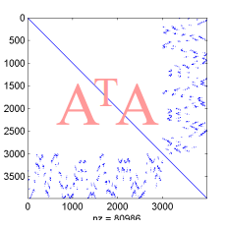
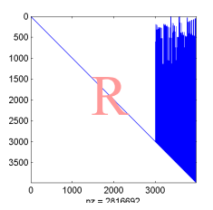
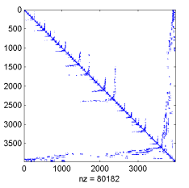
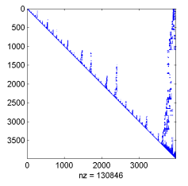
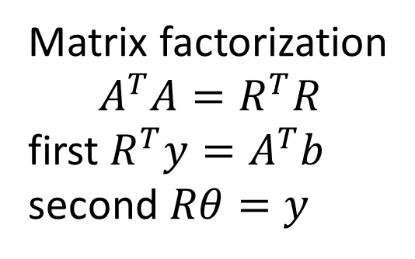
Retaining Sparsity: Variable Ordering
factor
Default Ordering
Matrix factorization
$$A^{T}A=R^{T}R$$
first $R^{T}y=A^{T}b$
second $Rθ=y$
COLAMD permute
factor
Ordering based on
COLAMD heuristic
Notes:
Unfortunately, if you directly decompose AtA, it end up with a dese matrix R,
As well known in linear algebra,
You can permute the rows and columns of the original matrix, and end up with an equivalent matrix denotes the same system. But when you factorize this one, you will end up with a sparse squared root matrix
Question is, how do you find such an ordering？
According to COLAMD heuristic, an approximate best ordering can be retrieved. This strategy has been used in matlab, so if in matlab you type A\b and A is a sparse matrix, it will exactly does the same as we have discussed here.

Slide 10
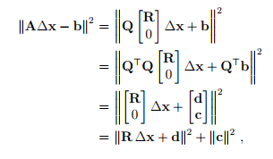
Solving the Linear Least Squares System
QR decomposition
A = QR
Givens
rotations
Measurement Jacobian
Notes:
Another solution to this linear Least squares problem is based on QR decomposition. You can decompose the measurement jacobian matrix A by a orthogonal matrix Q times a upper triangle matrix R. As denoted in this equation. Then the LSQ problem can be written in this form by using Q and R to represent A. Then times Q transpose to this equation, since Q is orthogonal matrix, times Q does not change the norm value.
QtQ equals to identity matrix, Qtb can be written as [d c]. By removing the bottom part, ends up with these two parts. The second item c square is const, so, the solution is to minimize the first item. And it can be simply computed by solving R dx = -d.
Again if R is sparse, then it can be solved very efficiently.

Slide 11
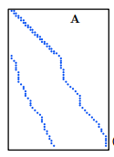
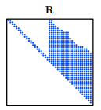
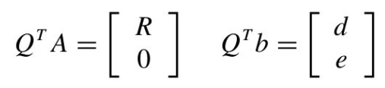
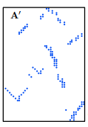
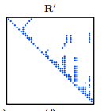
Retaining Sparsity: Variable Ordering
QR
Default Ordering
COLAMD permute
QR
Ordering based on
COLAMD heuristic
Notes:
Similarly, direct run QR decomposition will end up with a dense and usually large size matrix. Instead, applying the reordering algorithm based on COLAMD heuristic, we can get a permuted matrix A’ that represents the same system with A. Then running the QR decomposition again we will end up a sparse matrix R’. With this sparse one, the solution can be solved very efficiently.

Slide 12



Links between methods: Cholesky and QR
Hessian Matrix H
Measurement Jacobian A
Squared Root Matrix R
Notes:
It is interesting to see that the Cholesky method and the QR method are not that far apart. Indeed, if we consider a symmetric, positive-definite matrix H = A>A, with A rectangular, then the QR decomposition of A is. Whereas the Cholesky decomposition of H is, the two factorization share the same matrix R, as is shown in this equation.

Slide 13
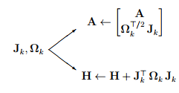



Links between G2O and GTSAM
GTSAM
G2O
Notes:
The cost for both methods is similar, for Cholesky is lighter but demands the construction of H = A>A. The following graph illustrates the paths for both methods, starting at the time where a factor wants to be incorporated to the problem.

Slide 14
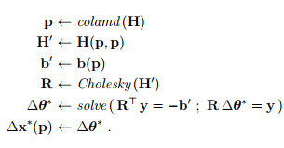
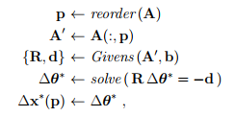
Algorithms
QR decomposition
Cholesky decomposition
GTSAM
G2O

Slide 15
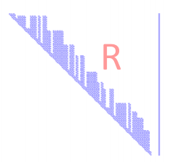
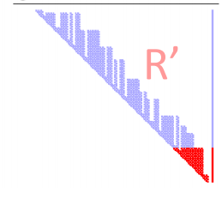
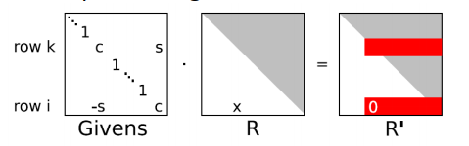
iSAM [Kaess et al., TRO 08]
Growing system
Batch solution becomes expensive
Incremental system
Given R from previous step, how to add new measurements ?
Key idea:
Append to existing matrix R
Using Givens rotations
Notes:
But SLAM problem involves a growing system, as the robot traverses round the environment, more robot poses and landmark observations result in a large-scale jacobian matrix. To solve the linearized system, we have to repeatedly decompose this matrix, which will become more expensive as the system grows with time.
A better way is incremental

Slide 16
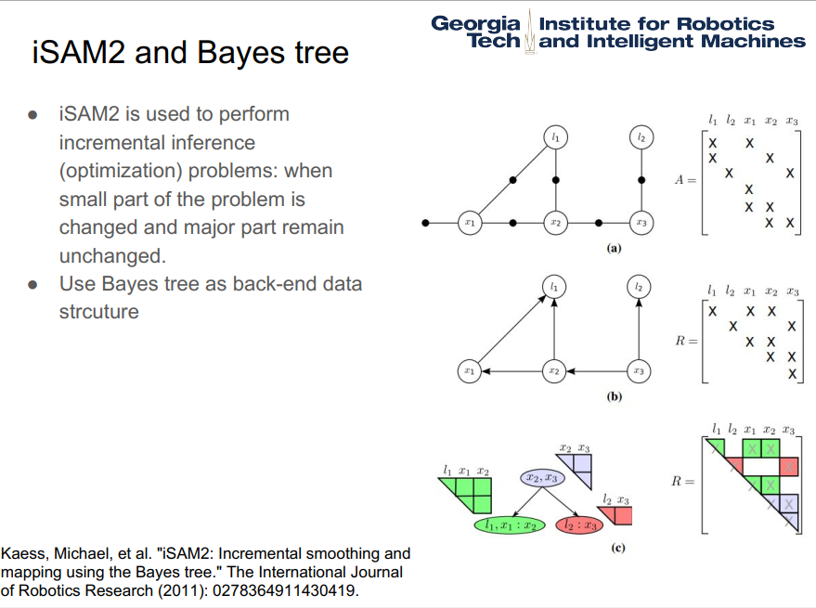

Slide 17
Materials
GTSAM 2006 & ISAM 2008 & ISAM2 2011
gtsam manual: Factor Graphs and GTSAM: A Hands-on Introduction
gtsam tutorial & icra16_slam_tutorial_kaess
Rosen, David M., Michael Kaess, and John J. Leonard. "Robust incremental online inference over sparse factor graphs: Beyond the Gaussian case." 2013 ICRA

Slide 18
Outline
Theory
SLAM as a Factor Graph
SLAM as a Non-linear Least Squares
iSAM
Applications
Visual-Inertial Odometry
Structure from Motion (SfM) - Mapping
Multi-Robot SLAM
Multi-View Stereo and Optical Flow
Motion Planning
Programming
C++ example
GTSAM in Matlab

Slide 19
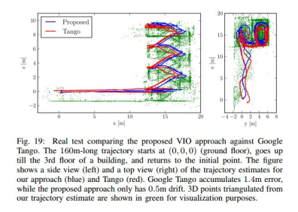
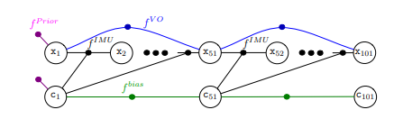
Visual-Inertial Odometry
IMU Integrate + Visual Odometry
https://www.youtube.com/watch?v=CsJkci5lfco&feature=youtu.be
Indelman, Vadim, et al. "Information fusion in navigation systems via factor graph based incremental smoothing." Robotics and Autonomous Systems 61.8 (2013): 721-738.

Slide 20
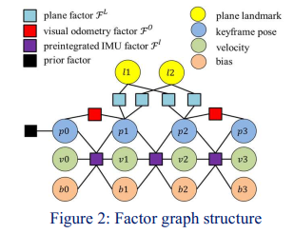
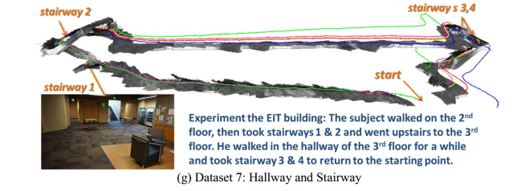
Visual-Inertial Odometry
IMU Integrate + Visual Odometry + Plane Landmark
Zhang, He, and Cang Ye. "Plane-aided visual-inertial odometry for pose estimation of a 3d camera based in-door blind navigation." 28th British Machine Vision Conference. 2017.

Slide 21
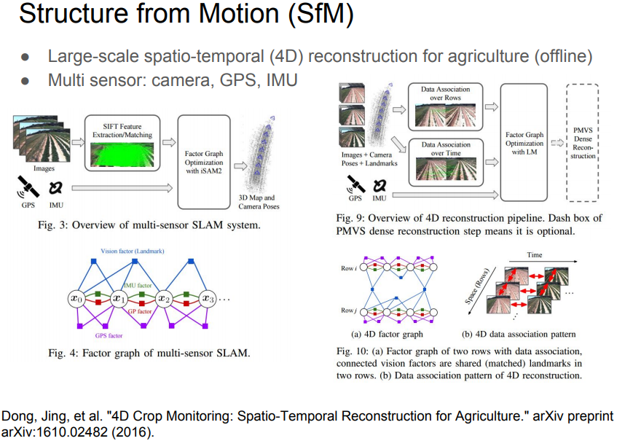
https://www.youtube.com/watch?v=BgLlLlsKWzI&feature=youtu.be

Slide 22
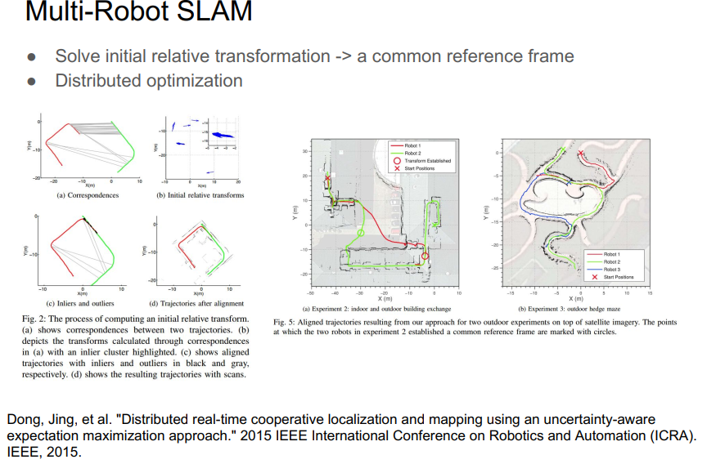
https://www.youtube.com/watch?v=m_bLSdsT2kg&feature=youtu.be

Slide 23
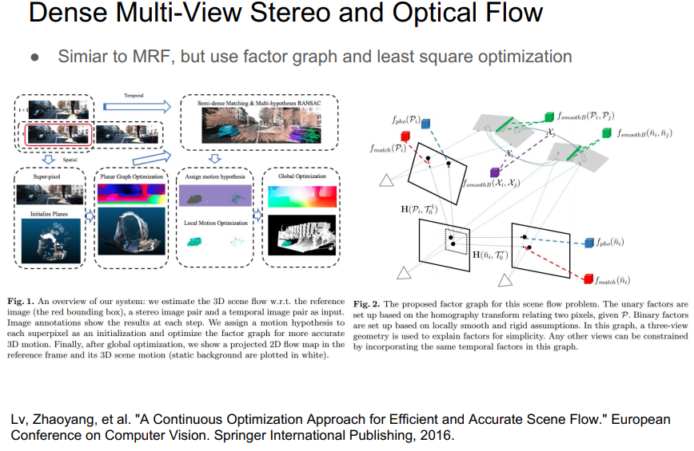
https://www.youtube.com/watch?v=2A7lOipPNBA&feature=youtu.be

Slide 24
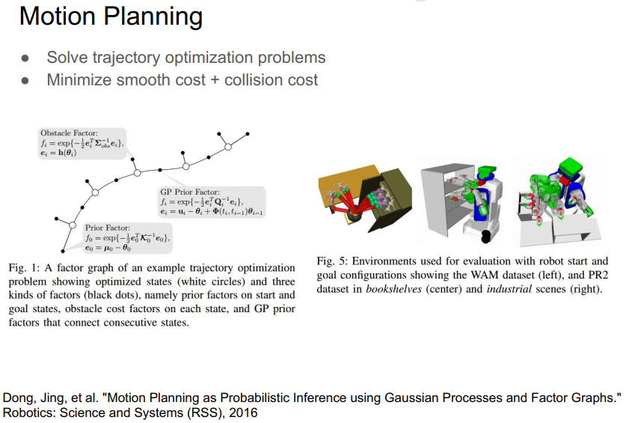
https://www.youtube.com/watch?v=mVA8qhGf7So&feature=youtu.be

Slide 25
Outline
Theory
SLAM as a Factor Graph
SLAM as a Non-linear Least Squares
iSAM
Applications
Visual-Inertial Odometry
Structure from Motion (SfM) - Mapping
Multi-Robot SLAM
Multi-View Stereo and Optical Flow
Motion Planning
Programming
C++ example
GTSAM in Matlab

Slide 26
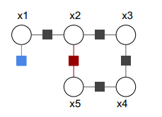
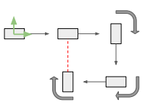
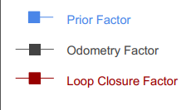
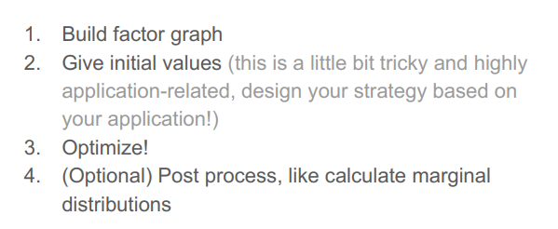

Slide 27
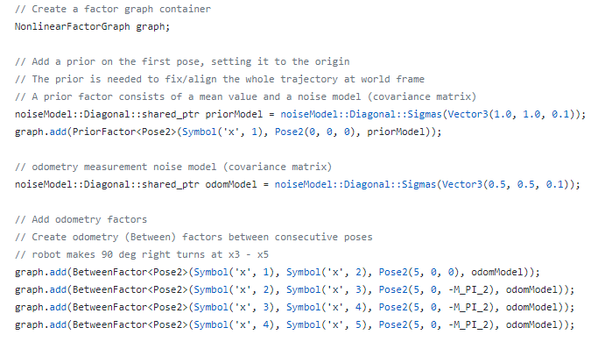
C++ Example

Slide 28
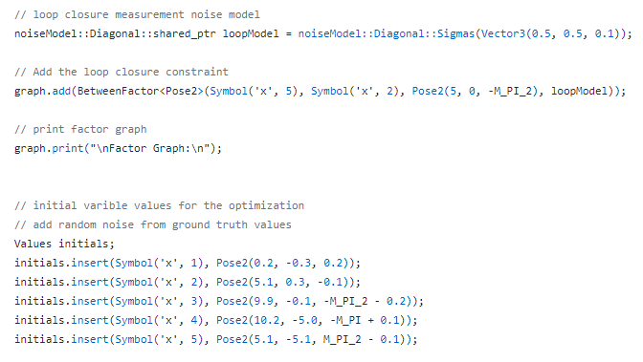
C++ Example

Slide 29
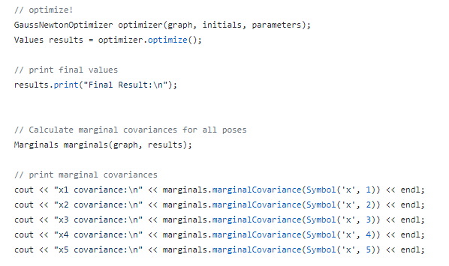
C++ Example

Slide 30
C++ Example
https://github.com/dongjing3309/gtsam-examples
https://github.com/rising-turtle/slam_course

Slide 31
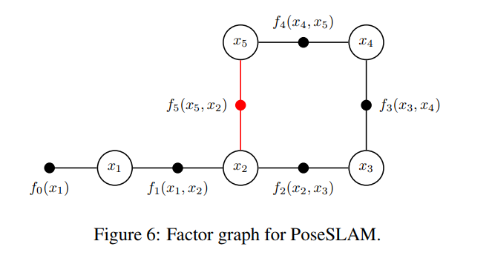
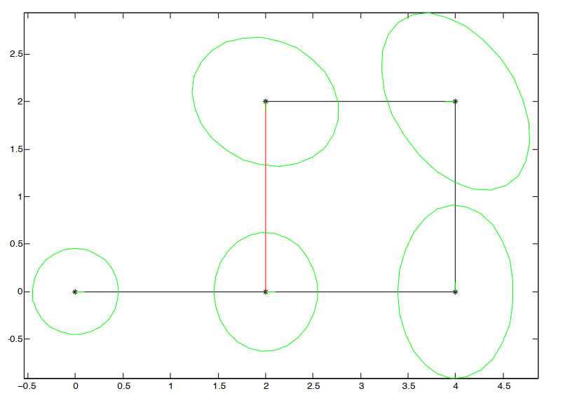
Matlab Example
https://borg.cc.gatech.edu/download.html

