Slide 1
Binary file I/O
Guido Klingbeil
Centre for Mathematical Biology
23.10.2012

Slide 2
What we will cover
What is a binary file?
What does binary mean?
Why do we use binary representation?
Number systems (for natural numbers only)

Slide 3
I assume you to know
We build directly on top of your file I/O lecture and you should know how to:
open a text file for reading and / or writing,
different access modes for files,
in which of them a file is created or truncated,
read or write a line or any number of bytes,
how to handle basic errors such as “File not found”.

Slide 4
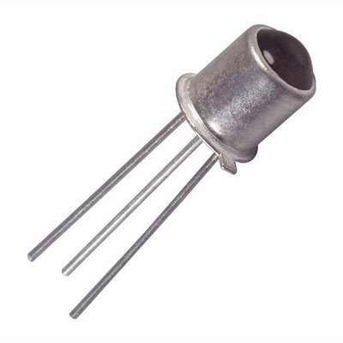
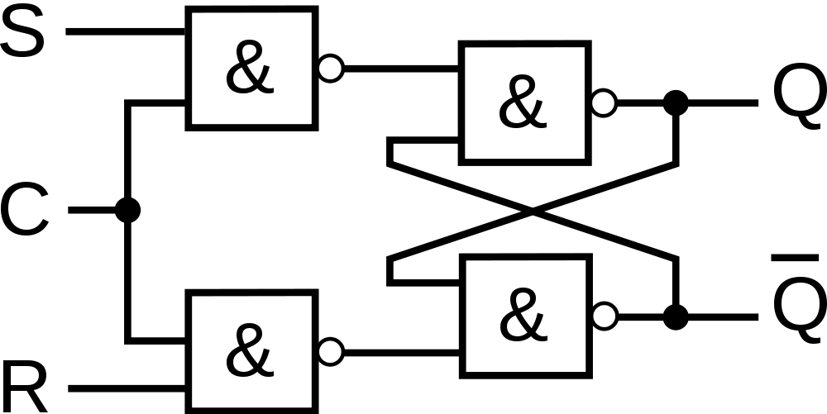
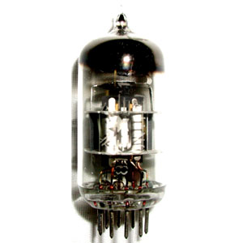
Bit and byte
A bit (binary digit) is the basic capacity of information in computing.
It can have the value of either 1 or 0 (one or zero) only.
A bit can be stored by any device that exists in either of two possible distinct states, such as a flip-flop or two positions of an electrical switch.
set
output
clock
not output
reset

Slide 5
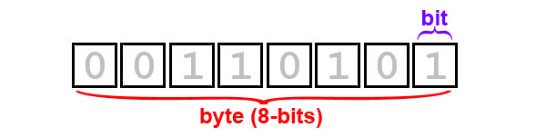
Bit and byte
A byte is a unit (or “package”) of digital information that most commonly consists of eight bits:
Historically, a byte was the number of bits used to encode a single character of text. Its size was hardware dependent and no definitive standards existed.

Slide 6
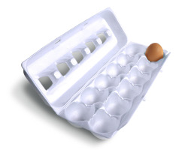
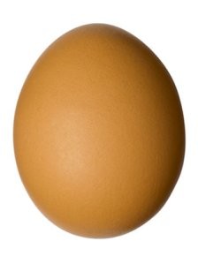
Motivation why to use binary data
Computers can only represent 0 and 1.
You may think of a byte as an egg box carrying several eggs, the bits.
However, to represent the 4 nucleotides of DNA or RNA takes only 2 bits.
By considering the individual bits, binary data is more efficient.

Slide 7
Binary file
In the context of this course, we may call any file that is not a text file a binary file.
However, from a technical point of view a character is just an agreed upon interpretation of 8 bits. So, a text file may be seen as a special type of binary file.

Slide 8
Binary files
Examples of binary files are:
Executables or program files,
Object files (*.o),
JPEG (*.jpg),
Office documents such as Word (*.doc), Excel (*.ppt).
Common characteristic:
The content has to be interpreted by some rules at the bit level. Sometimes these rules are known (*.o, *.jpg), sometimes not really (*.doc, *.ppt).

Slide 9
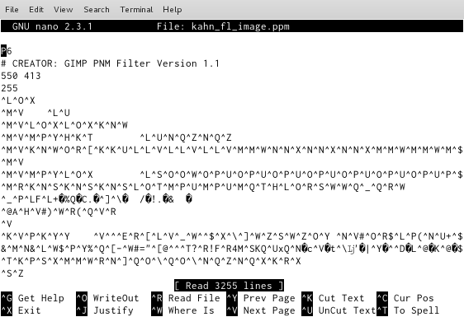
Open a binary file with a text editor

Slide 10
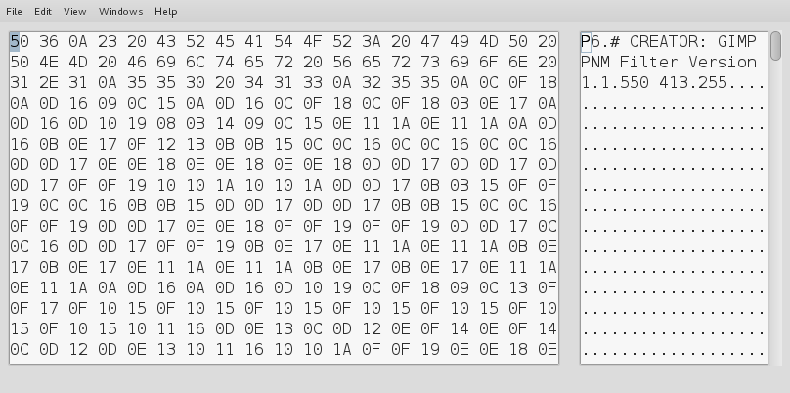
Open a binary file with a HEX editor

Slide 11
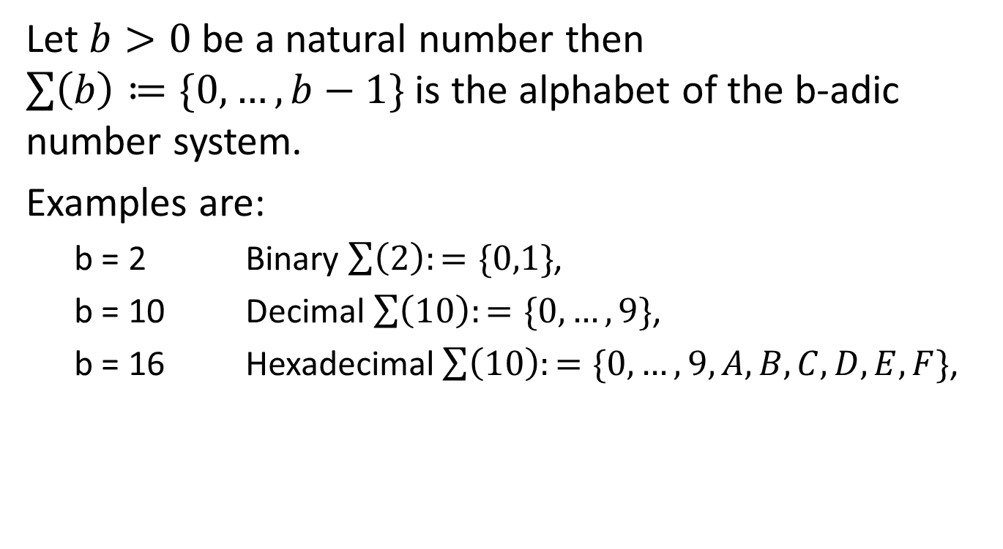
Number systems
Let $b>0$ be a natural number then $\sum{\left(b\right)≔\{0,…,b−1\}}$ is the alphabet of the b-adic number system.
Examples are:
b = 2 Binary $\sum{\left(2\right):=\{0,1\}}$,
b = 10 Decimal $\sum{\left(10\right):=\{0,…,9\}}$,
b = 16 Hexadecimal$\sum{\left(10\right):=\{0,…,9, A,B,C,D, E, F\}}$,

Slide 12
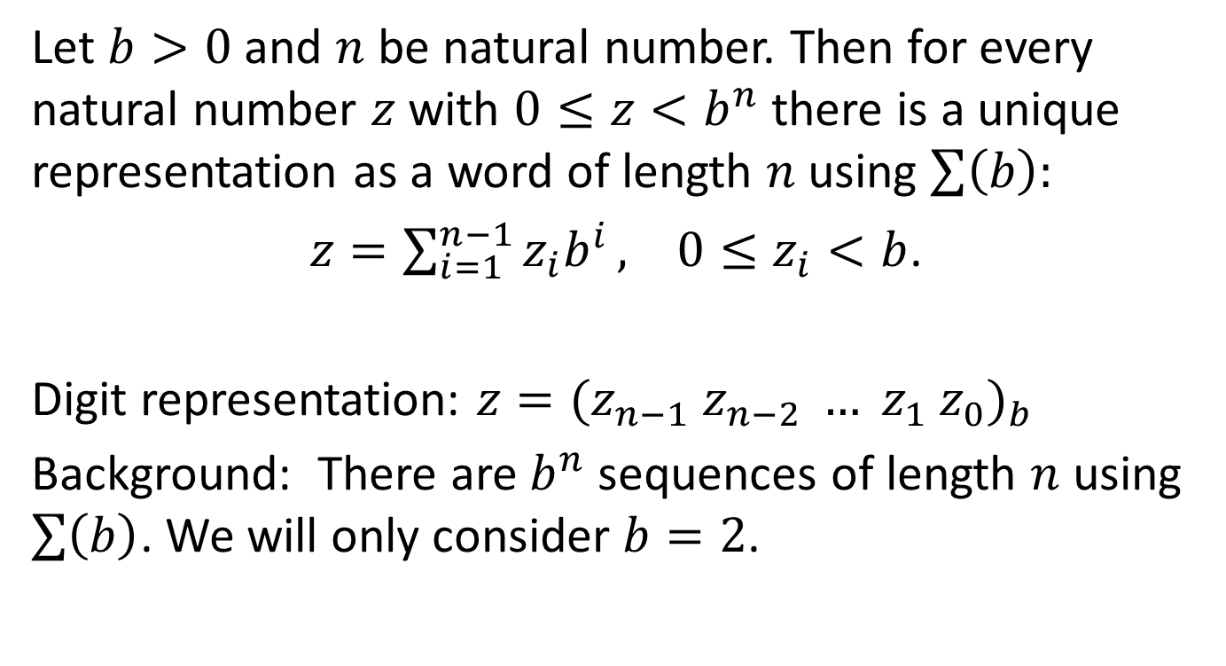
Number systems
Let $b>0$ and $n$ be natural number. Then for every natural number $z$ with $0≤z<b^{n}$ there is a unique representation as a word of length $n$using $\sum{\left(b\right):}$
$z=\sum_{i=1}^{n−1}{z_{i}b^{i}}, 0≤z_{i}<b$.
Digit representation: $z={(z_{n−1} z_{n−2} … z_{1} z_{0})}_{b}$
Background: There are $b^{n}$ sequences of length $n$ using $\sum{\left(b\right)}$. We will only consider $b=2$.

Slide 13
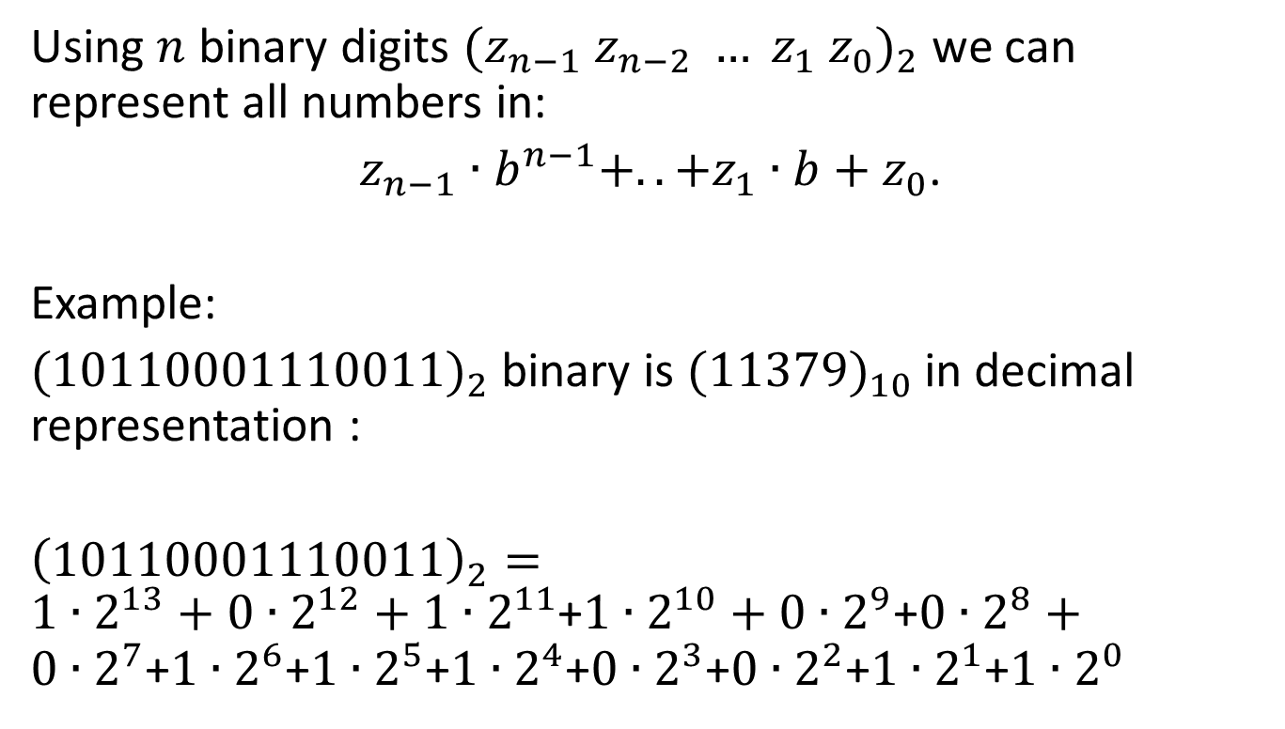
Convert binary to decimal
Using $n$ binary digits ${(z_{n−1} z_{n−2} … z_{1} z_{0})}_{2}$ we can represent all numbers in:
$z_{n−1}∙b^{n−1}+..+z_{1}∙b+z_{0}$.
Example:
$(10110001110011)_{2}$binary is $(11379)_{10}$ in decimal representation :
${\left(10110001110011\right)}_{2}={1∙2}^{13}+{0∙2}^{12}+{1∙2}^{11}$+${1∙2}^{10}+{0∙2}^{9}$+${0∙2}^{8}+{0∙2}^{7}$+${1∙2}^{6}$+${1∙2}^{5}$+${1∙2}^{4}$+${0∙2}^{3}$+${0∙2}^{2}$+${1∙2}^{1}$+${1∙2}^{0}$

Slide 14
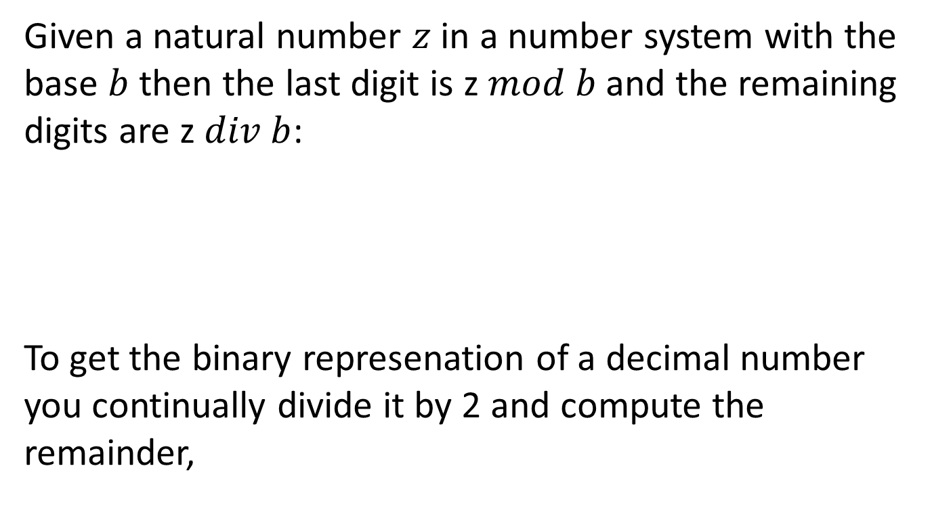


Convert decimal to binary
Given a natural number $z$ in a number system with the base $b$ then the last digit is z$mod b$ and the remaining digits are z$div b$:
To get the binary represenation of a decimal number you continually divide it by 2 and compute the remainder,
$$(10110001110011)_{2}=(11379)_{10}$$
$${\left(11379\right)}_{10}div 2= {\left(5699\right)}_{10}$$
$${\left(11379\right)}_{10}mod 2$$

Slide 15
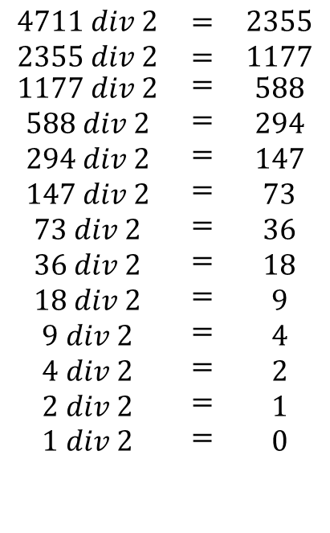
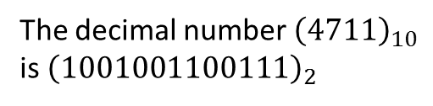
Conversion example
$$\begin{matrix}4711 div 2 & = & 2355 \\ 2355 div 2 & = & 1177 \\ \begin{aligned}1177 div 2 \\ 588 div 2 \\ 294 div 2 \\ 147 div 2 \\ 73 div 2 \\ 36 div 2 \\ 18 div 2 \\ 9 div 2 \\ 4 div 2 \\ 2 div 2 \\ 1 div 2 \\ \\ \end{aligned} & \begin{aligned}= \\ = \\ = \\ = \\ = \\ = \\ = \\ = \\ = \\ = \\ = \\ \\ \end{aligned} & \begin{aligned}588 \\ 294 \\ 147 \\ 73 \\ 36 \\ 18 \\ 9 \\ 4 \\ 2 \\ 1 \\ 0 \\ \\ \end{aligned}\end{matrix}$$
remainder 1
remainder 1
remainder 1
remainder 0
remainder 0
The decimal number ${\left(4711\right)}_{10}$
is ${\left(1001001100111\right)}_{2}$
remainder 1
remainder 1
remainder 0
remainder 0
remainder 1
remainder 0
remainder 0
remainder 1

Slide 16
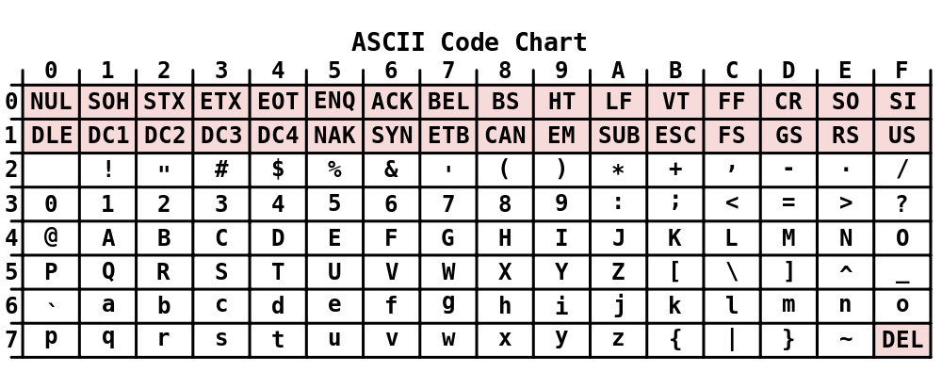
ASCII characters
American Standard Code for Information Interchange
7-bit encoding: 95 printable and 33 non-printable control characters
Important for you: the char ‘0’ is not decimal 0. You have to add 48.

Slide 17
Using binary files
There is hardly any difference in reading and writing a binary file from what you already know.
The main difference is in interpreting the data.
You can use all the functions you already know such as fread and fwrite in C, read and write in Perl:
fread() and fwrite() return the number of items successfully read or written,
if an error occurs, or the end-of-file is reached, the return value is a short item count (or zero),
Perl you have to switch to binary mode first:
open(F,”myfile.dat”);
binmode(F);

Slide 18
Summary
Handling binary files is very similar to handling text files. The basic operations are still: open, read or write, close.
The important difference is in the interpretation of the data:
Data items may be shorter or longer than a byte,
Data items are no longer strictly aligned to bytes.

Slide 19
Thank you!
I am happy to take any questions!

