Slide 1
OBJECT-DATABASE SYSTEM1
Object-Oriented database system
are proposed as an alternative to relational system and aimed at application domains where complex objects play a central role.
Object-relational database systems
can be thought of as an attempt to extend relational database system with the functionality necessary to support a broader class of application...

Slide 2
Object-database Systems
RDBMS
Relational Database Management Systems
OODBMS
Object-Oriented Database Management Systems
ORDBMS
Object-Relational Database Management Systems
Object-Database Management Systems

Slide 3
Object-database vendor
IBM (db2)
Oracle
Informix
Sybase
Microsoft SQL

Slide 4
Object database concepts (1)
Complex objects, object identity. Objects have arbitrary complexity. Each object has identity, i.e. a unique internal identitifier (OID) (with no meaning in the problem domain), and Each object has one or more external names.
Relationships, associations, links. Objects are connected by conceptual links. For instance, the Employee and Department objects can be connected by a link worksFor.
Encapsulation and information hiding. The internal properties of an object are subdivided into two parts: public and private (invisible from the outside).
Classes, types, interfaces. Each object is an instance of one or more classes. Objects are instantiated according to information presented in the class. The class contains the properties that are common for some collection of objects (objects’ invariants). Each object has a type. Objects are accessible via their interfaces.

Slide 5
Object database concepts (2)
Abstract data types (ADTs): a kind of a class, which assumes that any access to an object is limited to the predefined collection of operations.
Operations, methods and messages. An object is associated with a set of operations (methods). The object performs the operation after receiving a message with the name of operation to be performed (and its parameters).
Inheritance. Classes are organized in a hierarchy reflecting the hierarchy of real world concepts. For instance, the class Person is a superclass of the classes Employee and Student.
Polymorphism, late binding, overriding. The operation to be executed on an object is chosen dynamically, after the object receives the message with the operation name.
Persistence. Database objects are persistent, i.e., they live as long as necessary. They can outlive programs, which created them.

Slide 6
Complex Data Types
Extensions to SQL to support complex types include:
Collection and large object types
Nested relations are an example of collection types
Structured types
Nested record structures like composite attributes
Inheritance
Object orientation
Including object identifiers and references

Slide 7
Complex Data Types
Traditional database applications in data processing had conceptually simple data types
Relatively few data types, first normal form holds
Complex data types have grown more important in recent years
E.g. Addresses can be viewed as a
Single string, or
Separate attributes for each part, or
Composite attributes (which are not in first normal form)
E.g. it is often convenient to store multivalued attributes as-is, without creating a separate relation to store the values in first normal form
Applications
computer-aided design, computer-aided software engineering
multimedia and image databases, and document/hypertext databases.

Slide 8
Traditional and object-oriented application
The traditional structure
of an application
The object-oriented structure
of an application
Possive data
(relations)
Linked objects
...
...
...
Database
schema
Database
schema
...
...
...
...
...
...
...
...
...
Classes and types
...
...
...
...
...
...
...
...
...
...
...
...
...
...
...
...
...
...
...
...
Procedure and
function libraries
Application
modules
...
...
Types
Procedure and
function libraries
Application
modules
Dictionaries,
catalogs
Database procedures,
views, rules
Dictionaries,
catalogs
Database procedures,
views, rules

Slide 9
Nested Relations
Motivation:
Permit non-atomic domains
Example of non-atomic domain: set of integers, or set of tuples
Allows more intuitive modeling for applications with complex data
Intuitive definition:
allow relations whenever we allow atomic (scalar) values — relations within relations
Retains mathematical foundation of relational model
Violates first normal form.

Slide 10
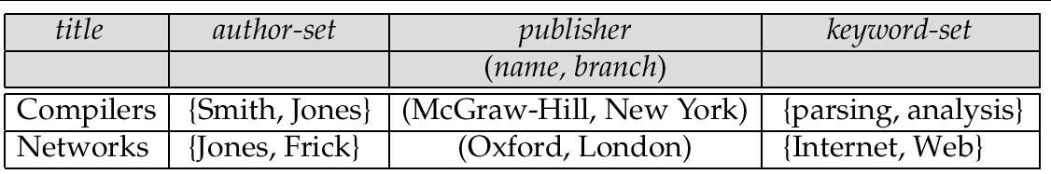
Example of a Nested Relation
Example: library information system
Each book has
title,
a set of authors,
Publisher, and
a set of keywords
Non-1NF relation books

Slide 11
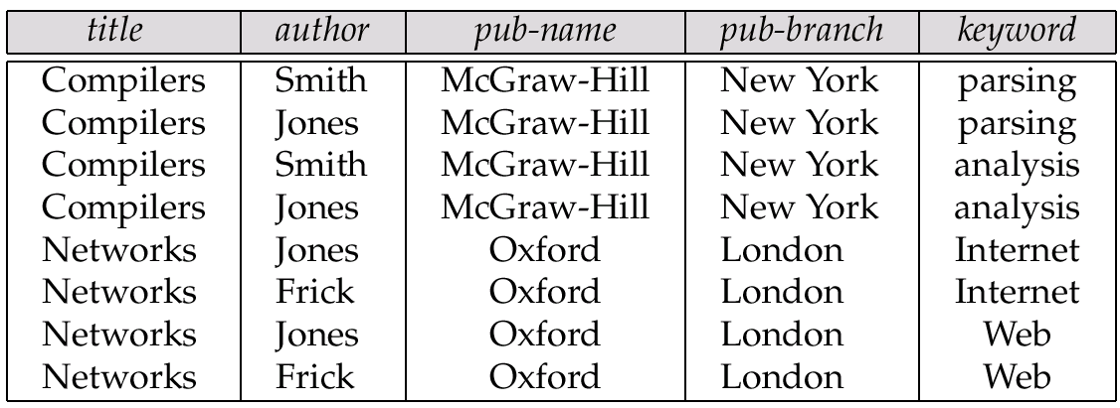
1NF Version of Nested Relation
1NF version of books
flat-books

Slide 12
4NF Decomposition of Nested Relation
Remove awkwardness of flat-books by assuming that the following multivalued dependencies hold:
title author
title keyword
title pub-name, pub-branch
Decompose flat-doc into 4NF using the schemas:
(title, author)
(title, keyword)
(title, pub-name, pub-branch)

Slide 13
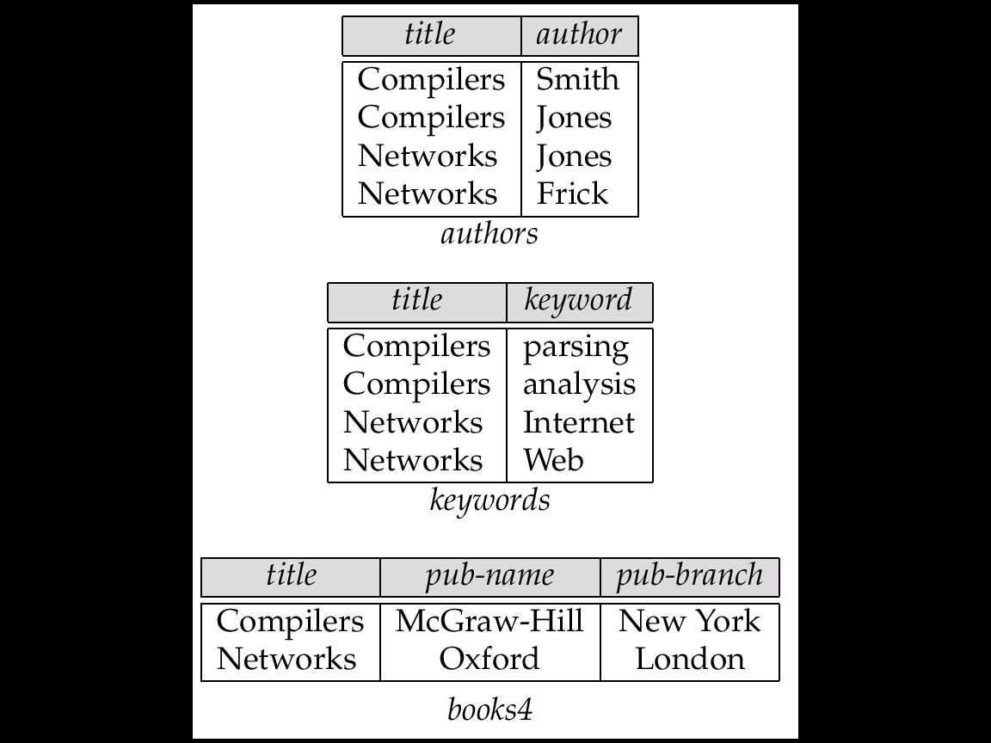
4NF Decomposition of flat–books

Slide 14
Problems with 4NF Schema
4NF design requires users to include joins in their queries.
1NF relational view flat-books defined by join of 4NF relations:
eliminates the need for users to perform joins,
but loses the one-to-one correspondence between tuples and documents.
And has a large amount of redundancy
Nested relations representation is much more natural here.

Slide 15
Complex object
Structure of complex object
O <i, c, v>
Type of constructer :-
Allows to determines how the object is constructed or the basic structure of object.
Type of constructer:-
Atom
Set
Bag
List
Array
Tuple
Types Complex object
Structured object
Unstructured object

Slide 16
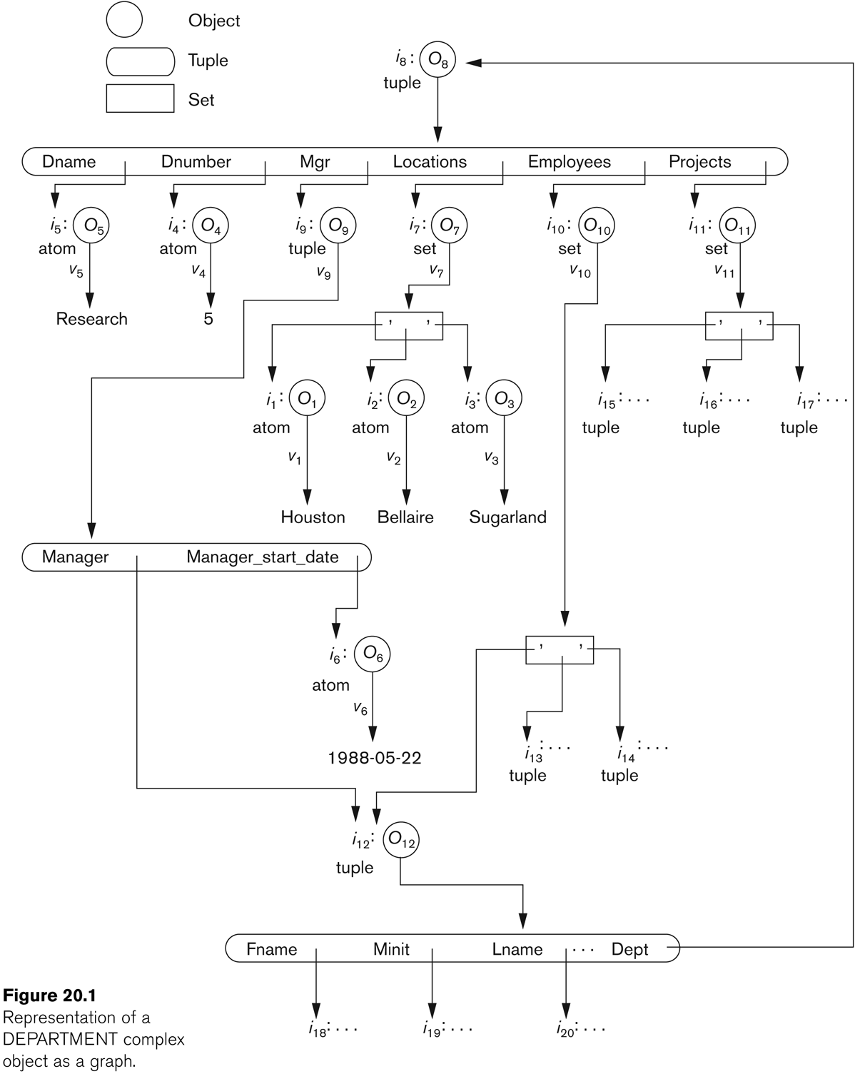
Object Identity, Object Structure, and Type Constructors

Slide 17
Large Object Types
Large object types
clob: Character large objects
book-review clob(10KB)
blob: binary large objects
image blob(10MB)
movie blob (2GB)
JDBC/ODBC provide special methods to access large objects in small pieces
Similar to accessing operating system files
Application retrieves a locator for the large object and then manipulates the large object from the host language

Slide 18
Complex Types and SQL:1999
Extensions to SQL to support complex types include:
Collection and large object types
Nested relations are an example of collection types
Structured types
Nested record structures like composite attributes
Inheritance
Object orientation
Including object identifiers and references
Our description is mainly based on the SQL:1999 standard
Not fully implemented in any database system currently
But some features are present in each of the major commercial database systems

Slide 19
Structured Types and Inheritance in SQL
Structured types can be declared and used in SQL
create type Name as (firstname varchar(20), lastname varchar(20)) final
create type Address as (street varchar(20), city varchar(20), zipcode varchar(20))
not final
Note: final and not final indicate whether subtypes can be created
Structured types can be used to create tables with composite attributes
create table customer (
name Name,
address Address,
dateOfBirth date)
Dot notation used to reference components: name.firstname

Slide 20
Structured Types (cont.)
User-defined row types
create type CustomerType as (
name Name,
address Address,
dateOfBirth date)
not final
Can then create a table whose rows are a user-defined type
create table customer of CustomerType
Alternative using unnamed row types.
Create table Custemer_r(
name row (firstname varchar(20),
lastname varchar(20))
address row (street varchar(20),
city varchar(20)
zipcode varchar(9)),
dateOfBirth date

Slide 21
Structured Types (cont.)
Query: find the last name and city of each customer.
select name.lastname,address.city
from customer
Methods:-
A structure type can have methods defined on it .We declare methods as part of the type definition of a structured type
create type CustomerType as (
name Name,
address Address,
dateOfBirth date)
not final
method ageOnDate (onDate date)
returns interval year;

Slide 22
Methods
Method body is given separately.
create instance method ageOnDate (onDate date)
returns interval year
for CustomerType
begin
return onDate - self.dateOfBirth;
end
The variable self refers to customer instance on which the method is invoked
We can now find the age of each customer:
select name.lastname, ageOnDate (current_date)
from customer

Slide 23
Constructor Functions
Constructor functions are used to create values of structured types
A function with the same name as structure type is a constructer function for the structure type.
E.g. create function Name(firstname varchar(20), lastname varchar(20)) returns Name begin set self.firstname = firstname; set self.lastname = lastname; end
To create a value of type Name, we use new Name(‘John’, ‘Smith’)
Normally used in insert statements insert into Person values (new Name(‘John’, ‘Smith), new Address(’20 Main St’, ‘New York’, ‘11001’), date ‘1960-8-22’);

Slide 24
Type Inheritance
Suppose that we have the following type definition for people:
create type Person (name varchar(20), address varchar(20))
Using inheritance to define the student and teacher types create type Student under Person (degree varchar(20), department varchar(20)) create type Teacher under Person (salary integer, department varchar(20))
The method of structured type are inherited by its subtype
Subtypes can redefine methods by using overriding method

Slide 25
Multiple Type Inheritance
SQL:1999 and SQL:2003 do not support multiple inheritance
If our type system supports multiple inheritance, we can define a type for teaching assistant as follows: create type Teaching Assistant under Student, Teacher
To avoid a conflict between the two occurrences of department we can rename them
create type Teaching Assistant under Student with (department as student_dept ), Teacher with (department as teacher_dept )
Each value must have a most-specific type

Slide 26
Table Inheritance
Tables created from subtypes can further be specified as subtables
E.g. create table people of Person; create table students of Student under people; create table teachers of Teacher under people;
Tuples added to a subtable are automatically visible to queries on the supertable
E.g. query on people also sees students and teachers.
Similarly updates/deletes on people also result in updates/deletes on subtables
To override this behaviour, use “only people” in query
Conceptually, multiple inheritance is possible with tables
e.g. create table teching_assistents
of teaching_assistants under students and teachers
But is not supported in SQL currently
So we cannot create a person (tuple in people) who is both a student and a teacher

Slide 27
Array and Multiset Types in SQL
Example of array and multiset declaration:
Multi set is an unordered collection element may occur multiple time
create type Publisher as (name varchar(20), branch varchar(20)); create type Book as (title varchar(20), author_array varchar(20) array [10], pub_date date, publisher Publisher, keyword-set varchar(20) multiset);
create table books of Book;

Slide 28
Creation of Collection Values
Array construction
array [‘Silberschatz’,`Korth’,`Sudarshan’]
Multisets
multiset [‘computer’, ‘database’, ‘SQL’]
To create a tuple of the type defined by the books relation: (‘Compilers’, array[`Smith’,`Jones’], new Publisher (`McGraw-Hill’,`New York’), multiset [`parsing’,`analysis’ ])
To insert the preceding tuple into the relation books
insert into books values (‘Compilers’, array[`Smith’,`Jones’], new Publisher (`McGraw-Hill’,`New York’), multiset [`parsing’,`analysis’ ]);

Slide 29
Querying Collection-Valued Attributes
To find all books that have the word “database” as a keyword,
select title from books where ‘database’ in (unnest(keyword-set ))
We can access individual elements of an array by using indices
E.g.: If we know that a particular book has three authors, we could write:
select author_array[1], author_array[2], author_array[3] from books where title = `Database System Concepts’
To get a relation containing pairs of the form “title, author_name” for each book and each author of the book
select B.title, A.author
from books as B, unnest (B.author_array) as A (author )
To retain ordering information we add a with ordinality clause
select B.title, A.author, A.position
from books as B, unnest (B.author_array) with ordinality as
A (author, position )

Slide 30
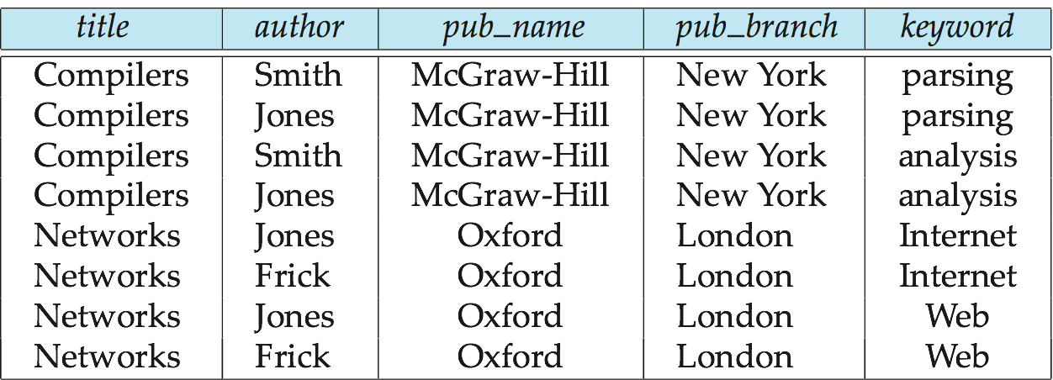
Unnesting
The transformation of a nested relation into a form with fewer (or no) relation-valued attributes us called unnesting.
E.g. select title, A as author, publisher.name as pub_name, publisher.branch as pub_branch, K.keyword from books as B, unnest(B.author_array ) as A (author ), unnest (B.keyword_set ) as K (keyword )
Result relation flat_books

Slide 31
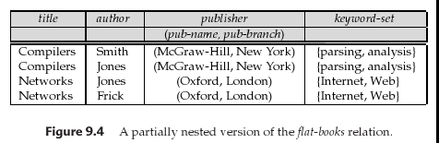
Nesting
Nesting is the opposite of unnesting, creating a collection-valued attribute
Nesting can be done in a manner similar to aggregation, but using the function collect() in place of an aggregation operation, to create a multiset
To nest the flat_books relation on the attribute keyword:
select title, author, Publisher (pub_name, pub_branch ) as publisher, collect (keyword) as keyword_set from flat_books groupby title, author, publisher

Slide 32
Nesting (Cont.)
To nest on both authors and keywords:
select title, collect (author ) as author_set, Publisher (pub_name, pub_branch) as publisher, collect (keyword ) as keyword_set from flat_books group by title, publisher
Another approach to creating nested relations is to use subqueries in the select clause, starting from the 4NF relation books4
select title, array (select author from authors as A where A.title = B.title order by A.position) as author_array, Publisher (pub-name, pub-branch) as publisher, multiset (select keyword from keywords as K where K.title = B.title) as keyword_set from books4 as B

Slide 33
Object-Identity and Reference Types
Define a type Department with a field name and a field head which is a reference to the type Person, with table people as scope:
create type Department ( name varchar (20), head ref (Person) scope people)
We can then create a table departments as follows
create table departments of Department
We can omit the declaration scope people from the type declaration and instead make an addition to the create table statement: create table departments of Department (head with options scope people)
Referenced table must have an attribute that stores the identifier, called the self-referential attribute
create table people of Person ref is person_id system generated;

Slide 34
Initializing Reference-Typed Values
To create a tuple with a reference value, we can first create the tuple with a null reference and then set the reference separately:
insert into departments
values (`CS’, null)
update departments
set head = (select p.person_id
from people as p
where name = `John’)
where name = `CS’

Slide 35
User Generated Identifiers
The type of the object-identifier must be specified as part of the type definition of the referenced table, and
The table definition must specify that the reference is user generated
create type Person (name varchar(20) address varchar(20)) ref using varchar(20) create table people of Person ref is person_id user generated
When creating a tuple, we must provide a unique value for the identifier:
insert into people (person_id, name, address ) values (‘01284567’, ‘John’, `23 Coyote Run’)
We can then use the identifier value when inserting a tuple into departments
Avoids need for a separate query to retrieve the identifier:
insert into departments values(`CS’, `02184567’)

Slide 36
User Generated Identifiers (Cont.)
Can use an existing primary key value as the identifier:
create type Person (name varchar (20) primary key, address varchar(20)) ref from (name) create table people of Person ref is person_id derived
When inserting a tuple for departments, we can then use
insert into departments values(`CS’,`John’)

Slide 37
Path Expressions
Find the names and addresses of the heads of all departments:
select head –>name, head –>address from departments
An expression such as “head–>name” is called a path expression
Path expressions help avoid explicit joins
If department head were not a reference, a join of departments with people would be required to get at the address
Makes expressing the query much easier for the user

Slide 38
Implementing O-R Features
Similar to how E-R features are mapped onto relation schemas
Subtable implementation
Each table stores primary key and those attributes defined in that table
or,
Each table stores both locally defined and inherited attributes

Slide 39
Persistent Programming Languages
Languages extended with constructs to handle persistent data
Programmer can manipulate persistent data directly
no need to fetch it into memory and store it back to disk (unlike embedded SQL)
Persistent objects:
Persistence by class - explicit declaration of persistence
Persistence by creation - special syntax to create persistent objects
Persistence by marking - make objects persistent after creation
Persistence by reachability - object is persistent if it is declared explicitly to be so or is reachable from a persistent object
Notes:
->Persistance data –data remain exist even after program created is terminated relation in db and tuples in db is example of pesistance data
->A persistent programming language is a programming language extended with constructs to handle persistent data.
->in a persistent programming language, the query language is fully integrated with the host language, and both share the same type system. Objects can be created and stored in the database without any explicit type or format changes; any format changes required are carried out transparently.
->The programmer using an embedded query language is responsible for writing explicit code to fetch data from the database into memory. If any updates are performed, the programmer must write code explicitly to store
the updated data back in the database.in a persistent programming language, the programmer can manipulate persistent data without writing code explicitly to fetch it into memory or store it back to disk.

Slide 40
Object Identity and Pointers
Degrees of permanence of object identity
Intraprocedure: only during execution of a single procedure
Intraprogram: only during execution of a single program or query
Interprogram: across program executions, but not if data-storage format on disk changes
Persistent: interprogram, plus persistent across data reorganizations
Persistent versions of C++ and Java have been implemented
C++
ODMG C++
ObjectStore
Java
Java Database Objects (JDO)
Notes:
In persistent extensions of languages such as C++, object identifiers for persistent objects are implemented as “persistent pointers.” A persistent pointer is a type of pointer that, unlike in-memory pointers, remains valid even after the
end of a program execution, and across some forms of data reorganization.

Slide 41
Persistent C++ Systems
Extensions of C++ language to support persistent storage of objects
Several proposals, ODMG standard proposed, but not much action of late
persistent pointers: e.g. d_Ref<T>
creation of persistent objects: e.g. new (db) T()
Class extents: access to all persistent objects of a particular class
Relationships: Represented by pointers stored in related objects
Issue: consistency of pointers
Solution: extension to type system to automatically maintain back-references
Iterator interface
Transactions
Updates: mark_modified() function to tell system that a persistent object that was fetched into memory has been updated
Query language

Slide 42
Persistent Java Systems
Standard for adding persistence to Java : Java Database Objects (JDO)
Persistence by reachability
Byte code enhancement
Classes separately declared as persistent
Byte code modifier program modifies class byte code to support persistence
E.g. Fetch object on demand
Mark modified objects to be written back to database
Database mapping
Allows objects to be stored in a relational database
Class extents
Single reference type
no difference between in-memory pointer and persistent pointer
Implementation technique based on hollow objects (a.k.a. pointer swizzling)

Slide 43
Object-Relational Mapping
Object-Relational Mapping (ORM) systems built on top of traditional relational databases
Implementor provides a mapping from objects to relations
Objects are purely transient, no permanent object identity
Objects can be retried from database
System uses mapping to fetch relevant data from relations and construct objects
Updated objects are stored back in database by generating corresponding update/insert/delete statements
The Hibernate ORM system is widely used
described in Section 9.4.2
Provides API to start/end transactions, fetch objects, etc
Provides query language operating direcly on object model
queries translated to SQL
Limitations: overheads, especially for bulk updates
Notes:
->It is approach to integration of object-oriented programming languages and databases.
->Implemented on top of normal relational db and allow programmer to define mapping betn tuple of db and Object in programming language
->Object-relational mapping systems in general, and in particular the widely used Hibernate system which provides an object-relational mapping to Java,
->The primary goal of object-relational mapping systems is to ease the job of programmers who build applications, by providing them an object-model, while retaining the benefits of using a robust relational database underneath.
->Object-relational mapping systems also provide query languages that allow programmers to write queries directly on the object model;
->Object-relational mapping systems allow programmers to build applications
using an object model,while using a traditional database system to store the data.

Slide 44
Comparison of O-O and O-R Databases
Relational systems
simple data types, powerful query languages, high protection.
Persistent-programming-language-based OODBs
complex data types, integration with programming language, high performance.
Object-relational systems
complex data types, powerful query languages, high protection.
Object-relational mapping systems
complex data types integrated with programming language, but built as a layer on top of a relational database system
Note: Many real systems blur these boundaries
E.g. persistent programming language built as a wrapper on a relational database offers first two benefits, but may have poor performance.
Notes:
O-O db->which are built around persistent programming languages,
O-R db->which are object-oriented databases built on top of the relation model

Slide 45
End of Chapter 22

