Slide 1
Final Project: Earnings Predictor
A model that predicts whether a company will beat consensus earnings estimate
Roberto Martin, Kedar Patil
Dec 16, 2015

Slide 2
Overview
Objective
Using Machine Learning, we want to build a model to
predict whether Actual Earnings will beat or fall short of
Analysts Estimates on a quarterly basis
Methodology
Gather Data
Generate Features
Train & Evaluate Models
Score new data (Make Predictions)

Slide 3
Tools
Apache Spark MLlib
Spark can be used for a number of steps in a
data science pipeline (feature transformation,
machine learning, etc). However, we only used
it’s MLlib library for building our models.
Logistic Regression SGD
Decision Tree (classification)

Slide 4
Tools
Python & Friends
We used Python (v2.x) for acquiring the relevant
data. We used a few Python packages
extensively in our data munging effort:
Pandas – Dataframes, Grouping/Aggregations
Numpy
SciPy
Matplotlib

Slide 5
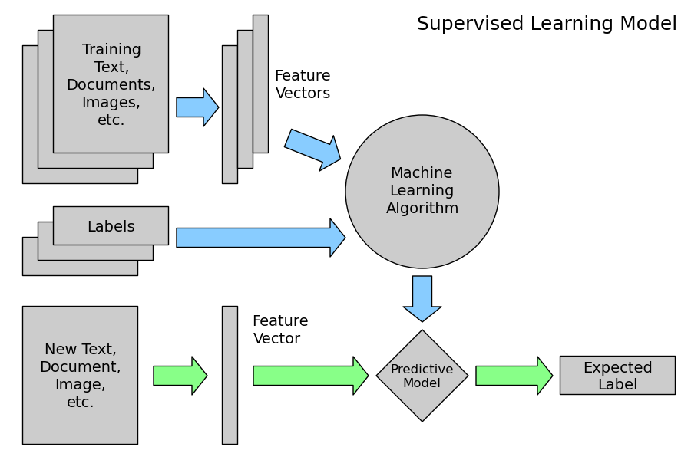
Machine Learning Model
Image Attributed to: www.astroml.com

Slide 6
Machine Learning Model
Stock Data is Time Series Data
Indexed by time
Period
Data aggregation by quarter is needed for our investigation
Aggregation will apply Technical Analysis methods to grouped data, and come up with “common sense” features.

Slide 7
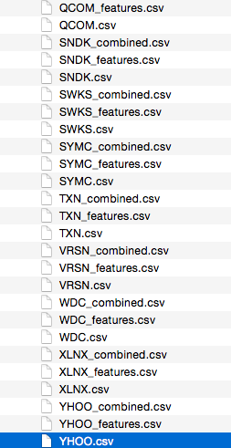
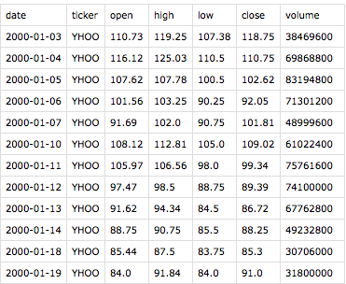
Data Gathering
Sources
Actual and Estimated earnings data came from Zacks/Quandl & Estimize. OHLCV stock
data came from Yahoo

Slide 8
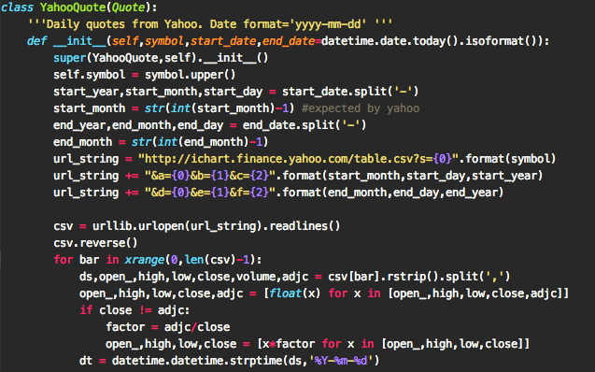
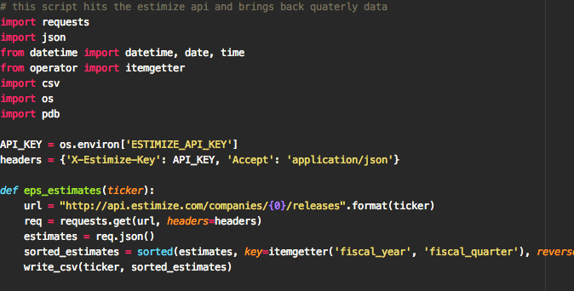
Data Gathering
Some Code…
A sampling of the code used to gather data from Yahoo &
Estimize

Slide 9
Tidy Data
Stock data is relatively “clean”. However, we still
ran into a few issues
Adjust for Splits/Reverse Splits
Re-index earnings estimate timelines to match OHLC Data
Deal with empty estimates (we just removed them).
Fill estimates to enable aggregation (explain)

Slide 10
Features
The challenge is to select features that are predictive of the desired target (beat/non-beat).
The features chosen should make sense to a human ‘analyst’ (visually be able to make predictions using them)
The features chosen should conform to input expectation of the model (e.g cannot use negative features in Naïve Bayes)

Slide 11
Features
Selecting the right features is one of the most important steps for generating a good model.
A few of our features came directly from the raw data, however most of our features are Engineered (calculated from Technical Analysis)
We use Price, Volume and compared these to their averages (20sma, 10ema, etc) to generate features.

Slide 12
Feature Generation
Features from Extraction
Quarter
Sector
Features from Engineering (for the quarter)
Close > Open more than 50% of the time
Price above 20sma more than 50% of days
Price above 10ema more than 50% of days
Number of times price and volume went up > 50%
Volume went up > 50% of the time
Number of times OBV went up from prior day
More…to come.

Slide 13
Features Generation
To generate these features we grouped/
aggregated the prices on a per year and then
quarterly basis. Next, we applied summarization
functions. Python’s awesome library, Pandas
was used for this.
This idiom is known as “Split-Apply-Combine”

Slide 14
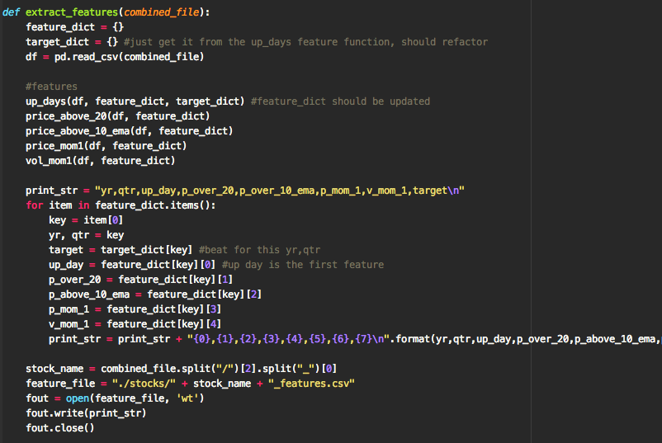
Features Code

Slide 15
Model Training
We trained 2 models:
Decision Tree
Good: non-linear data
Good: No normalization needed
Good: Easier interpretation
Bad: Over-fitting
Logistic Regression
Good: Scales and is fast
Good: Less prone to over-fitting
Bad: Better at modeling data where there’s a linear decision boundary

Slide 16
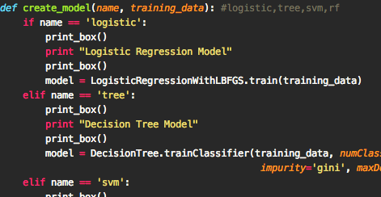
Model Training

Slide 17
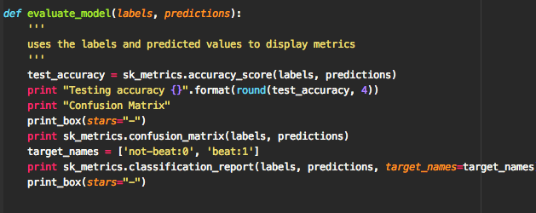
Model Evaluation
60% of data used for training the model
40% used for evaluation
Sample code used for evaluation

Slide 18
Model Evaluation
Accuracy
How often are we correct?
# correct / Total Examples
Problem: sensitive to imbalance classes! A simple predictor predicting only one class can do well based on this metric

Slide 19
Model Evaluation
Precision
How often does our model have false positives?
True positives / # predicted positive
True positives / (True positive + False positive)
Higher is better (closer to 1)
Higher precision means false positive are closer to zero.

Slide 20
Model Evaluation
Recall
How sensitive is our model?
Of all the actual beats, what fraction did we predict correctly?
True positives / # actual positives
True positives / (True positive + False negative)
Higher is better (close to 1)
This means that “False Negatives” are close to 0

Slide 21
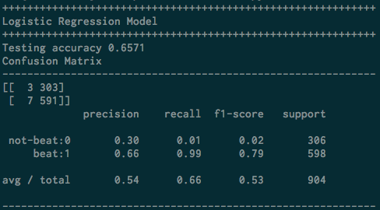
Model Evaluation
Results & Discussion

Slide 22
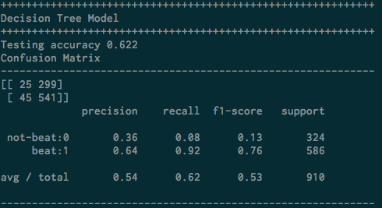
Model Evaluation

Slide 23
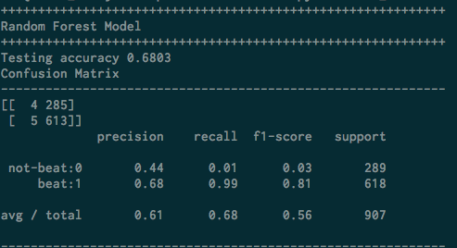
Model Evaluation

Slide 24
Further Work
Parameter search
More Feature Engineering
Cross Validation
Spark.ml vs MLlib

Slide 25




Thank You!

Slide 26
Discussion
Questions?

