Slide 1
Spatial Disaggregation of Rwandan
Building Exposure & Vulnerability via Conditional Census-Constrained Clustering (C4)
using Earth Observation Data: A Preliminary Result 28 July 2024

Slide 2
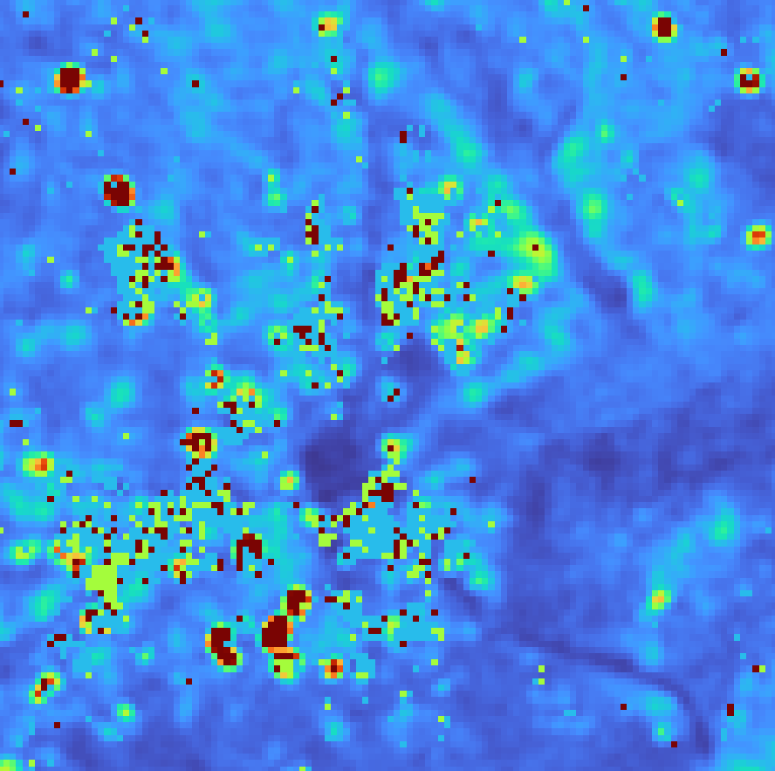
2022 Mean Sentinel-1 SAR GRD VV Band (10-meter)
0
1

Slide 3
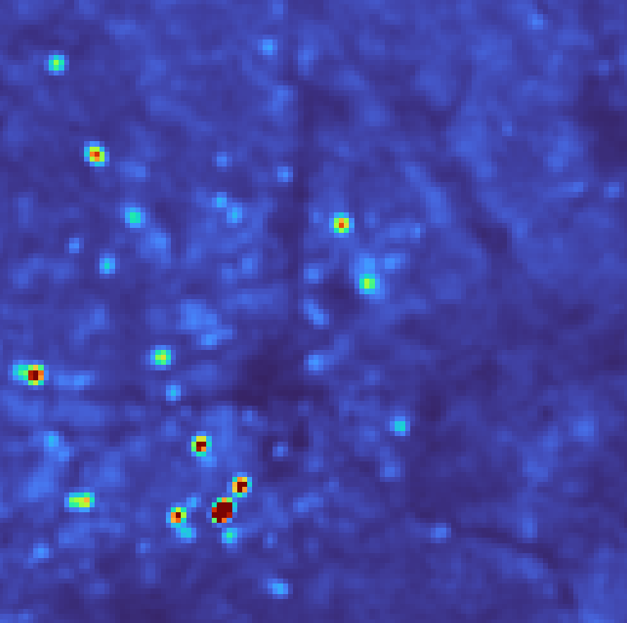
2022 Mean Sentinel-1 SAR GRD VH Band (10-meter)
0
0.5

Slide 4
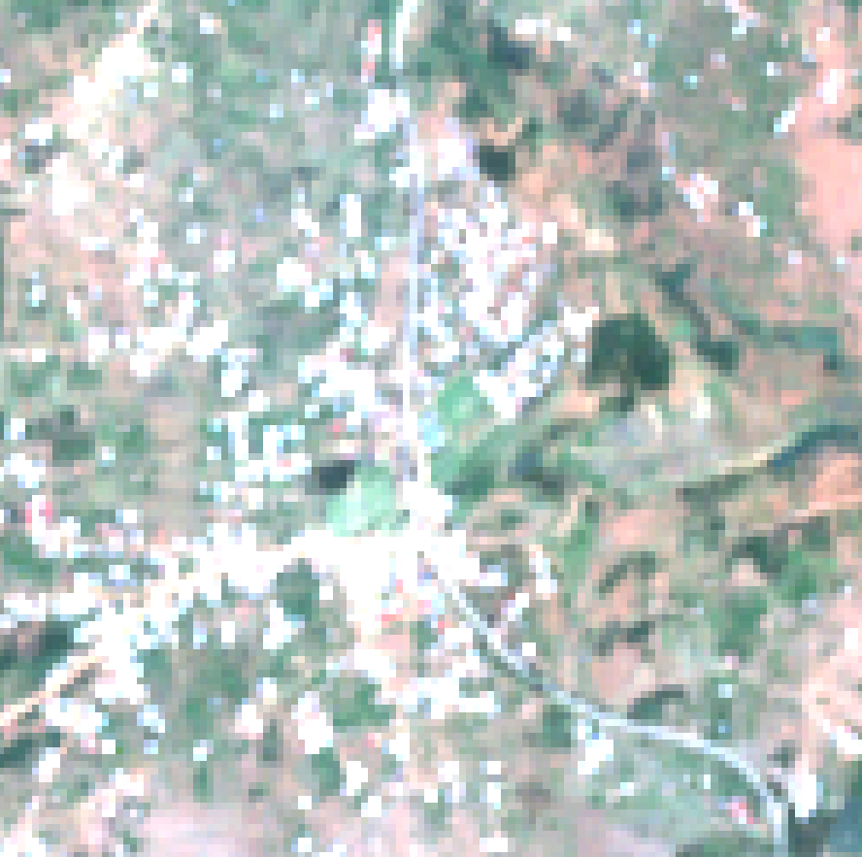
2022 Median Sentinel-2 MSI Red, Green, Blue (RGB) Bands (10-meter)

Slide 5
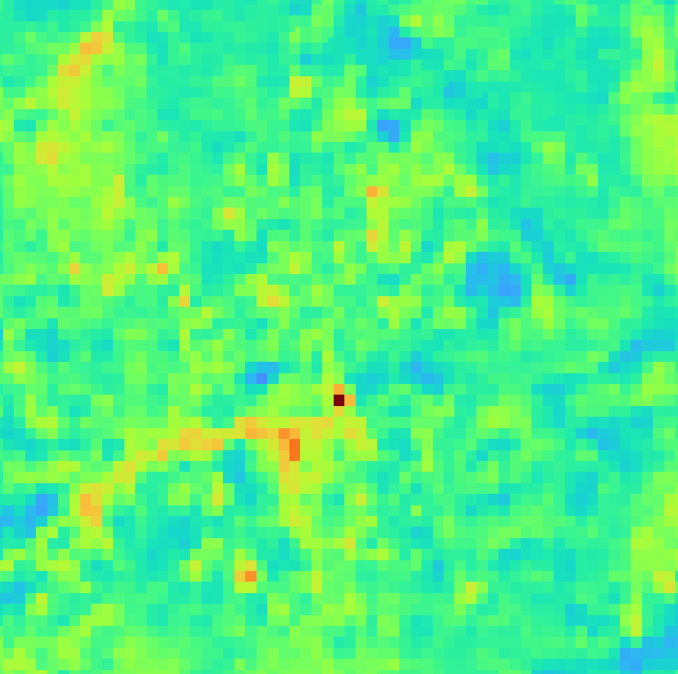
2022 Median Sentinel-2 MSI Red1 Band (10-meter)
0
3,500

Slide 6
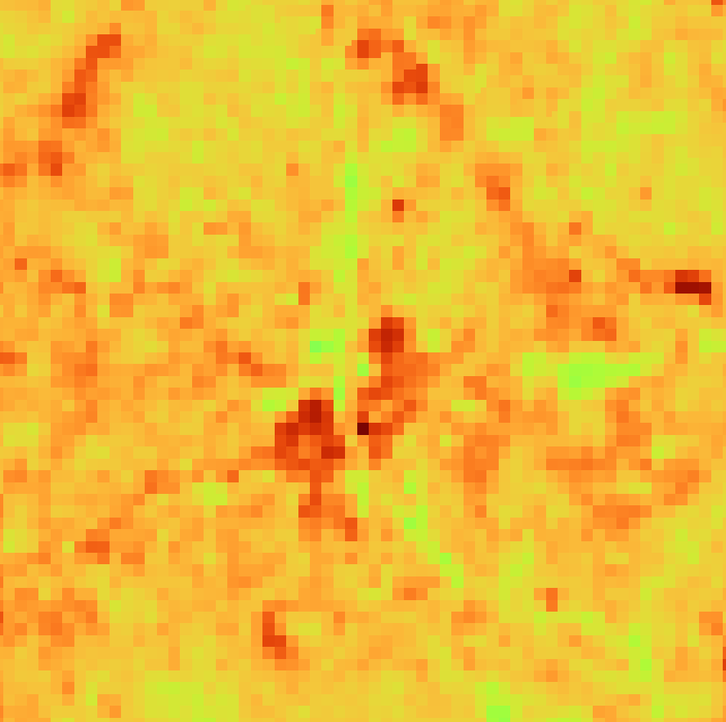
2022 Median Sentinel-2 MSI Red2 Band (10-meter)
0
3,500

Slide 7
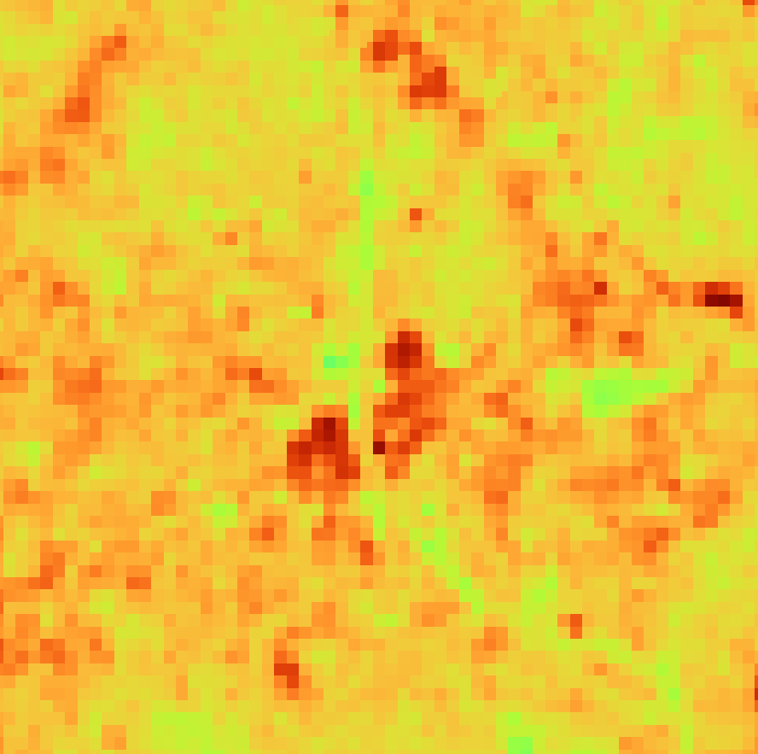
2022 Median Sentinel-2 MSI Red3 Band (10-meter)
0
4,000

Slide 8
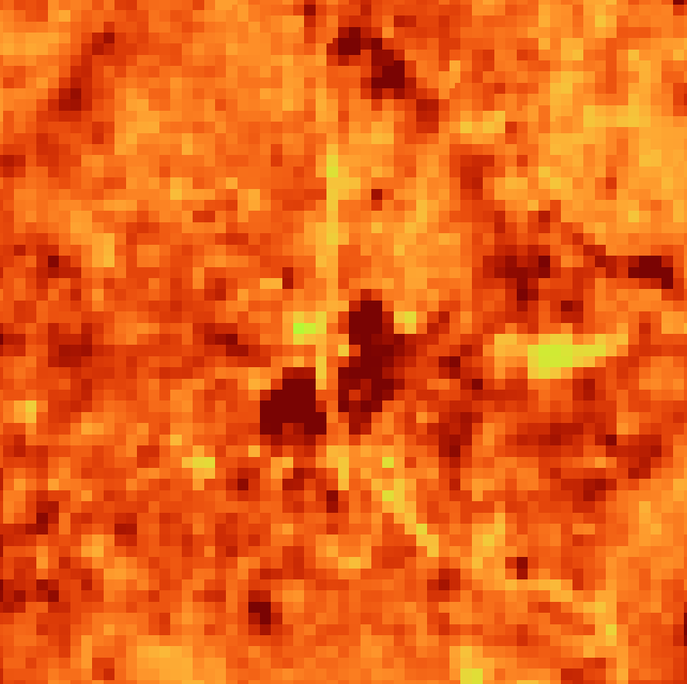
2022 Median Sentinel-2 MSI Red4 Band (10-meter)
0
3,500

Slide 9
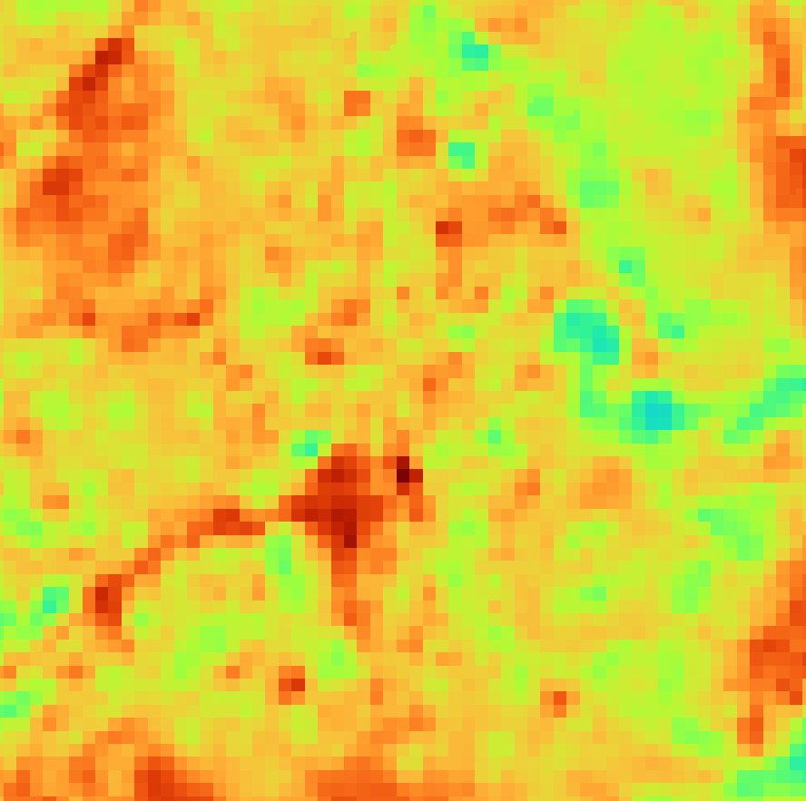
2022 Median Sentinel-2 MSI SWIR1 Band (10-meter)
0
4,000

Slide 10
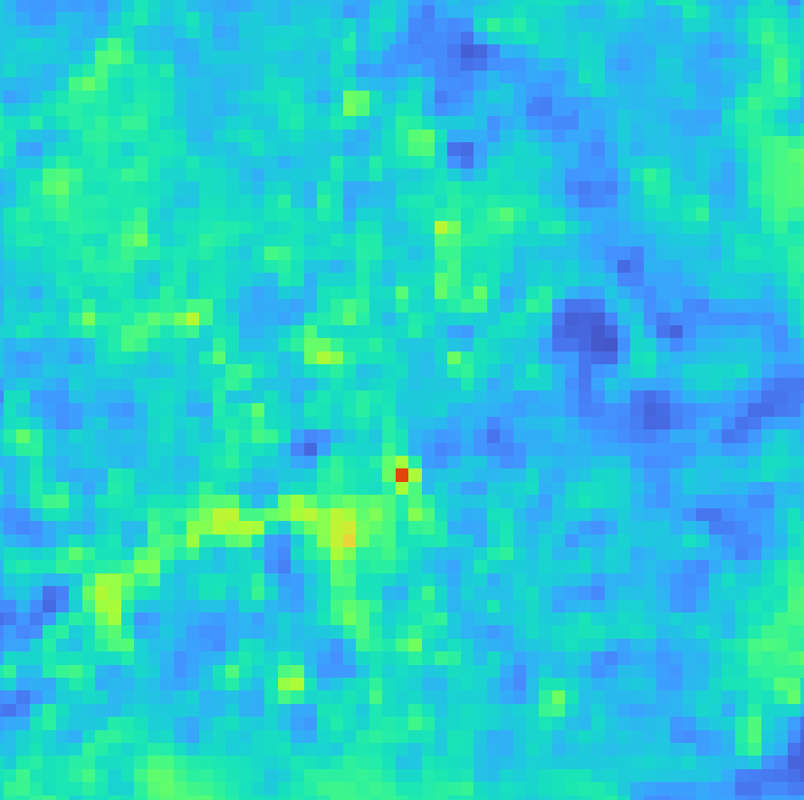
2022 Median Sentinel-2 MSI SWIR2 Band (10-meter)
0
6,200

Slide 11
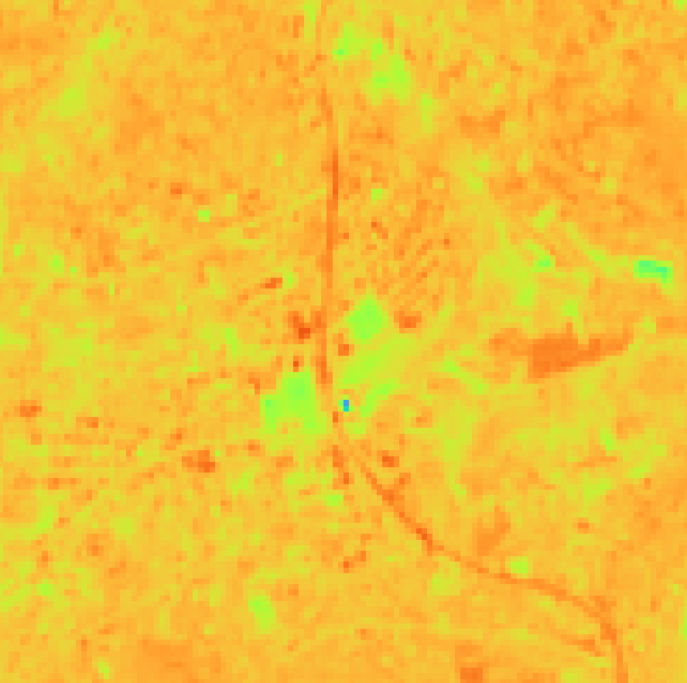
2022 Median Sentinel-2 MSI NIR Band (10-meter)
0
7,300

Slide 12
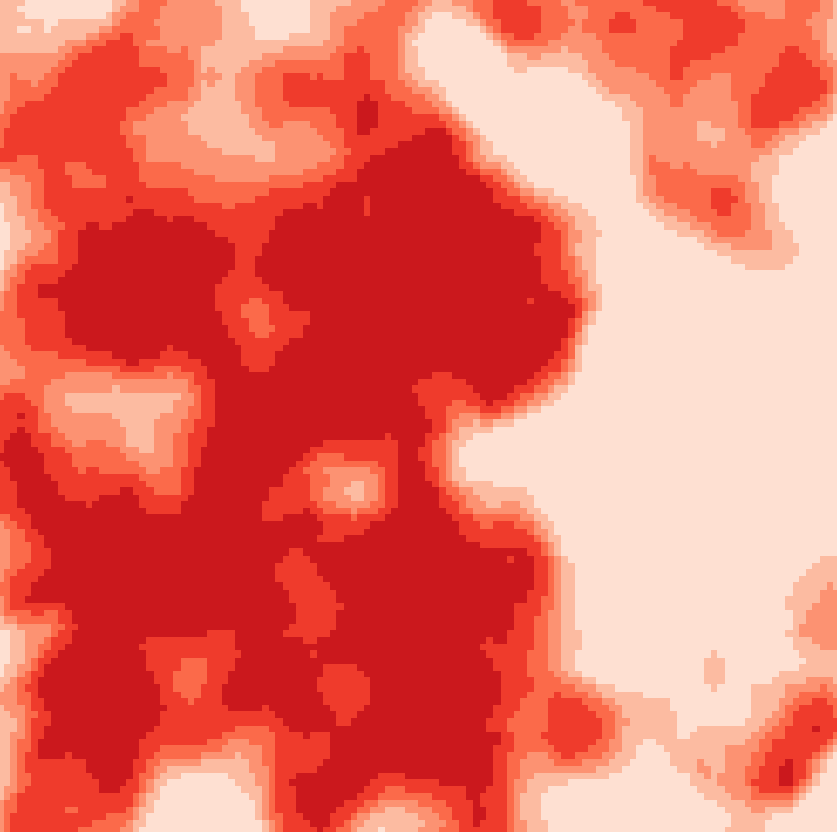
2022 Mean Probability of Dynamic World Land Cover being “Built” (10-meter)
0
1

Slide 13

2022 Locations of Most Frequent Dynamic World Land Cover being “Built” (10-meter)

Slide 14
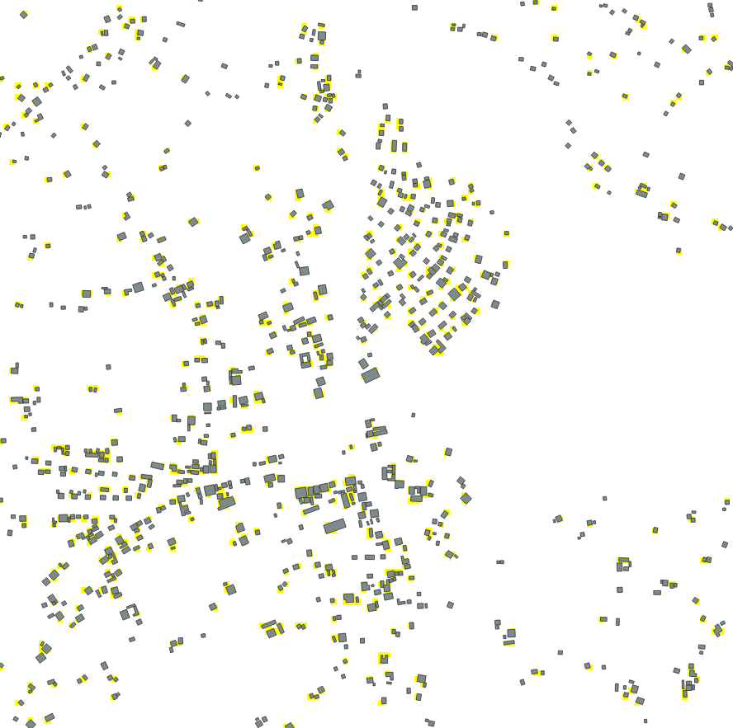
2014-2021 Microsoft Rwandan Building Footprint (Rasterized at 10-meter)

Slide 15
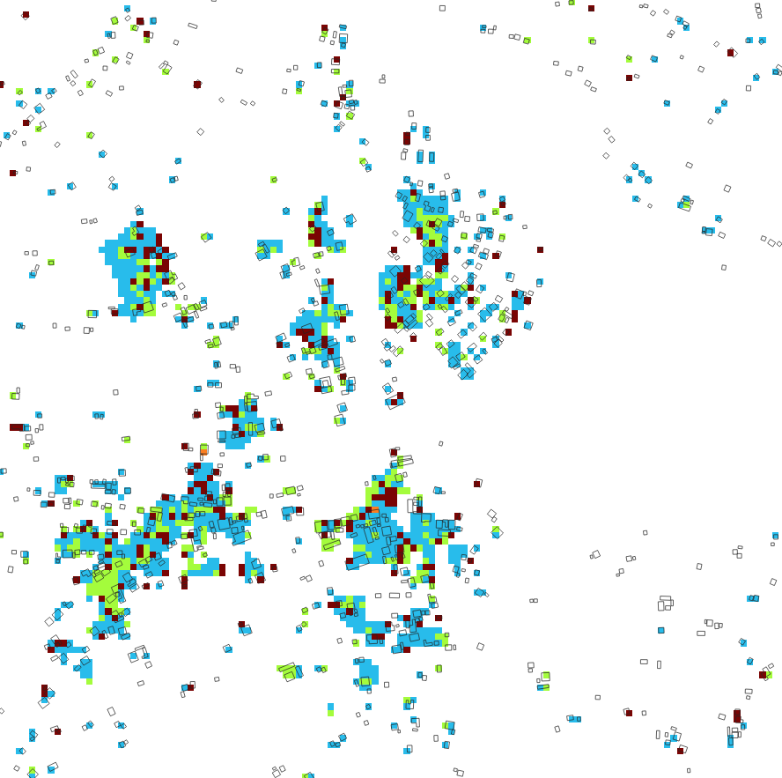
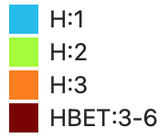
C4 Output: 2022 Building Height Map (10-meter)
Notice that we do not have predictions here. In fact, Microsoft Rwanda Bldg Footprint 2014-2021 (as shown) is not our “ground truth” as it just serves as a mere reinforcing belief to our approach whether a building could probably be in this location. When you check the Slide 12 and 13, the near-real-time Dynamic World Map even confirms the low likelihood of building presence here.

Slide 16
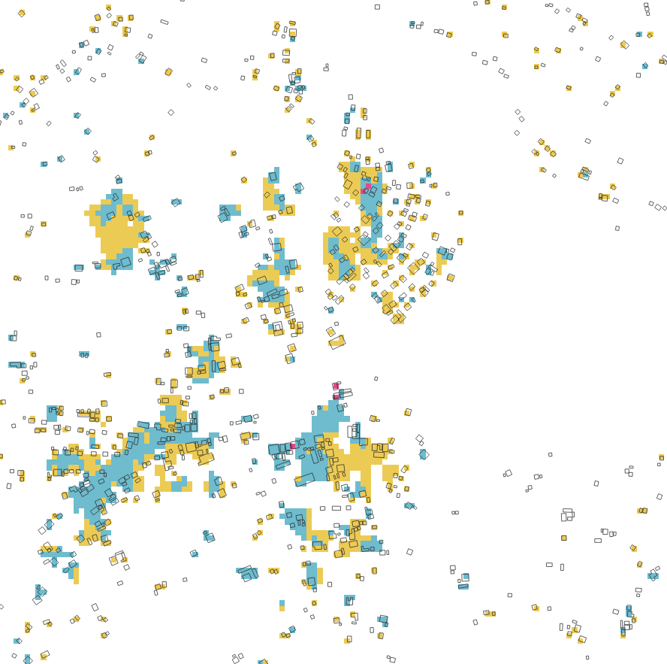
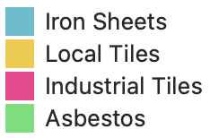
C4 Output: 2022 Building Roof Material Map (10-meter)

Slide 17
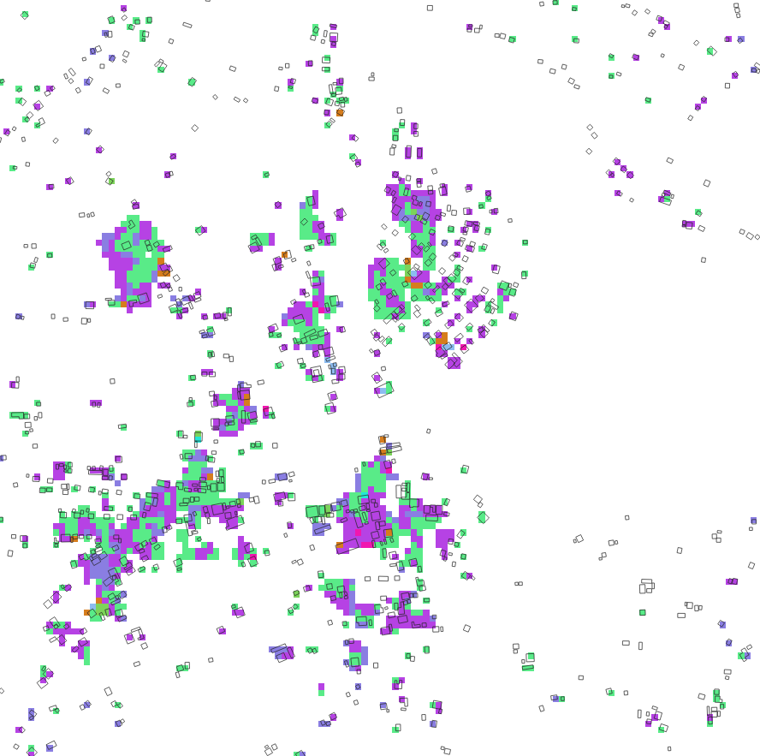
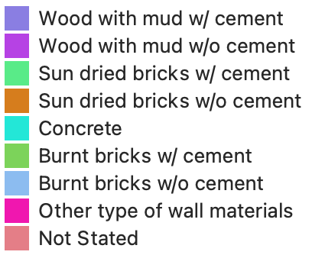
C4 Output: 2022 Building Wall Material Map (10-meter)

Slide 18
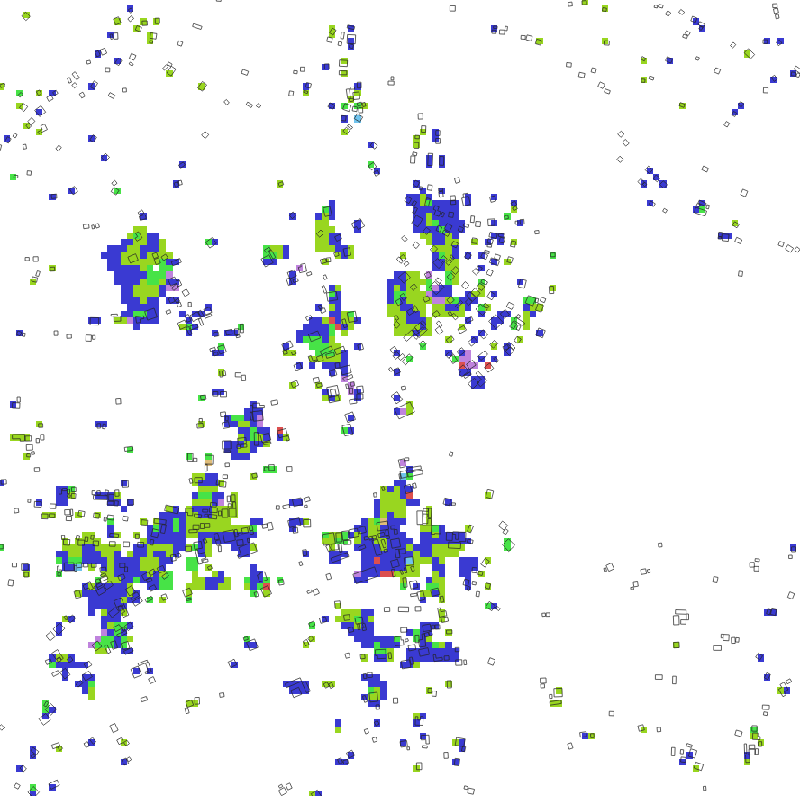
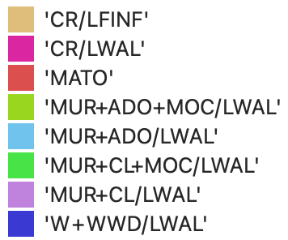
C4 Output: 2022 Building Macro-Taxonomy Map (10-meter)

