Slide 1
Fungsi Rekursi

Slide 2
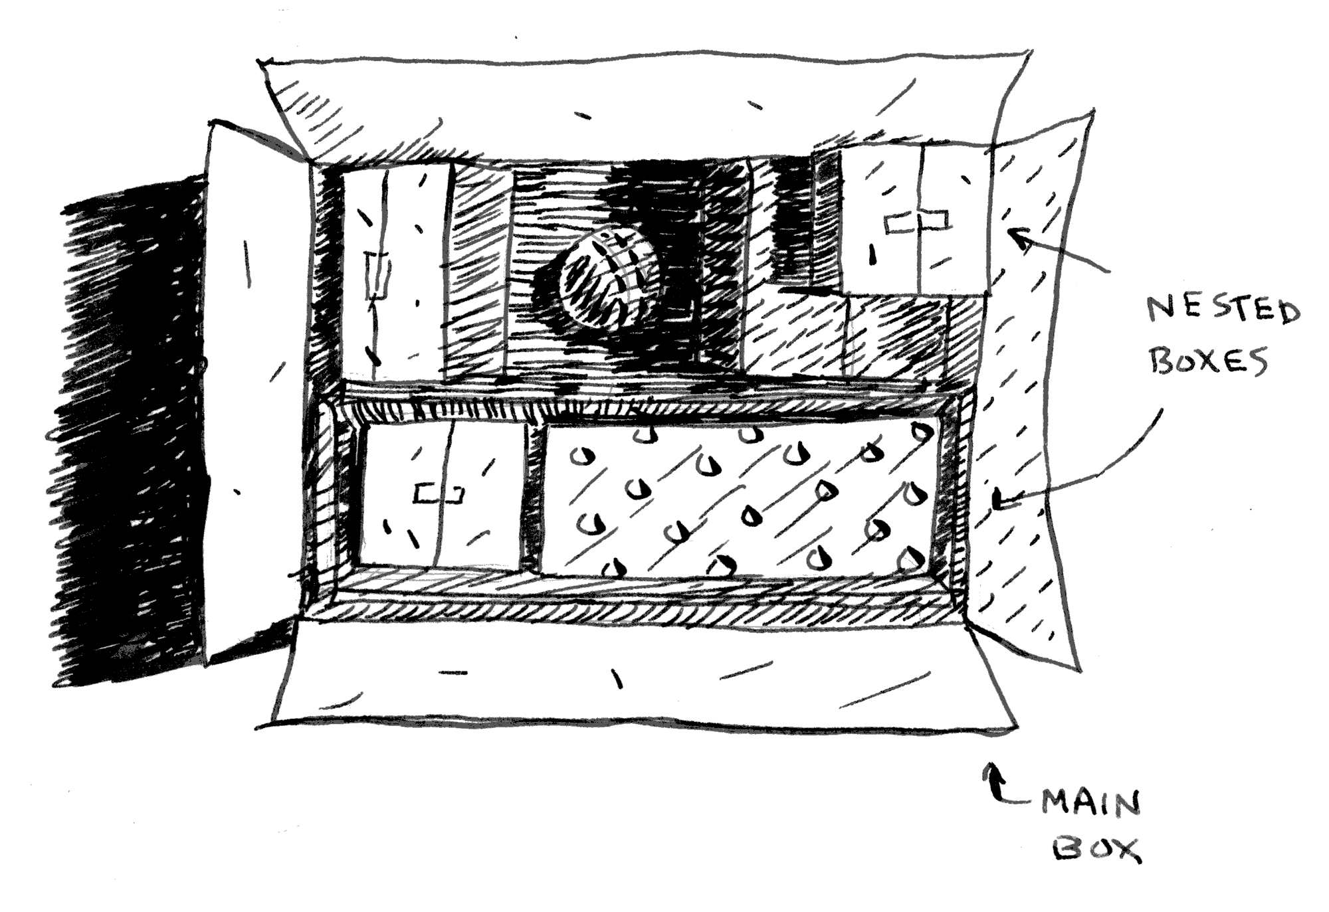

Slide 3
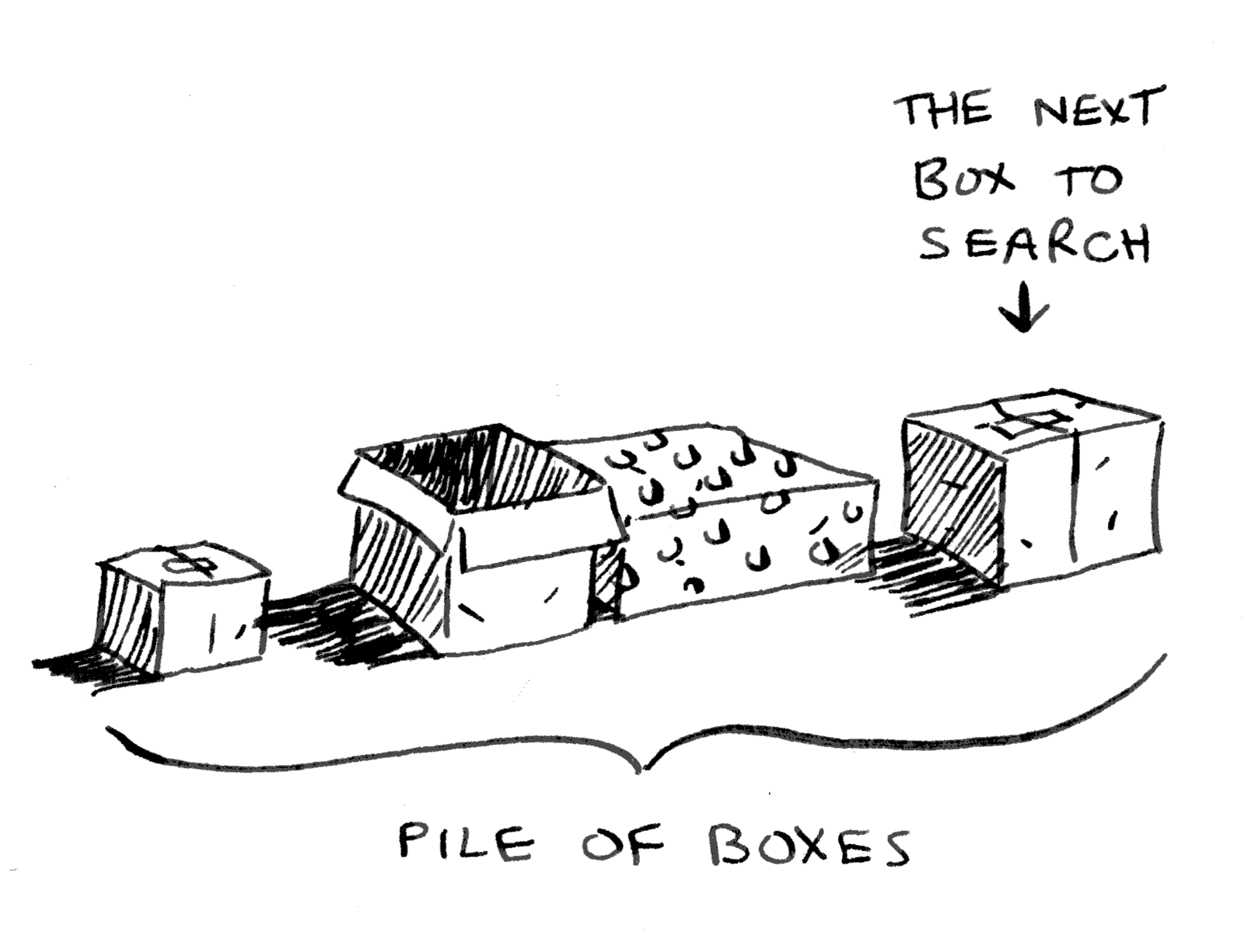

Slide 4
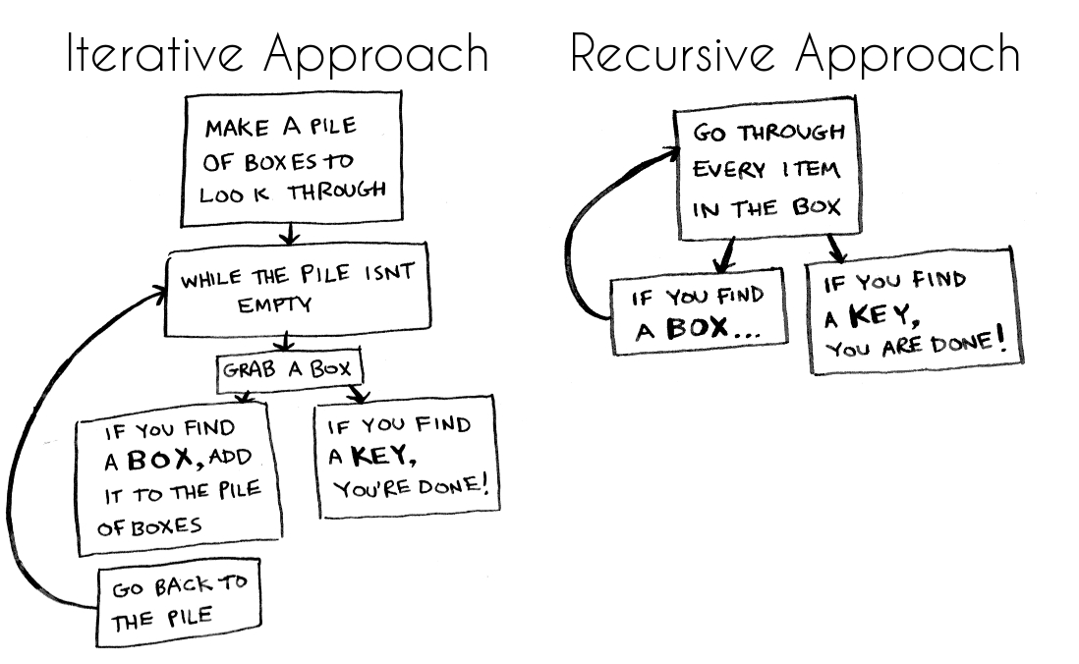

Slide 5
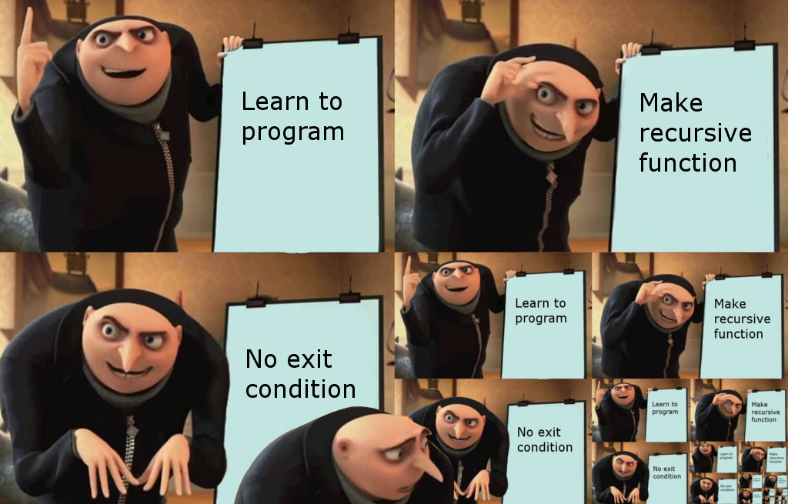

Slide 6
Fakotorial
Basis
f(n) = n!
n = 0, 1; f(n) = 1
n > 1; f(n) = n * (n-1)!
Rekursi

Slide 7
Iteratif Rekursi
int faktorial(int n) {
int result = 1;
for(int i=1; i<=n; i++) {
result *= i;
}
return result;
}
int faktorial(int n) {
if(n == 1) {
return 1;
}
return n * faktorial(n-1);
}

Slide 8
Execution flow
3 * f(n-1)
6
n = 3
2 * f(n-1)
int faktorial(int n) {
if(n == 1) {
return 1;
}
return n * faktorial(n-1);
}
n = 2
3 * 2
1 * f(n-1)
n = 1
2 * 1
1 * 1

Slide 9
Execution flow
2
main()
n = 2
1
void countDown(int n) {
if(n == 0) {
cout << “finish\n”;
}
cout << n << endl;
countDown(n-1);
}
n = 1
finish
n = 0

Slide 10
Execution flow
main()
n = 2
void countUp(int n) {
if(n == 0) {
cout << “start\n”;
}
countUp(n-1);
cout << n << endl;
}
n = 1
2
n = 0
1
start

