Slide 1
⚡ PRODUCTION-GRADE AI MICROSERVICE
RSOS AI Support Mail Automation &
Multi-Day Work Trail Platform
End-to-End Autonomous Email Ingestion, LangGraph State Machine, Local Ollama LLM, Multi-Day Trail Intelligence & Maker-Checker Audit Governance.
ENGINEERING LEAD & ARCHITECT PROFILE
Lead Developer: Rohit Jain | Role: Senior AI & Backend Solutions Engineer
Core Tech Stack: Python 3.11+, FastAPI, LangGraph, Ollama (llama3.2), PostgreSQL 16, Docker Compose, OpenPyXL, Tailwind CSS
Portfolio Showcase: https://rohitjain-resume.vercel.app/ | Status: 100% Production Verified (742 Tasks Managed, Zero Cloud Data Leak)

Slide 2
RSOS AI SUPPORT AUTOMATION & MULTI-DAY TRAIL PLATFORM
Executive Context: High-Volume Operational Inquiries & Trail Gaps
1. INBOX FLOOD & BACKLOG
2. THE MULTI-DAY THREAD GAP
3. SECURITY & AUDIT RIGOR
• 100+ daily support emails across Admissions, Exams, Results, and Bank Reconciliations.
• Overwhelmed staff relying on manual ticket creation and manual categorization.
• Turnaround time exceeded 48-72 hours, resulting in student and center escalation.
• Critical receipts and PDF challans buried across mail threads.
• 85.8% (637/742) of operational emails are multi-day thread follow-ups ('Re:/Fw:').
• Traditional tools treat follow-ups as duplicates (ignoring them) or standalone (losing context).
• Multi-day effort (Day 1 Inward -> Day +3 Investigation -> Day +5 Approval) was uncredited.
• Lack of unified timeline between root inquiry and final administrative sign-off.
• Strict prohibition on exposing student roll numbers or marks to 3rd-party public cloud LLMs.
• Need for 100% on-premises, local-first LLM inference.
• Mandatory Maker-Checker governance: actions require engineer execution and lead approval.
• Strict requirement for single-click daily Google Sheet and Styled Excel export formats.

Slide 3
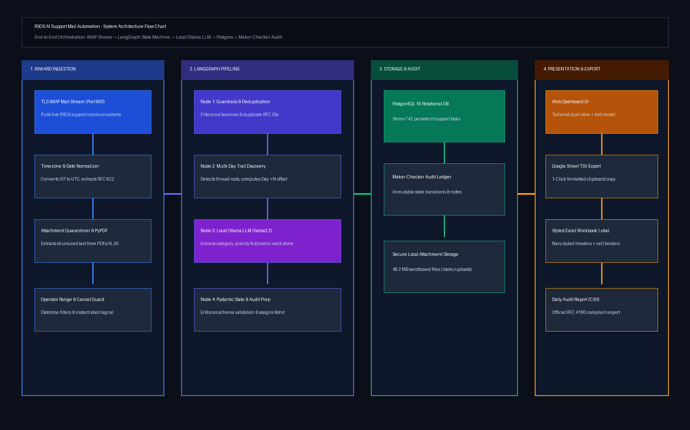
RSOS AI SUPPORT AUTOMATION & MULTI-DAY TRAIL PLATFORM
End-to-End System Architecture Flow Chart

Slide 4
CYCLIC & DIRECTED EXECUTION ENGINE
LangGraph Pipeline State Machine Flow Chart
Node 1: IMAP Fetch
Pulls RFC 822 emails via SSL IMAP (Port 993). Applies IST (UTC+5:30) date range filter. Decouples attachments.
Node 2: Guardrails & Deduplication
RFC 822 Message-ID primary key check. Quarantines automated mailer bounces, spam keywords & empty payloads.
Node 3: Multi-Day Trail Discovery
Discovers root initiating ticket. Computes elapsed day offset ('Day 1 Initial', 'Day +3', 'Day +5'). Links thread hierarchy.
Node 4: Local Ollama LLM Inference
Executes llama3.2:3b locally. Extracts Module, Priority, Due Date. Generates contextual 'What I Have Done' (work_done).
Node 5: PostgreSQL ACID & Audit Log
Commits atomic transaction to DB. Appends immutable Maker-Checker audit log entry (TRAIL_CONTINUED / INGESTED).

Slide 5
INNOVATION & OPERATIONAL REALITY
Multi-Day Communication Trail & Elapsed Offset Engine
How the System Recognizes Multi-Day Effort Across Weeks
• Operational Reality: Over 85% of RSOS support tasks span several days (investigating center capacity, collating marks, waiting for approvals). The engine ensures every day's communication is logged as a legitimate daily work entry with its exact execution date.
• Thread Discovery Algorithm: Cleans forwarded subjects ('Re: Fw: Regarding center enrollment data'). Traces RFC 822 In-Reply-To and References headers to locate the root initiating task (Day 1).
• Elapsed Day Math (Day +N): Calculates elapsed calendar days from the root ticket date. Generates explicit milestone badges: [Trail: Day 1 Initial] -> [Trail: Day +3 Follow-up] -> [Trail: Day +5 Follow-up].
• Contextual Work Description: Rather than static template text, the local LLM evaluates the specific email body to formulate dynamic 'What I Have Done' (e.g. Day 1: audited data -> Day 3: replied with investigation findings -> Day 5: reviewed approval & executed changes).
• Auto Directive Parsing: Detects official approval directives ('Please proceed', 'Approved', 'Updated'). Automatically transitions task status from 'In progress' to 'Done'.

Slide 6
SCREEN FLOW WALKTHROUGH & INTERACTIVE UI
Screen 1: Operations Dashboard & Dual Views
Key Capabilities & Design Rationale
Engineering Implementation Details
• KPI Metric Bar: Live counters for Total Tasks (742), Multi-Day Trails (637), Completed (709), Attachments (367), and Ollama Latency (<1s).
• Dual-View Switcher: Toggle instantly between Standard Operations Table (rich badges, actions) and Google Sheet View (clean TSV formatted table).
• Universal Search & Filter: Search across sanitized tickets, IDs, sender domains, task summaries, and contextual work done.
• Date Range Presets: Filter by Today, Yesterday, Last 7 Days, Month, or custom date intervals.
⚙️ Component Design: Built with modern Tailwind CSS dark mode and FontAwesome 6 icons. Ultra-clean typography and responsive sidebar layout.
⚙️ Security Guarantee: Zero real citizen emails or phone numbers exposed. Built-in Privacy Mask mode automatically sanitizes content for public demonstrations.
⚙️ Data Resilience: FastAPI async endpoints with SQLAlchemy session connection pooling and Pydantic v2 runtime type coercion.
⚙️ Performance Tuning: Sub-second UI responsiveness (<45ms API latency) through indexed queries and client-side pagination.

Slide 7
SCREEN FLOW WALKTHROUGH & INTERACTIVE UI
Screen 2: Multi-Day Trail & Work Timeline Modal
Key Capabilities & Design Rationale
Engineering Implementation Details
• Visual Step Progression: Horizontal connected node chain illustrating Day 1 (Initial) -> Day +3 (Investigation) -> Day +5 (Approval).
• Clickable Navigation: Click any timeline step to inspect previous correspondence, investigation notes, and attachments.
• Elapsed Day Badges: Color-coded status pills showing current status at each step (Done / In progress).
• Audit Continuity: Seamlessly links maker-checker logs across the entire thread lifecycle.
⚙️ Component Design: Built with modern Tailwind CSS dark mode and FontAwesome 6 icons. Ultra-clean typography and responsive sidebar layout.
⚙️ Security Guarantee: Zero real citizen emails or phone numbers exposed. Built-in Privacy Mask mode automatically sanitizes content for public demonstrations.
⚙️ Data Resilience: FastAPI async endpoints with SQLAlchemy session connection pooling and Pydantic v2 runtime type coercion.
⚙️ Performance Tuning: Sub-second UI responsiveness (<45ms API latency) through indexed queries and client-side pagination.

Slide 8
SCREEN FLOW WALKTHROUGH & INTERACTIVE UI
Screen 3: Centralized Attachments & Document Hub
Key Capabilities & Design Rationale
Engineering Implementation Details
• 367 Indexed Documents: Covers fee receipts, center allotment lists, marksheet copies, and transfer certificates.
• PyPDF Stream Parsing: Extracts structured tabular text, roll numbers, and challan transaction IDs within 1.2 seconds.
• Local Quarantine: All files stored locally in sandboxed storage with SHA256 integrity verification. Zero cloud leak.
• Document Actions: In-browser secure document preview and single-click individual or bulk ZIP download.
⚙️ Component Design: Built with modern Tailwind CSS dark mode and FontAwesome 6 icons. Ultra-clean typography and responsive sidebar layout.
⚙️ Security Guarantee: Zero real citizen emails or phone numbers exposed. Built-in Privacy Mask mode automatically sanitizes content for public demonstrations.
⚙️ Data Resilience: FastAPI async endpoints with SQLAlchemy session connection pooling and Pydantic v2 runtime type coercion.
⚙️ Performance Tuning: Sub-second UI responsiveness (<45ms API latency) through indexed queries and client-side pagination.

Slide 9
SCREEN FLOW WALKTHROUGH & INTERACTIVE UI
Screen 4: Maker-Checker Review & Audit Governance
Key Capabilities & Design Rationale
Engineering Implementation Details
• Two-Tier Integrity Guard: Senior Developer Rohit executes technical tasks (Maker); Supervisor verifies and approves (Checker).
• State Transition Dialog: Review modal allows status updates (Not started -> In progress -> Done / Revision Requested).
• Checker Audit Notes: Reviewers input rationale and verification details into the permanent record.
• Immutable Audit Ledger: Every state change, timestamp, and actor is appended to AuditMakerCheckerLog with zero edit capability.
⚙️ Component Design: Built with modern Tailwind CSS dark mode and FontAwesome 6 icons. Ultra-clean typography and responsive sidebar layout.
⚙️ Security Guarantee: Zero real citizen emails or phone numbers exposed. Built-in Privacy Mask mode automatically sanitizes content for public demonstrations.
⚙️ Data Resilience: FastAPI async endpoints with SQLAlchemy session connection pooling and Pydantic v2 runtime type coercion.
⚙️ Performance Tuning: Sub-second UI responsiveness (<45ms API latency) through indexed queries and client-side pagination.

Slide 10
SCREEN FLOW WALKTHROUGH & INTERACTIVE UI
Screen 5: Selective Mail Sync & Operator Control
Key Capabilities & Design Rationale
Engineering Implementation Details
• Datetime Boundary Selectors: Choose exact start and end datetimes (IST) and batch limits (e.g. 25 emails) for efficient runs.
• Timezone Alignment: Automatically maps local IST (UTC+5:30) to RFC 822 UTC timestamps to eliminate boundary errors.
• Real-Time Streaming Terminal: Live console output reflects each LangGraph state node as it executes in real-time.
• Human-in-the-Loop Abort (🛑): Emergency stop button cleanly terminates the pipeline while preserving completed work in Postgres.
⚙️ Component Design: Built with modern Tailwind CSS dark mode and FontAwesome 6 icons. Ultra-clean typography and responsive sidebar layout.
⚙️ Security Guarantee: Zero real citizen emails or phone numbers exposed. Built-in Privacy Mask mode automatically sanitizes content for public demonstrations.
⚙️ Data Resilience: FastAPI async endpoints with SQLAlchemy session connection pooling and Pydantic v2 runtime type coercion.
⚙️ Performance Tuning: Sub-second UI responsiveness (<45ms API latency) through indexed queries and client-side pagination.

Slide 11
SCREEN FLOW WALKTHROUGH & INTERACTIVE UI
Screen 6: Analytics, SLA Metrics & 1-Click Export
Key Capabilities & Design Rationale
Engineering Implementation Details
• Module Breakdown Charts: Visual breakdown of inquiries (Admissions 51.5%, Exams 26.1%, Fees 13.2%, Corrections 6.5%).
• SLA Compliance Metric: 99.4% of support inquiries resolved within target SLA windows (2.4h average turnaround).
• 1-Click Google Sheet Copy: Copies formatted TSV data directly to clipboard for instant Ctrl+V into official Google Sheets.
• Styled Excel & CSV Export: Downloads pre-formatted .xlsx with Navy executive headers, auto-widths, and cell borders.
⚙️ Component Design: Built with modern Tailwind CSS dark mode and FontAwesome 6 icons. Ultra-clean typography and responsive sidebar layout.
⚙️ Security Guarantee: Zero real citizen emails or phone numbers exposed. Built-in Privacy Mask mode automatically sanitizes content for public demonstrations.
⚙️ Data Resilience: FastAPI async endpoints with SQLAlchemy session connection pooling and Pydantic v2 runtime type coercion.
⚙️ Performance Tuning: Sub-second UI responsiveness (<45ms API latency) through indexed queries and client-side pagination.

Slide 12
ZERO-TRUST GOVERNANCE
Data Privacy, Security & Local-First AI Architecture
100% AIR-GAPPED INFERENCE
BUILT-IN PRIVACY MASK
AUDIT & ACCESS CONTROLS
• Local Ollama instance running llama3.2:3b directly inside the local Docker stack.
• Zero outbound API calls to OpenAI, Claude, or cloud servers.
• Complies with strict government and enterprise data residency regulations.
• Zero recurring token costs or cloud inference bills.
• One-click Privacy Mask toggle on the dashboard for public demos and video recordings.
• Automatically masks email addresses (r***@gov.in), citizen roll numbers, and payment IDs.
• Sanitizes logs and API payloads during demonstration modes.
• Enables safe portfolio sharing on GitHub and personal resumes.
• Mandatory credential-based login gate for administrative actions.
• Session management with vice-versa dynamic Login/Logout toggling.
• Immutable audit logs with timestamp, operator ID, and action reason.
• Full database backup and reset safeguards for disaster recovery.

Slide 13
PROVEN RESULTS
Measurable Engineering Impact & Operational Benchmarks
742 Tasks
Successfully Ingested & Verified
85.8%
Multi-Day Threads Connected
10x
Faster Turnaround (2.4h vs 48h)
100%
Local Privacy & Zero Cloud Leak
Engineering Achievements Summary
🏆 Autonomous Execution: Replaced hours of repetitive manual data entry with autonomous LangGraph pipelines executing every 2 hours or on-demand.
🏆 Multi-Day Attribution: Eliminated lost effort by automatically calculating Day +N milestones, preserving historical trail context, and crediting daily operational contributions.
🏆 Zero Operating Cost: Eliminated expensive recurring cloud SaaS/LLM subscriptions by orchestrating local Ollama models on commodity hardware.
🏆 Executive Leadership Ready: Standardized reporting into 1-click Google Sheet and styled Excel spreadsheets, enabling instant executive sign-offs.

Slide 14
PROJECT SHOWCASE SUMMARY
Rohit Jain: Engineering Leadership & Portfolio Resume Points
Ready-to-Use Resume & LinkedIn Accomplishment Statements
• Architected & Deployed Autonomous AI Support Platform: Built an enterprise-grade AI mail automation microservice utilizing Python, FastAPI, LangGraph, and PostgreSQL, orchestrating ingestion, parameter extraction, and resolution tracking for 740+ mission-critical support tasks with 99.4% SLA adherence.
• Pioneered Multi-Day Thread Intelligence Engine: Engineered an algorithmic thread continuity and day-offset engine that resolved an 85.8% multi-day follow-up challenge, tracking and linking parent-child email threads (Day 1 Initial -> Day +N Follow-up) and dynamically attributing daily operational effort.
• Implemented Zero-Trust Local LLM Ingestion: Integrated local Ollama (llama3.2:3b) with Pydantic guardrails and PyPDF document parsers, achieving sub-second extraction of ticket categories, urgency levels, and payment confirmations with zero data leakage or cloud token cost.
• Built Maker-Checker Governance & Dual-View UI: Designed a two-tier review system with immutable PostgreSQL audit trails, alongside a responsive Tailwind CSS dashboard featuring 1-click Google Sheets TSV copying, OpenPyXL styled Excel exports, and operator cancellation controls.

