Slide 1


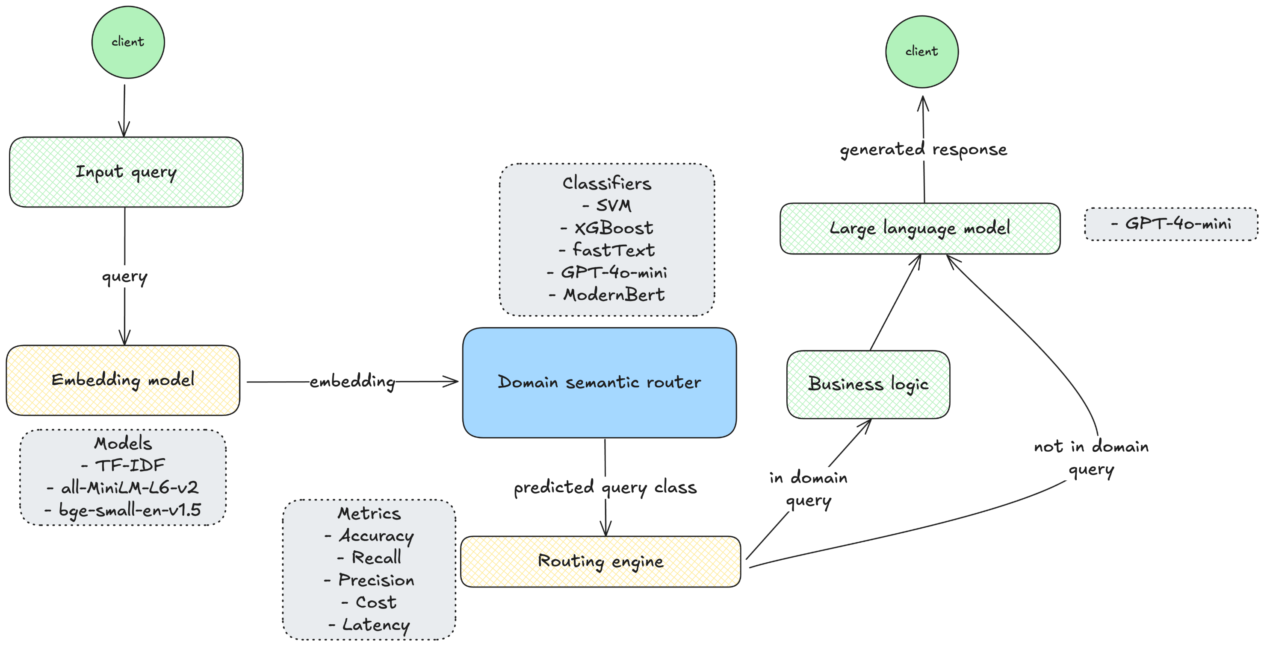
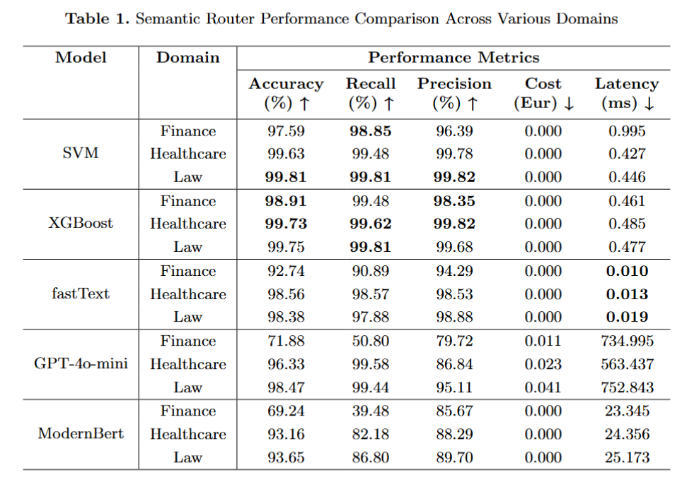
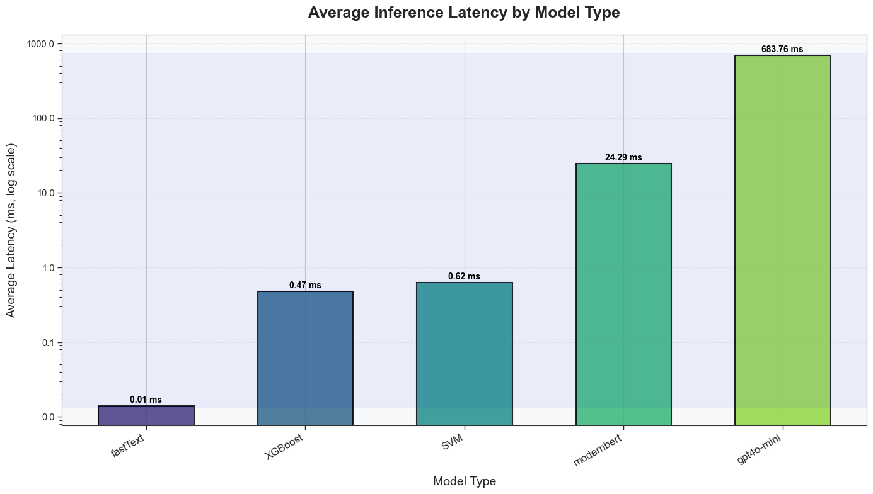
Does your Large Language Model need a Semantic Router?
Richard Šléher
Faculty of Informatics and Information Technologies STU in Bratislava, Slovakia
Introduction
Large Language Models (LLMs) have become widely used in query routing applications, but they pose significant challenges in terms of latency, computational cost, and interpretability.
This paper investigates whether domain-specific classifiers can provide more efficient semantic routing without sacrificing performance.
Methods
We conducted a comprehensive comparison of SVM, XGBoost, fastText, and Natural Language Inference model (ModernBert) against LLM-based approaches (GPT-4o-mini), evaluating the impact of TF-IDF, all-MiniLM-L6-v2, and bge-small-en-v1.5 embedding techniques.
Experiments on domain-specific datasets in law, finance, and healthcare reveal compelling performance differences.
Traditional machine learning approaches demonstrated superior accuracy/cost ratios compared to LLM methods.
Results
XGBoost consistently achieved the highest accuracy across all domains (98.91% in finance, 99.7% in healthcare, and 99.75% in law), while SVM delivered similarly impressive results (97.59%, 99.63%, and 99.81%, respectively).
In terms of latency, traditional models significantly outperformed LLM-based approaches, with processing times ranging from sub-milliseconds (fastText) to less than 1ms (SVM, XGBoost), compared to the much higher latencies of GPT-4o-mini (734.995ms for Finance, 563.437ms for Healthcare, and 752.843ms for Law).
Most importantly, all of the traditional models operated at zero cost, while the GPT-4o-mini incurred costs ranging from €0.011 to €0.041 per domain.
These results suggest that well-established machine learning models can effectively replace LLM-based semantic routers in domain-specific applications, providing organizations with practical options to optimize the performance-cost-latency triangle based on their specific requirements.

