Slide 1
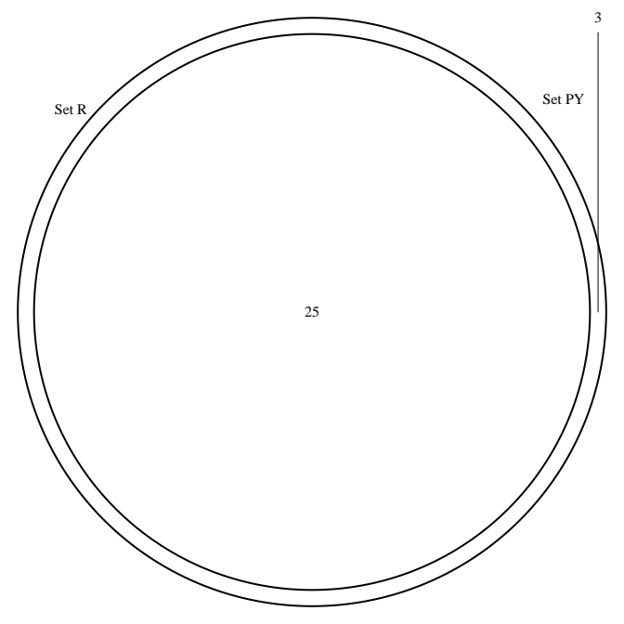
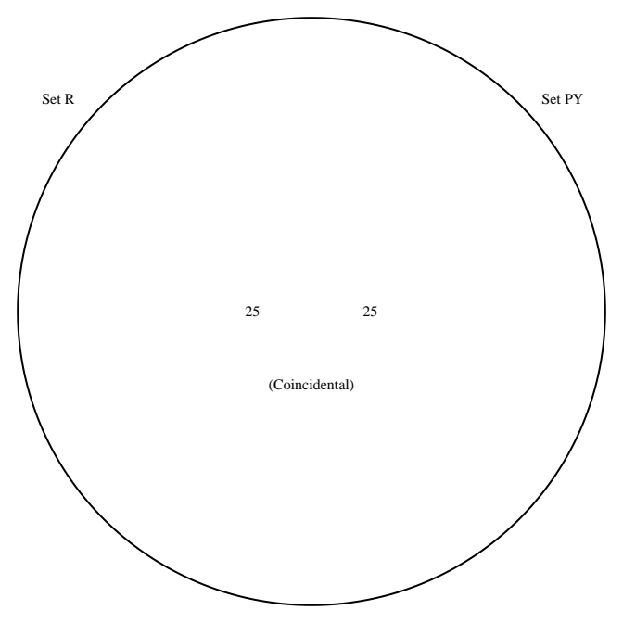
Python t-test & R t-test
CTR input condition control
Python t-test overestim var & R t-test
CTR input condition control

Slide 2
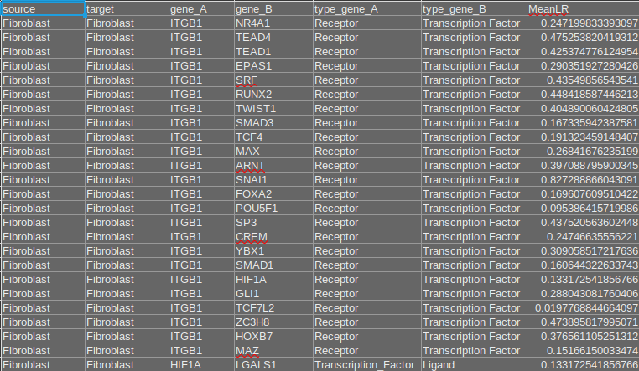

Python t-test & R t-test
CTR input condition control
Python t-test overestim var & R t-test
CTR input condition control
Unique entries in Python overestim var CTR input:
With SPIB, TP63 and CEBPA being the TFs

Slide 3
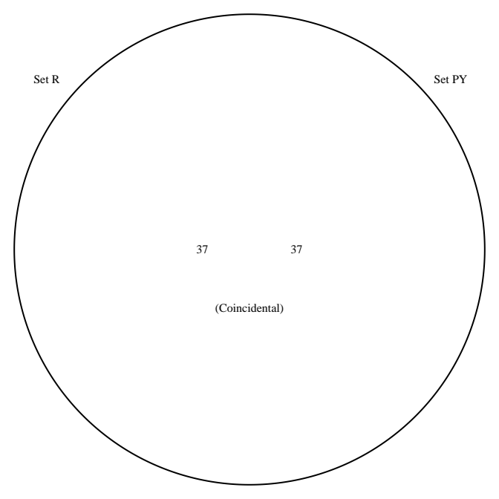
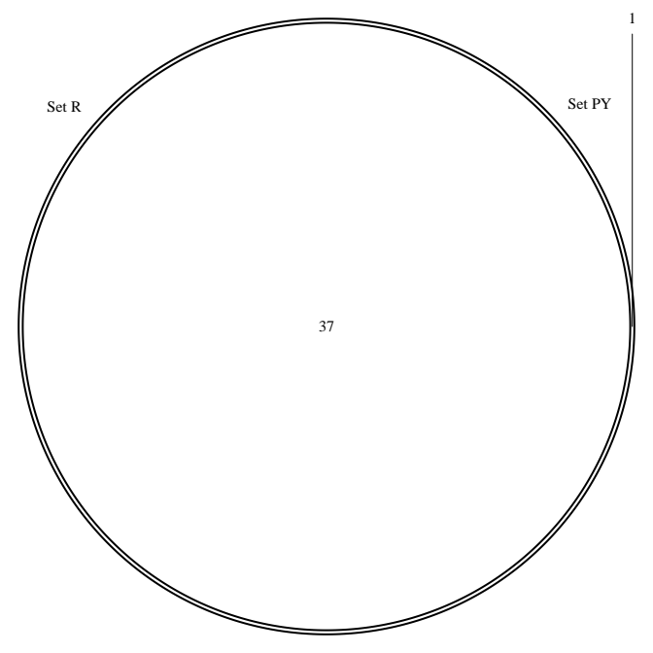
Python t-test & R t-test
CTR input condition PMF,MF2
Python t-test overestim var & R t-test
CTR input condition PMF,MF2

Slide 4
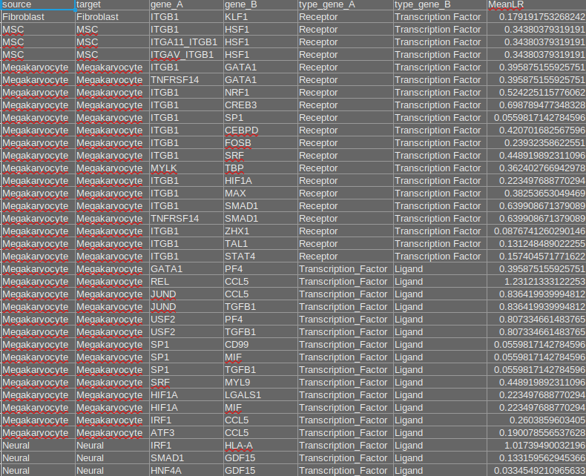
Python t-test & R t-test
CTR input condition PMF,MF2
Python t-test overestim var & R t-test
CTR input condition PMF,MF2
Unique Entry in Python t-test overestim var CTR input:
Myeloid,CEBPA,S100A9
with CEBPA being the TF

Slide 5
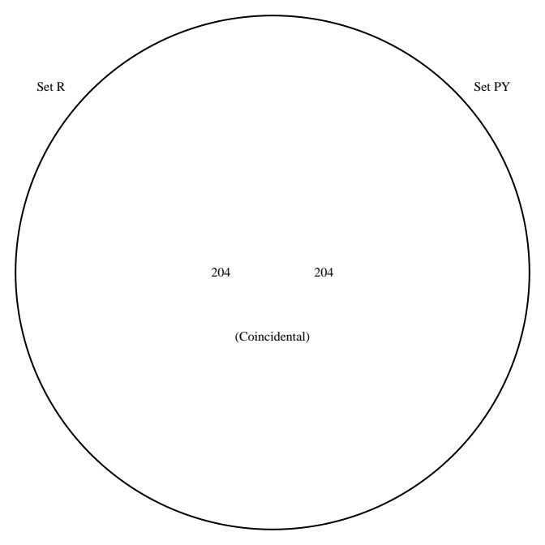
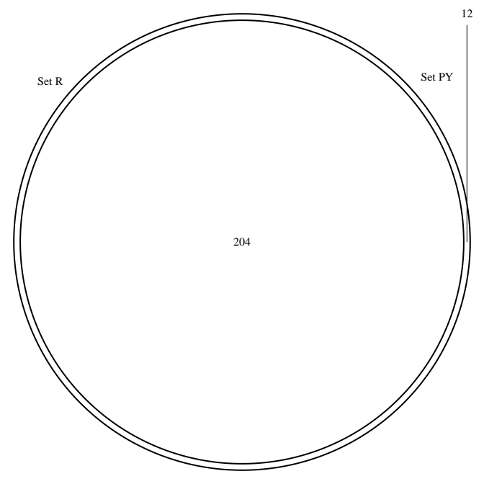
Python t-test & R t-test significant TFs condition control
Python t-test overestim var & R t-test significant TFs condition control

Slide 6
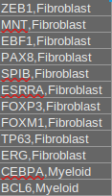
Python t-test & R t-test significant TFs condition control
Python t-test overestim var & R t-test significant TFs condition control
Unique TFs in Python:

Slide 7
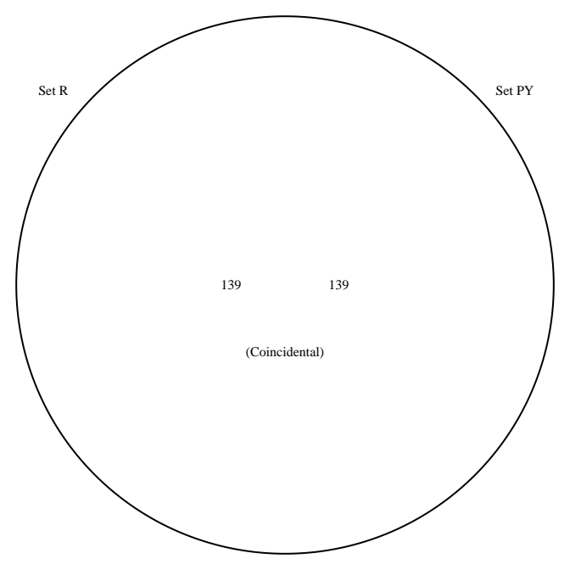
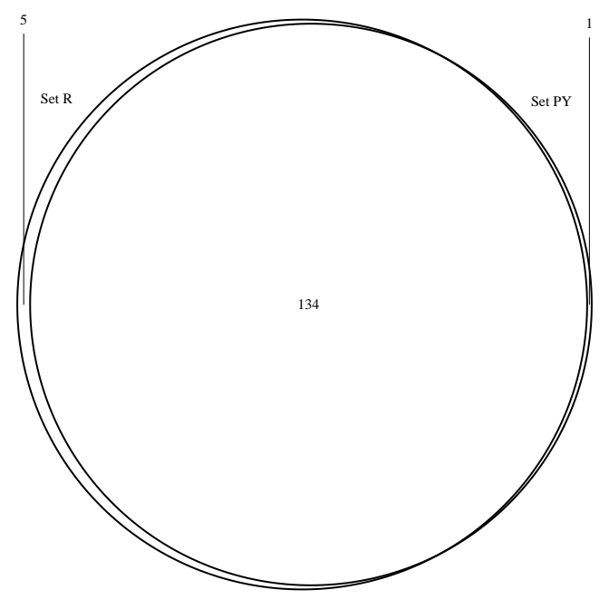
Python t-test & R t-test significant TFs condition PMF,MF2
Python t-test overestim var & R t-test significant TFs condition PMF,MF2

Slide 8

Python t-test & R t-test significant TFs condition PMF,MF2
Python t-test overestim var & R t-test significant TFs condition PMF,MF2
Unique TFs in R:
Unique TFs in Python:

