Slide 1
04.
01.
02.
03.
05.
06.
DOUBLY LINKED LISTS:
AND ADVANTAGES OVER SINGLY LINKED LISTS.
PRESENTED BY:
RISHABH SINGH, DAKSH PARAB
DSA, BCA 2ND SEM, E1

Slide 2
05.
01.
02.
03.
04.
05.
06.
DOUBLY LINKED LISTS:
AND ADVANTAGES OVER SINGLY LINKED LISTS.
PRESENTED BY:
RISHABH SINGH, DAKSH PARAB
DSA, BCA 2ND SEM, E1

Slide 3
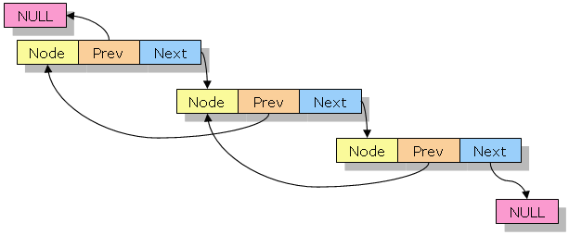
02.
03.
04.
05.
06.
What Is Doubly Linked List?
A doubly linked list is a type of linked list(Linear Data Structure) in which each node contains 3 parts, a data part and two addresses, one points to the previous node and one for the next node. It differs from the singly linked list as it has an extra pointer called previous that points to the previous node, allowing the traversal in both forward and backward directions.

Slide 4
03.
04.
05.
06.
Key Features:
Bidirectional traversal (forward & backward)
Efficient insertion and deletion
No need to shift elements like arrays
Dynamic memory allocation

Slide 5
04.
05.
06.
07.
Advantages of Doubly Linked Lists:
Unlike singly linked list, we can traverse in both the direction forward and reverse using doubly linked list which makes operations like reversing and searching from end easier and more efficient.
It is fast and easier to delete a node in doubly linked list, if the node to be deleted is given then we can search the previous node quickly and update its links.
Inserting a new node is also easier in doubly linked list, as we can simply insert a new node before a given node by updating the links.
In a doubly linked list, we need not to keep track of the previous node during traversal that is very useful in data structures like the binary tree where we need to keep track of the parent node.

Slide 6
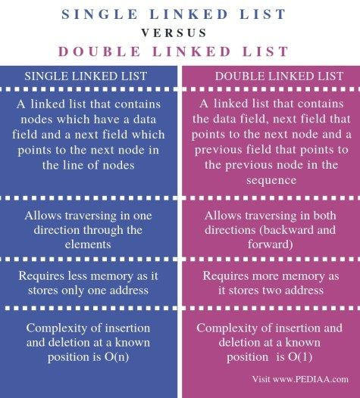
05.
06.
07.
08.

Slide 7

Real World Applications:
06.
07.
08.
09.
Undo/Redo in text editors
Browser back & forward buttons
Image viewers (next/previous)
LRU Cache implementation

Slide 8
07.
08.
09.
10.
Disadvantages of Doubly Linked Lists:
It uses extra memory when compared to the array and singly linked list.
Since elements in memory are stored randomly, therefore the elements are accessed sequentially no direct access is allowed.
Traversing a doubly linked list can be slower than traversing a singly linked list.
Implementing and maintaining doubly linked lists can be more complex than singly linked lists.

Slide 9
08.
09.
10.
Operations on Doubly Linked List
Common operations include:
Insertion at beginning
Insertion at end
Deletion of node
Traversal (forward & backward)
Searching

Slide 10
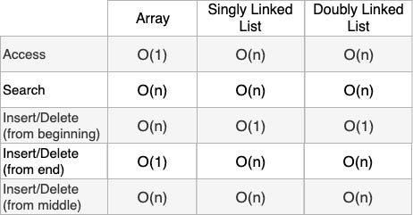
09.
10.

Slide 11
10.
THANK YOU

