Slide 1

Squillo
Dynamic App providing home values & prices across the U.S.

Slide 2
Team Members
Bryan Castleman: HTML, CSS, Materialize
Mai Hoang: JavaScript, jQuery, AJAX API
Marissa Wyss: Firebase (JavaScript)

Slide 3
Concept
Squillo is a dynamic app that allows users to enter their username and search for home values by zip code/current location including:
Home Value
Median Price
Rental Price
Foreclosures
Tax Rates
The app provides information by calling on respective APIs based on data input.
Save favorite locations and view data in one place

Slide 4
APIs used
API (Application program interface) used to generate data
Google Maps API
Quandl for Zillow Home Value Index data
Avalara for tax rates

Slide 5
Motivation for Development
This app provides a solution to individuals looking for a snapshot of home value information in one place.
People are relocating, or life events require you to move to another location. With this app, you can research a respective neighborhood for home prices, real estate & tax rates, and while you’re at it you can also link to resources for home owners.

Slide 6
Design Process
Simple interface with mobile responsiveness.
Implementing Materialize for CSS design elements.
Modal for opening screen user entry
Simple layout for data and favorites
Google Maps dynamically generated
Footer including useful links for home buying, construction, repair, remodeling.

Slide 7
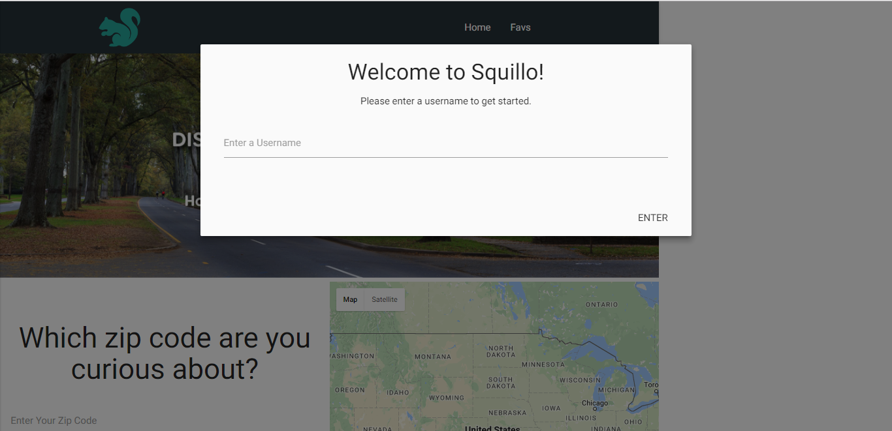
Modal to capture username

Slide 8
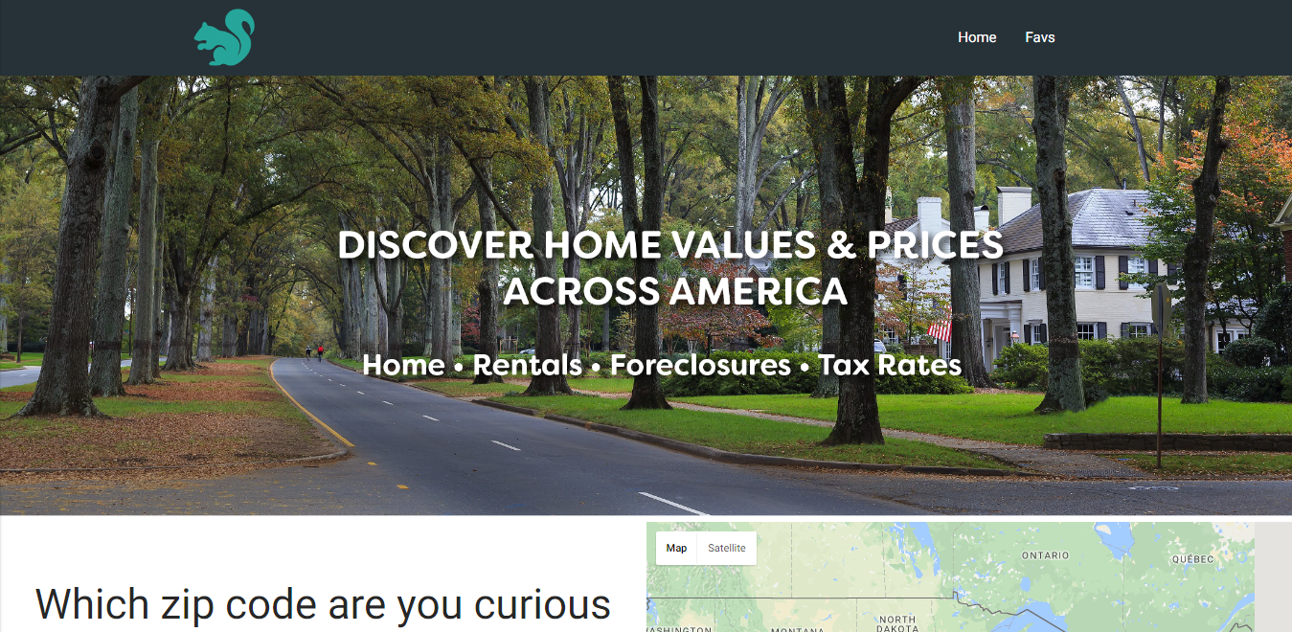
Home Page

Slide 9
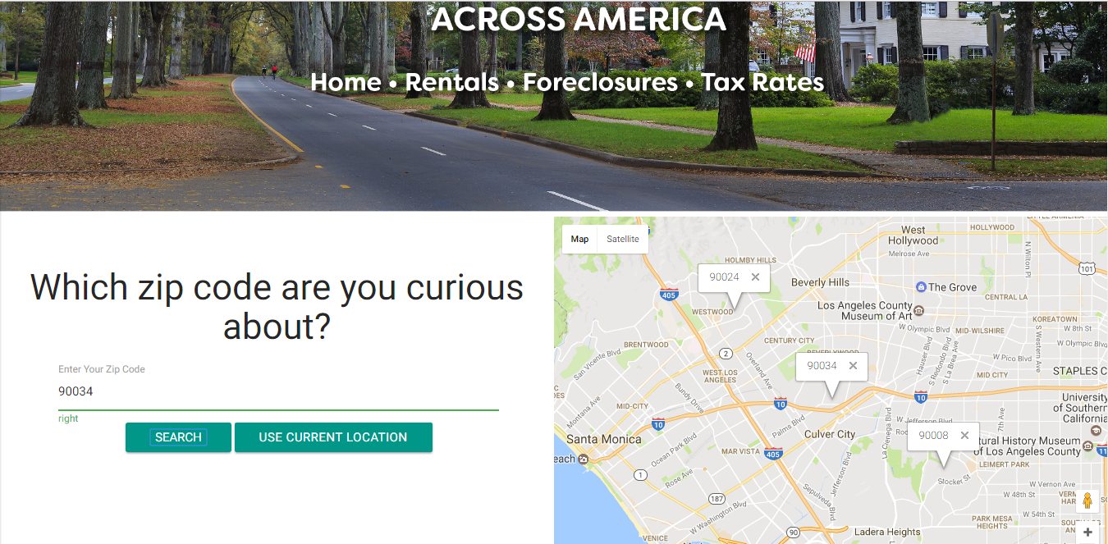
Google Maps Geo Location API

Slide 10
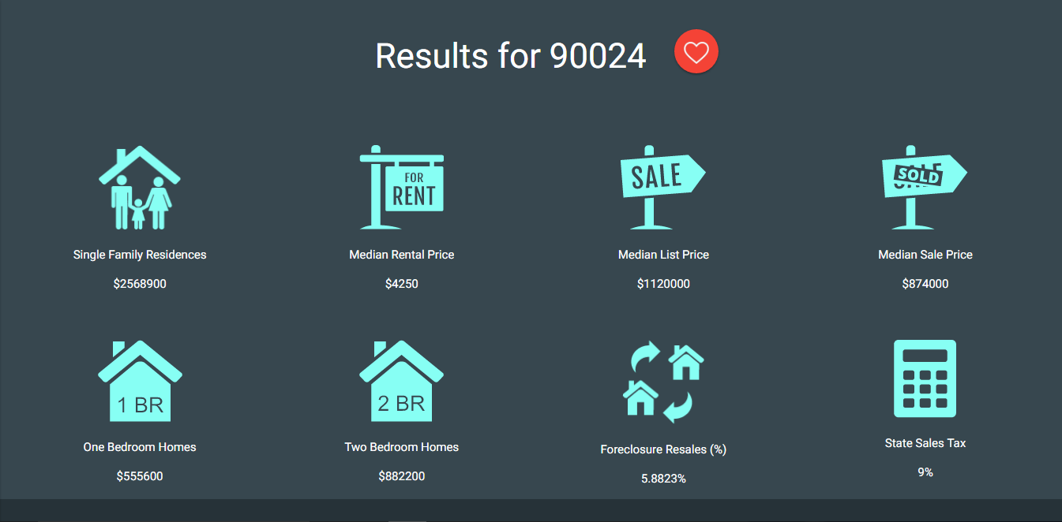
Search Results Display

Slide 11
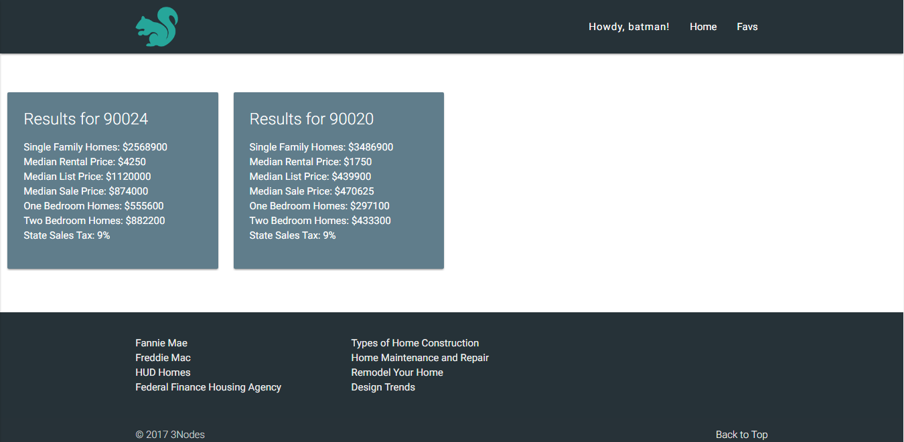
FAVS Page Displays Favorites in One Place

Slide 12
Technologies Used
HTML: to display page
Materialize & CSS: for styling and mobile responsiveness
JavaScript, jQuery: to make the page dynamic
AJAX, API: to retrieve respective api database info
Firebase, Local Storage: for data persistence and user recognition
GitHub for version control

Slide 13
Front End
Materialize – new library
Modal on user entry
Dynamic
Formatting

Slide 14
Back End
JavaScript logic - to capture user and click events for search and save
API’s - to access data
AJAX calls - to external sources
Local Storage - to capture username
Firebase – user data persistence (username & favorites)

