Slide 1
Epileptic seizure recognition using machine learning approaches
See “Notes” for each slide to see additional comments
Chris Hanson
BME 514
May 05, 2021

Slide 2
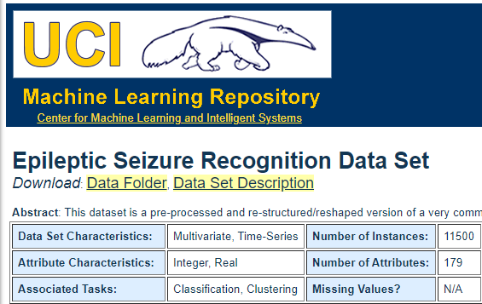
Epileptic seizure recognition – Introduction and Background
Original data set:
500 EEG recordings, each 23.6 seconds long, of individuals either conscious or in a state of seizure.
Modified data set:
Each of the 500 original EEG recordings has been broken up into 23 data sets, each 1 second long, to increase n. This gives 11500 data sets.
Each EEG has a label (y) indicating whether the individual was actively in seizure during recording.

Slide 3
Epileptic seizure recognition – Specific aims
I aim to use machine learning algorithms to detect whether an individual is in a state of seizure, based on features extracted from their EEG reading.
Algorithms to be employed:
K nearest neighbors
Logistic regression
Artificial neural network
Support vector machine

Slide 4
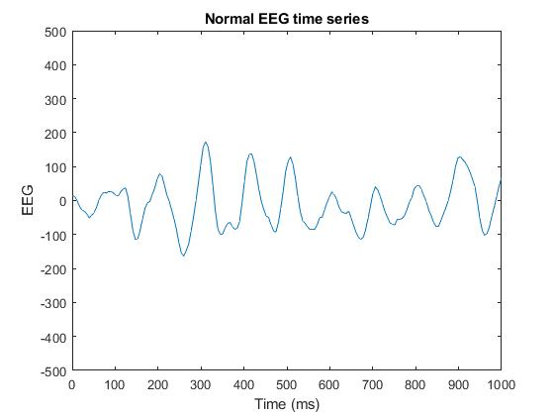
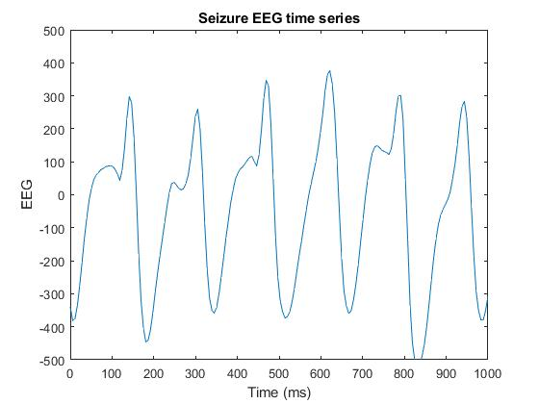
Epileptic seizure recognition – Methods: The time series
Notes:
A glance at some of the datasets suggests that a trend exists, as exemplified above: The normal EEG time series tend to have considerably smaller amplitudes in their fluctuations than do the seizure EEG time series.

Slide 5
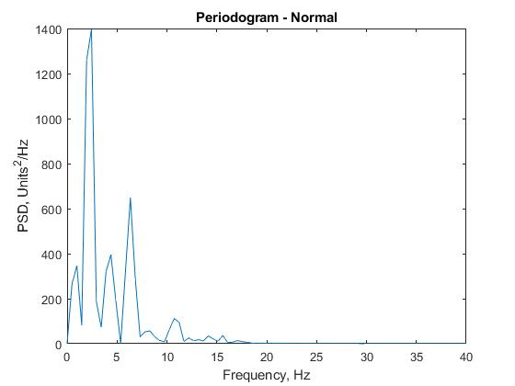
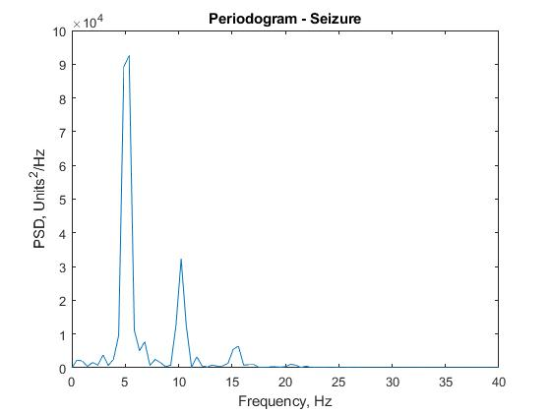
Epileptic seizure recognition – Methods: Feature extraction
Contribution of periodogram frequency bands (zero padded):
Delta: 0.5-4 Hz
Theta: 4-8 Hz
Alpha: 8-12 Hz
Beta: 12-35 Hz
Gamma: 35 - Hz
Median, standard deviation of each time series
Sample entropy
Notes:
As a follow up to the note in the previous slide, here we see example periodograms of two contrasting time series. While their shape may not differ radically, the scale of the power is notably different, with the seizure time series being orders of magnitude greater.
The relative contribution of each frequency band will be calculated, as a fraction of the total power. The median and standard deviation of the time series will be calculated as well. It is expected that the standard deviation will convey important information that will be critical for the implementation of the machine learning algorithms, as power and variance are related terms – as described in Parseval’s Theorem. Sample entropy will also be calculated.

Slide 6
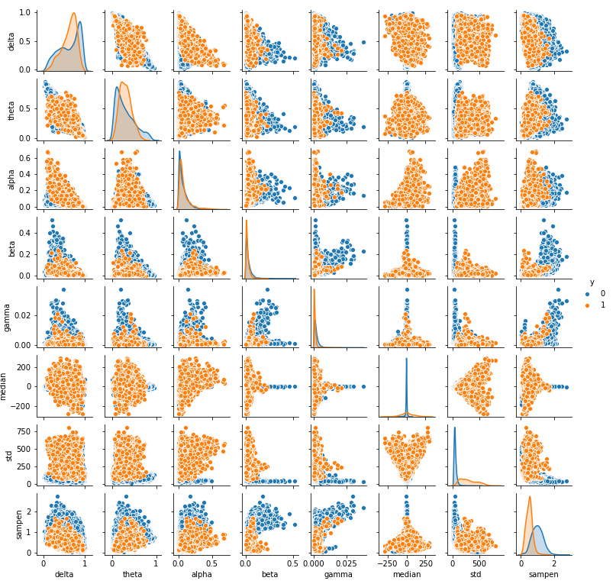
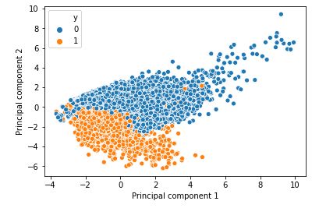
Epileptic seizure recognition – Methods: Feature examination
sklearn.feature_selection.SelectKBest
STD
Sample entropy
Gamma
Beta
Alpha
Median
Theta
Delta
Notes:
SelectKBest is an sklearn package which selects the features which are most predictive of the target, based on univariate statistical tests. The above is the ranked list of the most predictive of the 8 features being used. The graph on the right compares the distribution of the features against each other. Also, the first two principal components are graphed against each other.

Slide 7
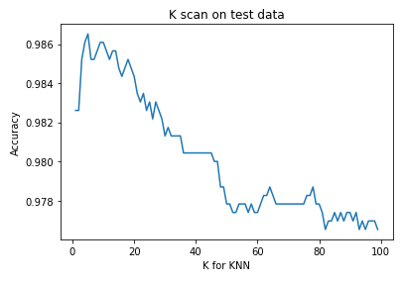
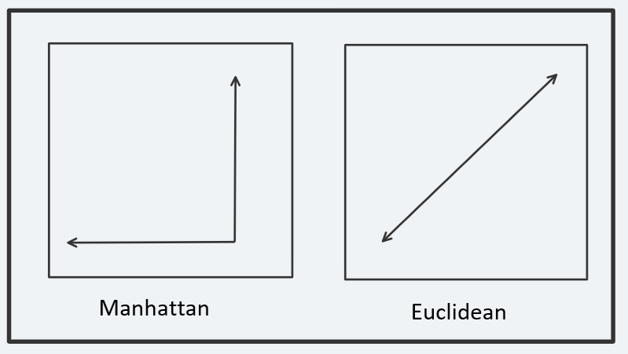
Epileptic seizure recognition – Results: KNN
K scan on test data (K = 4)
Improved accuracy by ~2%
Distance weighted
Improved accuracy by ~1%
Manhattan distance used to calculate neighbors
Improved accuracy by ~1%
Dimensionality reduction via cross validation
The 1 least correlated dimension was dropped
Improved accuracy by ~0.5%
Non-scaled features
Improved accuracy by ~0.2%
Notes:
These are the specific alterations I made to the standard KNN algorithm that optimized the predictiveness of the method. They can be seen in my Jupyter notebook.

Slide 8
Epileptic seizure recognition – Results: KNN
KNN Classification Report:
KNN Confusion Matrix:
KNN 10x cross-validation F1 score:
0.9561064
 | Precision | Recall | F1-Score | Support | Accuracy
0 – No seizure | 0.99 | 0.99 | 0.99 | 1869
1 – Seizure | 0.96 | 0.97 | 0.96 | 431
Accuracy |  |  |  |  | 0.99
 | Predicted 0 – No Seizure | Predicted 1 - Seizure
Actual 0 – No seizure | 1853 | 16
Actual 1 - Seizure | 15 | 416

Slide 9
Epileptic seizure recognition – Results: KNN Tests
sklearn.feature_selection.SelectKBest
STD
Sample entropy
Gamma
Beta
Alpha
Median
Theta
Delta
KNN F-1 with:
All predictors: 0.956
Just STD: 0.892
Just sample entropy: 0.56
STD & sample entropy: 0.905
Gamma, beta, alpha, median, theta, delta: 0.830
2 principal components: 0.884
Notes:
Here is a list of 5x cross validation F-1 scores from the KNN algorithm when using a variety of different predictors. This was done mostly to teach me about how robust each method is, and how predictive each feature was.

Slide 10
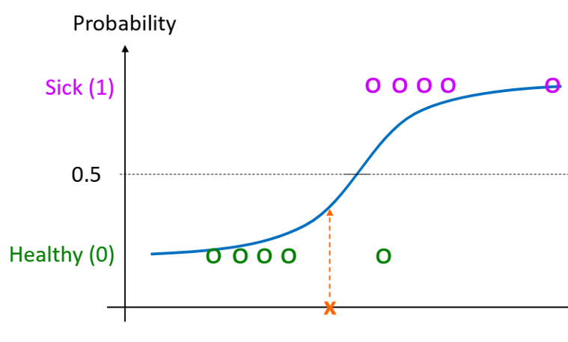
Epileptic seizure recognition – Results: Logistic Regression
Scaled features
Improved accuracy by ~1%
Increased L2 “ridge regularization” parameter
Improved accuracy by ~0.5%
“Balanced” class weight – under-represented classes given greater weight
Improved accuracy by ~0.5%
Notes:
Graph taken from class notes, as an example of the logistic regression method. Not representative of the data in consideration.
These are the specific alterations I made to the standard logistic regression algorithm that optimized the predictiveness of the method. They can be seen in my Jupyter notebook.

Slide 11
Epileptic seizure recognition – Results: Logistic Regression
LR Classification Report:
LR Confusion Matrix:
LR 10x cross-validation F1 score:
0.9100394
 | Precision | Recall | F1-Score | Support | Accuracy
0 – No seizure | 0.99 | 0.96 | 0.98 | 1869
1 – Seizure | 0.86 | 0.97 | 0.91 | 431
Accuracy |  |  |  |  | 0.96
 | Predicted 0 – No Seizure | Predicted 1 - Seizure
Actual 0 – No seizure | 1800 | 69
Actual 1 - Seizure | 15 | 416

Slide 12
Epileptic seizure recognition – Results: Logistic Regression Tests
sklearn.feature_selection.SelectKBest
STD
Sample entropy
Gamma
Beta
Alpha
Median
Theta
Delta
Logistic Regression F-1 with:
All predictors: 0.910
Just STD: 0.896
Just sample entropy: 0.544
STD & sample entropy: 0.897
Gamma, beta, alpha, median, theta, delta: 0.420
2 principal components: 0.568
Notes:
Here is a list of 5x cross validation F-1 scores from the logistic regression algorithm when using a variety of different predictors. This was done mostly to teach me about how robust each method is, and how predictive each feature was.
**Changes since presentation #3: I had previously stated “Just STD: 0.334, Just sample entropy: 0.00,” but have since found that my code was incorrect when determining this result. This has now been fixed, as seen above.

Slide 13
Epileptic seizure recognition – Results: ANN
Scaled features
Improved accuracy by ~1%
Hidden layer size: (4, 3) – 2 hidden layers, 4 & 3 hidden units
Determined by cross-validation
Improved accuracy by ~2%
Notes:
These are the specific alterations I made to the standard ANN algorithm that optimized the predictiveness of the method. They can be seen in my Jupyter notebook.

Slide 14
Epileptic seizure recognition – Results: ANN
ANN Classification Report:
ANN Confusion Matrix:
ANN 10x cross-validation F1 score:
0.9537313
 | Precision | Recall | F1-Score | Support | Accuracy
0 – No seizure | 0.99 | 0.99 | 0.99 | 1869
1 – Seizure | 0.95 | 0.96 | 0.95 | 431
Accuracy |  |  |  |  | 0.98
 | Predicted 0 – No Seizure | Predicted 1 - Seizure
Actual 0 – No seizure | 1847 | 22
Actual 1 - Seizure | 18 | 413

Slide 15
Epileptic seizure recognition – Results: ANN Tests
sklearn.feature_selection.SelectKBest
STD
Sample entropy
Gamma
Beta
Alpha
Median
Theta
Delta
ANN F-1 with:
All predictors: 0.948
Just STD: 0.815
Just sample entropy: 0.428
STD & sample entropy: 0.910
Gamma, beta, alpha, median, theta, delta: 0.828
2 principal components: 0.869
Notes:
Here is a list of 5x cross validation F-1 scores from the ANN algorithm when using a variety of different predictors. This was done mostly to teach me about how robust each method is, and how predictive each feature was.

Slide 16
Epileptic seizure recognition – Results: SVM
Scaled features
Improved accuracy by ~1%
Radial basis kernel (RBF)
Improved accuracy by ~3%
Increased L2 “ridge regularization” parameter
Improved accuracy by ~0.5%
Notes:
These are the specific alterations I made to the standard SVM algorithm that optimized the predictiveness of the method. They can be seen in my Jupyter notebook.

Slide 17
Epileptic seizure recognition – Results: SVM
SVM Classification Report:
SVM Confusion Matrix:
SVM 10x cross-validation F1 score:
0.9627562
 | Precision | Recall | F1-Score | Support | Accuracy
0 – No seizure | 0.99 | 0.99 | 0.99 | 1869
1 – Seizure | 0.96 | 0.97 | 0.96 | 431
Accuracy |  |  |  |  | 0.99
 | Predicted 0 – No Seizure | Predicted 1 - Seizure
Actual 0 – No seizure | 1853 | 16
Actual 1 - Seizure | 15 | 416

Slide 18
Epileptic seizure recognition – Results: SVM Tests
sklearn.feature_selection.SelectKBest
STD
Sample entropy
Gamma
Beta
Alpha
Median
Theta
Delta
SVM F-1 with:
All predictors: 0.962
Just STD: 0.902
Just sample entropy: 0.574
STD & sample entropy: 0.913
Gamma, beta, alpha, median, theta, delta: 0.773
2 principal components: 0.887
Notes:
These are the specific alterations I made to the standard SVM algorithm that optimized the predictiveness of the method. They can be seen in my Jupyter notebook.

Slide 19
Epileptic seizure recognition – Results: Final comparison
Method | 10x X-val F1 mean | 10x X-val F1 STD
KNN | 0.9561 | 0.00591
LR | 0.9100 | 0.00860
ANN | 0.9538 | 0.00804
SVC | 0.9627 | 0.00727
Discussion and limitations
This shows that many effective machine learning algorithms can be developed to detect seizures based on the chosen features of the EEG, at least for the data set under consideration. Each of SVC, ANN, and KNN appear to be nearly identical, statistically, regarding their ability to correctly predict seizure, while logistic regression is slightly less precise. Each of these methods are significantly improved by the addition of features beyond the one or two most predictive. These algorithms are limited by the fact that they have been trained and tested only on data from one source, which is doubtlessly biased by the methods of data generation and processing that were employed.
Notes:
These are the mean and standard deviation of the 10x cross validation F-1 scores of each machine learning algorithm, after optimizing them for peak performance.
**Sometimes the ANN value comes out much lower, as apparently the algorithm gets stuck in a local minimum for some of the iterations. However more often than not, it is approximately the above value.

Slide 20
Epileptic seizure recognition – References
“Epileptic Seizure Recognition Data Set,” UCI Machine Learning Repository, Center for Machine Learning and Intelligent Systems
https://archive.ics.uci.edu/ml/datasets/Epileptic+Seizure+Recognition
Andrzejak RG, Lehnertz K, Rieke C, Mormann F, David P, Elger CE (2001) Indications of nonlinear deterministic and finite dimensional structures in time series of brain electrical activity: Dependence on recording region and brain state, Phys. Rev. E, 64, 061907

