Slide 1

Web Development with AI
Anupam Sobti

Slide 2
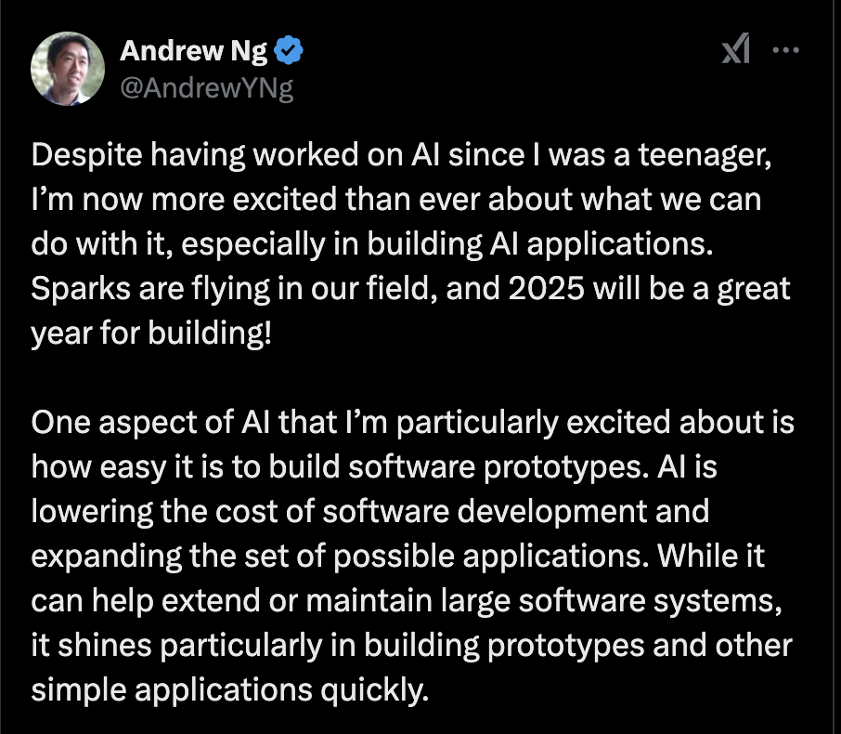

Why this course?
Barriers to code (of all types) are reducing
Infinite demand for software automation
Need to build software quickly with the best tools available and SELL!
LLMs are a tool to understand the best available methods and generate software.
  Let’s try to learn how to use it best!

Slide 3
Course Philosophy and Approach
Menu card approach
  Know your options. Explore more when required.
LLMs to mimic (expert) human behavior at a workflow level
Use flexible approaches
  With respect to models
  With respect to products, e.g., don’t depend too much on Cursor/VS Code.

Slide 4
What are we going to do?
Lect. | Topic | Details
1 | WTH is web? | HTML/Styling/Interactivity - JS; Bootstrap, Tailwind, React, Vue, D3.js, Chart.js
2 | What's possible in web? | Library usage examples
3 | Prompting LLMs | Single shot prompting, Editing with prompts, Maintaining context
4 | Expanding web users | Responsive Design, Web Sockets, Hooks
5 | Prompting in context | Multi-file editing with prompts, Sharing documentation with LLMs
6 | FastHTML/FastAPI | Basics, HTMX, async workflows, DB integration
7 | FastHTML - II | Websockets, Authentication
8 | Database design basics | User management, DB operations, atomicity, etc. Prompting for DB design.
9 | Stitching databases with frontend | Prompts for integrating DBs with web pages
10 | Beyond databases | Handling large data, caching
11 | Using reasoning models - o1, gemini 2.0 | Reason before you respond. Hybrid use of models.
12 | RAG | Vector embeddings, Retreiving content, Handling large data, Establish Causation
13 | Agentic RAG | Adding helpers to your RAG pipelines
14 | Multi agent systems | The benefit of having multi-role agents and orchestrating workflows in between agents
15 | Using memory with LLMs | How to orchestrate memory, what to retreive for context, what kind of context is good context, scratchpadding

Slide 5
Evaluation
Lab presentations (6) | 70% | The lab presentations would be updates on things you've tried towards your project from the lecture and its effect on your course project. Please read papers/watch youtube to see if people have tried similar things that you are trying to do. How did they phrase their prompts? What problems did they encounter?
Demo day | 20%
Attendance and class participation | 10% | More than 80% = 10 marks (full) 70 to 80 % = 8 marks 60 to 70 % = 6 marks Less than 60 % = 0 marks
There will be 3 star presentations declared every 2 weeks. If you get more than 3 stars, you get a grade bump.

Slide 6
Recommended read for when prompting isn’t enough
https://developer.mozilla.org/en-US/docs/Learn_web_development

Slide 7
What are websites?
Some basic terminologies
HTML – HyperText Markup Language
(latest version 5) [2014 onwards]
- Inbuilt support for multiple modalities like <audio>, <video>, <track>
- More structure for text, e.g., <header>, <footer>, <article>, <section>, <aside>, <figure>, <figcaption> etc.
- Enhanced forms
- Scriptable graphics
- LocalStorage/SessionStorage
- Improved scripting and APIs: websockets, web workers (background js)

Slide 8
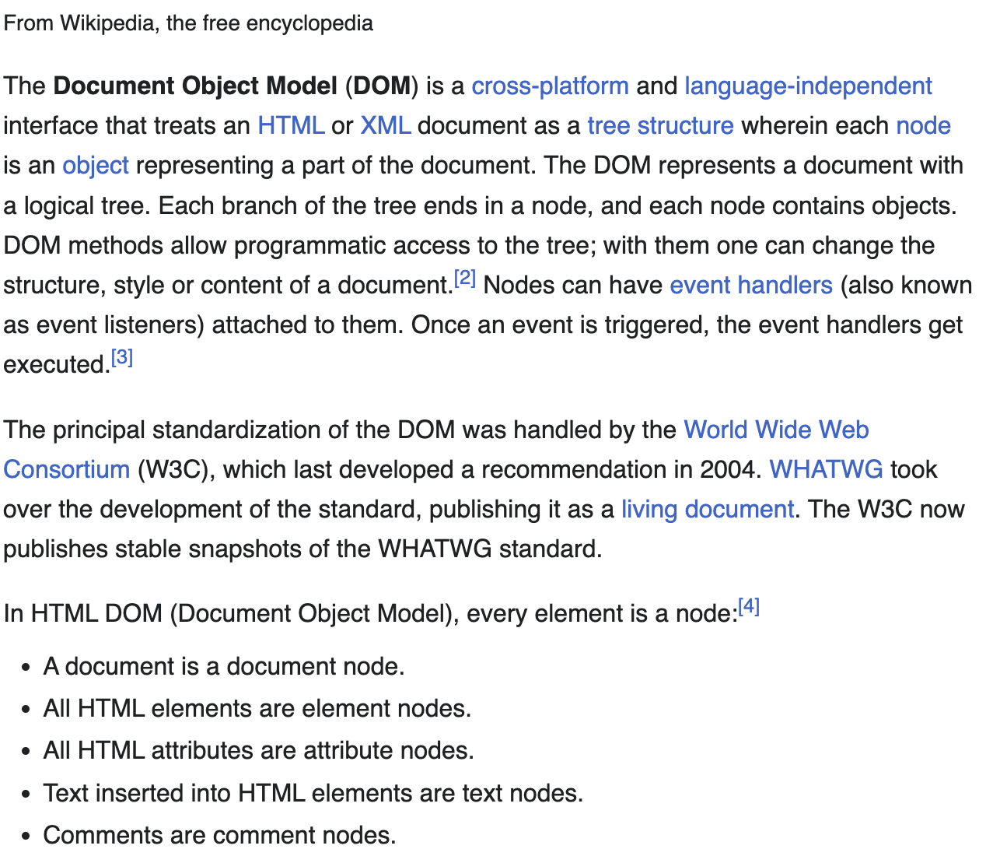
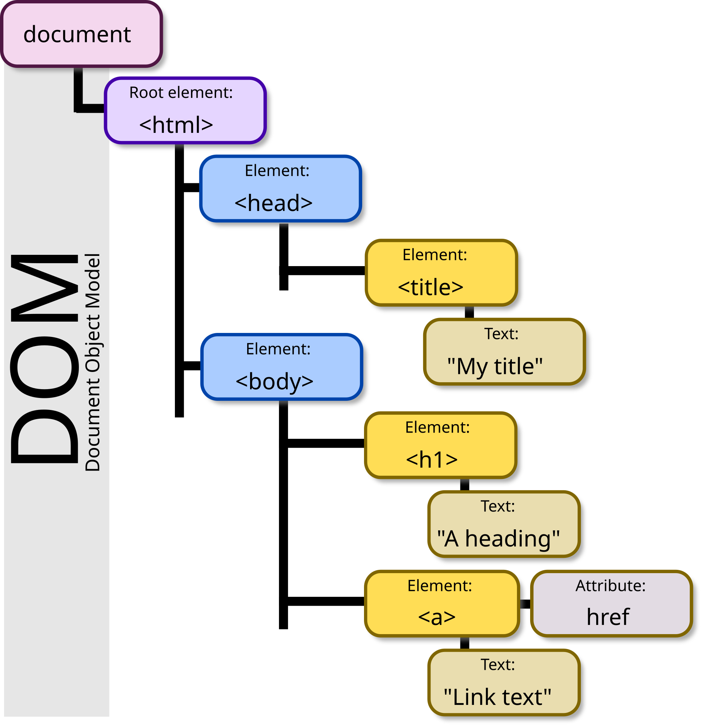
Programmatic access to a document (html/xml): DOM
https://developer.mozilla.org/en-US/docs/Web/API/Document_Object_Model/Introduction

Slide 9

What are scripts?
Things that allow dynamic interactions/content, e.g., mouse hovers, scroll, etc.
- JavaScript (JS), TypeScript (superset compiled to JS), WASM (Web Assembly for running Go/Rust in the browser)
Executable JS code (could be client or server side but mostly client side)

Slide 10
Styling content
Cascading Style Sheets (CSS)
- Style fixed for elements
- or rendered at load time on the server side (SSR – server side rendering)
Famous:
- https://ui.shadcn.com/
- https://tailwindcss.com/
- https://m3.material.io/styles/color/system/overview
https://playcode.io/css

Slide 11
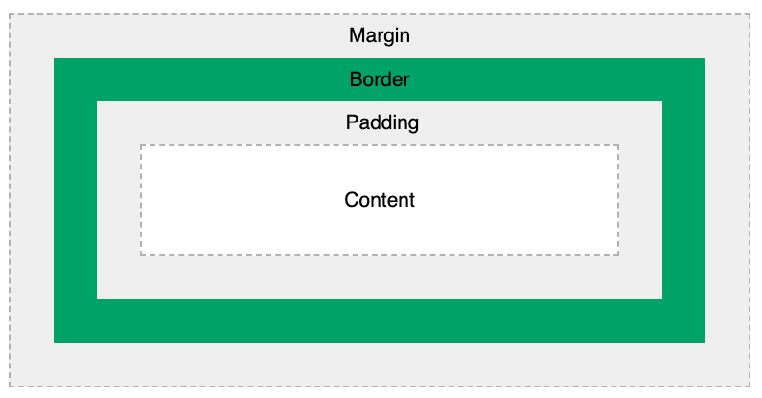
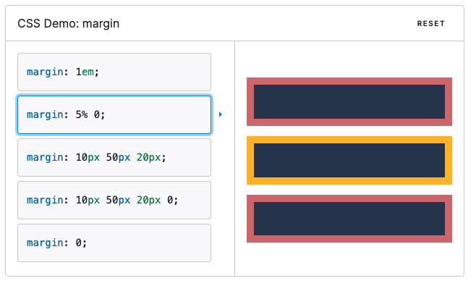
Margin
https://developer.mozilla.org/en-US/docs/Web/CSS/margin
https://www.w3schools.com/css/css_boxmodel.asp

Slide 12
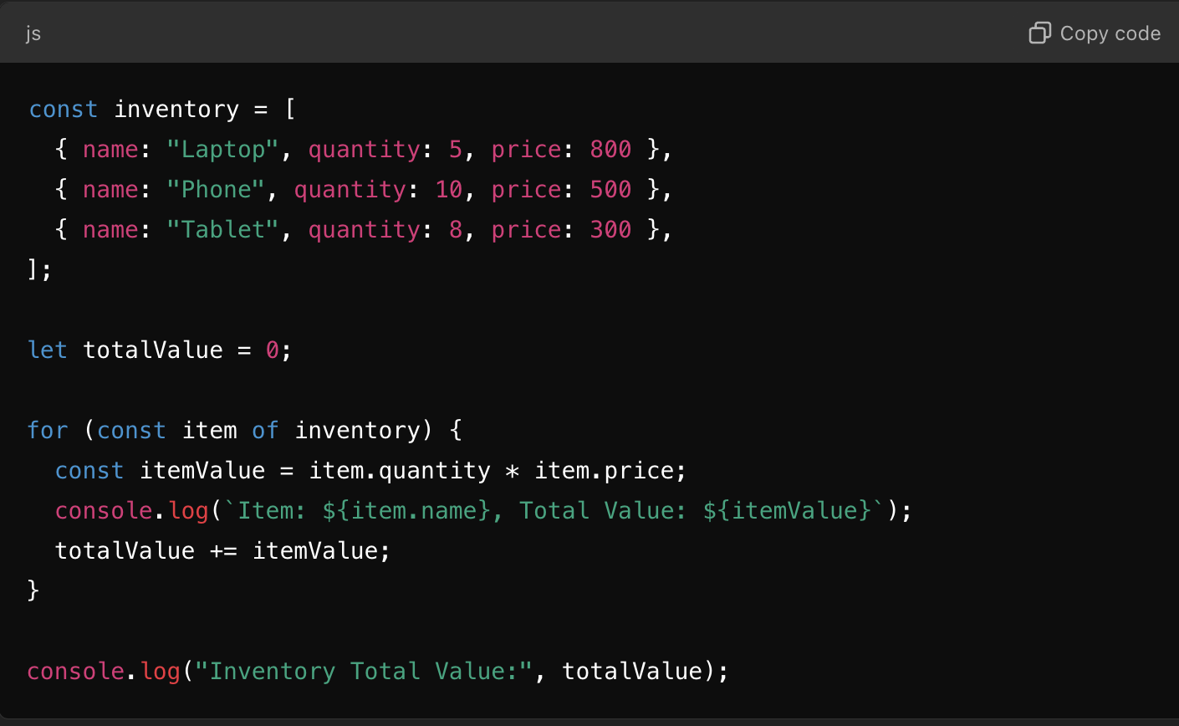
JS Basics

Slide 13
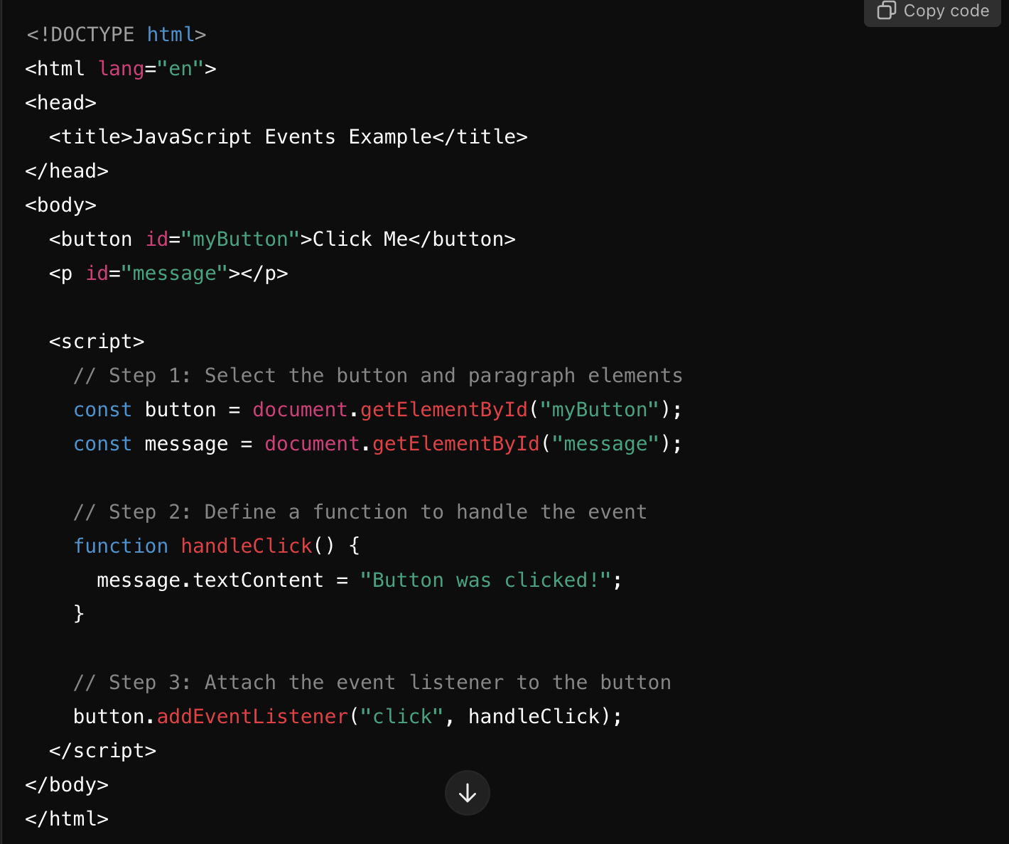
Events in JS

Slide 14
DO: Let’s make something?
A basic website for this course’s (your project’s) information.
Adding interactions.
Code for different types of events: onClick, onHover
Responsive designs

Slide 15
DO: Using variables for interactions
Try to make some sections collapsible.
Store the state in js.

Slide 16
DO: Let’s make different layouts and styles
Try three different styles and layouts for your website
Check them for responsiveness on three different devices
Add 3 types of interaction through js

Slide 17
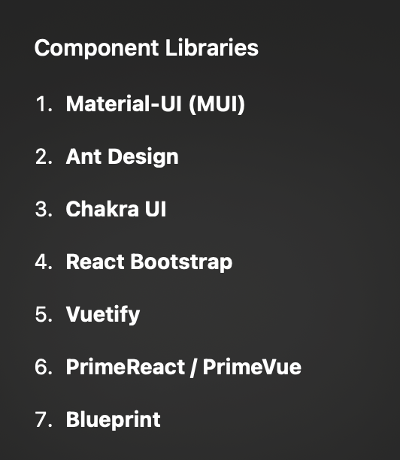
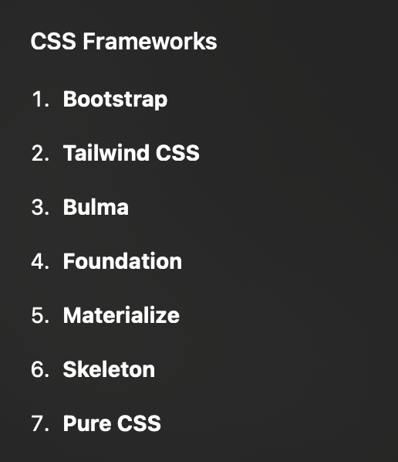
Some layout frameworks
Super lightweight: Pico.css

Slide 18
DO: Let’s make multipage apps
Common code for header, footer
Use scripts to include on all pages

Slide 19
Responsive Design
The term responsive design, coined by Ethan Marcotte in 2010, described using fluid grids, fluid images, and media queries to create responsive content.
https://developer.mozilla.org/en-US/docs/Learn_web_development/Core/CSS_layout/Responsive_Design
https://developer.mozilla.org/en-US/docs/Learn_web_development/Core/CSS_layout/Media_queries
Flexbox model

Slide 20

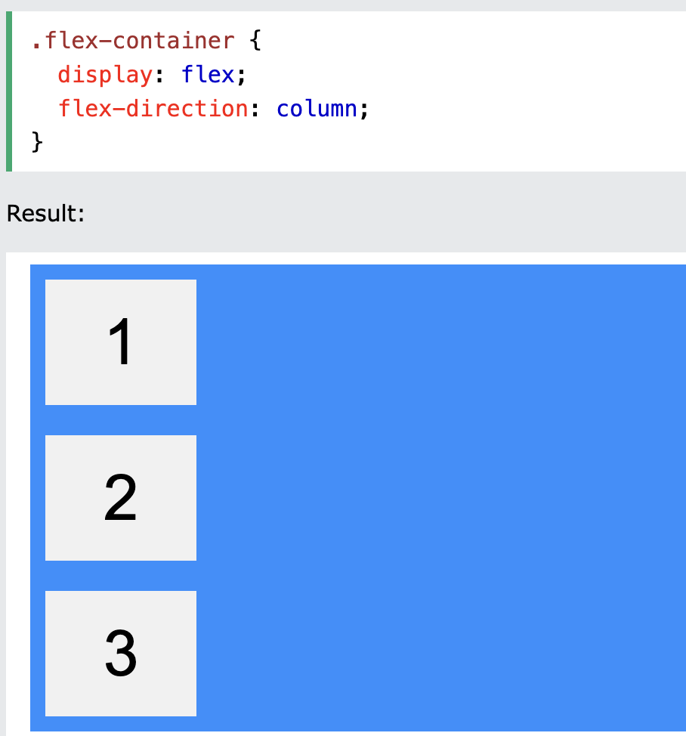
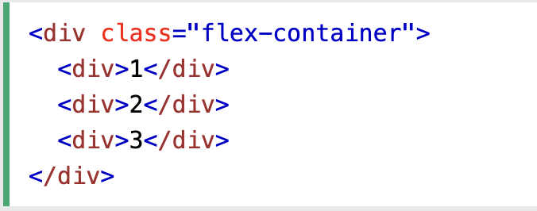
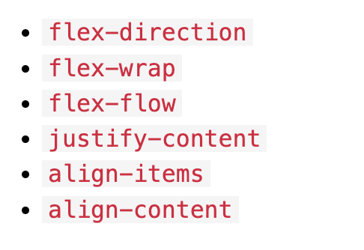
Understanding FlexBox
https://www.w3schools.com/css/css3_flexbox.asp

Slide 21
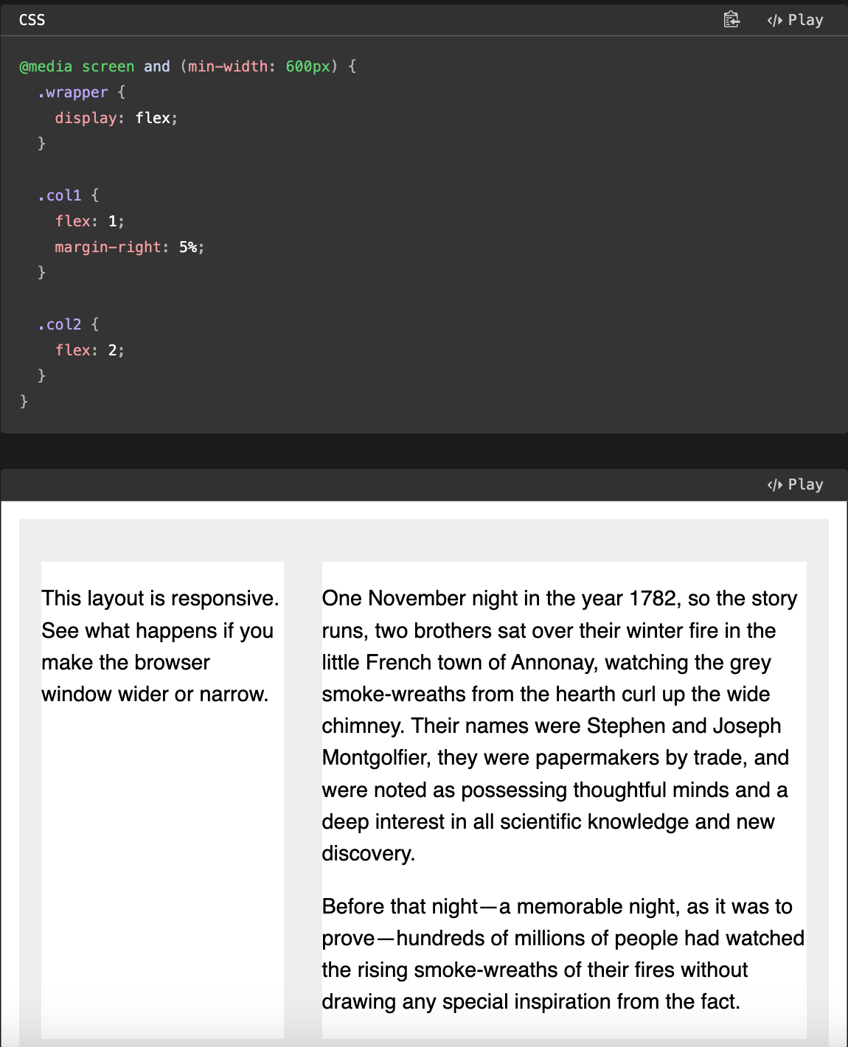
Flexbox example

Slide 22
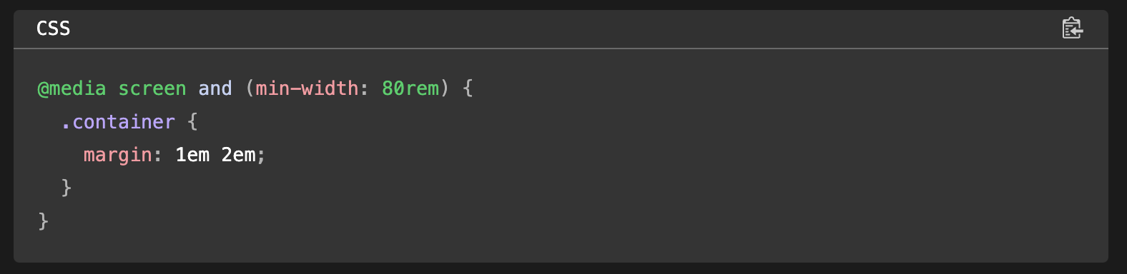
Media Queries
Screen-size/Viewport size dependent css

Slide 23
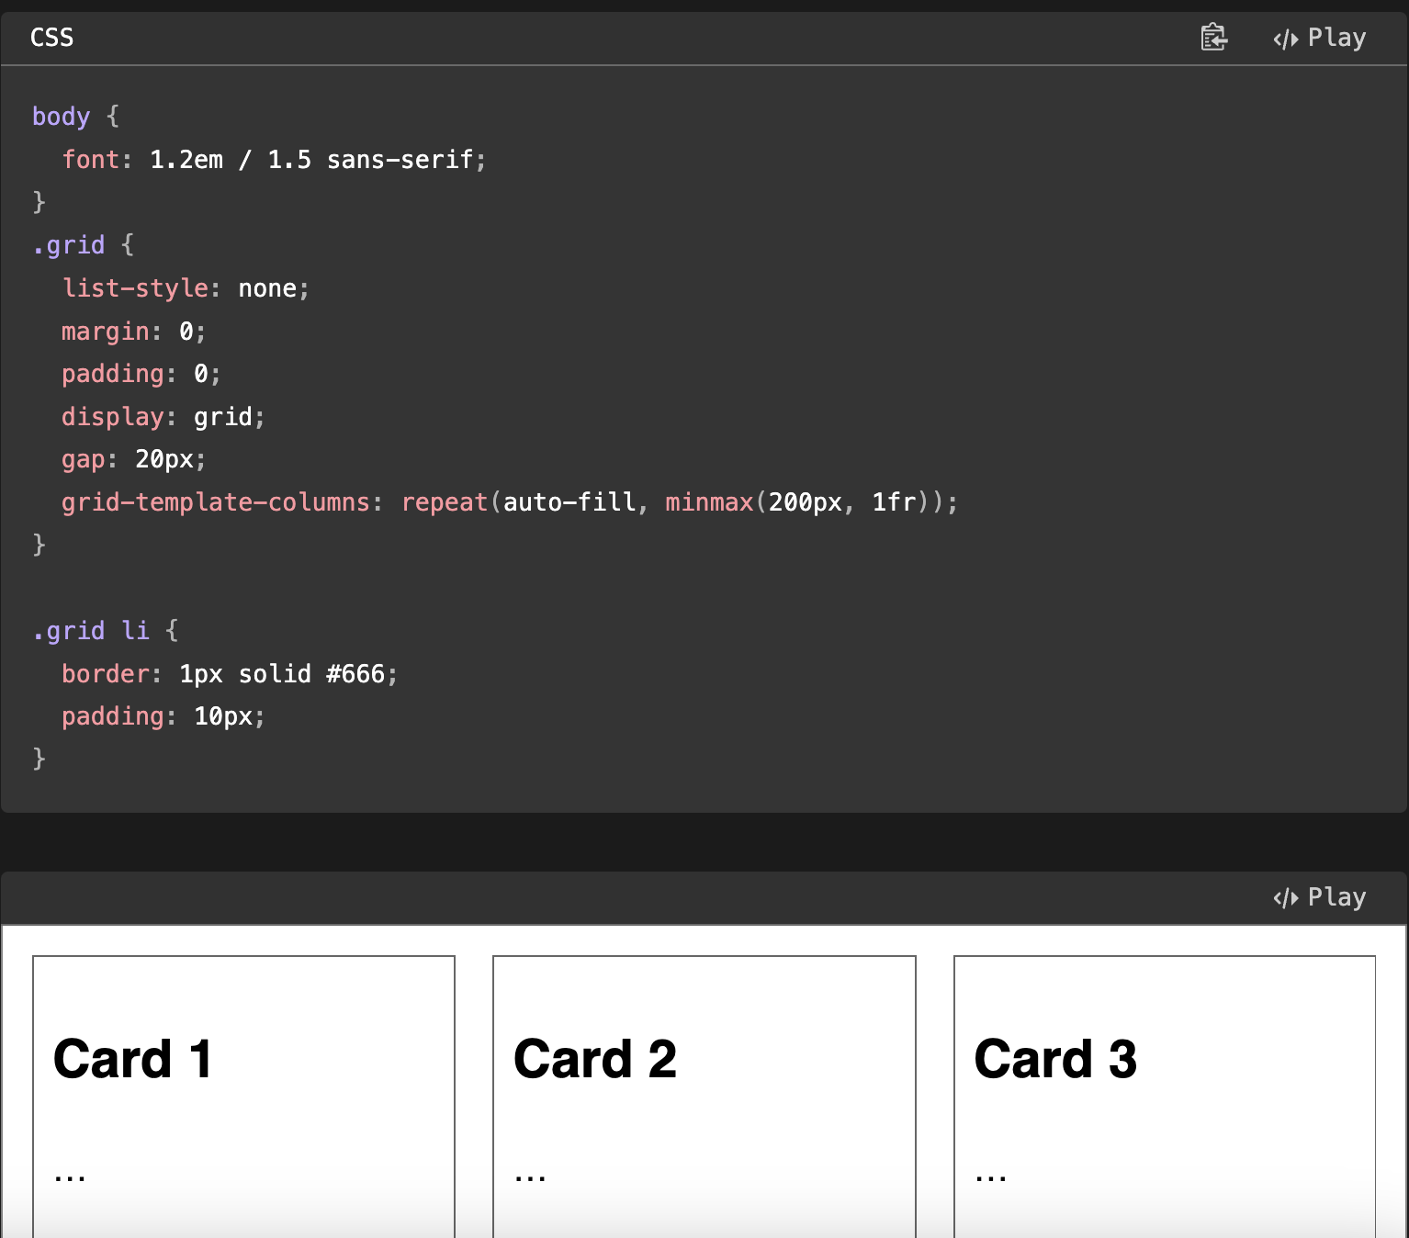
Do you need a media query?
Always prefer flexbox/css grid solutions since these are more general solutions!

Slide 24
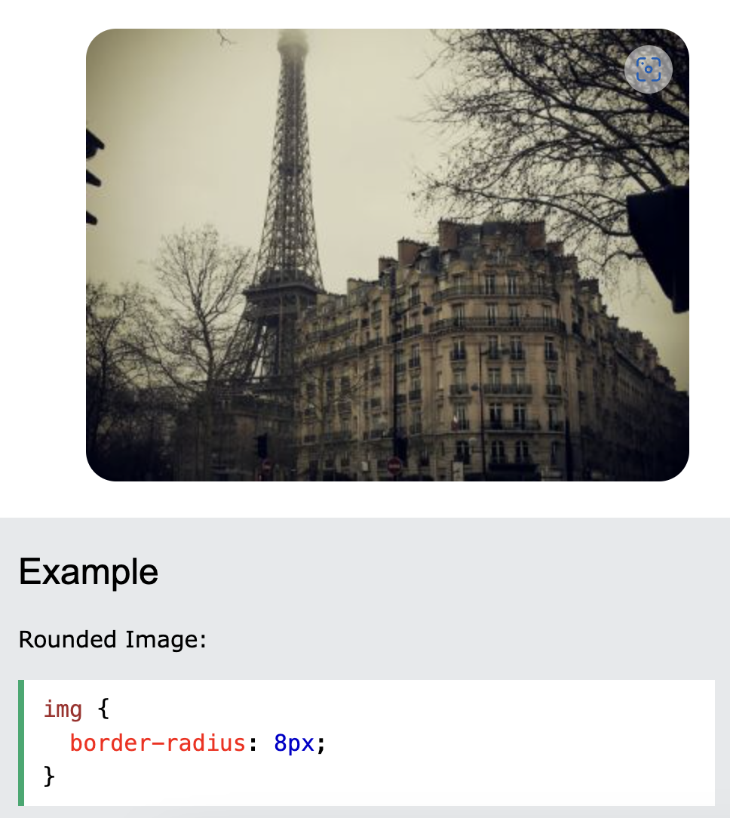

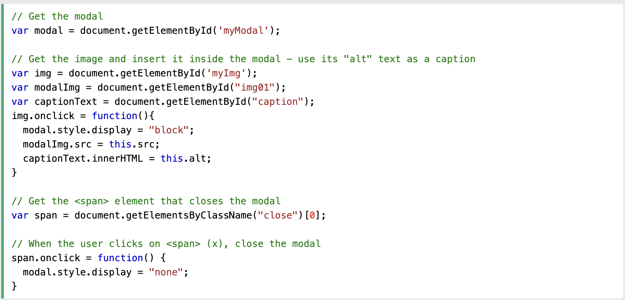
Styling images
https://www.w3schools.com/css/css3_images.asp
Guess what this does?

Slide 25
Frameworks

Slide 26
Common frameworks
React
Vue.js
Next.js

Slide 27
What do these bring to the table?
Large number of interactions in a component style
Good to use when highly functional SPAs (single page applications) are required

Slide 28
Reflections from last class
Guest lecture by Archit
My two cents.
If you’re imagining screens which are largely interactive:
  Next js based app
If you’re imagining screens which are largely static with interactive components:
  HTMX + Static site generator (Eleventy)
If you’re imagining screens with complex visualizations and custom interactions:
  Stick to raw html/css/js

Slide 29
Prompting like a pro

Slide 30
OpenAI

Slide 31
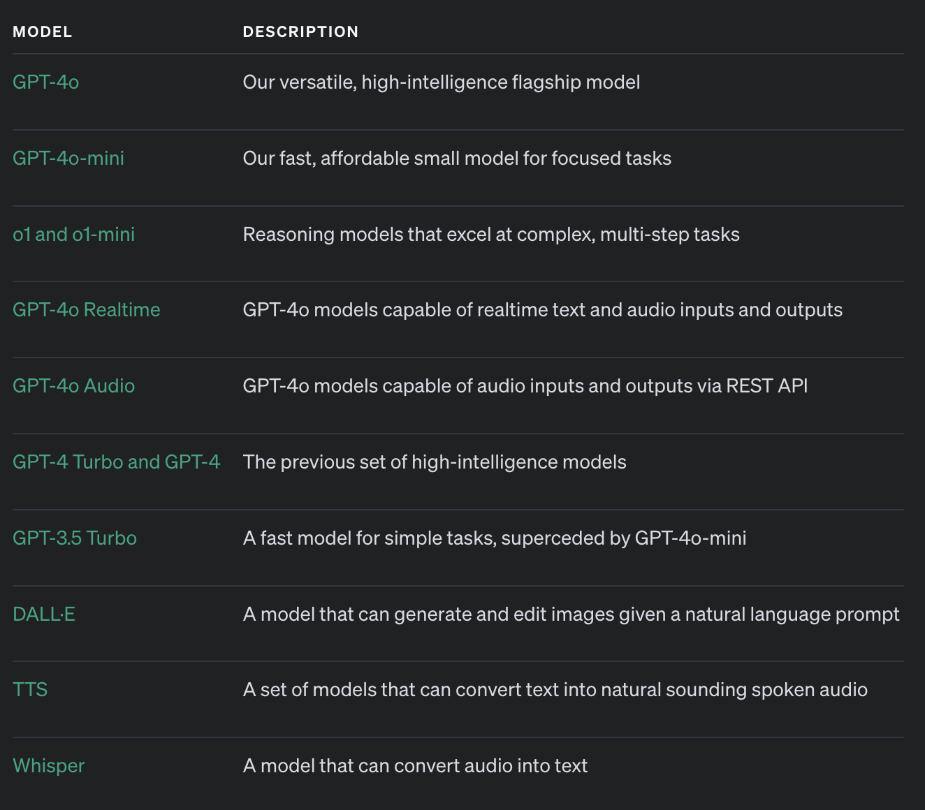
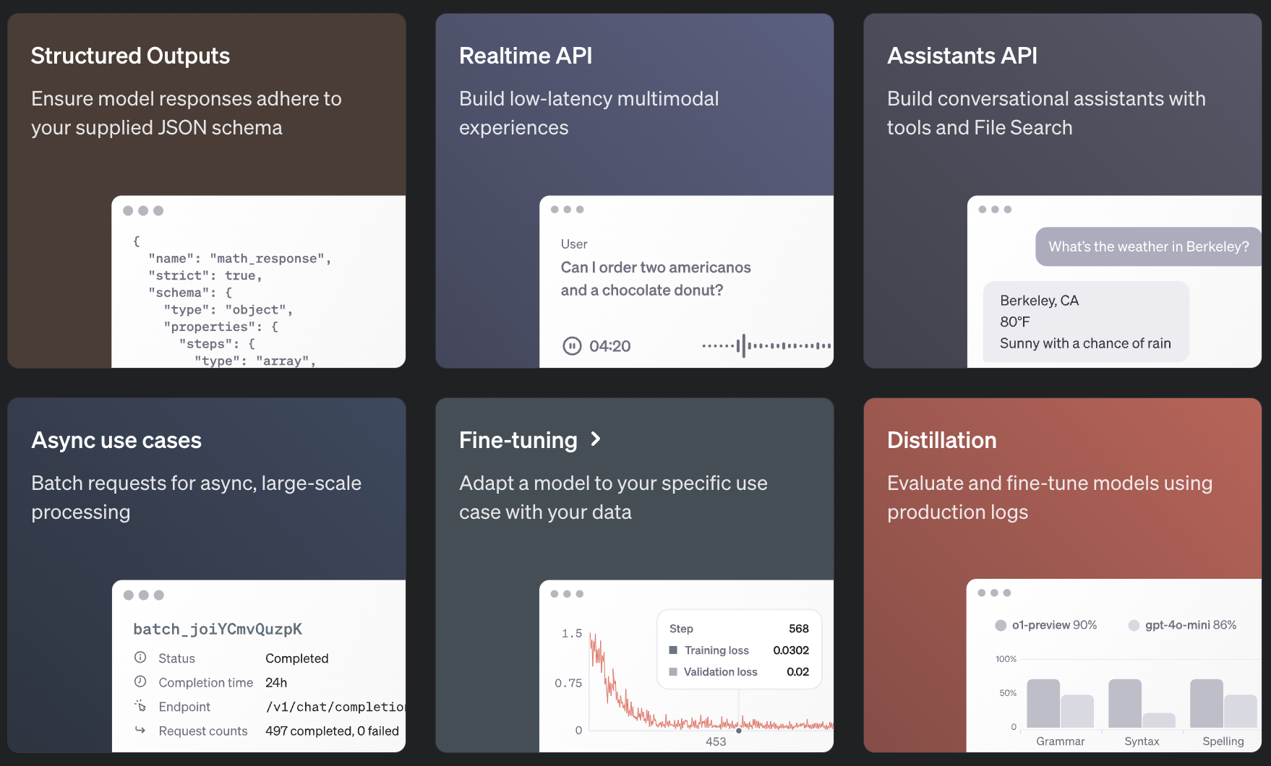
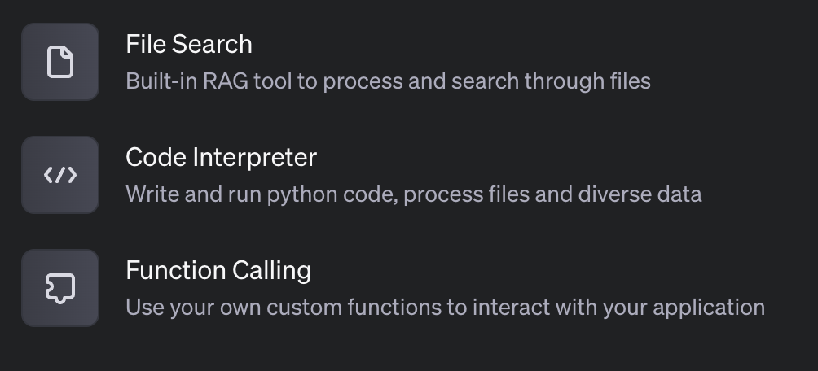
Services

Slide 32
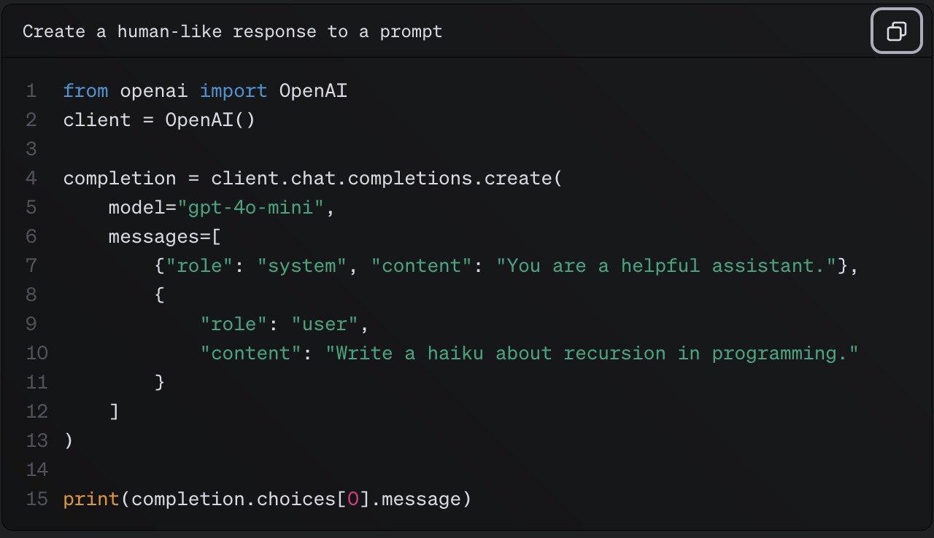
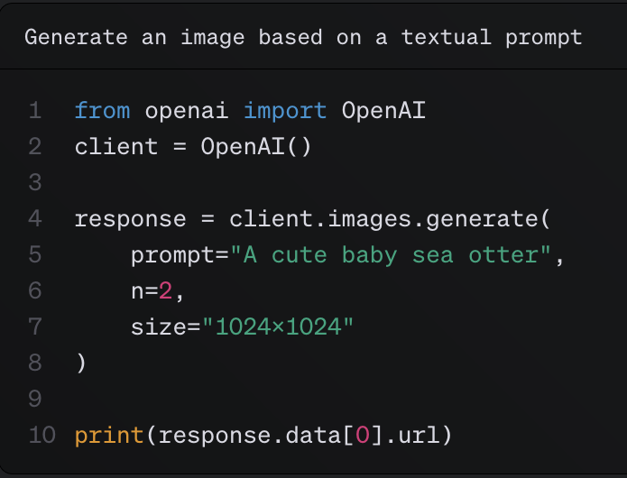
Prompting

Slide 33
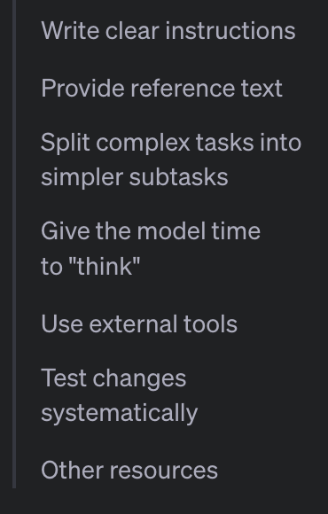
Strategies for prompting
Writing Clear Instructions
Include details in your query to get more relevant answers
Ask the model to adopt a persona
Use delimiters to clearly indicate distinct parts of the input
  “”” or <article></article> or even Santa: Banta:
  Explain task to the “system”
Specify the steps required to complete a task
Provide examples (Few shot prompting)
Specify the desired length of the output

Slide 34
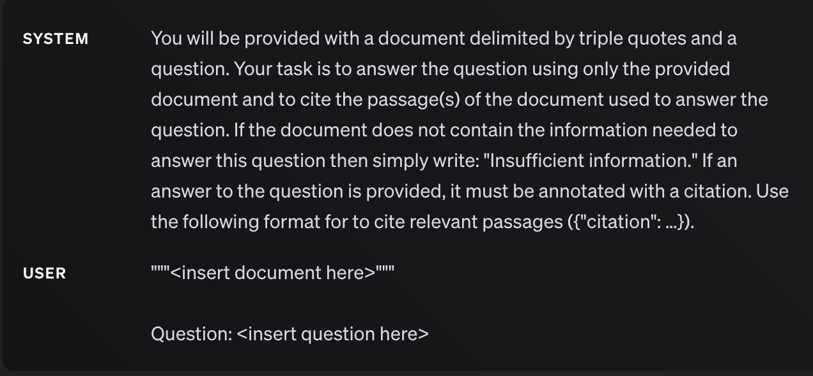
Providing reference text
Instruct the model to answer using a reference text
  Use embeddings when text is too big
Instruct the model to answer with citations from a reference text

Slide 35
Split complex tasks into simpler subtasks
Use intent classification to identify the most relevant instructions for a user query
For dialogue applications that require very long conversations, summarize or filter previous dialogue
  Think of it as note taking
Summarize long documents piecewise and construct a full summary recursively

Slide 36
Give the model time to "think"
Instruct the model to work out its own solution before rushing to a conclusion
Use inner monologue or a sequence of queries to hide the model's reasoning process
Ask the model if it missed anything on previous passes

Slide 37
Use tools
Use embeddings-based search to implement efficient knowledge retrieval
Use code execution to perform more accurate calculations or call external APIs
  Use for visualizations and dashboards
Give the model access to specific functions

Slide 38
Test changes systematically
Evaluate model outputs with reference to gold-standard answers

Slide 39
More from OpenAI
https://cookbook.openai.com/
Prompting libraries & tools
Prompting guides
Video courses
Papers on advanced prompting to improve reasoning

Slide 40
Gemini

Slide 41
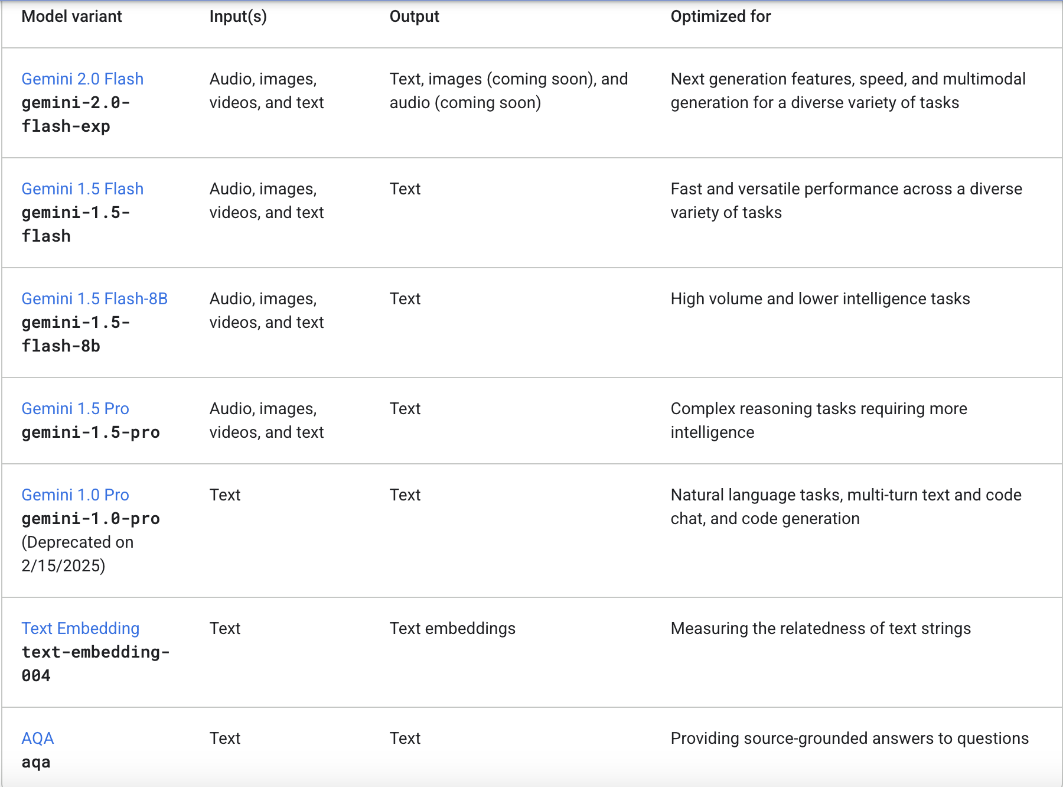
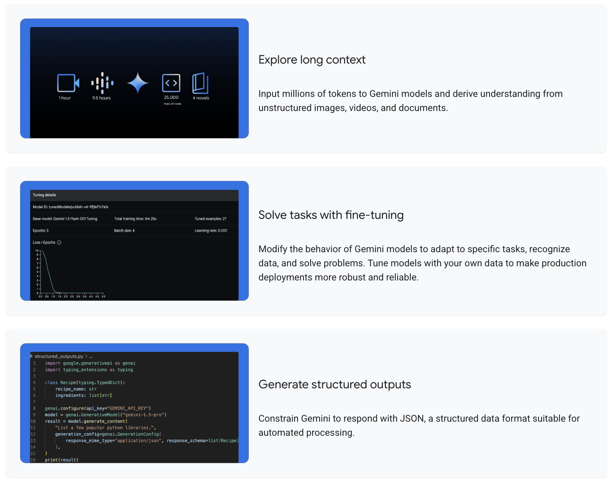
Services

Slide 42
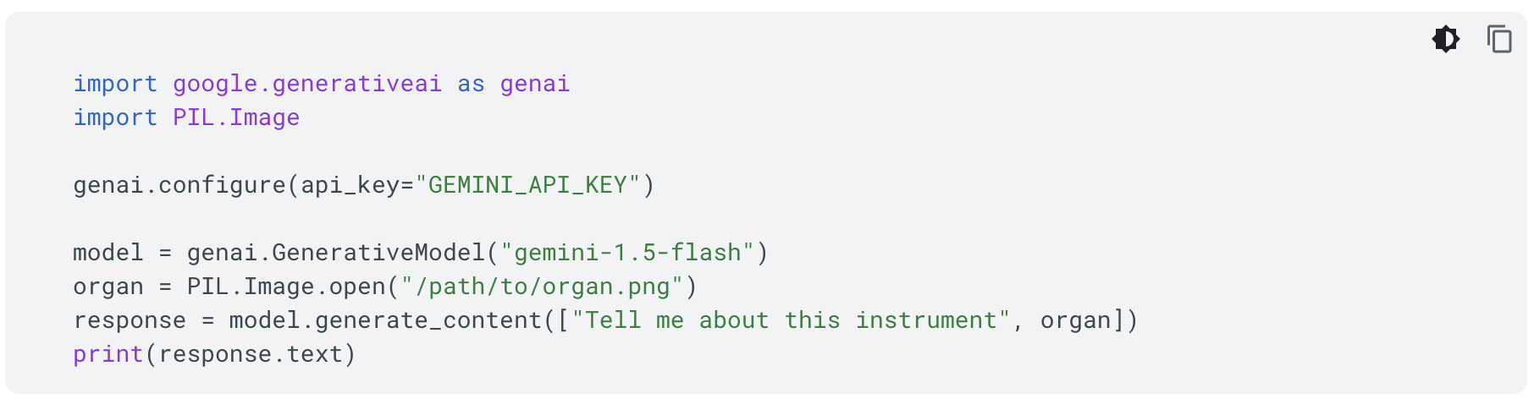
Basic usage

Slide 43
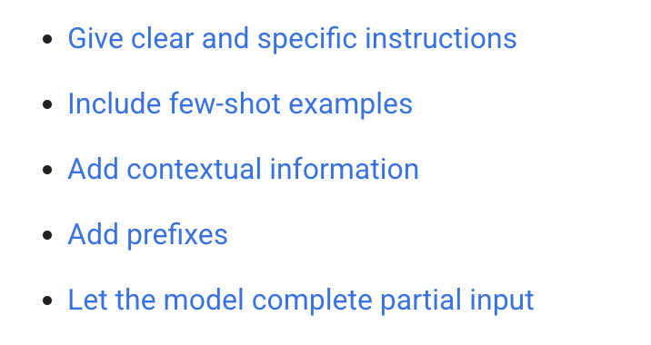
Strategies for prompting
Clear and specific instructions
  Define task clearly, in steps if required
  Specify constraints
  Define format

Slide 44
Include Few-shot Examples
Experiment with number of examples
Include patterns, not antipatterns
Use consistent formatting in examples

Slide 45
Adding contextual information
Include information (context) in the prompt that you want the model to use when generating a response.
  Specially useful when using tools
Give the model instructions on how to use the contextual information.

Slide 46
Add prefixes
Input, e.g., ARTICLE:
Output, e.g., JSON:
Include examples

Slide 47
Let the model complete partial output
If you give the model a partial input, the model completes that input based on any available examples or context in the prompt.
Having the model complete an input may sometimes be easier than describing the task in natural language.
Adding a partial answer to a prompt can guide the model to follow a desired pattern or format.

Slide 48
Break down prompts into simple components
Break down instructions
  Separate out major “functions” and use different prompts for each function
Chain prompts, e.g., running steps one after the other to ensure intermediate output
Aggregate results, e.g., going through your codebase

Slide 49
Different parameter values
Max output tokens
Temperature
  Higher the temperate, more creative
Top-K
  Sampling during generation
Top-P
  Tokens are selected from the most (see top-K) to least probable until the sum of their probabilities equals the top-P value.
  if tokens A, B, and C have a probability of 0.3, 0.2, and 0.1 and the top-P value is 0.5, then the model will select either A or B as the next token by using temperature and excludes C as a candidate.

Slide 50
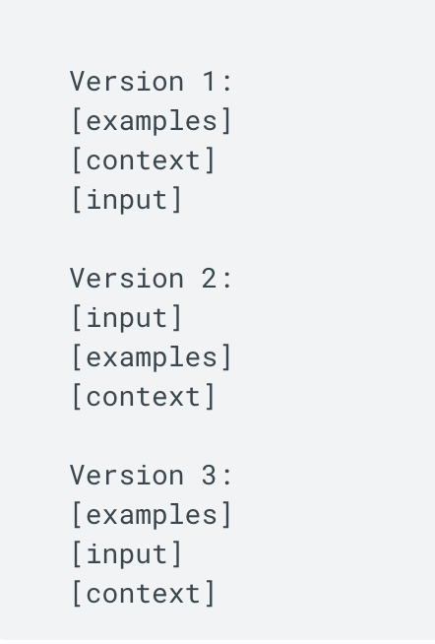
Iterating on prompts
Use different paraphrasing
Switch to analogous tasks
Change order of prompt content

Slide 51
Prompting with files
Prompt design fundamentals
  Be specific in your instructions: Craft clear and concise instructions that leave minimal room for misinterpretation.
  Add a few examples to your prompt: Use realistic few-shot examples to illustrate what you want to achieve.
  Break it down step-by-step: Divide complex tasks into manageable sub-goals, guiding the model through the process.
  Specify the output format: In your prompt, ask for the output to be in the format you want, like markdown, JSON, HTML and more.
  Put your image first for single-image prompts: While Gemini can handle image and text inputs in any order, for prompts containing a single image, it might perform better if that image is placed before the text prompt.
Troubleshooting your multimodal prompt
  If the model is not drawing information from the relevant part of the image: Drop hints with which aspects of the image you want the prompt to draw information from.
  If the model output is too generic (not tailored enough to the image): At the start of the prompt, try asking the model to describe the image(s) before providing the task instruction, or try asking the model to refer to what's in the image.

Slide 52
Claude

Slide 53
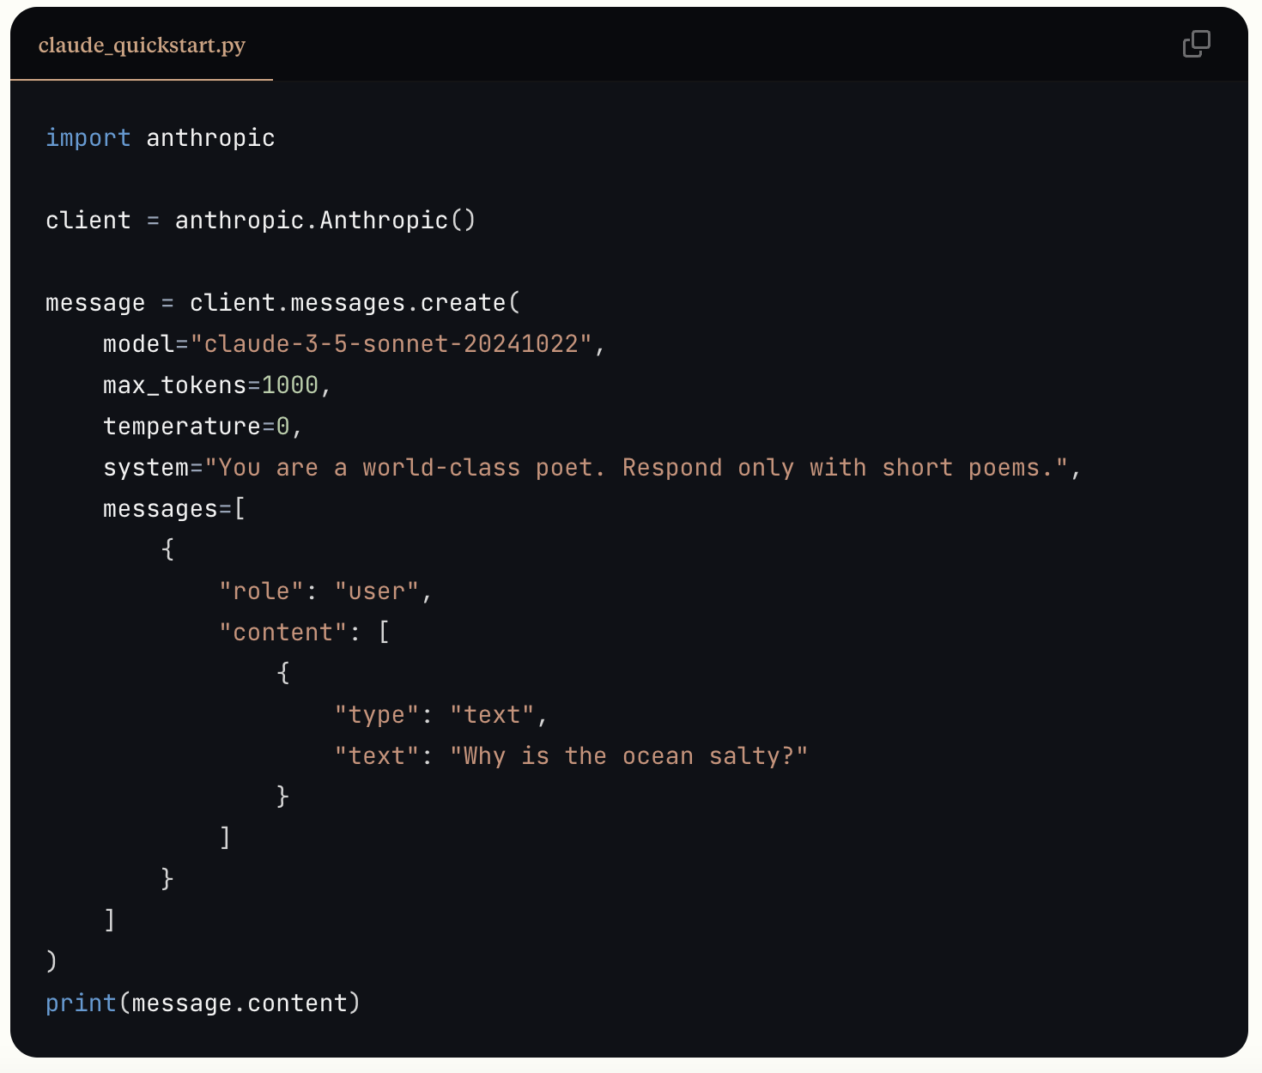
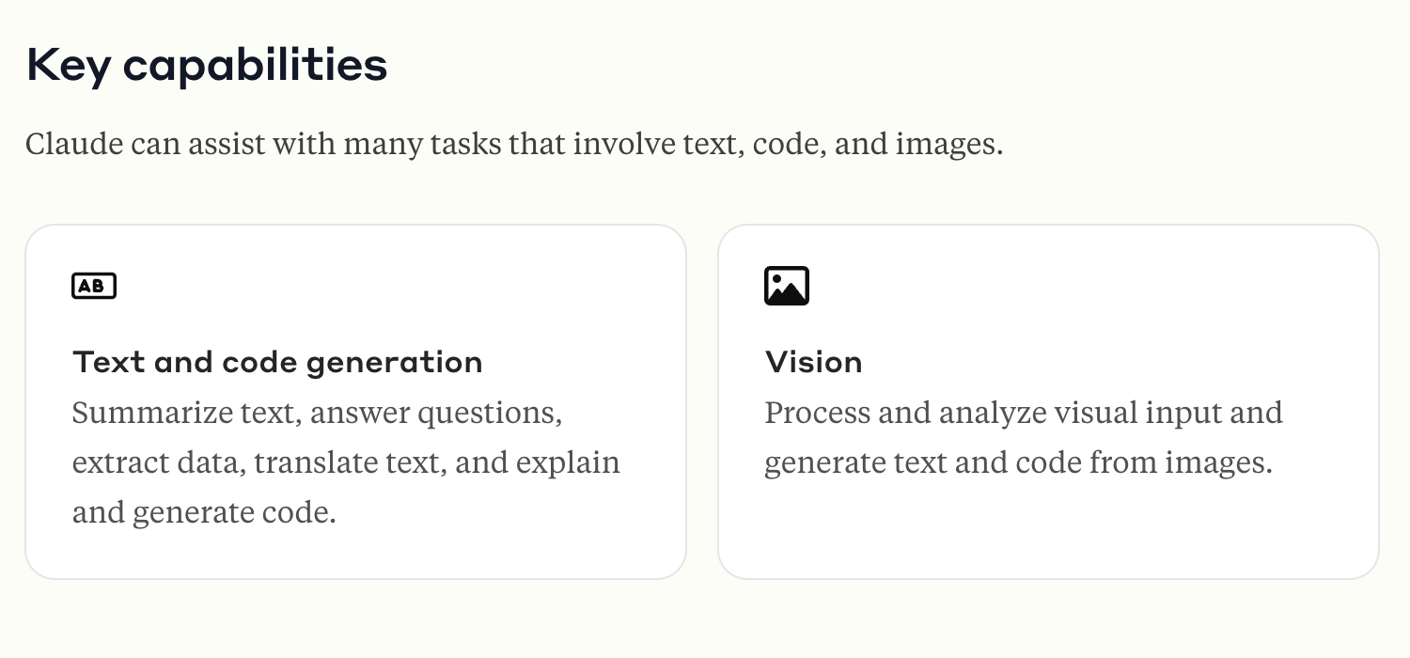
Key capabilities

Slide 54
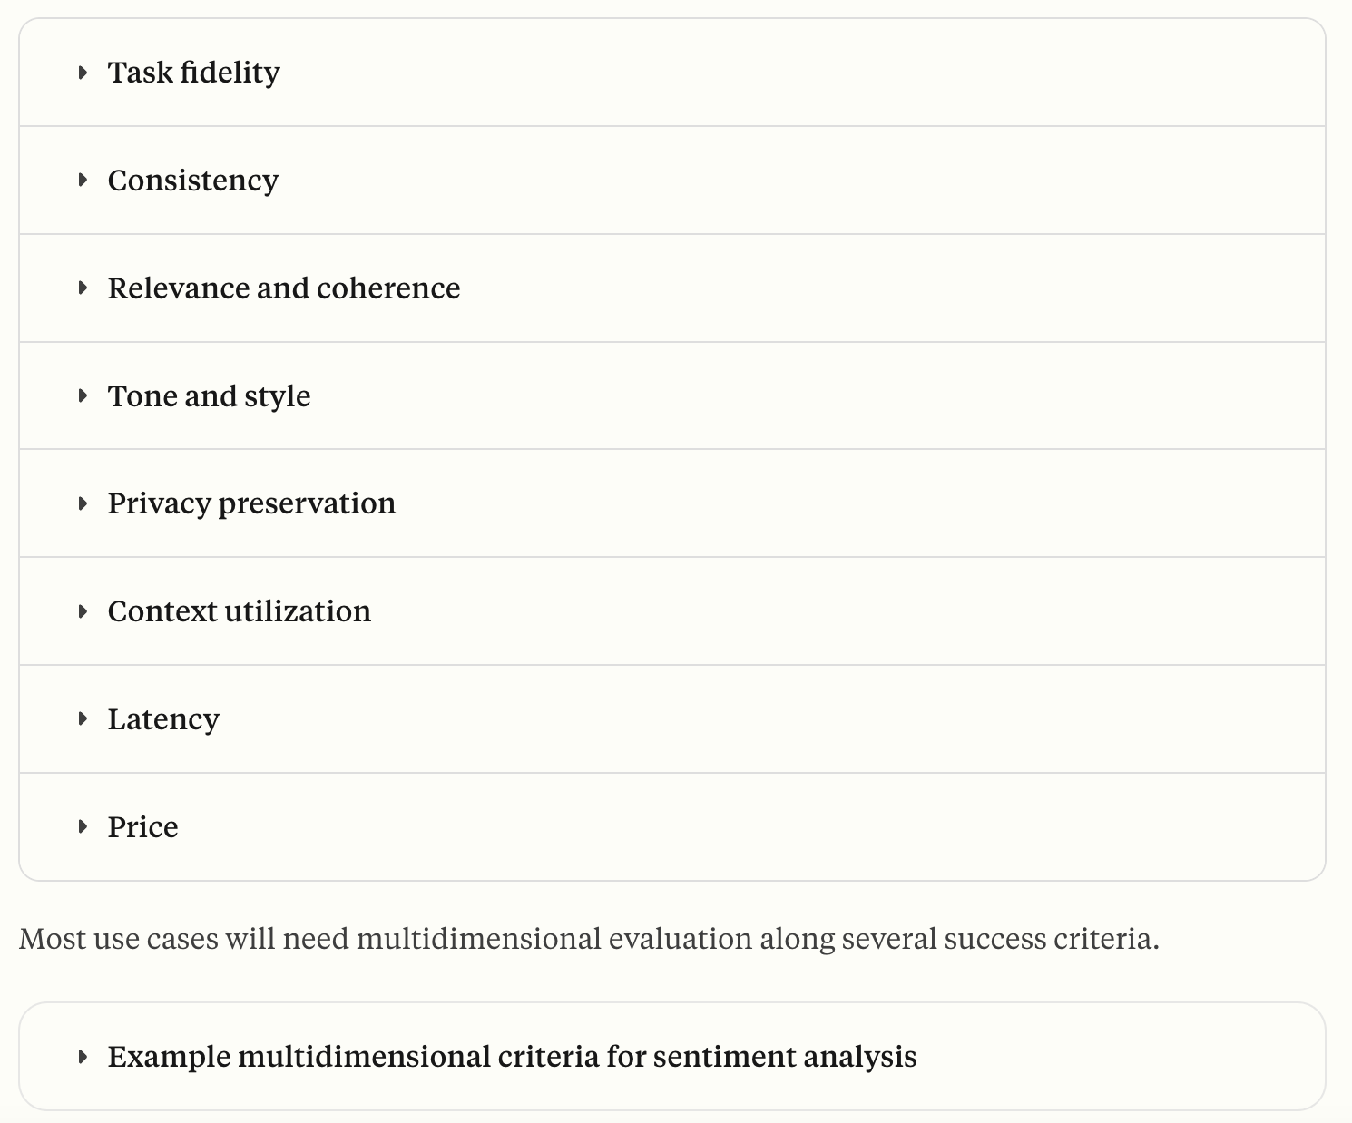
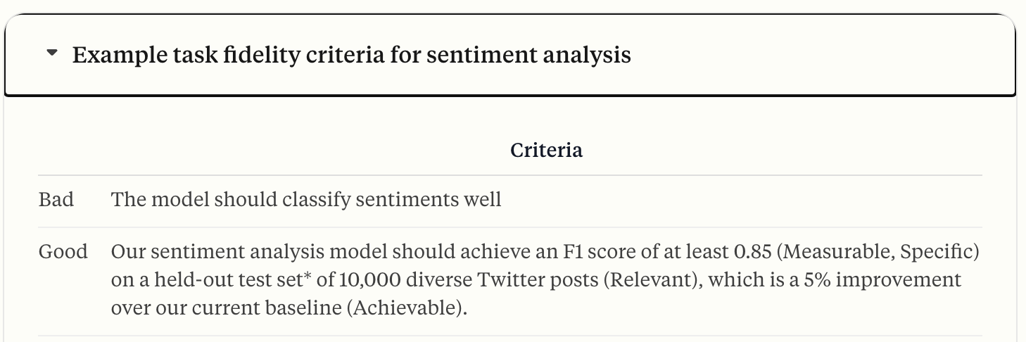
Before you prompt
Set a good goal
  https://docs.anthropic.com/en/docs/build-with-claude/define-success
  Specific
  Measurable
  Achievable
  Relevant

Slide 55
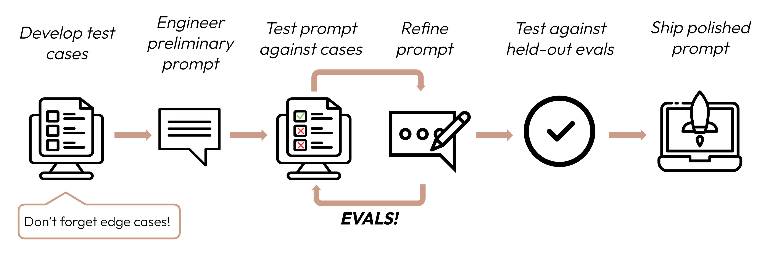
Create evals
e.g., in limited types of interactions within your website or retrieving data from the DB

Slide 56
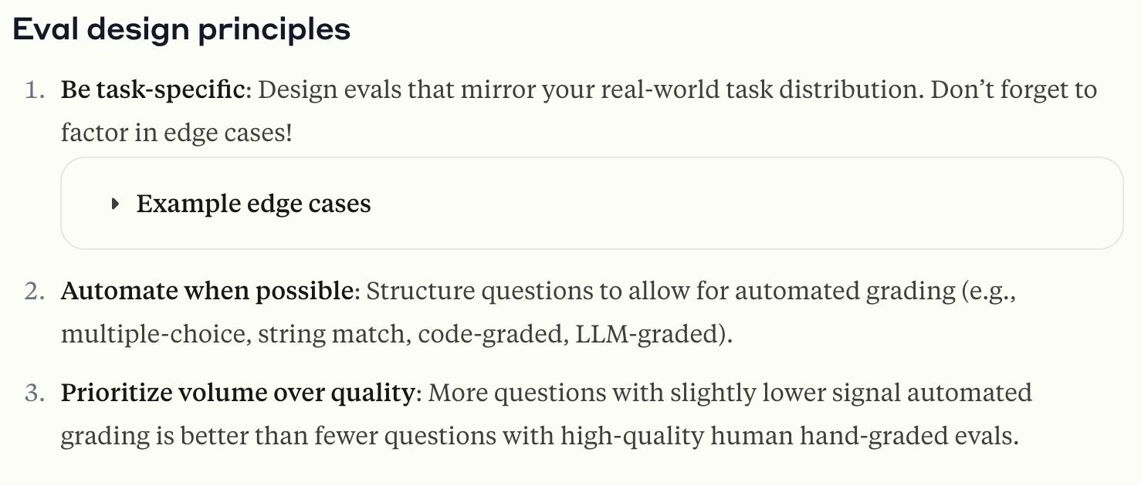
Levels of tests

Slide 57
How to prompt Claude?
Prompt generator
Be clear and direct
Use examples (multishot)
Let Claude think (chain of thought)
Use XML tags
Give Claude a role (system prompts)
Prefill Claude’s response
Chain complex prompts
Long context tips

Slide 58
Clear and direct prompts
Give contextual information
  Where is this going to be used?
  Who is the audience?
Be specific about what you want Claude to do
Provide instructions as sequential steps

Slide 59
Prompt to think
Basic: Think step-by-step
Intermediate: Outline steps
The notes approach: Use tags <thinking> <answer>.
  Additionally, use summarization on thinking
  Add other elements like absorbing PDFs or notes

Slide 60
System prompts
You are a X. You provide the service Y to the firm Z.

Slide 61
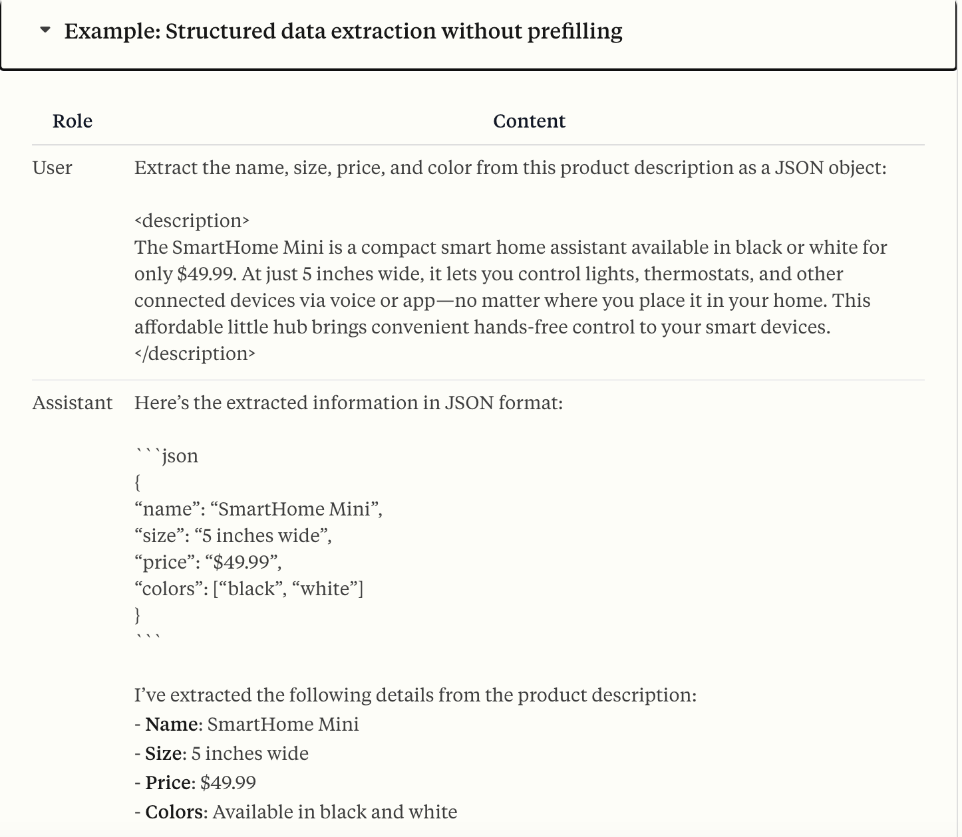
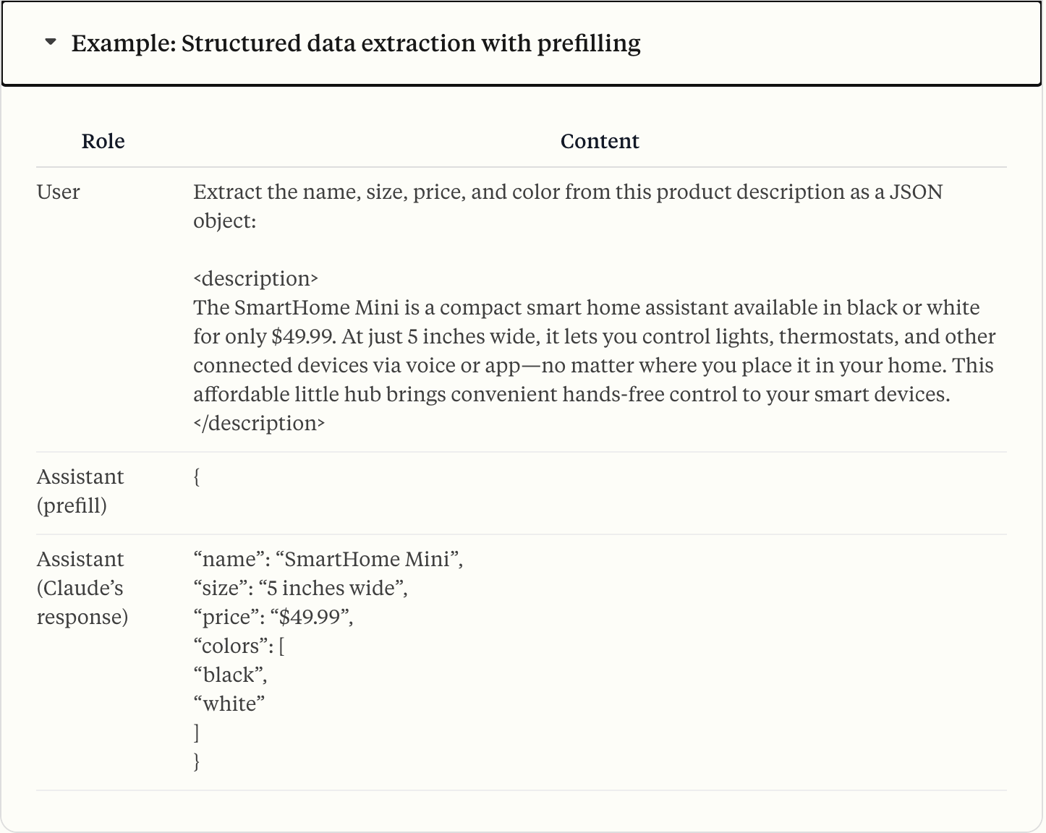
Prefill responses

Slide 62
Chain it up
Identify subtasks: Break your task into distinct, sequential steps.
Structure with XML for clear handoffs: Use XML tags to pass outputs between prompts.
Have a single-task goal: Each subtask should have a single, clear objective.
Iterate: Refine subtasks based on Claude’s performance.
Example chained workflows:
Multi-step analysis: See the legal and business examples below.
Content creation pipelines: Research → Outline → Draft → Edit → Format.
Data processing: Extract → Transform → Analyze → Visualize.
Decision-making: Gather info → List options → Analyze each → Recommend.
Verification loops: Generate content → Review → Refine → Re-review.

Slide 63
Long prompts
Keep queries at the end (30% improvement in response)
Structure each document and metadata with XML
Add quoting capabilities with explicit indexing

Slide 64
DO: Make screens for your web app
Let’s think through
  the kind of things our users require,
  the amount of reactivity required,
  source/destination for data
  Look/feel for the app

Slide 65
DO: Generate each screen using an API
Let’s do Ollama APIs this time
Try two models, may be
  a phi3 and
  a deepseek-r1/llama 3.2

Slide 66
Managing data
Databases
https://support.microsoft.com/en-us/office/database-design-basics-eb2159cf-1e30-401a-8084-bd4f9c9ca1f5

Slide 67
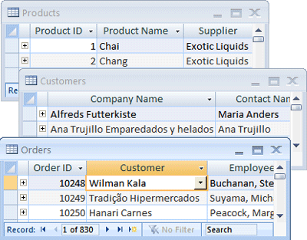
What are databases?
Which excel sheets would this person maintain?
What information will I require for my screens?
DB -> Table -> Record -> Field

Slide 68
Good DB Design
A good database design is, therefore, one that:
  Divides your information into subject-based tables to reduce redundant data.
  Provides Access with the information it requires to join the information in the tables together as needed.
  Helps support and ensure the accuracy and integrity of your information.
  Accommodates your data processing and reporting needs.

Slide 69
Designing your DB: The process
Determine the purpose of your database
Find and organize the information required
Divide the information into tables
Turn information items into columns
Specify primary keys
Set up the table relationships
Refine your design
Apply the normalization rules

Slide 70
The purpose
Number of users
  Is the user a single machine
  Or distributed machines that could work parallely? DB on server
What will you do with the data?
  Which reports to be generated
  What type of user interactions are required?
  What kind of questions will you need to answer later, e.g., which regions provide the best revenue?

Slide 71
Gathering information
For each type of information, think of
  What field would you keep if you give them a paper form, e.g., a customer
  From your screen, what would you display for different components of the screen

Slide 72
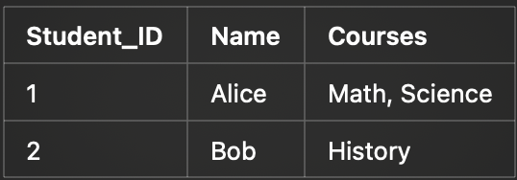
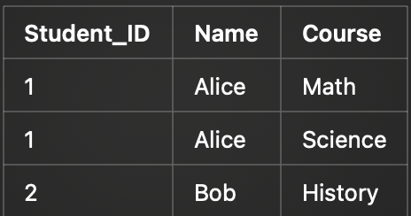


Dividing information into tables
1NF: 1st Normal Form (Atomicity)
A table is in 1NF if:
1. Each column contains atomic (indivisible) values (no lists, arrays, or nested values).
2. Each column contains values of a single type.
3. Each row has a unique identifier (Primary Key).

Slide 73
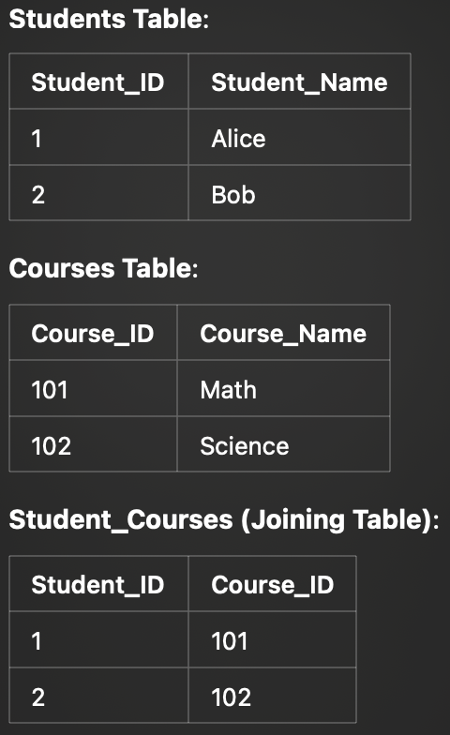
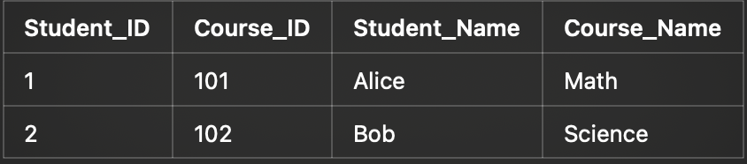
2NF: No partial dependencies
A table is in 2NF if:
1. It is in 1NF.
2. All non-key attributes must depend on the entire primary key, not just a part of it.
Student Name depends on Student_ID and Course_Name depends on Course ID

Slide 74
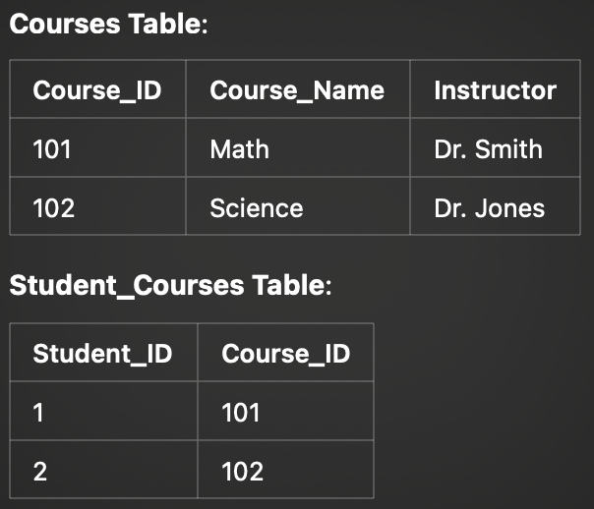
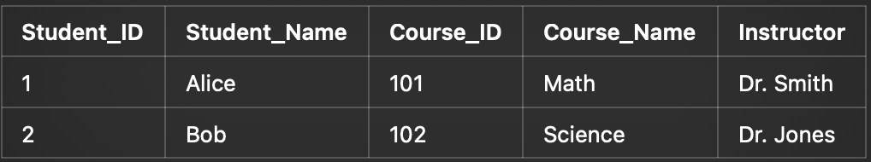
3NF: No transitive dependencies
A table is in 3NF if:
1. It is in 2NF.
2. All non-key attributes depend only on the primary key (no indirect dependencies).
Here, Course_Name and Instructor depend on Course_ID, not Student_ID, creating a transitive dependency.

Slide 75
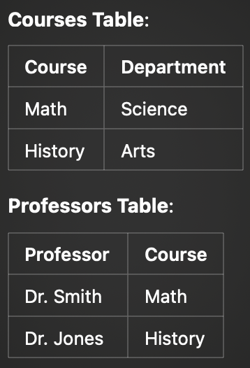
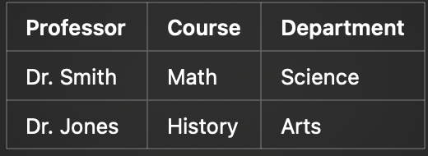
BCNF: Boyce Codd Normal Form
BCNF is a stricter version of 3NF. A table is in BCNF if:
1. It is in 3NF.
2. Every determinant is a candidate key.
Here, Professor → Course, but Course → Department. This means Course should be a primary key.

Slide 76
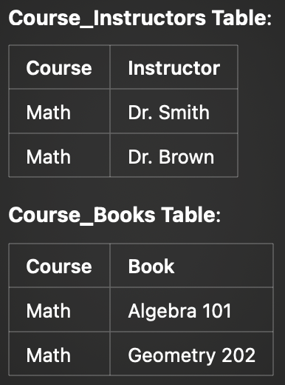
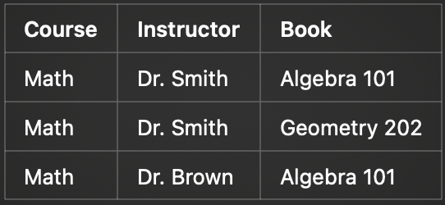
4th NF: No multi-valued dependencies
A table is in 4NF if:
1. It is in BCNF.
2. No column contains two or more independent multi-valued facts.
Instructor and book are independent

Slide 77
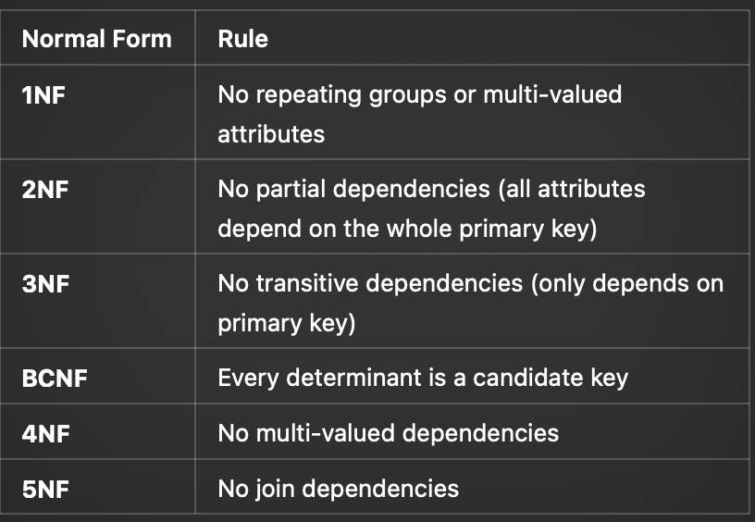
When to Stop Normalizing?
• 3NF is sufficient for most practical applications.
• BCNF is used in complex enterprise applications.
• 4NF and 5NF are used in advanced use cases like data warehouses.

Slide 78
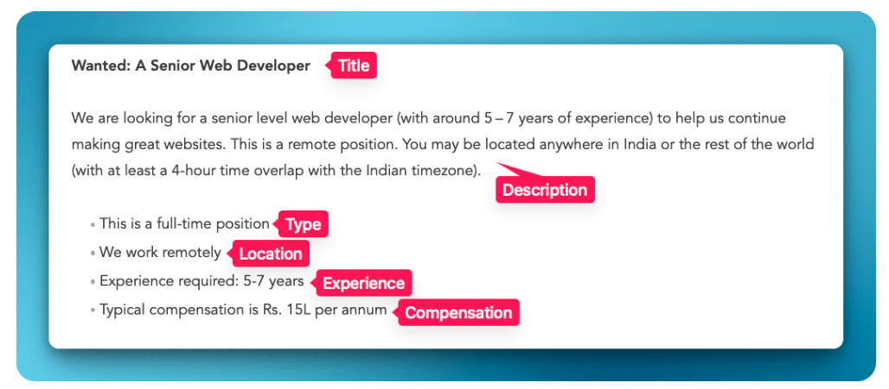
Recap from guest lecture:
Designing your DB
Start with Content
Create a data model
Break down content model into objects
Define properties and types
Map Object relationships

Slide 79
API endpoints

Slide 80

Making requests
Source: https://medium.com/@shikha.ritu17/rest-api-architecture-6f1c3c99f0d3

Slide 81
Using calls for interactions

Slide 82
HTMX

Slide 83
Connecting with other tools/resources
https://www.anthropic.com/news/model-context-protocol

