Slide 1
QUICHE E-Graphs in Python
Rebecca Swords | EGRAPHS 2022

Slide 2

Introductions
Who am I?
What is Quiche?
Why is Quiche?
Notes:
Who am I?
I am the lead developer for Quiche
What is Quiche?
Python library for e-graphs that includes dedicated support for Python ASTs, including source-to-source rewriting
Why Quiche?
- At the time (~ 1 year ago) no Python bindings, unclear if egg would support the full AST grammar and how well transition to/from e-graph would work (because egg generates its own text parser), and the idea of having a native tool was very appealing

Slide 3
A Quick Example
def hours_to_seconds(hours):
return hours * 60 * 60
def days_to_seconds(days):
return days * 24 * 60 * 60
def seconds_to_days(seconds):
return seconds / 24 / 60 / 60
def hours_to_seconds(hours):
return hours * 3600
def days_to_seconds(days):
return days * 86400
def seconds_to_days(seconds):
return seconds / 86400
Quiche parses the AST and creates an e-graph. Using rewrite rules and e-class analysis, we can do constant folding
Notes:
I promised source-to-source rewriting, so let’s look at some Python code we might like to rewrite!
We have a few simple time conversions, with multiplication and division fully spelled out, and we will do constant folding to apply the operations where possible.
Using a couple of rewriting rules for properties of mult/div and an e-class analysis, Quiche can do this full rewrite.

Slide 4
How?
1
quiche_tree = ASTQuicheTree("time_conversion.py")
egraph = EGraph(quiche_tree, ASTConstantFolding())
mul_assoc = ASTQuicheTree.make_rule(
"__quiche__x * __quiche__y * __quiche__z",
"__quiche__x * (__quiche__y * __quiche__z)") mul_div = ASTQuicheTree.make_rule(
"__quiche__x / __quiche__y / __quiche__z",
"__quiche__x / (__quiche__y * __quiche__z)")
rules = [mul_assoc, mul_div]
while not egraph.is_saturated():
egraph.apply_rules(rules)
extracted = MinimumCostExtractor().extract(
ASTSizeCostModel(), egraph, egraph.root,
ASTQuicheTree.make_node)
extracted.to_file("time_folding.py")
Parse the Python into an ASTQuicheTree and turn it into an e-graph with constant folding analysis.
Rewrite rules for multiplication associativity and division rewriting.
Apply rules until saturation.
Extract the smallest AST.
Export to file.
2
3
4
5
Notes:
In Quiche, we always create e-graphs from trees, rather than from a language spec. ASTQuicheTree is a wrapper for creating the Python AST that can be used to construct an e-graph. This e-graph is created with the AST Constant Folding analysis
In 2, we define a couple of rewrite rules. These use a different syntax from egg because we are leveraging the Python parser which doesn’t support variables named with a leading ?
Once we have a list of rules, we can apply them to the e-graph until it’s saturated
Similar to egg, we use a combination of cost model and term extractor to pull out the “best” node – here, it’s the one with the smallest AST (the one with all the constants folded)
Finally, for Python ASTs, we have a to_file method to generate the source code

Slide 5

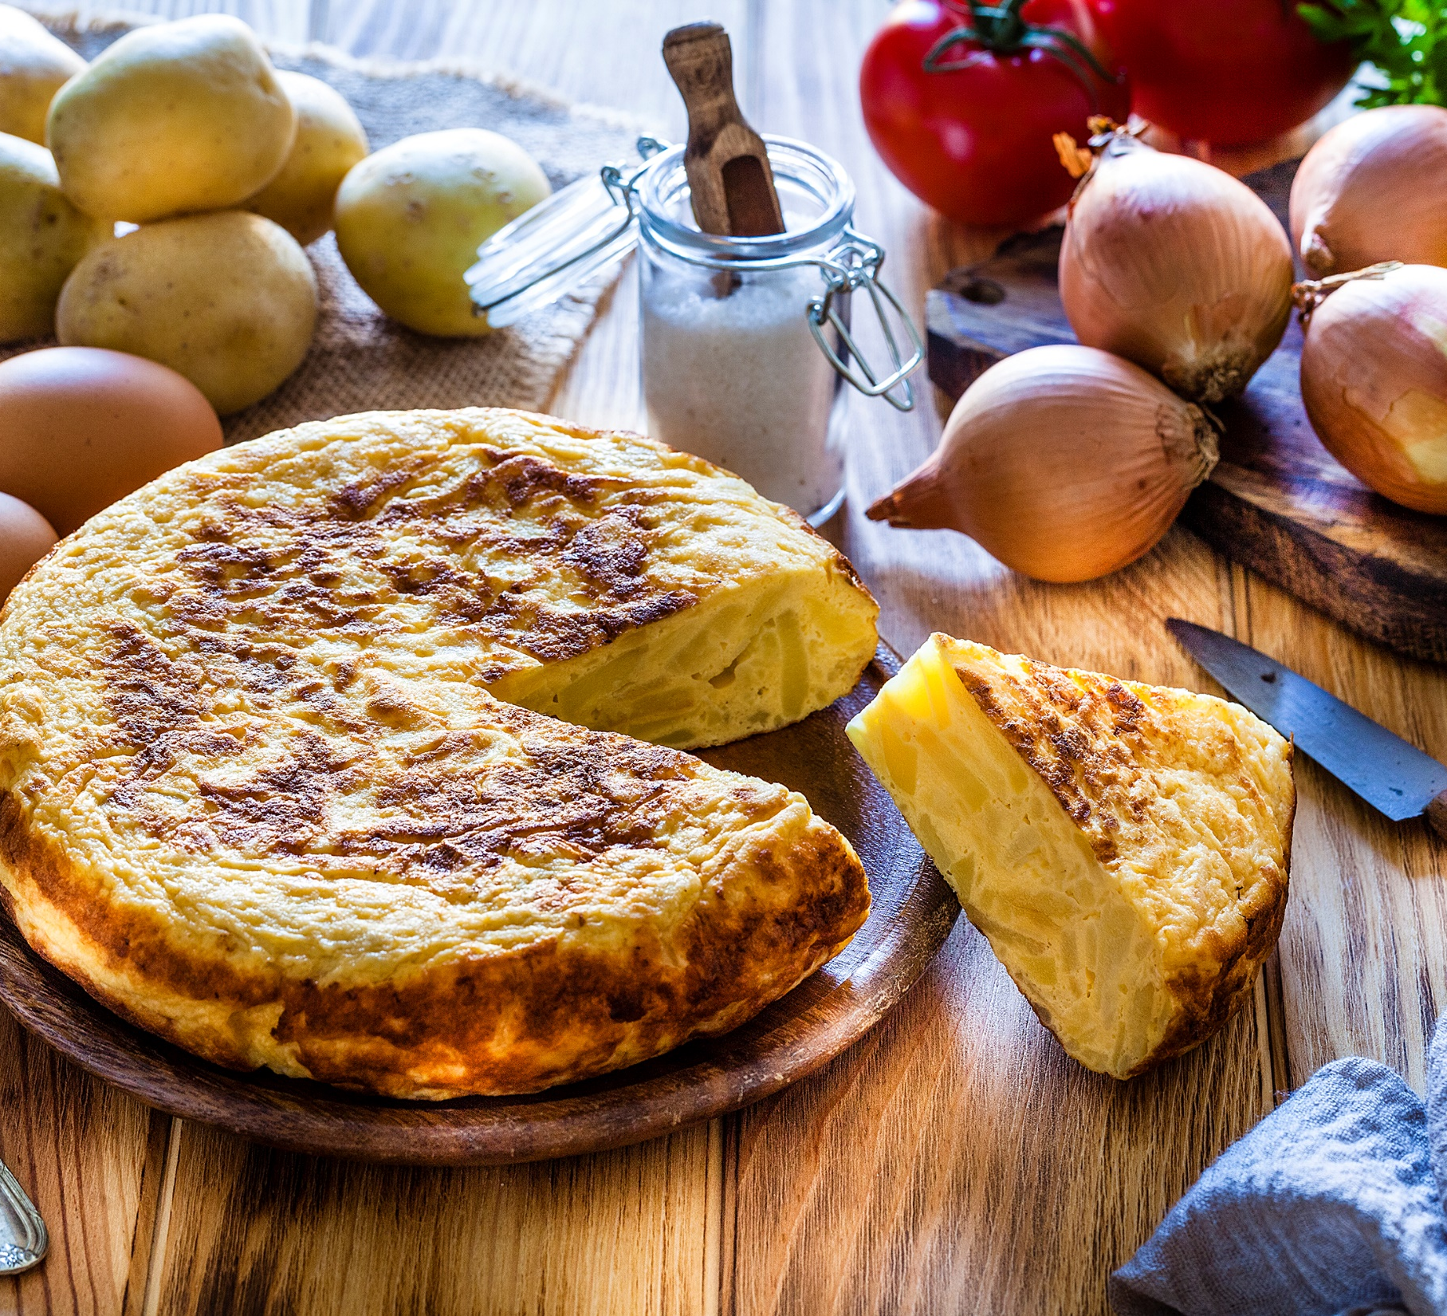
Core Implementation
Quiche Internals

Slide 6
Core Components
EGraph | E-graph implementation using algorithms described in egg
QuicheTree | Tree representation used for building e-graphs, rewriting, and term extraction
EClassAnalysis | Running e-class analysis, as described in egg
Rule | Rewriting rules, specifying term equivalences
CostModel | Calculate cost for each e-node
Extractor | Extract terms based on the cost model
Notes:
E-graph class - largely as described in egg paper
QuicheTree – tree representation used for building e-graphs, rewriting, and term extraction

Slide 7
Core Components
EGraph | E-graph implementation using algorithms described in egg
QuicheTree | Tree representation used for building e-graphs, rewriting, and term extraction
EClassAnalysis | Running e-class analysis, as described in egg
Rule | Rewriting rules, specifying term equivalences
CostModel | Calculate cost for each e-node
Extractor | Extract terms based on the cost model
Notes:
E-graph class - largely as described in egg paper
QuicheTree – tree representation used for building e-graphs, rewriting, and term extraction

Slide 8
E-Graph Representation
Follows the e-graph algorithms in egg.
Constructor arguments are optional.
add() takes a QuicheTree object.
class EGraph():
def __init__(self, tree, analysis)
def add(self, quiche_tree)
def merge(self, eclass1, eclass2)
def rebuild(self)
def repair(self, eclass)
def apply_rules(self, rules)
Notes:
Very closely follows algorithms described in the egg paper
Some callouts:
constructor args are optional (can initialize with a tree for convenience or not). If so, root field holds the e-class ID of the e-class for the top-level node of the QuicheTree
- Adding to the e-graph is done through QuicheTree terms. For Python, ASTQuicheTree is the QT implementation for working with Python ASTs.

Slide 9
Quiche Trees
Quiche requires the user to provide a parsed tree that implements QuicheTree (“bring your own parser”).
value() the e-node key
children()
list of the node's children
is_pattern_symbol()
for e-matching; indicates if the node is a pattern
class QuicheTree(ABC):
@abstractmethod
def value(self)
@abstractmethod
def children(self)
@abstractmethod
def is_pattern_symbol(self)
Notes:
Quiche uses a parsed tree (AST) as input, and each node in the tree needs to be able to provide the following:
value(): what to use as the e-node key for comparisons, must be hashable and comparable (__eq__)
children(): list of the node’s children (as QuicheTrees)
is_pattern_symbol(): Because it’s “bring your own parser”, we can’t determine a priori what a parser will permit in terms of pattern syntax, so the user has to specify what qualifies as a pattern. In fact, the egg syntax of preceding with “?” is invalid in Python

Slide 10
Rules and Pattern Symbols
A Rule is just a pair of QuicheTrees
For Python ASTs, patterns are variables or strings prefixed with __quiche__ (more later).
make_rule() is provided for convenience
class Rule:
def __init__(self, lhs, rhs):
self.lhs = lhs
self.rhs = rhs
# Makes a Python AST rule.
mul_assoc = ASTQuicheTree.make_rule(
"__quiche__x * __quiche__y * __quiche__z",
"__quiche__x * (__quiche__y * __quiche__z)")

Slide 11
Cost Models
Similar to egg:
enode_cost: calculate cost based on e-node value
enode_cost_rec: recursive cost calculation, including children;
costs: [EClassID → (cost, ENode)]
class CostModel(ABC):
@abstractmethod
def enode_cost(self, enode)
@abstractmethod
def enode_cost_rec(self, enode, costs)
Notes:
Very similar to egg, including method names, so not talking too much about it

Slide 12
Term Extraction
Use a cost model to extract the QuicheTree term for an e-class in the e-graph.
Generally, use MinimumCostExtractor
build_tree(value, children): method for re-constructing a QuicheTree from an e-node
class CostExtractor(ABC):
@abstractmethod
def extract(self, cost_model, egraph,
eclassid, build_tree)
Notes:
Similar interface to egg, just the extract method
Generally, users will want to use the MinimumCostExtractor to pull out the lowest cost term (join semi-lattice, not meet-)
Main difference from egg is this build_tree method for re-constructing a QuicheTree from the e-node data. (Because we’re allowed to add new e-nodes to the e-graph and we don’t know how value() or children() are derived from a QT, we have to have this to be able to turn e-nodes into QTs)

Slide 13
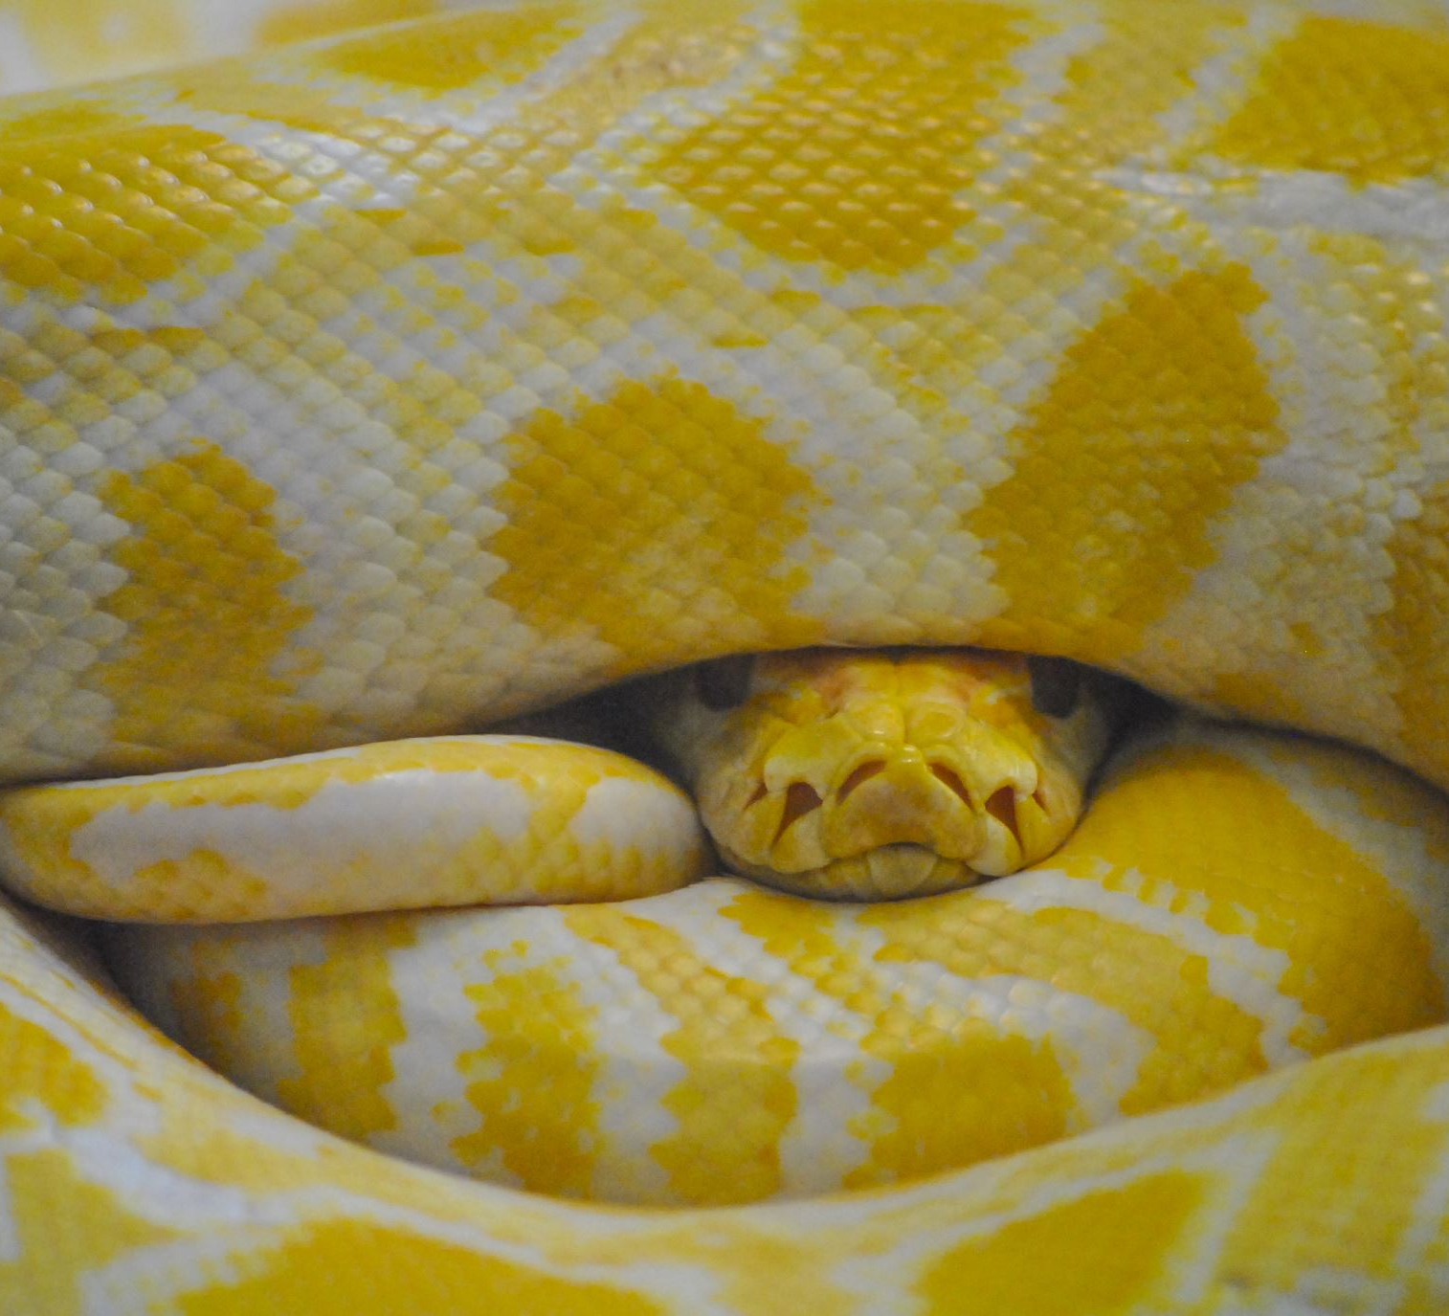
Python ASTs in Quiche

Slide 14

Python Pipeline
Parse source file
Lift through Python Abstraction Layer (v3.7 -3.10)
Convert to ASTQuicheTree
Extract through PAL, Generate Python
Perform E-Graph Operations
Notes:
Overview of source-to-source pipeline for Python
* Parse source file, lift it through PAL into an ASTQuicheTree. Then, turn that into an e-graph and perform any operations on it. After that, extract back to ASTQuicheTree and back through PAL for source generation

Slide 15

Python Abstraction Layer (PAL)
Abstract differences between Python versions for Quiche input and output (versions 3.7 – 3.10 supported)
Ensure all tree nodes extend AST
Wrap lists of statements, expressions, etc. in blocks
Collapse constants and vars into a simpler leaf node
Notes:
Essentially, PAL tidies up code so it will more easily go in/out of the e-graph and so differences between AST versions are less obtrusive
(We have a visitor pattern traversal that does all of this at once)
We want all the nodes in the ASTQuicheTree to correspond to an AST node, so we lift anything that’s not an AST into one, including lists.
Here’s the example for “if”: the body is a list of statements, so we wrap it in a StmtBlock node.

Slide 16
ASTQuicheTree
value()
AST Node type or a special tuple for leaves
children()
List of values from each field in _fields, wrapped in an ASTQuicheTree
is_pattern_symbol()
Variables or strings beginning with __quiche__
def value(self):
root_type = type(root)
if is_primitive_type(root_type):
return (root.kind, root.constr, *root.args)
else:
return root_type
Examples:
If(test, body, orelse) → If
Constant(5, None) →
(“int”, Constant, 5, None)
Notes:
ASTQuicheTree is the QuicheTree implementation for working with Python ASTs
It has to implement the 3 abstract methods: value, children, and is_pattern_symbol. The actual implementations include more details, but this is just to give an idea for what it looks like.
1. value() – AST node type (If, While, BinOp) or special tuple for leaves (type tag, constructor, constr args for an integer)

Slide 17
ASTQuicheTree
value()
AST Node type or a special tuple for leaves
children()
List of values from each field in _fields, wrapped in an ASTQuicheTree
is_pattern_symbol()
Variables or strings beginning with __quiche__
self._children = []
for field in getattr(self.root, "_fields", []):
child = getattr(self.root, field, None)
self._children.append(ASTQuicheTree(child))
Examples:
If(test, then_block, else_block) →
[ASTQuicheTree(test),
ASTQuicheTree(then_block),
ASTQuicheTree(else_block)]
Notes:
The children is just a list of values from the AST fields, as you’d expect

Slide 18
ASTQuicheTree
value()
AST Node type or a special tuple for leaves
children()
List of values from each field in _fields, wrapped in an ASTQuicheTree
is_pattern_symbol()
Variable names or strings beginning with __quiche__
Examples:
Constant(“__quiche__x”, None)
Name(“__quiche__y”, Load)
→ Why not “?x” like egg?
→ Why include strings?
Notes:
This is the interesting one – for Python, we can’t use the “?” syntax that egg uses because it’s invalid syntax (parser won’t allow it)
So, I picked a dedicated prefix that would work for Python instead: the dunder notation is reserved, so we’re very unlikely to have any clashes.
The Python parser is fairly lax – it will allow you to put an undeclared/unused variable pretty much anywhere, so this works out pretty well. We do also have to include strings because there are some contexts (like function names for example), where the grammar just uses a string identifier, so if we want to rewrite those contexts, we have to recognize strings as potential patterns as well.

Slide 19
Extraction
Rebuild ASTQuicheTree
Extract through PAL
Remove extra blocks
Re-expand leaf nodes
Generate source code with astor
Notes:
Essentially, PAL tidies up code so it will more easily go in/out of the e-graph and so differences between AST versions are less obtrusive
(We have a visitor pattern traversal that does all of this at once)
We want all the nodes in the ASTQuicheTree to correspond to an AST node, so we lift anything that’s not an AST into one, including lists.
Here’s the example for “if”: the body is a list of statements, so we wrap it in a StmtBlock node.

Slide 20
Python Pipeline
Parse source file
Lift through Python Abstraction Layer (v3.7 -3.10)
Convert to ASTQuicheTree
Extract through PAL, Generate Python
Perform E-Graph Operations
Notes:
Overview of source-to-source pipeline for Python
* Parse source file, lift it through PAL into an ASTQuicheTree. Then, turn that into an e-graph and perform any operations on it. After that, extract back to ASTQuicheTree and back through PAL for source generation

Slide 21
Future Work
Implement new analyses and cost models
Create a full suite of rewrite rules for known Python optimizations
Add better project support
Explore options for legacy Python systems
Notes:
1.
2. Lots of known, fairly simple Python rewrites that can be applied statically – would like to make a useful tool where people can easily apply these to large projects (which brings us to 3)
3. Currently, you can of course add multiple files to an e-graph by parsing and adding them one at a time. It might be nice to support file detection, importing a list of files all at once, etc.
4.

Slide 22

Thank You! github.com/riswords/quiche
Parse source file
Lift through Python Abstraction Layer (v3.7 -3.10)
Convert to ASTQuicheTree
Extract through PAL, Generate Python
Perform E-Graph Operations
Notes:
1.
2. Lots of known, fairly simple Python rewrites that can be applied statically – would like to make a useful tool where people can easily apply these to large projects (which brings us to 3)
3. Currently, you can of course add multiple files to an e-graph by parsing and adding them one at a time. It might be nice to support file detection, importing a list of files all at once, etc.
4.

Slide 25
Python 3.9 AST Highlights https://docs.python.org/3.9/library/ast.html
ASDL's 4 builtin types are: identifier, int, string, constant
mod = Module(stmt* body, type_ignore* type_ignores) | Expression(expr body)
stmt = FunctionDef(identifier name, arguments args,
stmt* body, expr* decorator_list,
expr? returns, string? type_comment)
| Assign(expr* targets, expr value,
string? type_comment)
| While(expr test, stmt* body, stmt* orelse)
| If(expr test, stmt* body, stmt* orelse)
| Expr(expr value)

Slide 26
Python 3.9 AST Highlights https://docs.python.org/3.9/library/ast.html
expr = BinOp(expr left, operator op, expr right) | UnaryOp(unaryop op, expr operand) | Lambda(arguments args, expr body)
| Constant(constant value, string? kind) | Name(identifier id, expr_context ctx)

