Slide 1
PROJECT
DESCRIPTION:
This project is user Instagram analytics and giving insights to the development team for executing certain queries required by Marketing and Department and investor for generating and enhancing their revenue budget by which we track how users engage and interact with our digital product (software or mobile application) in an attempt to derive business insights for marketing, product & development teams
Beside the business requirement I further would like to use the data for visualization using some tools like Tableau for my better learning and use those pictorial form in the same. Would like to go with the conventional method of querying the database in concise. Let me take you deep dive into how it should be like.

Slide 2
APPROACH AND TECH-STACK USED
We have been given quite decent problem statements for that my idea to execute those with the business logic and for that I’ll be using a database of the company and will go through each table once before any decision to understand what kind of data it is and how this works its relationship with other tables.
I’ll be using some of the tools like -
MySQL workbench 8.0 CE
MySQL Server
Tableau
Moreover jot down the important insights of tables like tag, photos, users, comments to understand fully their uses and records.

Slide 3
INSIGHTS
I have worked on this project while understanding have noted down the pricing model how it should be build for ads campaign and how to make platform more appealing and engaging so that it involves inactive users too.
Looking at the data there are several tables where users table is main and the username_id is the primary key where it has been used as a foreign table.
It is also observable how much tags have been using by audience and where the targeted people is actually interested in , what type of content so all of these are cleared by organizing the tables and finding out the relationships by data binding , joints and aggregartion.
These will be sufficient for the product team to design the Instagram something like this and what more features need to be added.
So here are the following queries for the respective business requirements -

Slide 4
table users;
select count(*) from users;
/*solution-1 Rewarding Most Loyal Users*/
SELECT * FROM users
ORDER BY created_at
LIMIT 5;
/*solution-2 Remind Inactive Users to Start Posting*/
SELECT username FROM users LEFT JOIN photos ON photos.user_id=users.id WHERE image_url IS NULL;
/*solution-3 Declaring Contest Winner*/
SELECT
username,
photos.id,
photos.image_url,
COUNT(*) AS total_votes
FROM photos
INNER JOIN likes
ON likes.photo_id = photos.id
INNER JOIN users
ON photos.user_id = users.id
GROUP BY photos.id ORDER BY total_votes DESC LIMIT 1;

Slide 5
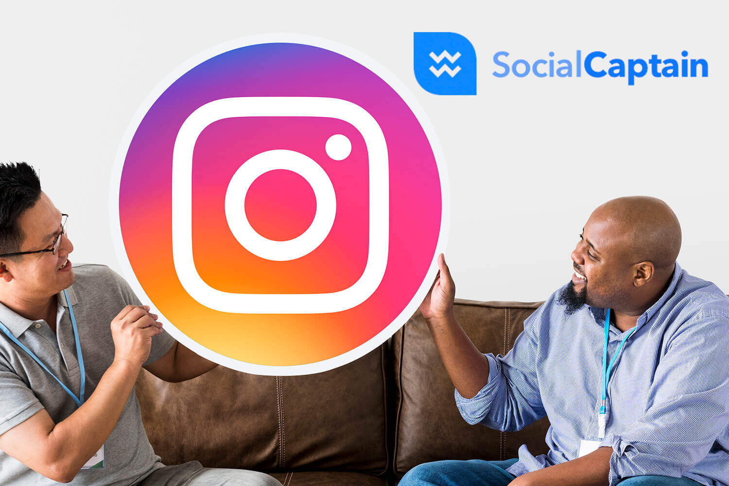
/* Solution-4 Identify and suggest the top 5 most commonly used hashtags on the platform*/
SELECT tag_name,COUNT(*) AS total_tags FROM tags JOIN photo_tags ON photo_tags.tag_id=tags.id GROUP BY tags.id ORDER BY total_tags DESC LIMIT 5;
/*Solution-5 Launch AD Campaign*/
SELECT
DAYNAME(created_at) AS weekday,
COUNT(*) AS total_member
FROM users
GROUP BY weekday
ORDER BY total_member DESC LIMIT 2;

Slide 6
/*solution-B User Engagement*/
SELECT (SELECT COUNT(*) FROM photos) / (SELECT COUNT(*) FROM users) AS Avg;
/*solution Bots & Fake Accounts*/
SELECT username,
Count(*) AS num_likes
FROM users
INNER JOIN likes
ON users.id = likes.user_id
GROUP BY likes.user_id
HAVING num_likes = (SELECT Count(*)
FROM photos);

Slide 7
RESULTS
I have figured out that this project gave me insights how to use the data and the use of MYSQL I’m able to implement what I have learnt.
I also did practice sets from Trainity learning portal where I used the aggregation and joins in the project for retrieving data from database.
Also for marketing team there are certain days like Thursday and Tuesday where users where found to be more active and registered so it would be helpful for their ads camp.
I also gave quick look to the loyal customers and their patter of using insta through tableau.
I have learnt a lot about MYSQL , from installation to execute through server through this project all from scratch. Miles to go!

