Slide 1

GIT AND GITHUB
Epic Week of Crash Courses 20112
Originally given 12/2/11 by Derek Erdmann

Slide 2
What the heck is Git?
Git is a distributed version control system focused on speed, effectivity and real-world usability on large projects.

Slide 3

I still have no idea what Git is.

Slide 4
Revision Control
Version control systems (VCSs) help you manage changes to your source code
To save a version of your code, commit or check in the current changes
If you commit regularly, you’ll be able to go back to any previous version of your code
Notes:
Example: Wikipedia – you can always see the history of the page, and can revert back to any previous version

Slide 5
Distributed Revision Control Systems
Many older systems use a central server to which all team members push their changes
Git (and Mercurial) keeps a copy of the entire repository on each team member’s local machine
Why is this good?
Team members can commit without breaking tests
If the connection to the server is lost, everyone can still commit changes locally
Team members can push changes to each other, bypassing the server entirely
Notes:
Problem with central server:
Each team member only has the most recent copy of the workspace
If the connection to the server is lost, team members can’t check in changes
Can’t check in code in intermediate stages, since it could break tests and other members’ code

Slide 6
How to Git
(off my lawn)

Slide 7
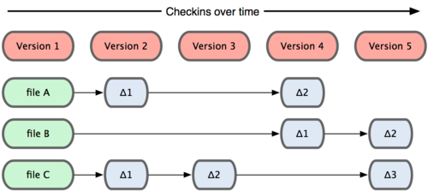
How many VCSs store changes
Other VCSs store a base version of a file and a set of changes to that file
Image source: http://progit.org/book/ch1-3.html

Slide 8
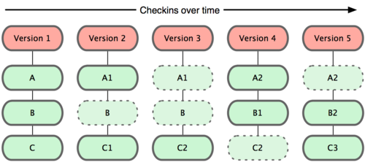
How Git stores changes
Git stores a snapshot of the working directory, linking unchanged files to the previous versions
Image source: http://progit.org/book/ch1-3.html
Notes:
Git is really a file system that plays a VCS on TV

Slide 9
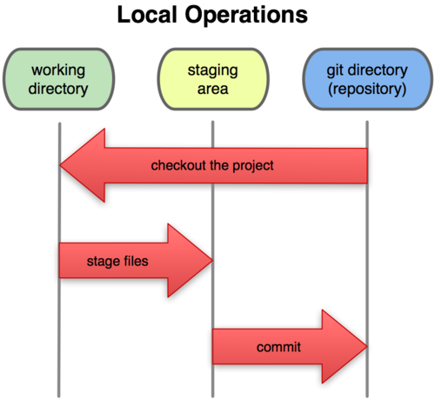
Files live in 3 places
Working directory
Where you work
Staging area
Where you stage changes before committing
Repository
Stores all the old versions of your files
Image source: http://progit.org/book/ch1-3.html

Slide 10
Other cool Git features
Branching
Merging
Stashing changes
Submodules
Hooks
Patches
Rebasing
Bare repositories

Slide 11
Installing Git
Visit http://git-scm.com/download and follow directions
Linux
Use your favorite package manager
Windows
Msysgit
Cygwin
TortoiseGit – needs Msysgit
OS X
Git OSX Installer

Slide 12
Great Git Resources
Official Git website - http://git-scm.com
Pro Git - http://progit.org/
  It’s a full book, for free!
Git Reference – http://gitref.org
Github Help - http://help.github.com/
Git Manual - http://www.kernel.org/pub/software/scm/git/docs/
  Too bad kernel.org is down

Slide 13
GitHub
Social coding at its best

Slide 14
What is GitHub?
Source code hosting
Issue tracking
Project hosting
Activity tracking
“We make it easier to collaborate with others and share your projects with the universe”
GitHub is one of the best reasons to use Git

Slide 15
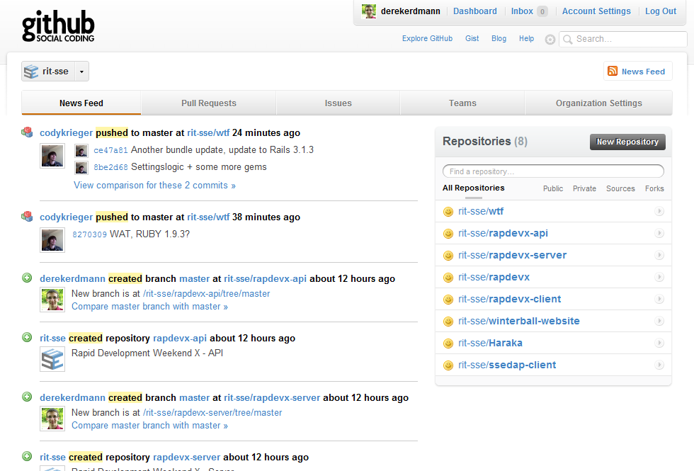

Slide 16
Forking
Forking repositories makes open-source development incredibly easy
It allows you to clone someone else’s repository and create a new one on your account
It’s as easy as going to a repository and clicking the “Fork” button

Slide 17
Pull Requests
Pull requests are used to get changes from a forked repo or branch in the same repo
A notification is sent to the repo owner, and they can view the changes and choose whether or not to pull them into their original repo or the master branch

Slide 18
Setting up Git for GitHub
We’ll be following the guide at
  http://help.github.com/win-set-up-git/
Basic setup procedure:
Make an account
Set up an SSH key
Add the SSH key to GitHub
We’ll do it live!

Slide 19
Rapdev… GO!

