Slide 1
PHASE 1 PROJECT by Rita Nyaga
Aviation Accidents

Slide 2
Data Understanding
In this project we are going to use data from the National Transportation Safety Board, AviationData.csv. The data has been collected from 1962 to 2023.The data includes aviation accidents data in the United States and international waters.
We are going to use it to uncover the risks involved in this industry and give us insights on what we can do to mitigate

Slide 3
Key Features in the dataset:
Event.Id: Unique identifier for each aviation event (accident or incident).
Event.Date: The date on which the event occurred.
Location: The city, region, or specific area where the event took place.
Country: The country in which the event occurred.
Injury.Severity: Categorization of the event based on injuries sustained
Aircraft.Damage: Description of the damage to the aircraft
Aircraft.Category: Classification of the aircraft
Make and Model: Manufacturer of the aircraft and specific model
Number.of.Engines and Type: Specifies the number of engines on the aircraft and the type
Purpose.of.Flight: The primary purpose of the flight
Air.Carrier: The name of the airline or operator involved in the event.
Injuries: The number of injuries resulting from the event. Fatal/serious/minor/uninjured
Weather.Condition: Description of the tool used to check the weather during the event

Slide 4
Business Goal
Understanding Aviation risks:
Identify key factors that influence flight accidents, such as weather, location engines, purpose,make,model…
Identifying Trends:
Explore patterns in accidents across various countries, period…
Recommendations
Provide actionable recommendations to minimize the accidents and fatalities .

Slide 5
Questions to Address:
Is the number of engines, make and model a contributing factor?
Is weather condition a contributing factor to the number of accidents recorded.
Are there locations that are riskier than others?
What are the trends over time?

Slide 6
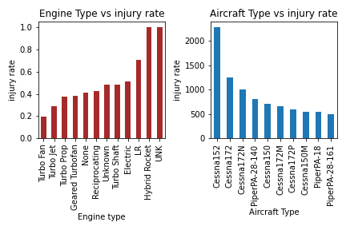
Question 1:Findings
The bar graphs here are showing whether the type of engine determines the severity of the accident. The Turbo Fan kind of engine has the lowest severity making it the safest.
The second bar graph shows the aircraft type(make and mode) and the number of accidents each type coarse. Cessna 152 and Cessna 172 are recording the highest values

Slide 7
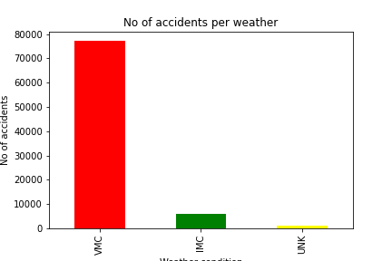
Question 2: Is weather condition a contributing factor to the number of accidents recorded.
We realize that quite a number of accidents are triggered by the selection of the weather condition instrument use.
Majority of the accidents occurred when the weather is good with clear visibility ,high clouds and no rains.

Slide 8
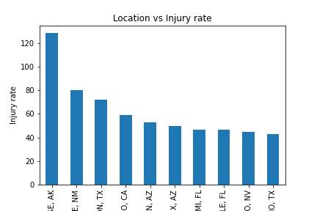
Question 3: Are there locations that are riskier than others?
Some locations are more prone to accidents than others. When accidents happen there they are more severe leading to more serious and fatal injuries.
Other locations have recorded fewer accidents and when they happen they are less fatal

Slide 9
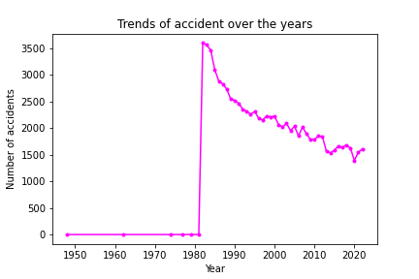
Question 4: What are the trends over time?
Number of accidents have significantly gone down since 1980 . However the numbers are still high.

Slide 10
Recommendations
The decrease in aviation accidents since since after 1981 is encouraging, but there are countries that one needs to deploy more measures to safeguard life and business. In high-accident states, there should be a concerted effort to increase surveillance and regulatory enforcement activities to mitigate the risks associated with aviation accidents.
We have to be on the lookout on weather. From our data we got a very interesting find, contrary to what we know that bad weather causes most accidents, our data states differently. The VMC - Visual Metrological Condition, which involves clear skies no heavy rains and clear visibility, has the highest number of accidents. This shows that mostly, its not really about the weather, its about the pilot, the engine type, the plane model and make etc. Also so many planes are in the

Slide 11
Recommendations … Con’t
All engine types have recorded accidents but the Turbo Fan engine has the least number of injury rates. Its a safer engine as compared to the rest. If we purchase aircrafts with this kind of engines then we are assured of safer flights. Cessna 152, and Cessna 172 have the highest have the highest number of accidents. Its probably they are the most purchased make. We can choose to avoid this models for safer flights
It is also important to note the higher the number of engines the safer the flights and the lesser the number of accidents. Purchasing aircrafts with more engines will help in reducing the number of accidents

Slide 12
Thank You!
QUESTIONS?

Slide 13
References
Youtube tutorials
Class work

