Slide 1

”Beat the ATS” - Key Skills and Tools for Data Analyst
An Exploratory Data Analysis based on keywords for Data Analyst Job Postings
By HR Hackers
Hamza Hersi
Olaleke Sangogade
Rita Starzyk

Slide 2







Used technologies

Slide 3

01
PROJECT DESCRIPTION
02
RESEARCH QUESTIONS
03
DATASETS
AGENDA
04
DATA EXPLORATION AND CLEANUP PROCESS
05
ANALYSIS PROCESS
06
CONCLUSIONS
07
IMPLICATIONS OF FINDINGS
08
REFERENCES
09
Q & A

Slide 4

01
”Beat the ATS” - Project description
According to , “99% of Fortune 500 companies use an Applicant Tracking System (ATS) as their recruitment strategy”
All ATS’ store candidates’ information by using keywords , so it’s easy to parse and filter them
”Beat the ATS” project aims to address this problem by analysing the most popular keywords, relationship between education, experience and earnings for Data Analytics field and enabling creation of an effective resume for Data Analytics Positions, based on strategic keywords

Slide 5
02
Research Questions
What are the most popular tools employers seek in Data Analytics field in the period 2020-2021 in the USA?
What are the most popular technologies employers seek in Data Analytics field?
What are the most popular soft skills?
Is there a relationship between education and earnings?
Is there a relationship between experience and earnings?

Slide 6
03
Datasets
Two data sets from www.kaggle.com
Over 60 thousand records

Slide 7
04
Data Exploration and cleanup Process
Initial cleaning of CSV file
Removing irrelevant columns
Renaming columns
Removing rows of missing data
Adding new columns using pandas
Creating a new Data Frame

Slide 8
05
Analysis Process
CountVectoriser – NLP word processing – partial success
Pandas words analysis – failed due to multiple “\n”
Retrieving the highest occurrence of words using Python – success
Retrieving salary, education, experience and location from CSV
Filtering the data by education level and setting a baseline of 5 years of experience
to compare the average salary to education level
Retrieving longitude and latitude for each location
Grouping data by average salary by location and plotting the data
Calculation of central tendencies
Comparison between annual salary and years of experience
Comparison of salaries between different positions in Data Analytics field

Slide 9
06
Conclusions
The analysis has confirmed all five hypotheses.
The most sought after language for Data Analytics is SQL, the second is Python, the third is SAS.
The most sought after tool is Tableau and then Power BI.
The most sought after soft skill is Communication and ability to work in agile as well as problem-solving skills (in this order).
There is a correlation between education level and earnings: the higher education education lever, the higher earnings. Relationship is linear, but depends on location.
There is a correlation between experience level (measured in years) and earnings: as years of experience increase, the annual salary increases proportionally.

Slide 10
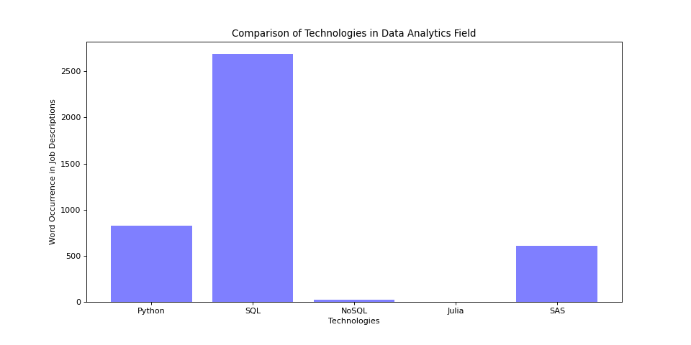
06
Conclusions - Visualization

Slide 11
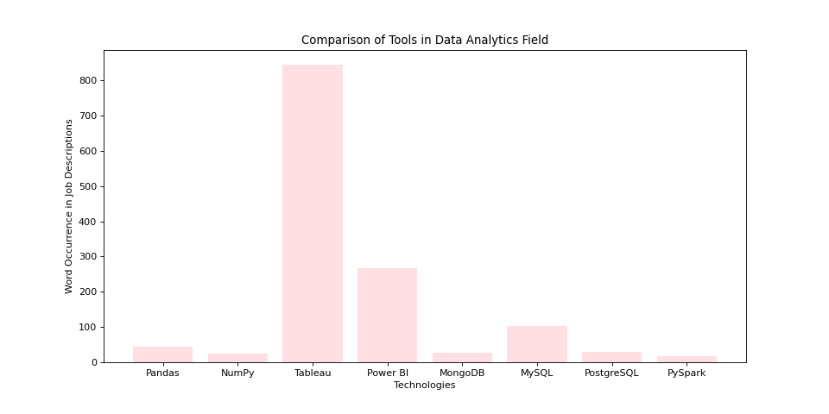
06
Conclusions - Visualization

Slide 12
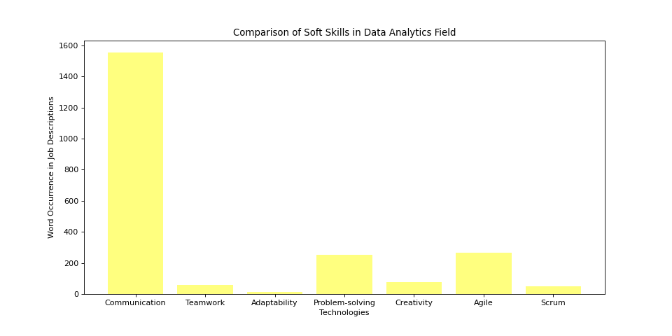
06
Conclusions - Visualization

Slide 13
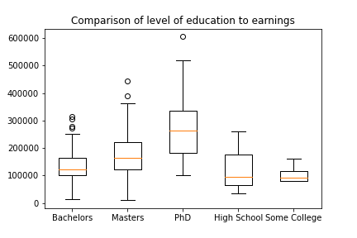
06
Conclusions - Visualization
Calculating p value (if above 0.05 then hypothesis is supported) fvalue, pvalue = st.f_oneway(bach_sal['Salary'], master_sal['Salary'], phd_sal['Salary'], high_sal['Salary'],sc_sal['Salary']) fvalue, pvalue
(15.579110485414866, 2.8460943269255683e-11)

Slide 14
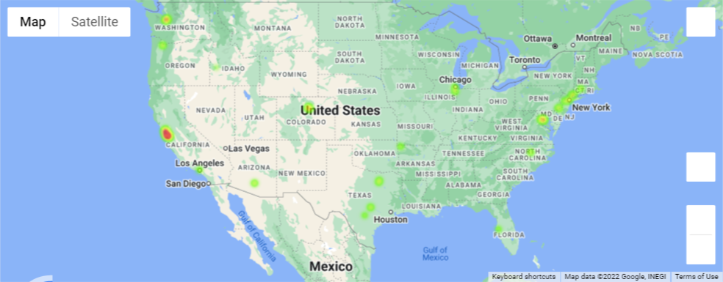
06
Conclusions - Visualisation

Slide 15
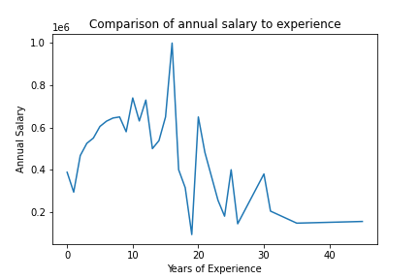
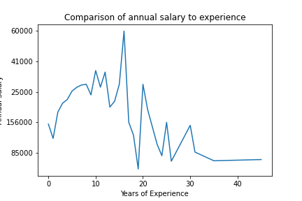
06
Conclusions - Visualisation

Slide 16
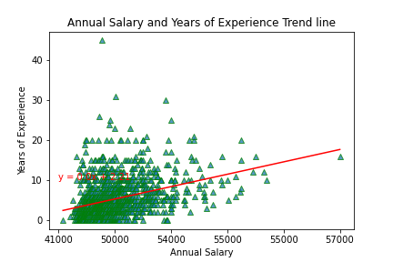
06
Conclusions - Visualisation

Slide 17
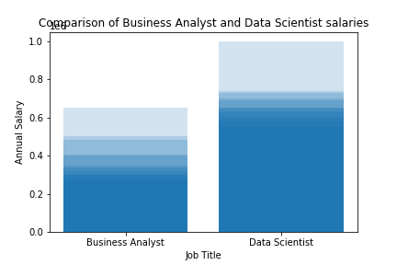
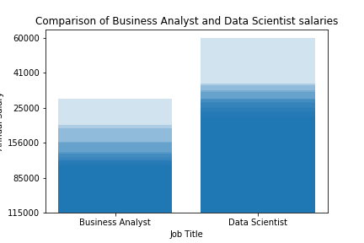
06
Conclusions - Visualisation

Slide 18
07
Implications of findings
If you want to be successful as a Data Analyst, you should master the following:
Technologies: SQL, Python, SAS
Tools: Tableau, Power BI
Soft Skills: Communication, Agile Methodology, Problem-Solving
You should have at least Bachelor Degree in relevant field
You should persist as the longer you are in the field, the higher potential of earnings you will have

Slide 19
08
References
Matplotlib – Bar Plot: https://www.tutorialspoint.com/matplotlib/matplotlib_bar_plot.htm
Your Machine Learning and Data Science Community: https://www.kaggle.com/
Optimize Your Resume and Boost Interview Chances: https://www.jobscan.co/
ANOVA using Python (with examples): https://www.reneshbedre.com/blog/anova.html
Descriptive Statistics: https://www.w3schools.com/statistics/index.php
Maps API: https://mapsplatform.google.com/
Statistics plots: https://matplotlib.org/stable/plot_types/index.html

Slide 20

09
Q&A

