Slide 1
Blender

Slide 2
Variables and Features
Variables | Affected Features
 | Render engine, # of kind of material(scene and camera), # of kind of textures(scene and camera), Render time
Duplicate objects | # of objects(scene and camera), # of vertices(scene and camera), # of edges(scene and camera), # of faces(scene and camera), # of lights(scene), # of each kind of light(scene), Surface area(camera), Coverage
Increase the angle of FOV | Coverage
Change the percentage of resolution | Width, Height, Pixels

Slide 3
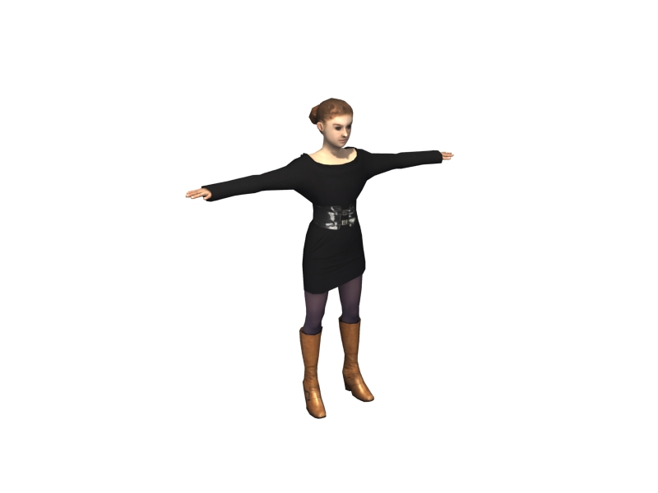
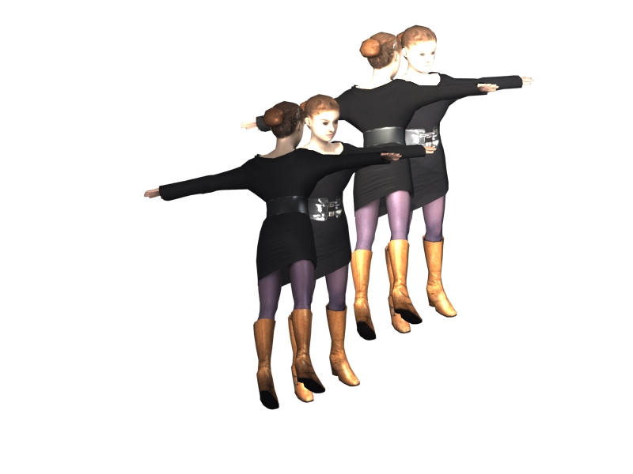
Duplicate objects
Original | 4 times
9.989707s
36.284812s

Slide 4
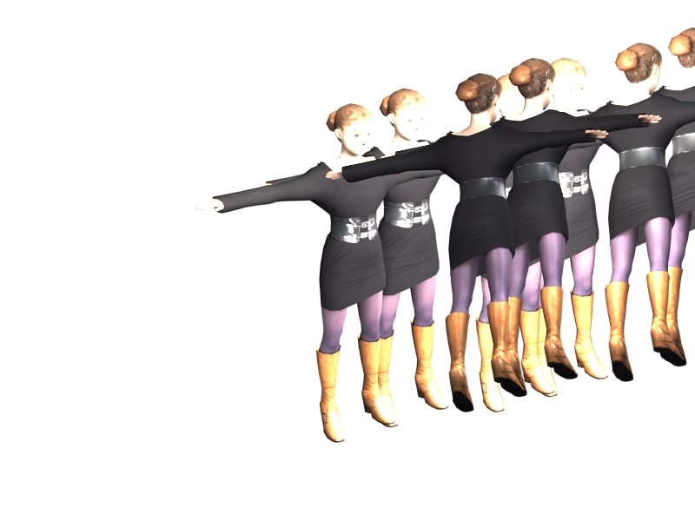
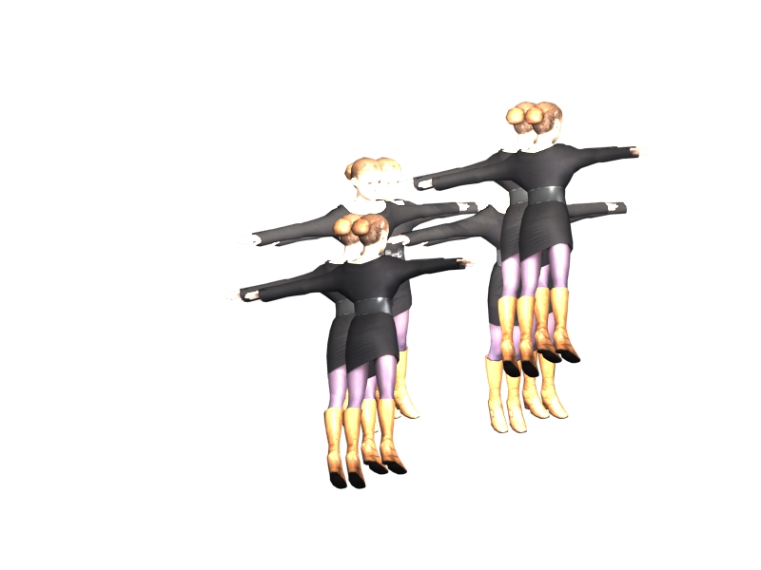
Increase the angle of FOV
Original | Increase 0.122(12˚) of FOV
Coverage: 0.5718
Render time: 60.246984s
Coverage: 0.3777
Render time: 49.85658s

Slide 5
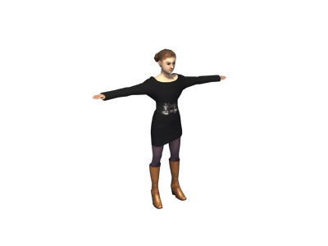
Change the percentage of resolution
Original: 100% of resolution | 50% of resolution
Width: 800
Height: 600
9.989707s
Width: 400
Height: 300
7.180146s

Slide 6
Create scenes
6
x
5
x
5
x
5
||
725
6 resource scenes
Objects: 1 time, 2 times, 4 times, 8 times, 16 times
Increase the angle: 0, 0.122, 0.244, 0.366, 0.488
Resolution: 20%, 40%, 60%, 80%, 100%

