Slide 1
Quantum hackathon
Get your hands dirty

Slide 2

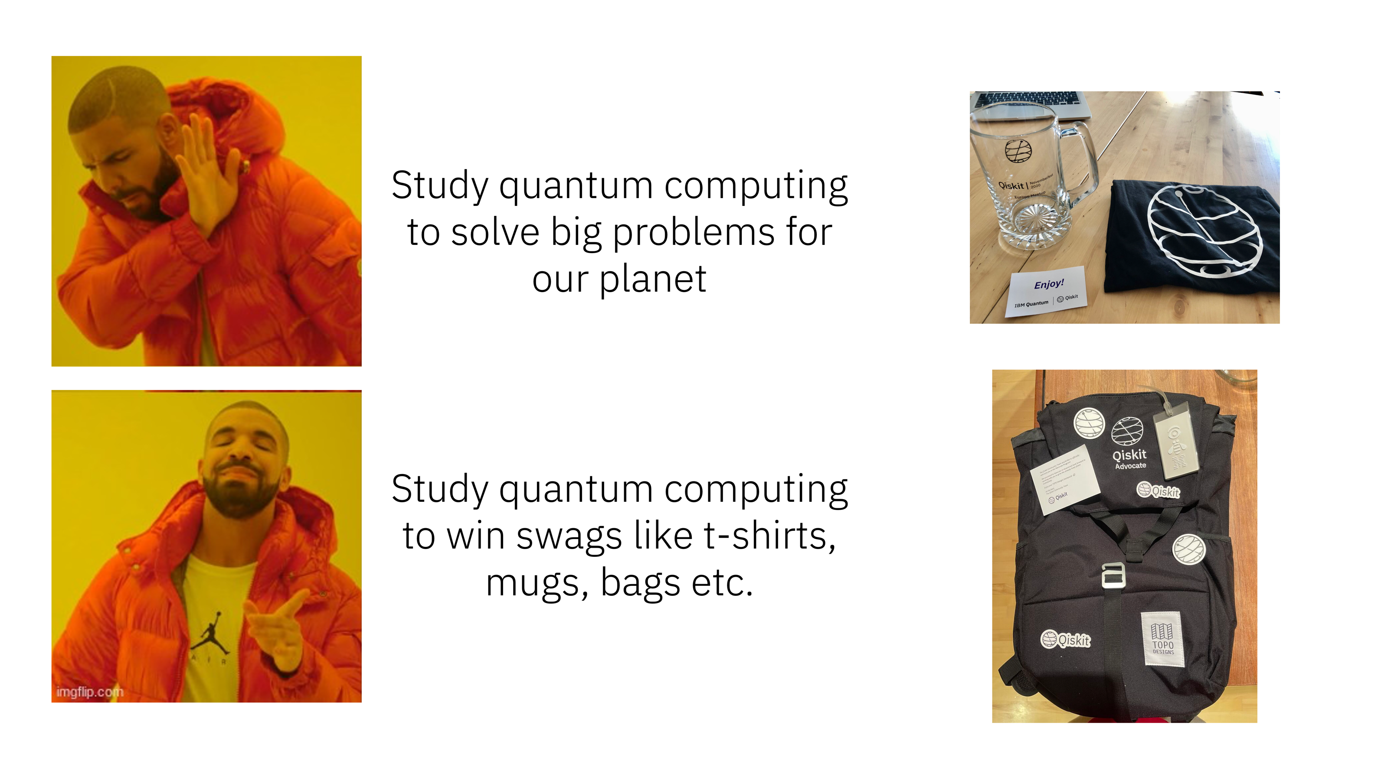
Goal of this hackathon
It is one thing to hear lectures and talk, but a completely different experience of learn while working on a problem them yourself.
This hackathon gets your hand dirty, and provides you with hands-on understanding of physics, chemistry and biochemistry problems
By the end of this hackathon you will
Be confident about trying out large-scale quantum problems on your own
(Potentially) Write a perspective paper as you extend the knowledge base of certain research capability tools
(Depending on how you do) win some IBM Swag

Slide 3
Types of problems
Sample bitstrings
Estimate expectation value
Applications in:
Chemistry
Biochemistry
Applications in:
Physics
Machine learning

Slide 4
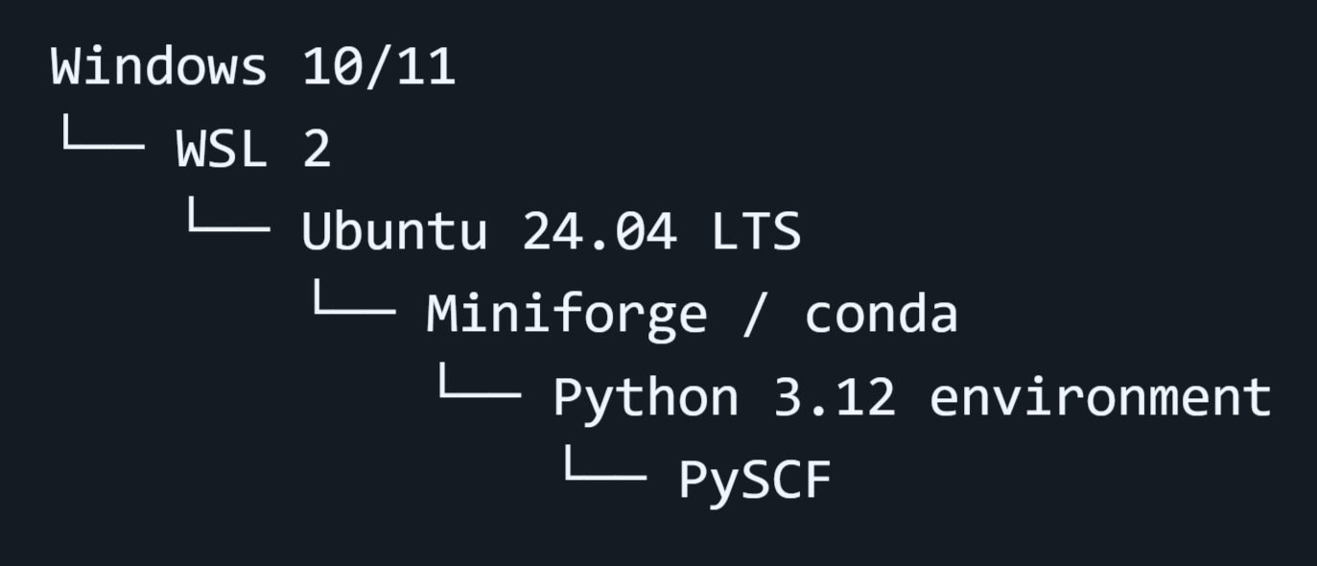
Notice for Windows users
For problem set 1-2 (regarding SQD), you need environment for pyscf.
For windows user, follow the instructions in
to construct wsl+pyscf environment.
wsl_pyscf_windows_setup_v1.md

Slide 5
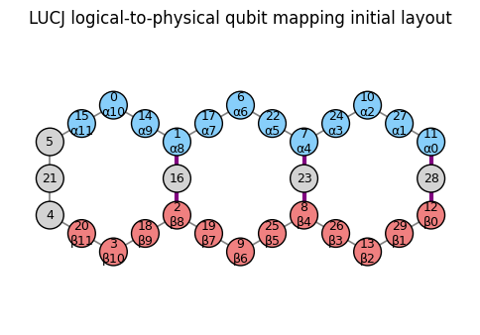
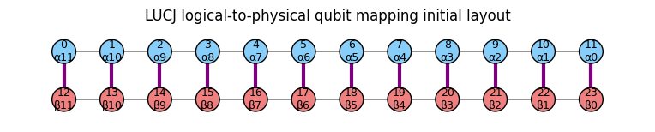
Problem type:
sample bitstrings
Problem set 1: Applying SQD for H₂O stretch
Apply SQD method to estimate the ground state energy of water molecule.
Let’s see how the results change for the heavy-hex-based and square-lattice-based LUCJ ansatz.

Slide 6
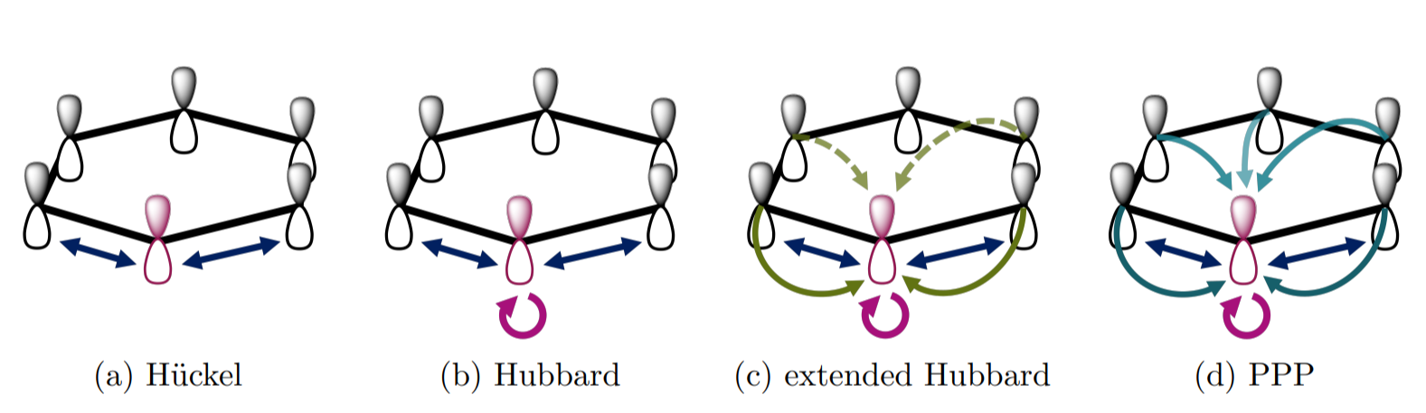
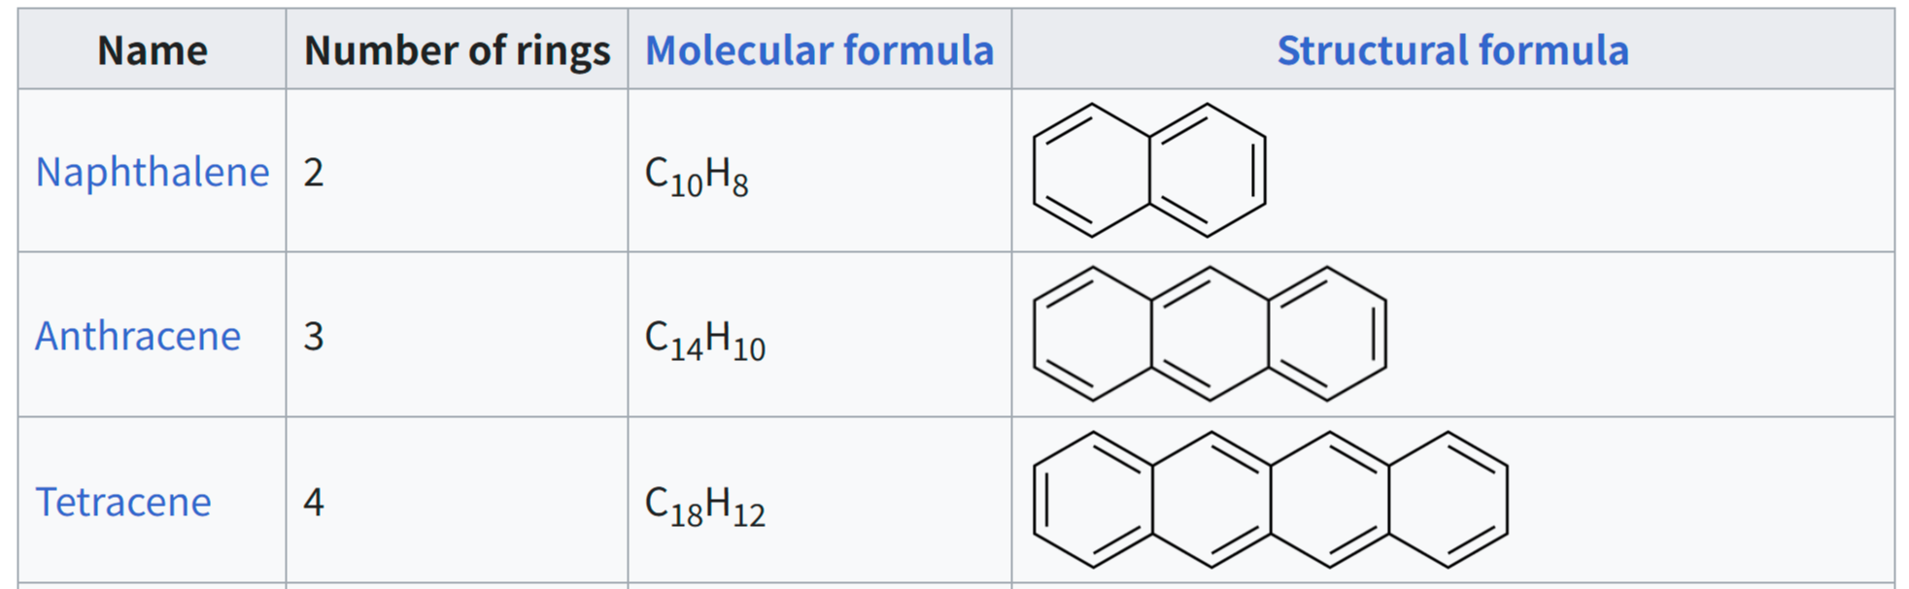
Problem set 2: SQD for Polyacene molecules
Apply SQD method to approximated model for polyacene molecule; PPP model
Let’s learn how the orbital optimization achieves the advantages in the sampling.

Slide 7
Problem type:
estimate expectation values
Schrodinger equation: $iℏ\frac{dψ}{dt}=Hψ$
Can come from:
Condensed matter physics
Many-body physics
High energy physics
…

Slide 8
Problem type:
estimate expectation values
Basic:
Compute a 1D Hamiltonian simulation problem on a quantum computer via trotterization (breaking up the time of evolution into multiple smaller steps)
Check how a 1D system, where some or all sites are initially filled, evolve over time and compute the probability of occupancy over time
Intermediate:
Compute a 1D Hamiltonian simulation problem on a quantum computer via trotterization (breaking up the time of evolution into multiple smaller steps)
Use AQC tensor or OBP to test whether a given Hamiltonian circuit can be easily compressed by tensor network, easily backpropagated and computed classically

Slide 9
Approximate quantum compilation (AQC)
domain inputs
Map
AQC – preprocess
Many problems require calculating the time evolution of a Hamiltonian. The time evolution is approximated by trotter circuits
higher the trotter steps, better is the accuracy
higher the trotter steps, more is the circuit depth, hence noise
AQC used tensor network method to compress initial few trotter steps of the circuit. The final circuit that is computed on the hardware contains the compressed circuit composed with the subsequent trotter steps.
compressed circuits, observable
Optimize
Transpile circuit
compressed ISA circuits, observable
Execute
Estimator Primitive
expectation values
Computational tradeoffs/scaling: Some classical overhead for the tensor network compression.
Problem domains: Applicable to any use case involving Trotter formulas.
Postprocess
postprocess
expectation value
IBM Quantum

Slide 10
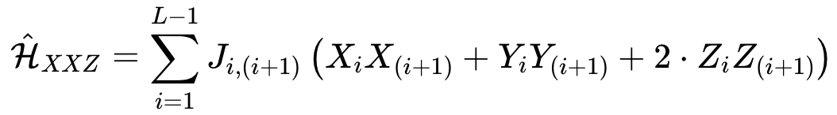
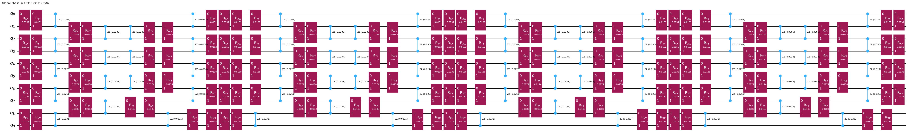
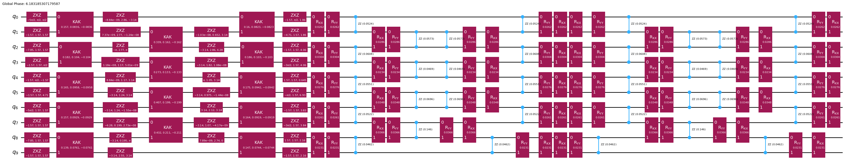
Approximate quantum compilation (AQC)
Example circuit with 10 qubits, and 4 trotter steps
For a 100 qubit Hamiltonian Simulation circuit with 40 trotter steps:
Depth of original circuit: 325
Depth of circuit post AQC: 147
Compressed initial part of the circuit = lower overall depth
IBM Quantum

Slide 11
Operator backpropagation (OBP)
domain inputs
Map
Create circuit, observable
Experimental errors limit the depth of quantum circuits that can be executed on near-term devices.
OBP reduces circuit depth by trimming operations from its end at the cost of more operator measurements.
circuit, observable
Transpile circuit
Optimize
ISA circuit, expanded observable
OBP
Computational tradeoffs: The number of quantum circuits grows exponentially with number of non-Clifford gates which are backpropagated
Problem domains: Applicable to expectation value estimation. Is well-suited to Hamiltonian simulation.
Shorter circuit, expanded observable
Execute
Estimator Primitive
expectation value
Postprocess
postprocess
IBM Quantum
domain outputs

Slide 12
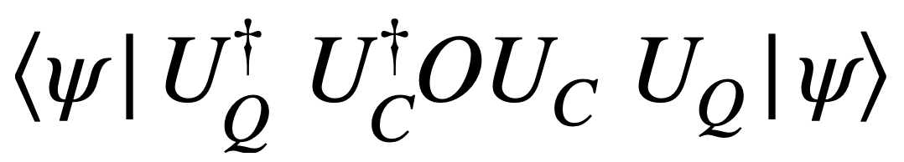
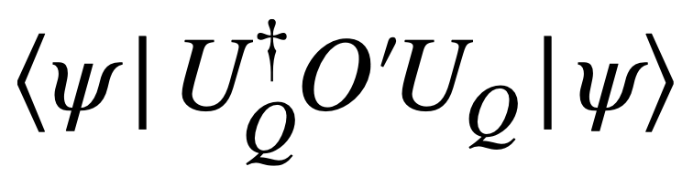
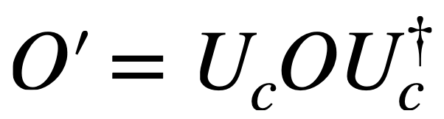
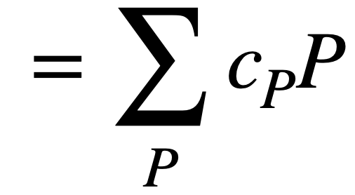

Operator backpropagation (OBP)
$$O$$
U_{Q}
U_{C}
Classically absorb U_{C} into O
Trading reduced circuit depth for more observables to measure (i.e., more circuit executions) and more classical processing.
U_{Q}
IBM Quantum

Slide 13
Problem type:
estimate expectation values
Basic:
Compute a 1D Hamiltonian simulation problem on a quantum computer via trotterization (breaking up the time of evolution into multiple smaller steps)
Check how a 1D system, where some or all sites are initially filled, evolve over time and compute the probability of occupancy over time
Intermediate:
Compute a 1D Hamiltonian simulation problem on a quantum computer via trotterization (breaking up the time of evolution into multiple smaller steps)
Use AQC tensor or OBP to test whether a given Hamiltonian circuit can be easily compressed by tensor network, easily backpropagated and computed classically
Low entanglement = high compressibility
Not advantage candidates
Low magic (non-Clifford) = high backpropagation

