Slide 1
1M1B AI FOR SUSTAINABILITY VIRTUAL INTERNSHIP
AquaSense
An AI-Powered Advisor for Smart Water Use on Campus & at Home
SDG 6 · Clean Water and Sanitation
Name: Ritam Saha
College Name: Institute of Engineering & Management

Slide 2
1
Project Description
Title · SDG Alignment · Problem Statement · AI Solution Overview · Target Users · Responsible AI · Expected Impact

Slide 3
PROJECT DESCRIPTION → SDG ALIGNMENT
SDG Alignment
PRIMARY
SECONDARY
SECONDARY
SDG 6
SDG 12
SDG 13
Clean Water and Sanitation
Responsible Consumption & Production
Climate Action
Ensuring availability and sustainable management of water through better everyday monitoring and awareness.
Encourages efficient, non-wasteful use of a shared natural resource.
Water efficiency reduces the energy used to pump, treat, and heat water.

Slide 4
PROJECT DESCRIPTION → PROBLEM STATEMENT
How might we use AI to help people see and understand their water use in real time so that campuses and households can cut waste early and build lasting conservation habits?
Who's Affected
Current Gaps
Is Data Involved?
Hostel wardens & facility teams, households in water-stressed towns, and (at scale) municipal water departments.
Monthly billing cycles, no personalized feedback loop, and leaks or overuse that go unnoticed for weeks.
Yes — daily usage readings per activity, which is exactly the kind of data AI can track, baseline, and act on.

Slide 5
PROJECT DESCRIPTION → AI SOLUTION OVERVIEW
AI Solution Overview
AquaSense is a conversational advisor: log usage in plain language, and it detects anomalies, retrieves grounded tips, and forecasts your trend.
1
Pattern Detection
Compares daily readings against a rolling personal baseline to flag spikes that look like a running tap or a leak.
2
Personalized Guidance (RAG)
Retrieves the most relevant tip from a knowledge base of verified water-conservation guidelines — not a generic script.
3
Conversational Access
Anyone can just type or speak their usage in plain language — no app training or technical skill required.
4
Simple Forecasting
Projects next month's usage from recent trends, so people can act before the bill arrives, not after.
Built with prompt engineering + a lightweight retrieval-augmented (RAG) knowledge base — no advanced coding or model training required.

Slide 6
PROJECT DESCRIPTION → TARGET USERS
Target Users
Three people this project is designed around
H
H
M
Hostel Warden
Household Resident
Municipal Officer
Manages water for 300+ students
Pays a monthly water bill
Oversees local water supply
Can't tell which block or floor is overusing water until the bulk bill arrives.
Wants to cut usage but has no simple, daily way to track it or know where it's going.
Needs early signals of neighborhood-level overuse to plan supply and repairs.

Slide 7
PROJECT DESCRIPTION → RESPONSIBLE AI
Responsible AI Considerations
Fairness
Transparency
Baselines are calculated per household/hostel, not against a single national average — so smaller families or water-scarce regions aren't unfairly flagged.
Every tip cites the guideline it came from, and every alert explains the exact comparison (e.g. "40L vs. your 25L average") that triggered it.
Ethics
Privacy
Tone stays supportive, never shaming — the goal is habit change, not penalty or surveillance of individual behavior.
Only usage volumes and activity types are stored, in aggregate; no location tracking, no data sold or shared, and users can delete their history anytime.

Slide 8
PROJECT DESCRIPTION → EXPECTED IMPACT
Expected Impact
At a glance — deeper detail follows in the Impact Statement (Section 3)
Students & Residents
Hostel & Campus Teams
Local Water Systems
Daily visibility into their own water use, and specific, practical tips instead of generic posters.
Early alerts on unusual usage let facilities staff catch leaks and overuse within days, not a full billing cycle.
Aggregated, anonymized trends can help municipal teams anticipate demand and plan maintenance.

Slide 9
2
Prototype / Demo
Prompt Workflows · Screenshots & Flow Diagram

Slide 10
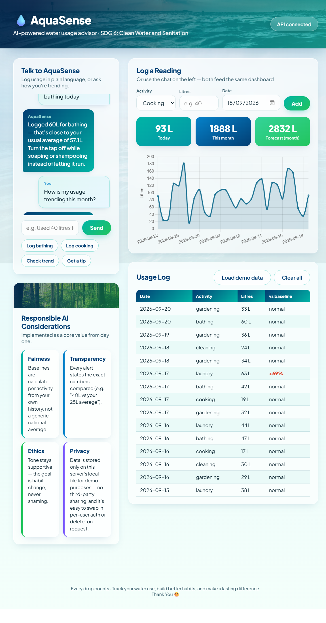
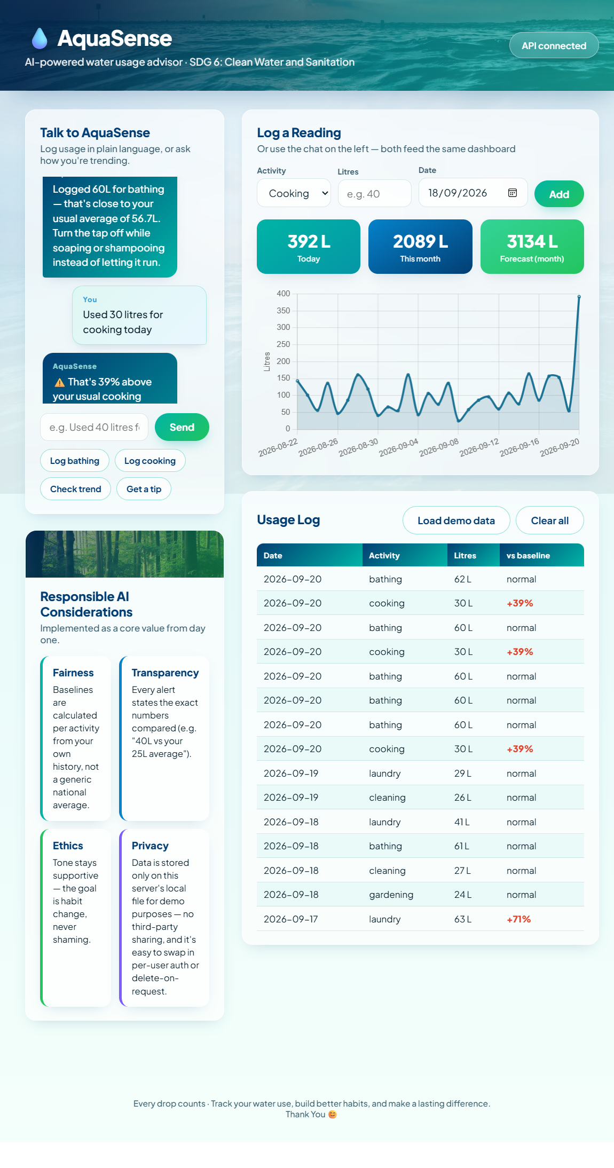
PROTOTYPE / DEMO

Slide 11
PROTOTYPE / DEMO → FLOW DIAGRAM
How It Works — AI Workflow Diagram
User Input
Parse & Classify
Compare to Baseline
RAG Retrieval
Chat Response
"Used 40L for laundry today" — typed or spoken
→
Prompt extracts activity, quantity, and date
→
Checks against the user's rolling average
→
Pulls the matching tip from the guideline knowledge base
→
Personalized tip + leak/overuse alert if needed
Knowledge base: verified water-conservation guidelines, campus water policy, and municipal advisories.

Slide 12
3
Impact Statement
What Changes If Implemented · Who Benefits and How

Slide 13
IMPACT STATEMENT
Impact Statement
WHAT CHANGES
WHO BENEFITS & HOW
If This Solution Is Implemented
Students & Households
Water use shifts from a once-a-month surprise to a daily, visible habit
Lower water bills and a clear, judgment-free way to build better habits.
Hostel & Campus Facilities Teams
Leaks and overuse are caught within days instead of a full billing cycle
Faster leak detection saves money and prevents larger repair costs.
Conservation advice becomes personal and specific, not a generic poster
Local Water Utilities
Aggregated, anonymized demand trends support better supply planning.
Usage data starts accumulating — useful for future planning and audits
The Environment
Less water waste supports SDG 6, 12, and 13 at a community scale.

Slide 14


GITHUB REPOSITORY
Project Source Code & Resources
AquaSense AI
Complete prototype code, prompt workflows, and water benchmark guidelines
https://github.com/ritam-5/AquaSense.git

Slide 15

Thank You
Making everyday water conservation simple, explainable, and accessible for everyone.

