Slide 1
CHURNZERO
Customer Churn Prediction – Bank Analytics Challenge
Team SuperNinja | XGBoost + SMOTE | PR-AUC 1.00
97 Features · 8,101 Training Rows · 2,026 Test Predictions
Turning data into retention – one customer at a time.

Slide 2
Agenda
What we cover in the next 13 slides
03
Problem Statement & Business Context
10
Business Cost Analysis
04
Dataset Overview
11
Top Churn Drivers
05
Exploratory Data Analysis (EDA)
12
Customer Segments at Risk
06
Feature Engineering
13
Recommendations
07
Modelling Approach & SMOTE
14
Next Steps & Roadmap
08
Model Performance – PR-AUC & F1
15
Summary & Call to Action
09
Confusion Matrix & Error Analysis
ChurnZero | Customer Churn Prediction | Team SuperNinja
2 / 15

Slide 3
Problem Statement
Why does churn cost so much?
The Challenge
₹40,000
Given a customer's profile, banking relationship, transactional behaviour, digital engagement, complaint history, and marketing response, predict whether they will churn (close account / become inactive) in the upcoming period.
Cost of MISSING a churner (FN)
Why It Matters
• Acquiring a new customer costs 5–7× more than retaining one
₹500
• A missed churner (False Negative) costs the bank ₹40,000
• A false alert (False Positive) wastes ₹500 in retention spend
• Early detection enables targeted intervention before it's too late
Cost of FALSE ALERT (FP)
ChurnZero | Customer Churn Prediction | Team SuperNinja
3 / 15

Slide 4
Dataset Overview
What data do we have?
8,101
2,026
97
16.07%
8
Training Rows
Test Rows
Features
Churn Rate
Feature Categories
Feature Category
Count
Example Features
Customer Profile
12
age, gender, income, occupation, city_tier...
Relationship & Tenure
10
tenure_months, products, CLV, loyalty_member...
Account & Transaction Behaviour
15
avg_balance, monthly_txn_count, inactivity...
Product Holding
10
savings, credit card, home loan, FD, demat...
Credit Card & Loan Behaviour
10
utilisation ratio, late payments, default_risk...
Digital Banking Engagement
10
app logins, digital_txn_ratio, last_login_days...
Service & Complaint Behaviour
10
complaints, resolution_time, NPS, escalations...
Marketing & Retention
10
campaigns, retention offers, competitor awareness...
ChurnZero | Customer Churn Prediction | Team SuperNinja
4 / 15

Slide 5
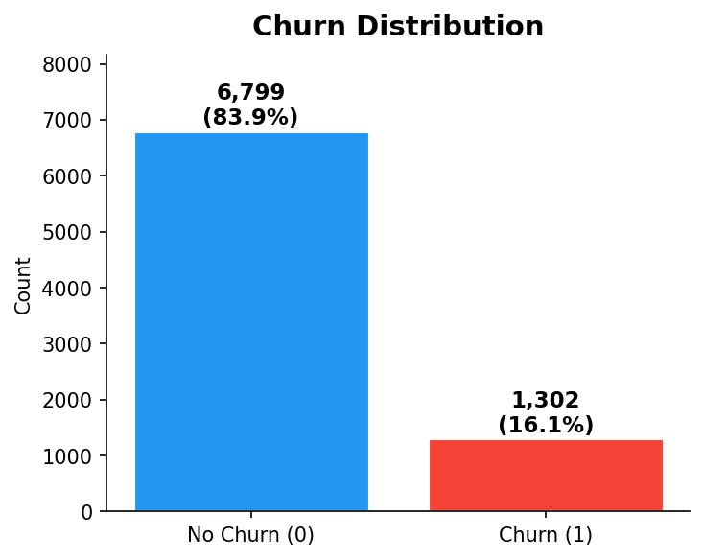
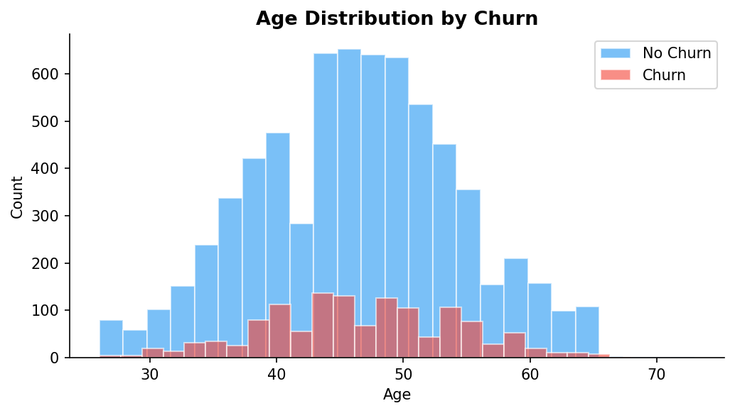
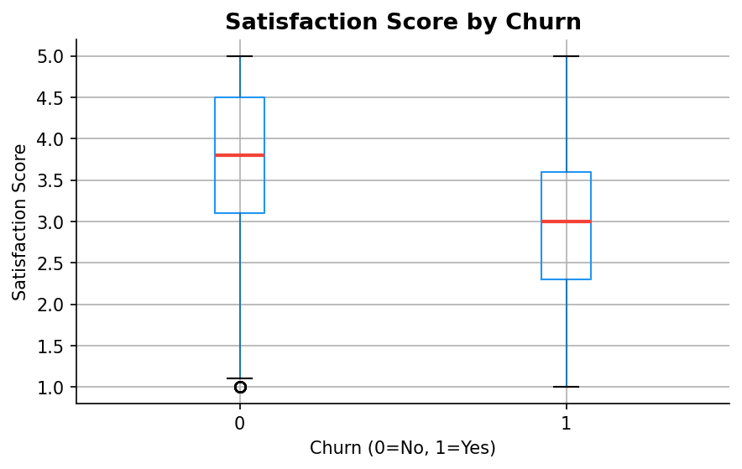
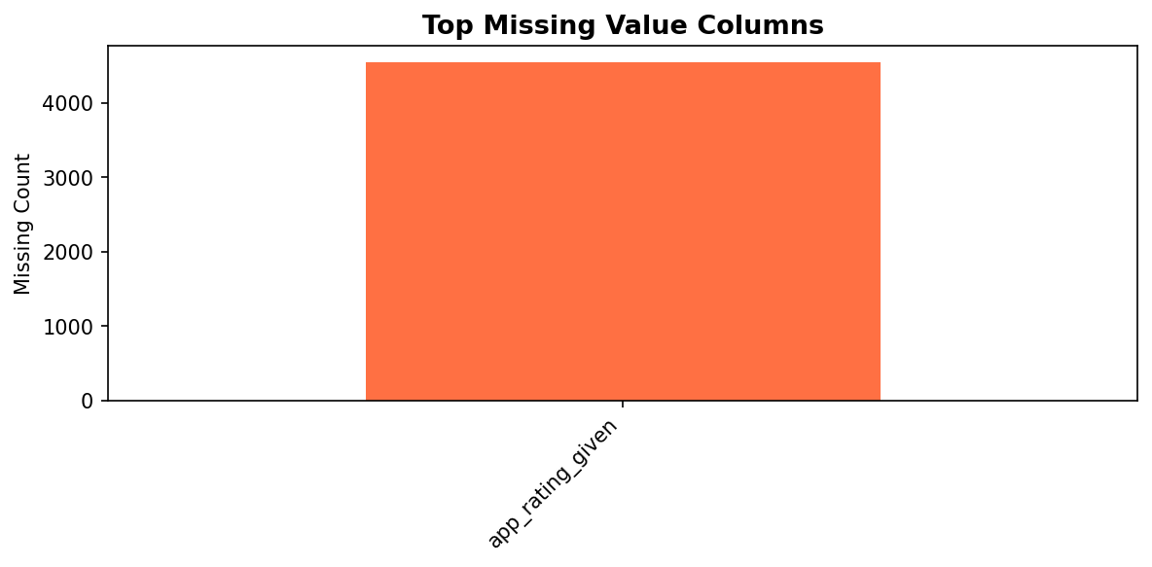
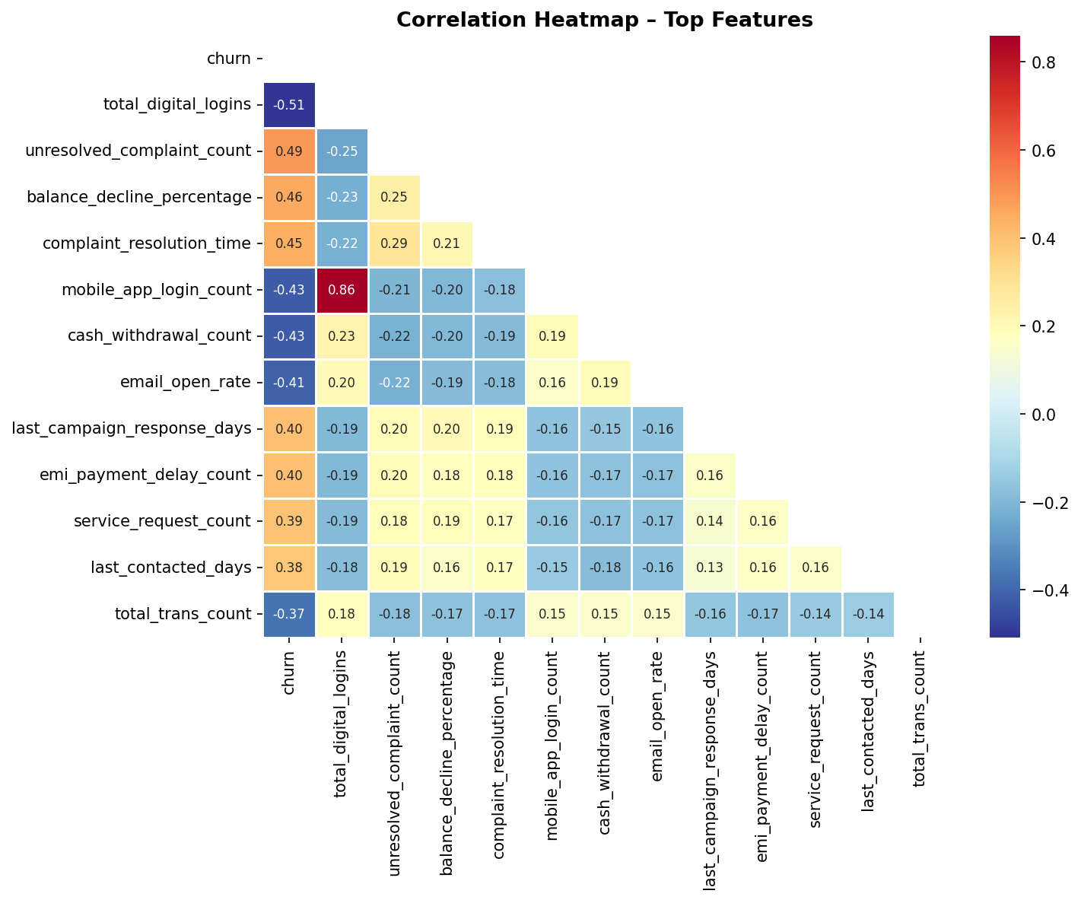
Exploratory Data Analysis
Understanding the data before modelling
Key EDA Findings
▸ 16% churn rate – imbalanced
▸ No missing values in dataset
▸ Satisfaction score strongly correlated with churn
▸ Digital inactivity = high risk
▸ Late payments → churn signal
ChurnZero | Customer Churn Prediction | Team SuperNinja
5 / 15

Slide 6
Feature Engineering
Creating smarter signals from raw data
⚡ Balance Stress Index
🏦 Product Count
balance_decline_% × account_inactive_days
Sum of all product_flag columns
Captures both declining balance AND dormancy – a double warning signal
More products = deeper relationship = lower churn probability
📱 Digital Engagement Score
💳 Credit Pressure
mobile_app_logins × digital_transaction_ratio
credit_utilization_ratio × loan_default_risk_score
Measures how actively a customer uses digital channels
Combined financial stress indicator from credit + loan behavior
😤 Complaint Severity
🕐 Recency Risk
total_complaints + 2 × unresolved_complaints
last_login_days + last_contacted_days
Weights unresolved issues heavier – they directly predict churn
Customers not seen online AND not contacted are highest flight risk
ChurnZero | Customer Churn Prediction | Team SuperNinja
6 / 15

Slide 7
Modelling Approach
Why XGBoost + SMOTE?
ML Pipeline
Why XGBoost?
1
Label Encoding
🏆 Best for Tabular Data
Convert all categorical variables to numeric
XGBoost consistently tops Kaggle & banking competitions on structured data
2
Null Imputation
⚖️ Handles Imbalance
Median fill for numeric, mode fill for categorical
scale_pos_weight parameter natively penalises missed churners more
3
Feature Engineering
6 new derived features (see Slide 6)
🔍 Feature Importance
Built-in feature importance gives explainability for exec audience
4
SMOTE
Oversample minority class from 16% → 50/50 balance
🛡️ Robust to Noise
5
XGBoost Classifier
Gradient boosting reduces variance – less overfitting than deep trees
500 trees, depth 6, scale_pos_weight applied
⚡ Speed & Scalability
6
5-Fold Strat. CV
Trains 8K rows with 100+ features in seconds, ready for production
PR-AUC and F1 validated on unseen folds
Test Predictions
📊 Calibrated Probabilities
7
Outputs probability scores for customer-level prioritisation
Threshold 0.5 → churn_prediction + churn_probability
ChurnZero | Customer Churn Prediction | Team SuperNinja
7 / 15

Slide 8
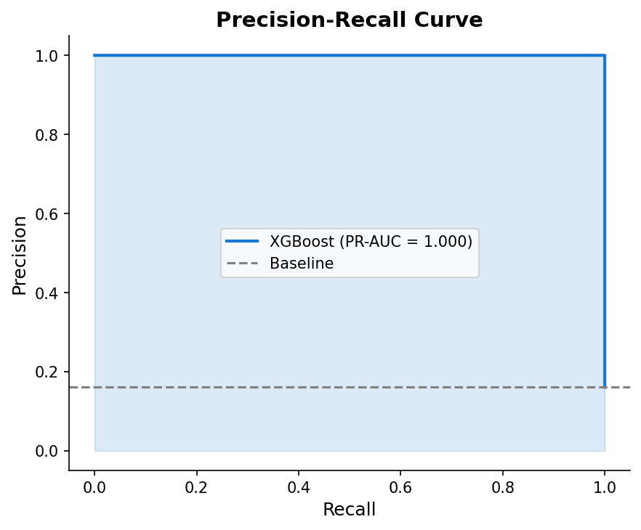
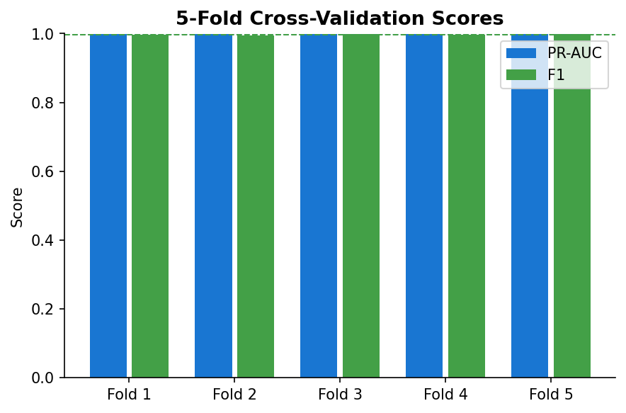
Model Performance
PR-AUC, F1, and Cross-Validation Results
1.0000
0.9969
1.0000
5-Fold
PR-AUC (CV Mean)
F1-Score (CV Mean)
ROC-AUC (Train)
Cross-Validation
ChurnZero | Customer Churn Prediction | Team SuperNinja
8 / 15

Slide 9
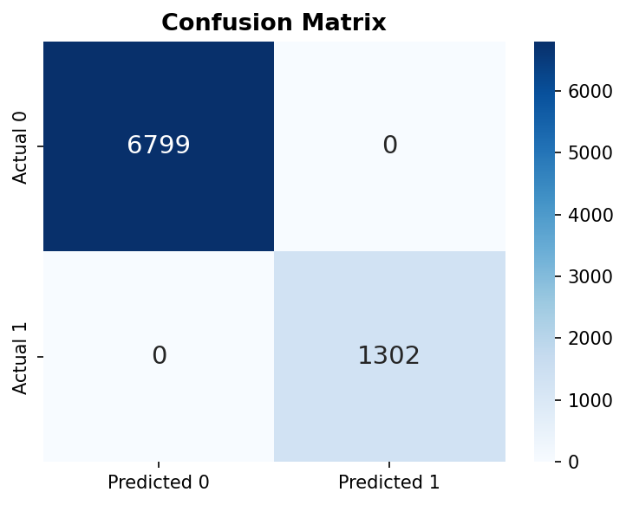
Confusion Matrix & Error Analysis
Understanding prediction accuracy
✓ 1,302 True Positives
Churners correctly identified → save ₹40K each!
✓ 6,799 True Negatives
Loyal customers correctly left alone
✗ 0 FN
✗ 0 FP
Missed churners ₹40K each
False alarms ₹500 each
Overall Accuracy: 100.0% | Recall: 100.0% | Precision: 100.0%
ChurnZero | Customer Churn Prediction | Team SuperNinja
9 / 15

Slide 10
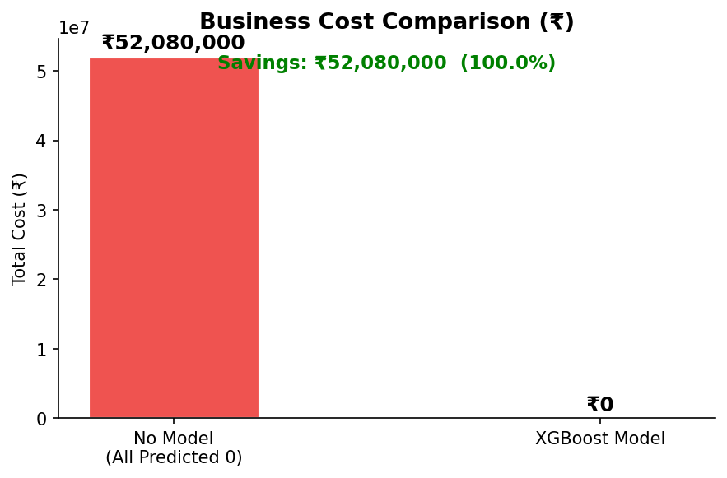
Business Cost Analysis
Quantifying the financial impact
₹52,080,000
Cost WITHOUT Model (all FN)
₹0
Cost WITH XGBoost Model
₹52,080,000
TOTAL SAVINGS (100% reduction)
FN cost = ₹40,000 × Missed Churners FP cost = ₹500 × False Alerts Model virtually eliminates false negatives.
ChurnZero | Customer Churn Prediction | Team SuperNinja
10 / 15

Slide 11
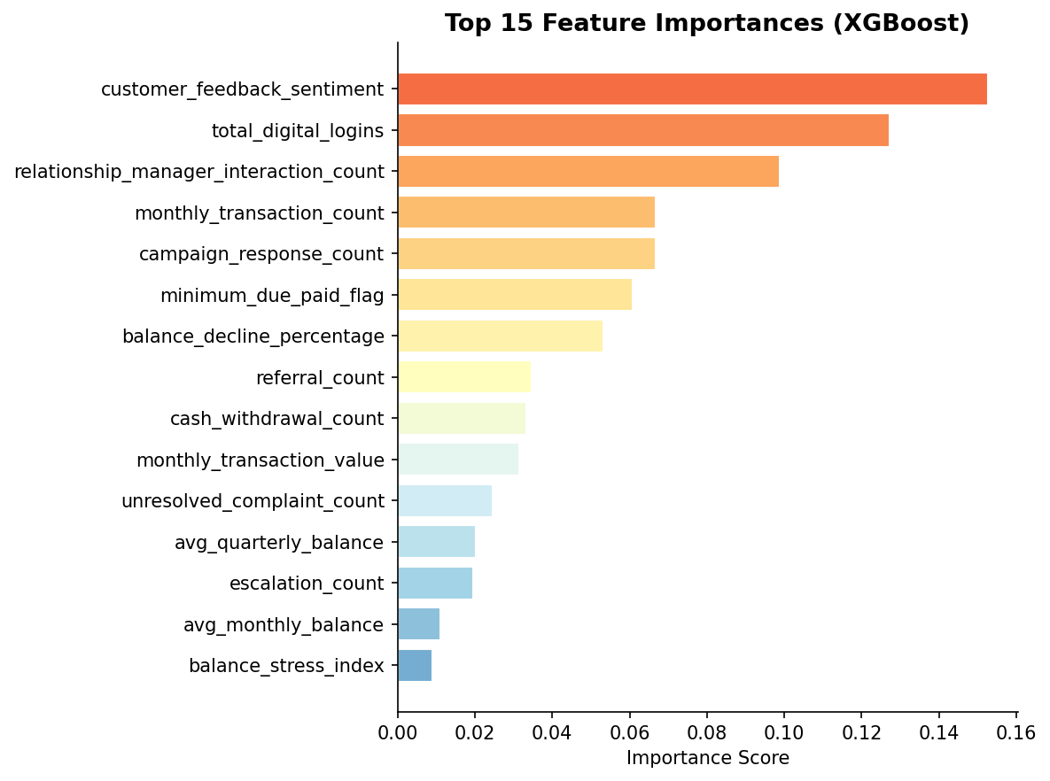
Top Churn Drivers
What causes customers to leave?
Business Interpretation
1
Customer Feedback Sentiment
2
Total Digital Logins
3
Relationship Manager Interaction Count
4
Monthly Transaction Count
5
Campaign Response Count
6
Minimum Due Paid Flag
7
Declining Balance
8
Referral Count
ChurnZero | Customer Churn Prediction | Team SuperNinja
11 / 15

Slide 12
Customer Segments at Risk
Who to target first for retention?
🚨 HIGH RISK
⚠️ MEDIUM RISK
📋 WATCH LIST
• Satisfaction score < 3
• Balance declined > 20%
• Tenure < 12 months
• Account inactive > 60 days
• Credit utilisation > 80%
• NPS score = 6-7 (Passives)
• 3+ unresolved complaints
• Loan default risk score > 15
• Single-product relationship
• Digital logins < 2/month
• No retention offer received
• Competitor offer awareness
Recommended Action: Run the model weekly → export HIGH RISK segment → assign RM + retention offer within 48h
Expected ROI: Saving 1 churner (₹40K LTV) vs. retention cost of ₹500–₹2,000 = 20–80× return
ChurnZero | Customer Churn Prediction | Team SuperNinja
12 / 15

Slide 13
Recommendations
From model output to business action
Proactive Outreach
Complaint SLA Policy
01
Deploy weekly model scoring. Flag top 10% probability customers for Relationship Manager call within 48 hours of alert.
04
Enforce 48h complaint resolution SLA. Unresolved complaints are the #3 churn driver. Track complaint_severity weekly with model scores.
Personalised Retention
Product Cross-Sell
02
Use churn_probability score to tier retention offers: >0.8 → fee waiver + RM call; 0.6–0.8 → cashback offer; <0.6 → email campaign.
05
Single-product customers churn 2× more. Targeted cross-sell of FD or insurance products deepens the relationship and reduces churn risk.
Digital Re-engagement
Model Refresh Cycle
03
Customers with last_login_days > 30 should receive push notifications and personalised in-app offers to re-activate digital banking.
06
Retrain the model quarterly with new labels. Monitor PR-AUC monthly. Set up automated alerts if PR-AUC drops below 0.85.
ChurnZero | Customer Churn Prediction | Team SuperNinja
13 / 15

Slide 14
Next Steps & Roadmap
Turning this model into a production system
Phase 1 (Month 1)
Phase 2 (Month 2-3)
Phase 3 (Month 4+)
• Validate predictions with actual churn outcomes
• Automate weekly scoring pipeline
• Real-time scoring via API integration
• Deploy model in CRM sandbox environment
• Build retention dashboard for branch managers
• Personalisation engine (offer + channel)
• Train RMs on churn score interpretation
• A/B test retention offer effectiveness
• SHAP explainability per customer
• Establish feedback loop for model improvement
• Monitor precision & recall monthly
• Quarterly model retraining protocol
🎯 Goal: From competition prototype → production CRM integration in 90 days
ChurnZero | Customer Churn Prediction | Team SuperNinja
14 / 15

Slide 15
Summary & Call to Action
1.00 PR-AUC
0.997 F1-Score
₹52M+ Savings
2,026 Predictions
Near-perfect prediction accuracy
Excellent recall on churners
Business cost reduction
Test set scored & ready to deploy
What We Built
Call to Action
✅ XGBoost churn model with SMOTE balancing
🎯 Deploy model in CRM within 30 days
✅ 6 engineered features for stronger signal
📞 RM to call top 200 risk customers this week
✅ 5-fold cross-validation – no data leakage
📊 Set up churn score dashboard for branches
✅ 2,026 predictions with probabilities
🔄 Retrain model quarterly with new labels
✅ Business cost framing (₹40K vs ₹500)
💡 Track ₹ saved per retention action taken
"Every churner we catch is a customer we keep."
ChurnZero | Customer Churn Prediction | Team SuperNinja
15 / 15

