Slide 1

DSTRESS
Life is too short to be stressful

Slide 2
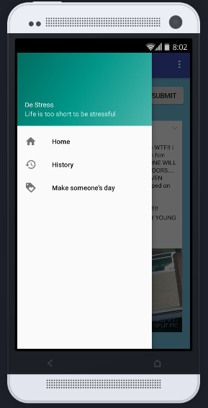
OVERVIEW
Simple, Sweet and Significant
Given the amount of stress people in this fast paced world experience, we provide an application that aids in de-stressing people by developing a feeling of happiness. The user can dump their problems and get reminded of the good experiences they go through on a daily basis. They also get a daily goal to complete, making someone else’s day and spreading joy.

Slide 3
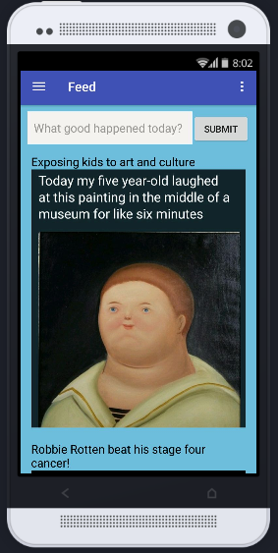
Never feel low!
Take a break from the negativity of the world.
Scroll through a curated feed of posts that are certain to de-stress your mind and lift your spirits.

Slide 4
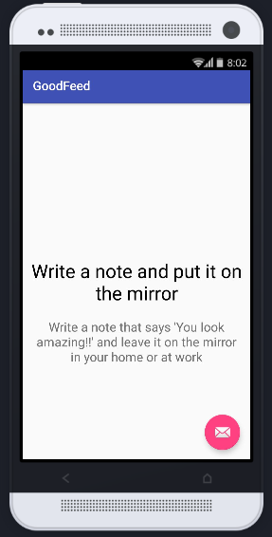
Small steps every day
Do you ever feel like making someone happy?
We provide you with a small activity daily that will bring joy not only to the other person, but also give you a sense of fulfillment.

Slide 5
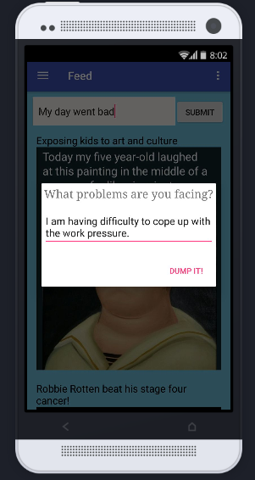
Throw away your problems
Dwelling on one’s problems does
no one any good.
Write down your problems / worries and watch them get thrown into the trash, relieving your mind.

Slide 6
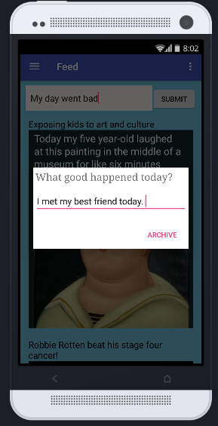
Remember the good
Do you focus more on the bad than the good?
Take a look at the list of your positive experiences over the week and embrace the good parts of your life.

