Slide 1


OPTIMIZATION:SIMUTECH Mentors: Ayush Raj & Md. Saif
End-term report

Slide 2
TOPICS COVERED
Basic concepts of Heat Transfer
Concepts and applications of Fins
Vapor liquid equilibrium
Basics of Distillation
McCabe–Thiele method

Slide 3
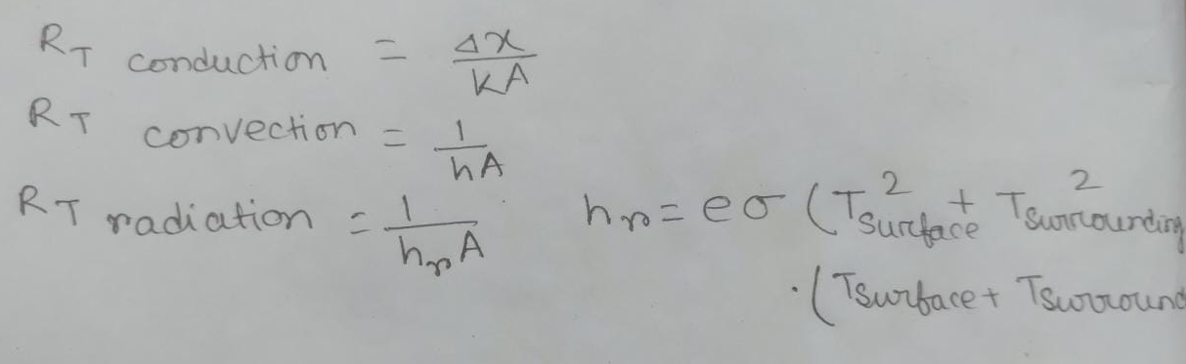
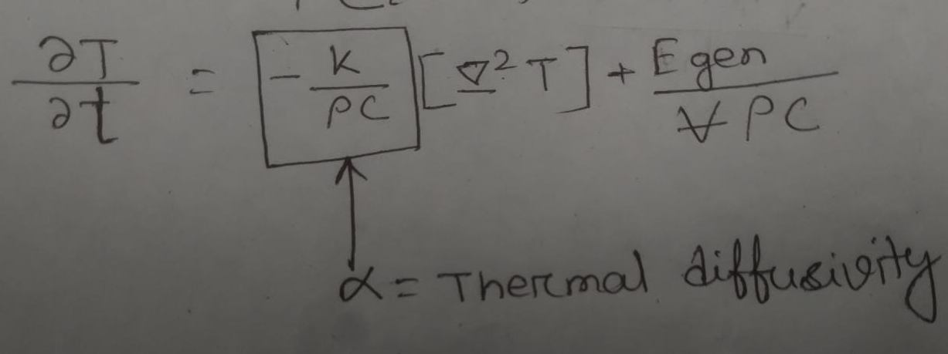
Heat Transfer
Heat can be transferred in three ways: by conduction, by convection, and by radiation.
Thermal resistance:
Heat conduction equation:

Slide 4
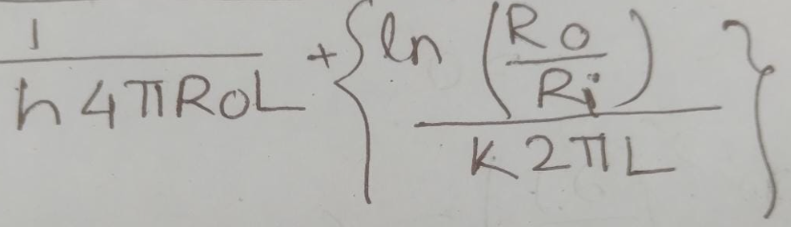
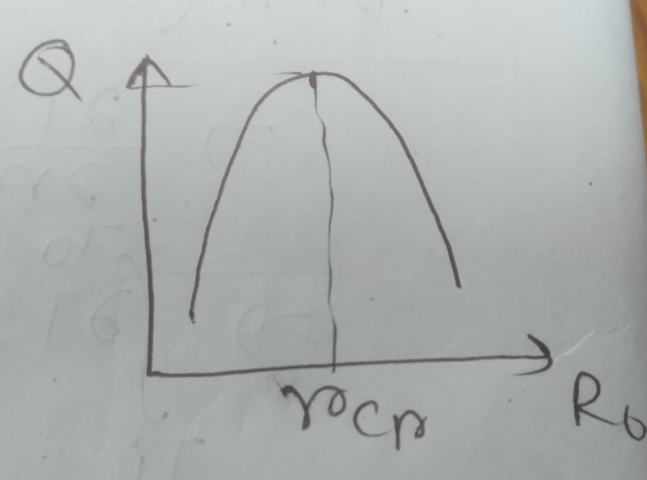
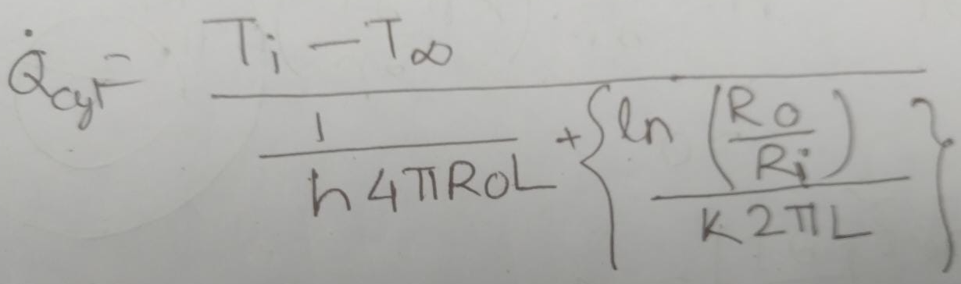
Heat transfer
For cylinder with radius Ri and radius with coating Ro and length L thermal resistance will be:
Heat transfer rate will be:
We can calculate critical thickness by the plot shown using Matlab, we solved this kind of problem using Matlab in our assignment.

Slide 5
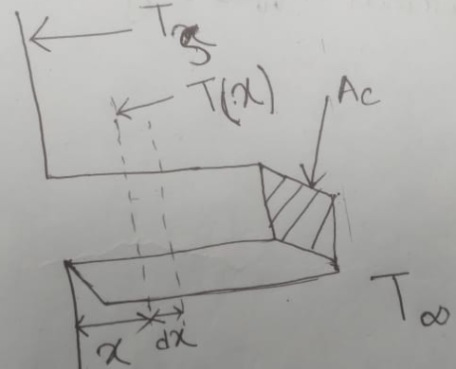
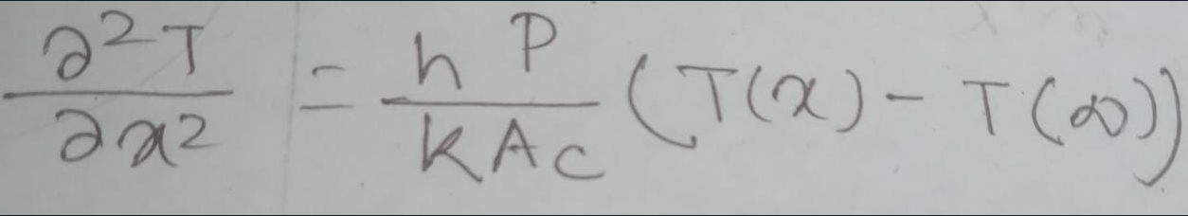
Fins
Fins are surfaces that extend from an object to increase the rate of heat transfer to or from the environment by increasing convection.
We got an equation:

Slide 6
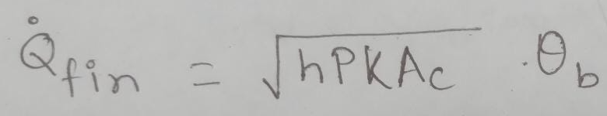
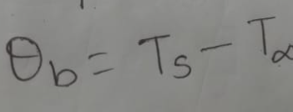
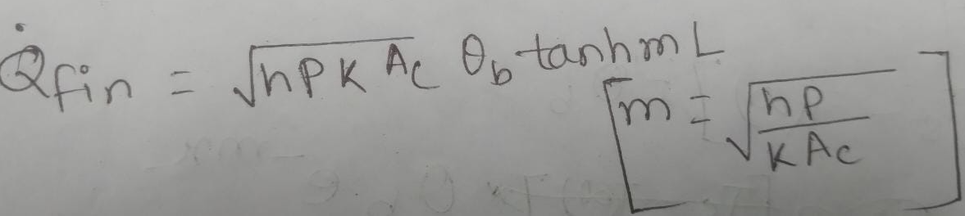
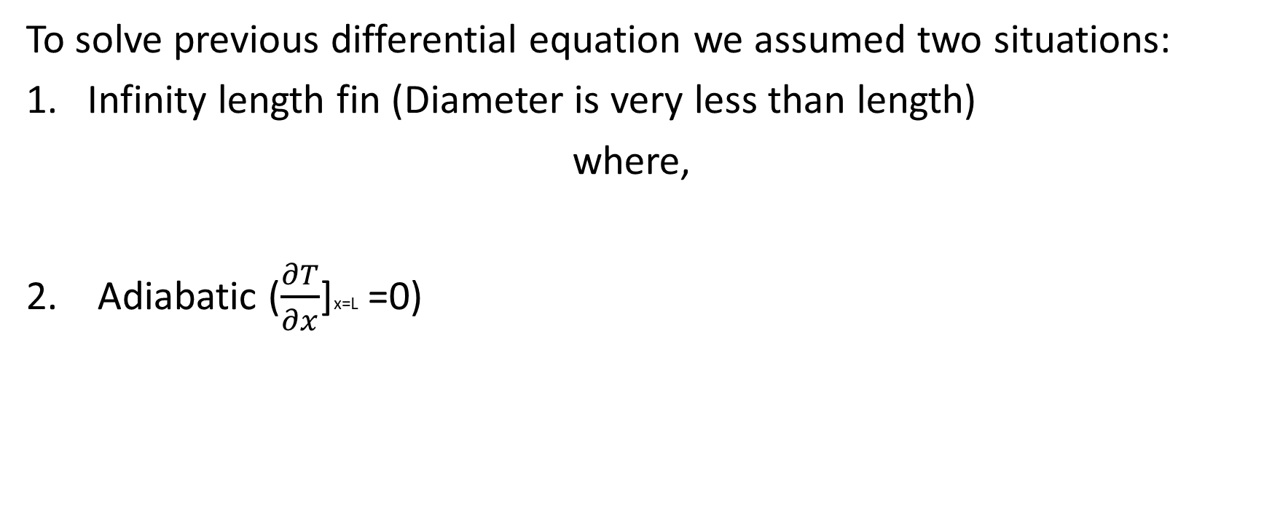
Fins
To solve previous differential equation we assumed two situations:
Infinity length fin (Diameter is very less than length)
where,
2. Adiabatic ($\frac{∂T}{∂x}$]x=L =0)

Slide 7

Fins
Efficiency (η) = Q fin/Q ideal fin =$\frac{\sqrt{hPKAc}}{hA}$
Effectiveness =Q fin/Q no fin

Slide 8
Distillation
Boiling point: The normal boiling point is the temperature at which the vapor pressure is equal to the standard sea-level atmospheric pressure.
Volatility: Volatility is a material quality which describes how readily a substance vaporizes.
Relative volatility: Comparison of volatility with other substance. For same volatility of two components RV will be 1.
Bubble point: Liquid refrigerant starts to boil at this pressure and temperature in the evaporator.
Dew point: The last of the liquid refrigerant boils away.

Slide 9
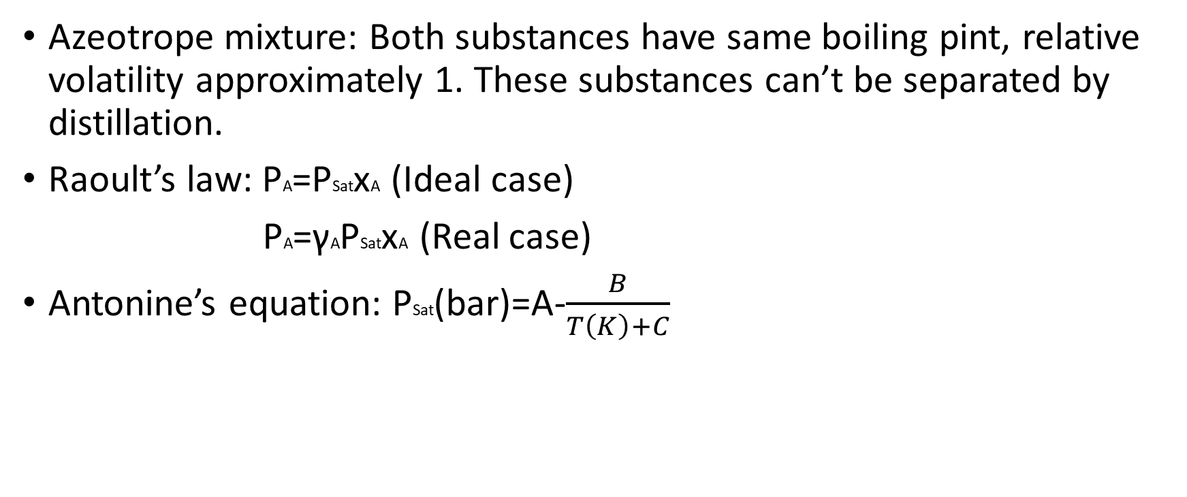
Distillation
Azeotrope mixture: Both substances have same boiling pint, relative volatility approximately 1. These substances can’t be separated by distillation.
Raoult’s law: PA=PSatxA (Ideal case)
PA=γAPSatxA (Real case)
Antonine’s equation: PSat(bar)=A-$\frac{B}{T\left(K\right)+C}$

Slide 10
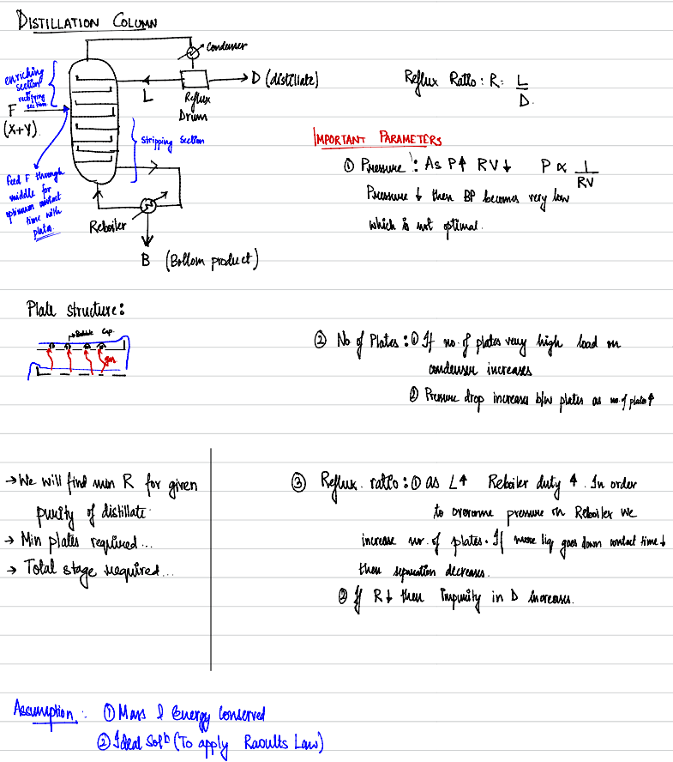
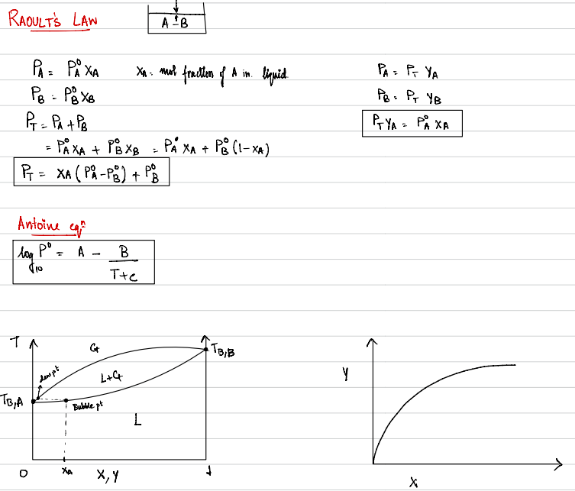
Distillation

Slide 11
McCabe–Thiele method
The McCabe–Thiele method a technique to model the separation of two substances by a distillation column. It uses the fact that the composition at each theoretical tray is completely determined by the mole fraction of one of the two components. This method is based on the assumption of constant molar overflow, which requires that:
the molar heats of vaporization of the feed components are equal;
for every mole of liquid vaporized, a mole of vapor is condensed; and
heat effects such as heat of solution are negligible.

Slide 12
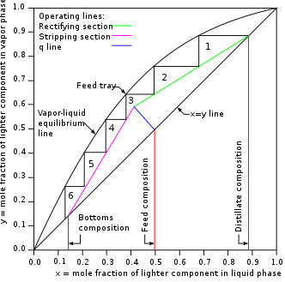
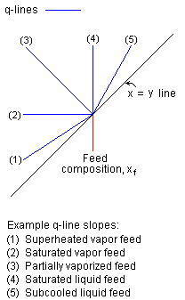
McCabe–Thiele method

Slide 13
Thank You

