Slide 1
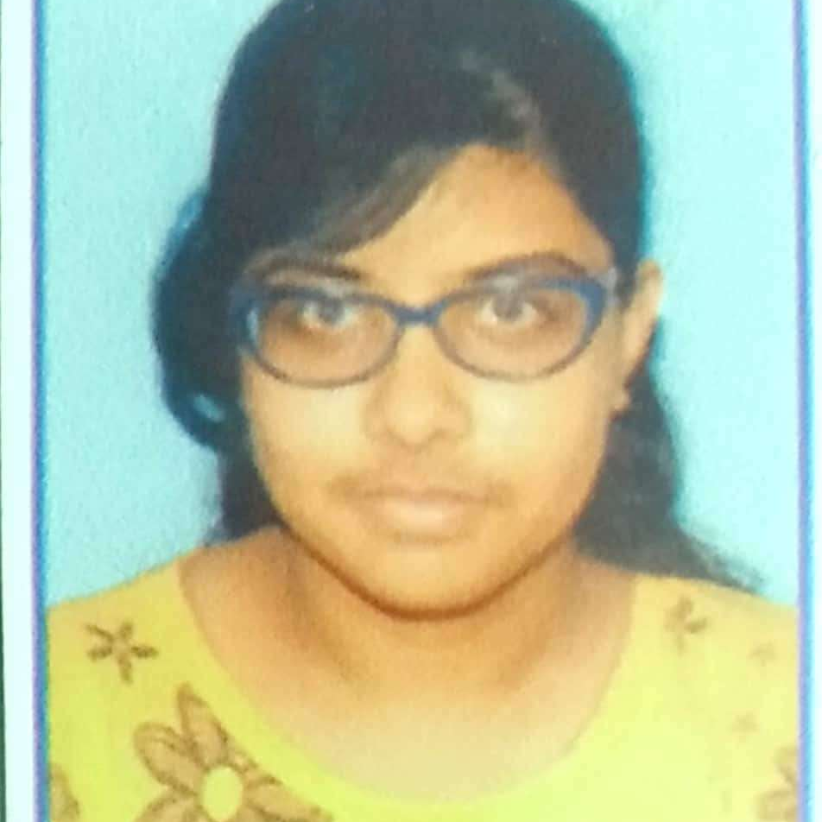



Ritambhara Chatterjee
Analyst/Software Engineer
Bachelor of Technology
Computer Science : 2016 - 2020
Skills Java 8
Spring Boot, MVC
Spring Security
MERN Stack
NodeJS
MongoDB
Database
SQL database – Oracle, MySQL
No SQL database – MongoDB
Web Technologies
HTML5
CSS3
Javascript
AddOns
Github
Maven
Postman
Additional Details
Leadership
Quick Learner
Team management
Pune
ritambhara.chatterjee@capgemini.com
+91 9831370809
A4
Software Engineer who is Strong in design and integration with intuitive problem-solving skills. Passionate about implementing and launching new projects.
Ready to learn new technologies and implement them to further improve my knowledge.
Eager to work in a team of dedicated people and serve a key role in the enhancement and development of the project.
Hands on experience in creating microservices with Springboot, Spring Security, Spring Cloud API Gateway, Eureka server..
E-Commerce Shopping Cart Application
Completed end to end case study of Shopping Cart Application along with JWT authentication, Swagger and payment testing using Braintree in MERN Stack. Material-UI and Angular Bootstrap used for user interface.

