Slide 1
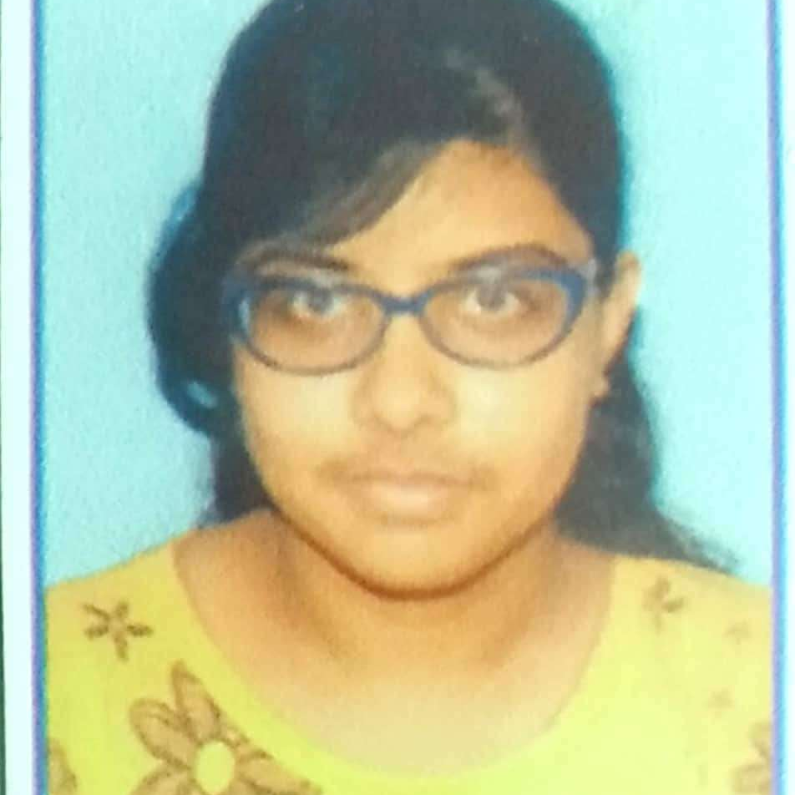



Ritambhara Chatterjee
Analyst/Software Engineer
Bachelor of Technology
Computer Science : 2016 - 2020
Skills Java 11
Spring Boot, MVC
Spring Security
MERN Stack
NodeJS
MongoDB
Database
SQL database – Oracle, MySQL
No SQL database – MongoDB
Web Technologies
HTML5
CSS3
Javascript
AddOns
Github
Maven
Postman
Additional Details
Leadership
Quick Learner
Team management
Pune
ritambhara.chatterjee@capgemini.com
+91 9831370809
A4
Software Engineer who is Strong in design and integration with intuitive problem-solving skills. Passionate about implementing and launching new projects.
Ready to learn new technologies and implement them to further improve my knowledge.
Eager to work in a team of dedicated people and serve a key role in the enhancement and development of the project.
Hands on experience in creating microservices with Springboot, Spring Security, Spring Cloud API Gateway, Eureka server..
E-Commerce Shopping Cart Application
Completed end to end case study of Shopping Cart Application along with JWT authentication, Swagger and payment testing using Braintree in MERN Stack. Material-UI and Angular Bootstrap used for user interface.
Backend(MongoDB), Middleware(Spring microservices) and Frontend(Angular) completed from Capgemini Degreed Platform.
Completed this course as part of my training and designed responsive Restaurant Website using HTML5, CSS3 and Angular.

