Slide 1
Target Detection & Tracking

Slide 2
Project Supervisor :
Team Members :
Rohit Kamboj
Dhiraj Kumar Saini 160110084
Ritam Ghosh 160111046
Rachit Goyal 160112002
IBM Trainer
Department Of CSE
DIT University

Slide 3
Presentation Outline :
Introduction
Objective
Datasets
Model
Conclusion
Scope of Future Work

Slide 4
Introduction:
In our project “Target Detection and Tracking” the main aim is to detect any specific object in the video stream. Recognize and Identify the moving objects for (specific) interest, and to track those moving objects throughout the video frame. It can be widely used in computer vision task such as face detection, face recognition, video object co-segmentation. It is also used in Object Detection, Object Tracking, Object Classification, Video Surveillance, Background Modelling for example tracking a ball during a football match, tracking movement of a cricket bat, tracking a person in a video, detect the movement of car, bike truck in games and real life, to detect a specific target in surveillance video footage.

Slide 5
OBJECTIVE:
Recognize and Identify the moving objects for (specific) interest, and to track those moving objects throughout their life spans. This project aims for the existence challenging issue in the area of surveillance and security. For this we need to create dataset that will change itself from time to time so that it can detect those part of the object that are not in the previous dataset that will be done only by using a specific and correct algorithm and by choosing correct images for our first dataset. We need to create an algorithm that will detect our specific object in a fast and accurate manner (able to detect a specific object at a speed of nearly 30 frame per second) so that it will be used in our video stream

Slide 6
DATASET
COLLECTION:
We collected images from google images.
PREPROCESSING:
We resized our images into 299x299. because
our model takes input 299x299

Slide 7
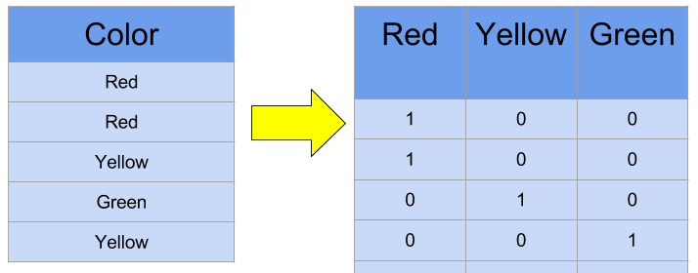
HOT ENCODING:
:
BATCH NORMALIZATION:
It mean gauss normalization. We normalize our data
so that All feature in the same range And contribute equally

Slide 8
MODEL
DEFINITION:
This approach is also used in the Inception-ResnetV2.This project
is implementation on the basis of Inception-ResnetV2. It is one
of the fastest algorithms present now. Google came up with new
approach and divide the model In modules. Google came up
with new approach and divide the model In modules.

Slide 9
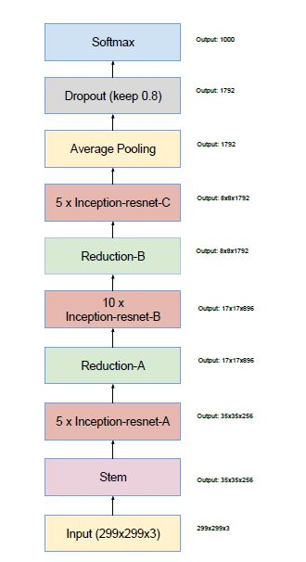
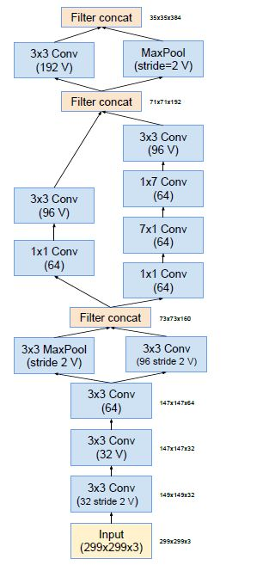
SCHEMA
STEM CELL

Slide 10
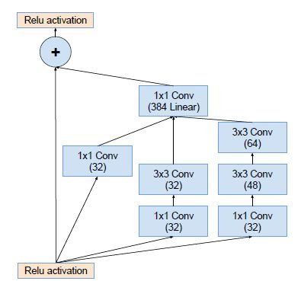
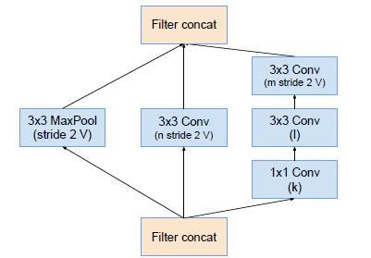
MODULE A
REDUCTION A

Slide 11
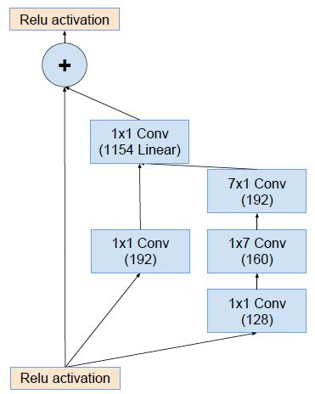
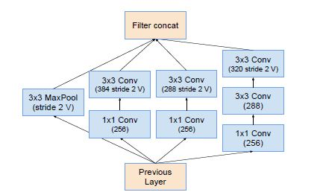
MODULE B
REDUCTION B

Slide 12
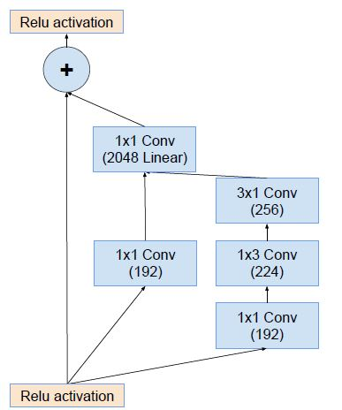
MODULE C

Slide 13
TRAINING:
EPOCHS: 25
BATCHES: 16
ACTIVATION: RELU ACTIVATION
OPTIMIZATION: SOFTMAX

Slide 14
MODEL SAVING
Our model is saved in Jason format.
Weight saved in H5 format.

Slide 15
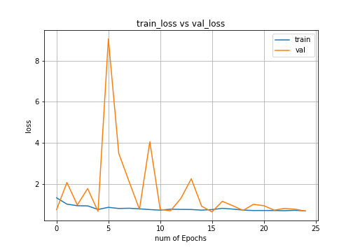
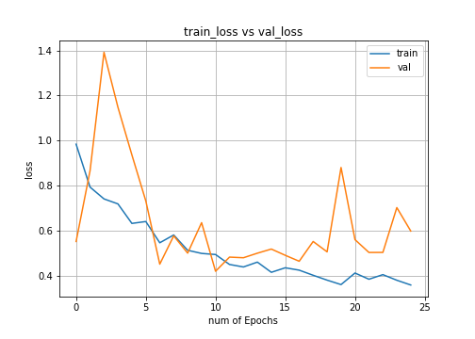
OVERFITTING:

Slide 16
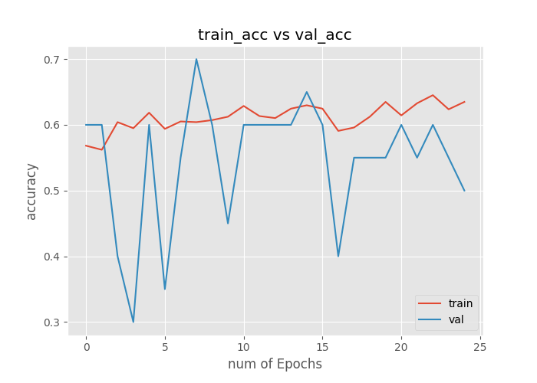
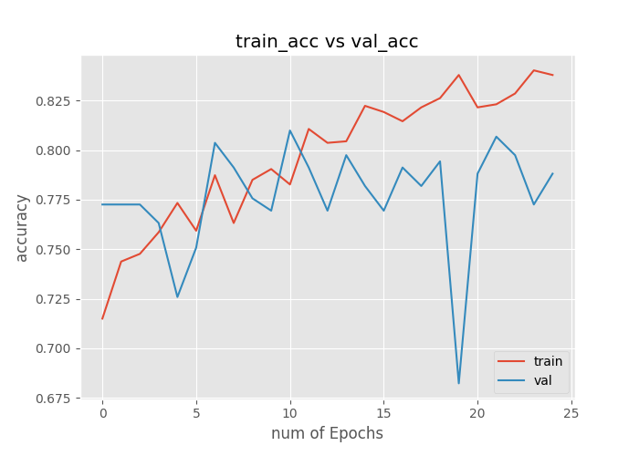

Slide 17
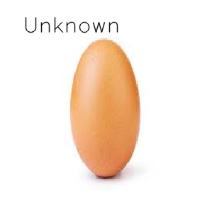
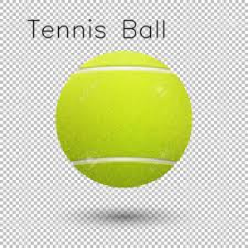
IMAGE PREDICTION:

Slide 18
VIDEO PREDICTION:

Slide 19
CONCLUSION:
In this project, a ball detection and tracking algorithm is presented for
Object Detection, Object Tracking, Object Classification, Video
Surveillance, Background Modelling sequence. We have presented
our model based on research paper inception V4 and inception-resnet
that classify images and label videos based on the training it received it
has many application in field of medical diagnoses, defense, games
and virtualization and have high accuracy and high speed compare to
other model presented so far. For this project, we achieve with an
object-tracking program that can automatically track multiple objects.
It can also use to detect multiple object in wide range.

Slide 20
SCOPE OF FUTURE:
Processing time: Full search in the frame takes large amount of time.
We reduce searching time by searching only in some parts of the image.
We use motion to trigger the search and search only in the moving region,
However, this is still too slow for real time applications. Searching algorithm
such as Inception V4 and Inception resent version 2 algorithm might be
able to make this program faster because it reduce number of pixels
to be searched.
Motion Analysis: Another area that is very challenging. The segmented
moving object from tracking can be further analyzed with the statistics
of each motion to verify whether object is spreading or not.

Slide 21
Occlusion: We do not include occlusion in this program. If occlusion
occurs, tracking accuracy will be severely degraded. One way to fix it
to use the template data of a couple of last frames, and keep track
of the mean absolute difference or correlation in template matching.
If the difference increases (or the correlation decreases) dramatically
and abruptly, it suggests that occlusion already occurs. Then, the
program could wait until the occlusion passes, or use an old template
in a database instead of an occluded object.

Slide 22
Thankyou

